Slide 1
CBME “Need to Know” for Geriatric Psychiatrists
Tracy Cheng
Geri Psych Program Director
JoAnn Corey
Gen Psych Program Director
& CBME Lead
Winter 2021
What you need to know about CBME as it applies to the General Psychiatry Pgy3 Core Geriatric Psychiatry Rotation & the Geriatric Subspecialty Program

Slide 2
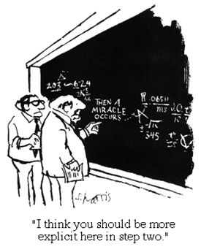
Notes:
CBME may have felt like a mystery to you.
It did to me when I first heard about it.
It still may feel like a mystery to some.

Slide 3
Quick Review of CBME on the Ground Basics
EPAs relevant to the Pgy3 Geri Core Rotation
EPAs for Geriatric Subspecialty Program
New CBME Program Design
Other

Slide 4
Many things still the same…
ITARs
Scholarly Projects
Psychotherapy
StACERs*
CQI Project
Grand Rounds
Poster presentation
Longitudinal training
Reduced # Modules
Mid- & end- rotation
*# StACERs TBD for July 2022

Slide 5
Still have defined rotations

Slide 6
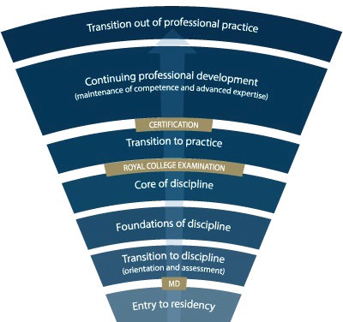
Competence Continuum -Stages of Training-
PGY-5
PGY-4
PGY-6
PGY-3
PGY-2
PGY-1
PGY-5
General Program
Geri Subspecialty Program
Notes:
-Royal College outlines what needs to be accomplished within each Stage of training and give a range of time for min & max duration of that stage
-Programs will then decide the duration of each stage (within the RC parameters) and what rotations will be included in each stage
-RC is also going to outline what skills & knowledge must be accomplished by a resident before they are to be allowed to progress to the next stage of training. Those required skills & knowledge are packaged into what is called the EPAs and Milestones (which I will explain in a minute)
-Programs then map which EPAs should be accomplished in which rotations for their residents

Slide 7
Key Points
Residents will progress thro’
Stages of Training
along the Competence Continuum.
There will be defined
Required Training Experiences
in each stage of training.
Its all about Feedback & Assessment
Quality
Acceptance & Incorporation

Slide 8
During each stage of training there will be defined Competencies (i.e. knowledge & skills) that a resident must acquire

Slide 9
Entrustable Professional Activites (EPAs)
These competencies are called

Slide 10
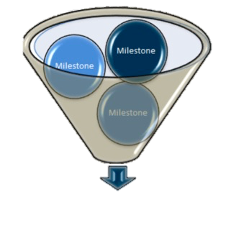
The Royal College has defined which EPAs a resident must acquire before they can advance to the next Stage of Training.
Transition to Practice
Core of Discipline
Foundations of Discipline
Transition to Discipline

Slide 11
Audience Check-in

Slide 12
How will this work?

Slide 13
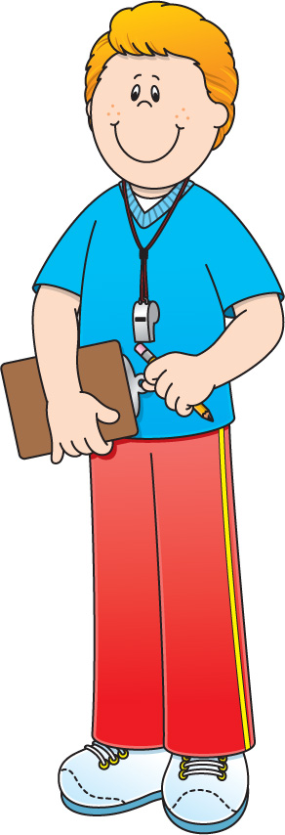
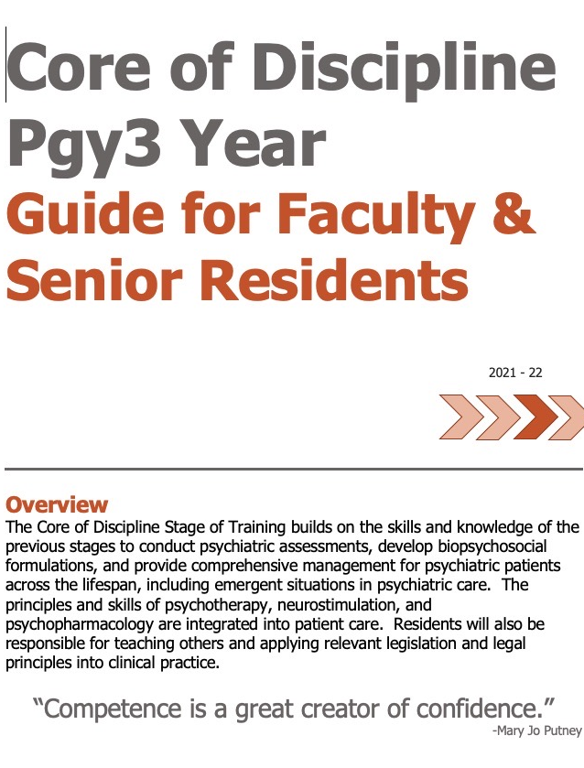
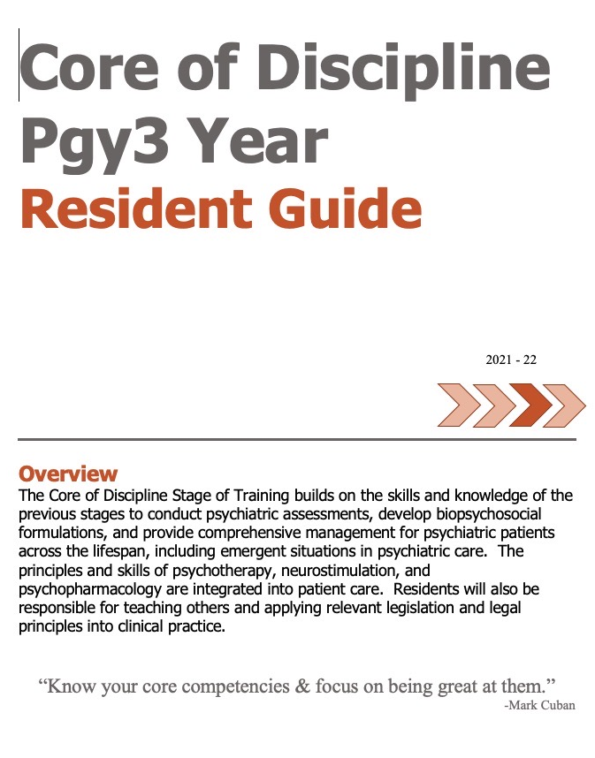
Academic Coach
Plans their learning
Views Curriculum Map
Know what EPAs working on
Develops a Personal Learning Plan
Supervisor
Resident
Sets Objectives for Rotation
Based on Curriculum Map
Based on Personal Learning Plan
Supported by technology

Slide 14
Performing psychiatric assessments and providing differential diagnoses & management plans for Older Adults.
6 Observations of Achievement
At least:
3 neurocognitive disorders, including 1 BPSD
1 major depressive disorder and/or bereavement
1 anxiety disorder
1 case with rationalization of polypharmacy
2 different observers
4 direct observations including review of documentation
2 by geriatric psychiatrist or psychiatrist with special interest in older adult patients
EPA C-3

Slide 15
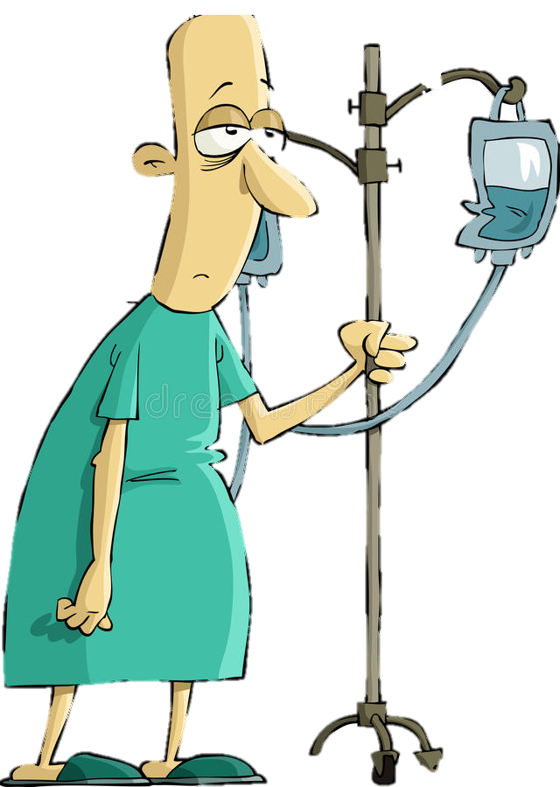
Program
Director
Academic
Coach
Competence Committee
Regional
Education Lead
Notes:
Resident and faculty identify an opportunity for an EPA assessment. Supervisor might review expectations and remind resident of feedback to build on from a previous encounter.
Resident goes to do the EPA activity. Supervisor supervises either directly or indirectly depending on the EPA
Supervisor provides verbal feedback to the resident, giving 1 or 2 specific, actionable pieces of feedback
Supervisor documents the assessment on MedSIS.
They cycle repeats itself, resulting in multiple assessments of the same EPA over time, by different observers.
These get collated on MedSIS, with the data being available to the resident, the Program Director, the REL, the resident’s academic coach and the Competence Committee (formerly the Evaluation Committee)
It is the Competence Committee that makes decisions around progression, promotion

Slide 16
Assessment of EPAs
Aiming for 2 – 3 EPA assessments a week, between daytime rotation & on-call experiences

Slide 17
Audience Check-in

Slide 18
CBME Assessment Form
EPAs will be assessed using a

Slide 19
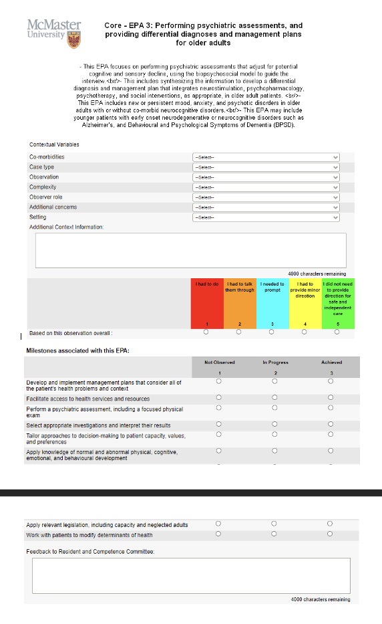
EPA Assessment Form

Slide 20
Entrustment Scale
Resident demonstrates sound knowledge & skill but needed help with unexpected challenges. A few things you needed to f/u on. No significant concerns.
Learner required
constant direction
1 | 2 | 3 | 4 | 5
I had to do. | I had to talk them through. | I needed to prompt. | I had to provide minor direction. | No direction required for safe, indpt care.
Learner didn’t do task or
Needed complete hands on guidance
Some independence but required intermittent direction
Complete independence. Understands risks. Performs safely. Practice ready.
**If any concerns with risk assessment or safety, should not score above 3.
Notes:
Level 1 – the supervisor had to perform the clinical activity while the resident observed. This may apply if resident has never done the task before, or they started but situation became too challenging so supervisor elected to complete the task. Ideally, the supervisor would provide direction and teaching afterwards.
Level 2 – self-explanatory
Level 3 – The resident required frequent direction, requiring occasional prompting and guidance, particularly with more complex aspects of the encounter OR the encounter required supervisor to follow-up on a number of important aspects not completed by the resident
Level 4 – Previously “I needed to be there just in case”. Now Changed to: “I had to provide minor direction.“ Resident demonstrates sound technique but you were not confident that their knowledge base or skill was sufficient to ensure that if they had run into an unexpected challenge or complication, they would have been able to manage this. Examples might include: when you posed questions as to how they would handle a complication of the situation, they were not able to explain; they completed the assessment adequately but there were nuances that made it more akward or less effective; resident completed the assessment thoroughly but it took them a much longer than normal time.
Level 5: Previously”I did not need to be there”. Now changed to: “I did not need to provide direction for safe, independent care” or “No direction required for safe, independent care”. Resident able to complete all aspects of the assessment independently and safely including troubleshooting unexpected challenges; completed in sufficient time frame (may not have been as fast as experienced staff person). Any teaching you provided was more to enrich a competenct knowledge base. Any prompts given were not necessary for resident to complete the task safely and independently.

Slide 21
EPA Assessment Form

Slide 22
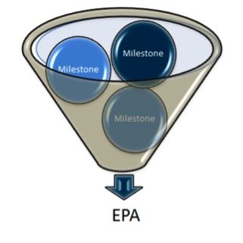
Developmental Milestones
EPAs can be broken down into smaller, component parts called

Slide 23
EPA Assessment Form

Slide 24
Assessment of EPAs
may involve direct or indirect observation
Complete WBAs even if task rated less than a 4 or 5, to promote knowledge & skill development
it may take 2-3 attempts before a resident achieves a successful assessment.

Slide 25
Audience Check-in

Slide 26
What if…?
The resident does not do well

Slide 27
What if…?
Patient presentation changes or is above resident skill level

Slide 28
What if…?
Patient presentation is not in line with the EPA task

Slide 29
Audience Check-in

Slide 30
EPAs during Pgy3 Year

Slide 31
Core Clinical Rotations for General Program
Pgy-3 Year

Slide 32
The Royal College has defined which EPAs a resident must acquire before they can advance to the next Stage of Training.
Transition to Practice
Core of Discipline
Foundations of Discipline
Transition to Discipline

Slide 33
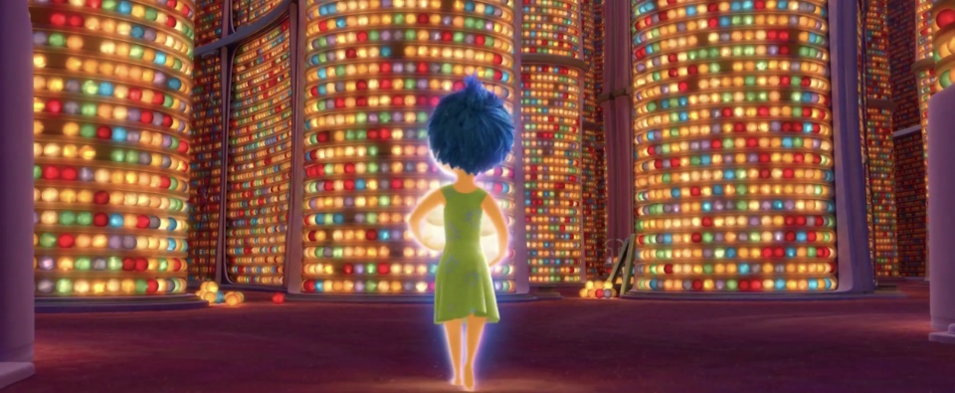
Core of Discipline EPAs
of
High Yield During Pgy3 Core Geriatric Psychiatry Rotation
Notes:
Here are the EPAs that residents must complete by the end of the Foundations of Discipline Stage of Training. Ie. by the end of Pgy2
There are five EPAs that must be achieved during the Foundations Stage of training
Remember – Foundations runs through 2/3 of Pgy1 and all of Pgy2
They must successfully complete all 5 of them by the end of Pgy2

Slide 34
Performing psychiatric assessments and providing differential diagnoses & management plans for Older Adults.
6 Observations of Achievement
At least:
3 neurocognitive disorders, including 1 BPSD
1 major depressive disorder and/or bereavement
1 anxiety disorder
1 case with rationalization of polypharmacy
2 different observers
4 direct observations including review of documentation
2 by geriatric psychiatrist or psychiatrist with special interest in older adult patients
EPA C-3

Slide 35
Developing comprehensive Biopsychosocial Formulations for patients across the lifespan.
EPA C-4
8 Observations of Achievement
At least:
1 child
1 adolescent
4 adults
2 older adults
3 w supervisor having observed the pt ass’t
3 high complexity
4 by psychiatrists
1 by child & adolescent psychiatrist
1 by geriatric psychiatrist

Slide 36
Integrating the principles & skills of Neurostimulation into patient care.
EPA C-7
Part A: Suitability for Neurostimulation
3 Observations of Achievement:
1 older adult
1 adult
At least:
2 for ECT
Part B: Delivery of Neurostimulation
3 Observations of Achievement:
At least:
2 for ECT

Slide 37
EPA C-8
Integrating the principles & skills of Psychopharmacology into patient care.
12 Observations of Achievement
At least:
1 starting & monitoring LAI
1 starting & monitoring Oral Antipsychotic
2 starting & monitoring 2 different classes Antidepressants
1 starting & monitoring Sedative / Hypnotic
1 starting and/or monitoring Lithium
1 starting and/or monitoring Clozapine
1 managing Benzodiazepine
1 managing Opioid Agonist Therapy
1 Mood Stabilizer Other Than Lithium
12 Observations of Achievement
1 agent to treat Mx-induced SEs
1 patient on multiple psychiatric medications
2 patients in C/L setting
2 Child/Adolescent including starting & managing 1 stimulant
2 Older Adults, including 1 w cognitive enhancer
1 Pregnant or Breastfeeding patient
5 Different Observers
3 by Psychiatrist Observers

Slide 38
Providing Teaching for students, residents, the public and other health care professionals.
EPA C-10
During Core Geri Rotation
At least:
1 Teaching of Patient / Family
1 Leading Multidisciplinary Rounds
As of July 1, 2021, use EPA C10
to assess Resident as Educator activities
for General Program Residents

Slide 39
Core of Discipline EPAs of Medium Yield

Slide 40
EPA C-1
Developing comprehensive Treatment / Management Plans for adult patients (of medium to high complexity)
8 Observations of Achievement
At least:
2 emergency setting
2 inpatient setting
2 outpatient setting
2 consultation-liaison setting
2 psychotic disorders
1 substance use disorder
1 anxiety disorder
1 history of trauma
1 major depressive disorder
8 Observations of Achievement
1 bipolar disorder
1 personality disorder
1 intellectual disability / autism spectrum comorbidity
3 high complexity
5 direct observations with review of documentation
4 different observers
3 by psychiatrists

Slide 41
Identifying, assessing, and managing Emergent Situations in psychiatric care across the lifespan.
EPA C-5
8 Observations of Achievement
At least:
2 patients with acute agitation & aggression
2 patients with active suicidal ideation
1 patient with homicidal/violent ideation or risk of harm to others
2 patients with medical emergencies related to delirium
1 patient with acute dystonic reaction, catatonia, serotonin syndrome or NMS
3 by psychiatrist / psychiatric subspecialist

Slide 42
Integrating the principles and skills of Psychotherapy into patient care.
EPA C-6
Relevant to Geri Psych Rotation:
At least:
3 observations demonstrating integration of psychotherapeutic interventions in regular clinical care

Slide 43
Applying relevant Legislation & Legal Principles to patient care and clinical practice.
EPA C-9
6 Observations of Achievement
At least:
2 Capacity to Consent to Tx in Complex Patients.
2 Restricting/Limiting Rights with Due Process Protections
1 Evaluation for Restrictions/Limitations re: Disability
1 Mandatory or Discretionary Reporting
4 by Psychiatrists
2 Different Psychiatrist Observers

Slide 44
Audience Check-in

Slide 45
Key Points
This Photo by Unknown Author is licensed under CC BY-NC-ND

Slide 46
High Yield Core EPAs during Pgy-3 Geri Rotation:
C8: Psychopharmacology
C4: Formulation
C10: Teaching others
C7: Neurostimulation
C3: Older Adults

Slide 47
Medium Yield Core EPAs during Pgy-3 Geri Rotation:
C1: Management Plans (med to hi complexity adult patients)
C5: Emergent Situations
C9: Legislation
C6: Psychotherapy (integration in regular clinical care)

Slide 48
Still going to do…
ITARs
Mid-unit
End-unit
StACERs*
Mid-unit
End-unit
RaEs using EPA C10
Pt/Family
Team Rounds

Slide 49
Key Points
Its all about regular assessment & feedback day to day.
Quality
Acceptance & Incorporation

Slide 50
Questions?

Slide 51
Muddiest Moment:
What still feels unclear?
This Photo by Unknown Author is licensed under CC BY-SA

Slide 52
MedSIS Demonstration
This Photo by Unknown Author is licensed under CC BY-NC-ND

Slide 53
Questions?

Slide 54
Pops! Reflection:
What popped out for you today?

