Slide 1
Planning for Pgy-1
Requirements, Expectations & Opportunities

Slide 2
Congratulations!

Slide 3
Where are we going from here

Slide 4
Foundations of Discipline
Stage of training

Slide 5
Foundations of discipline pgy-1 & pgy-2

Slide 6
Foundations of discipline pgy-1 Year

Slide 7
Foundations of Discipline pgy1 clinical rotations
Notes:
Reference Foundations Orientation Guide as go through each type of clinical rotation (page 7)

Slide 8
Holidays & Attendance during one-month rotations

Slide 9
Pgy-1 Elective Block
Your design! (if you need help, let us know)
Contact potential supervisors about availability
Review with supervisor(s) your personal goals & objectives for the elective
At least one month in advance, submit to JoAnn & Shuang your Elective Proposal:
Name of Elective & Dates
Name of Supervisor (& site & contact info if not McMaster Faculty)
Goals of Elective written in CanMEDS roles

Slide 10
Pgy-1 Academic Days (Wednesdays)
During GIM, Neurology, FM, EM, Peds Neuro, Selective, MT2IP
On Rotation in AM
If can make it to Enrichment Session & you are interested, you are welcome to join Enrichment Sessions
12:30 – 2:00 pm
Academic Enrichment Session
PRAM; Evidence Based Rnds; Interviewing Skills; OSCE Prep; Complex Case Rnds
2:30– 4:30 pm
Psychiatry Pgy1 Core Curriculum Seminar

Slide 11
Pgy-1 Academic Days (Wednesdays)
During ER Psych, Elective & Addictions*
9 – 10 am
Departmental Grand Rounds
West 5th Auditorium; Video-conferenced
10 am – 12 pm
Non-scheduled
12:30 – 2:00 pm
Academic Enrichment Session
PRAM; Evidence Based Rnds; Interviewing Skills; OSCE Prep; Complex Case Rnds
2:30– 4:30 pm
Psychiatry Pgy-1 Core Curriculum Seminar
*check with supervisor if something interesting in AM they think would be a good experience
Notes:
Ask if anyone wants to be Core Curriculum Rep
CBME Rep

Slide 12
Foundations of Discipline pgy-1 Longitudinal Requirements - Logs
Addictions Log – minimum 90 hours over residency
Developmental Disorders Log – ensure experience throughout residency
Date of Encounter | Supervisor | Patient Initials | Diagnosis | Description of Addictions Encounter | Learning Points | Time (hours)
Date of Encounter | Supervisor | Patient Initials | Diagnosis | Description of DDx Encounter | Learning Points

Slide 13
Questions?

Slide 14
Potential Impacts of CoVID
This Photo by Unknown Author is licensed under CC BY

Slide 15
Potential Impacts of CoVID
If you feel unwell…
If there is another surge…
If you need more info about CoVID related topics…
August 26th AHD – review CoVID folder
CoVID Curriculum continuing through Fall – all sessions recorded

Slide 16
Entrustable Professional Activities (EPAs)
Foundations (and a few core)

Slide 17
”Observation of Achievement” = 4 or 5
1 | 2 | 3 | 4 | 5
I had to do. | I had to talk them through. | I needed to prompt. | I had to provide minor direction. | No direction required for safe, indpt care.
**If any concerns with risk assessment or safety, should not score above 3.

Slide 18
EPA Benchmarks:
Aim for 2 - 3 assessments per week across all experiences
On Call in Psych Emerg aim for at least one EPA assessment / shift

Slide 19
Foundations of Discipline
EPAs
Notes:
Here are the EPAs that residents must complete by the end of the Foundations of Discipline Stage of Training. Ie. by the end of Pgy2
There are five EPAs that must be achieved during the Foundations Stage of training
Remember – Foundations runs through 2/3 of Pgy1 and all of Pgy2
They must successfully complete all 5 of them by the end of Pgy2

Slide 20
EPA F-1 Assessing, diagnosing & participating in the management of medical presentations relevant to Psychiatry.
8 Observations of Achievement
At least:
2 Medical Emergencies
1 Substance Intoxication
1 OD &/or Withdrawal
1 Neuropsychiatric Presentation
1 Endocrine or Metabolic Disorder
4 Different Observers
3 by Supervising Staff MD
HIGH YIELD ROTATIONS
Internal Medicine
Neurology
Emergency Medicine
Family Medicine
Pediatric Neurology
Addictions
ER Psychiatry
Palliative
Adolescent Medicine
Medical Team IP
Notes:
Evaluations during soft launch, at least at beginning, may be paper based.

Slide 21
EPA F-2 Performing psychiatric assessments referencing a biopsychosocial approach, & developing basic DDx for patients with mental disorders. (Low to Medium Complexity)
6 Observations of Achievement
At least:
1 Emergency Setting
2 Inpatient Settings
2 Outpatient Settings
3 Different Case Types
2 by Psychiatrist Observer
3 Different Observers
At most:
2 Child/Adolescent Patients
2 Older Adult patients
HIGH YIELD ROTATIONS
Emergency Psychiatry
Elective
Pgy2 General Inpatients
Pgy2 General Outpatients
Addictions
Notes:
Evaluations during soft launch, at least at beginning, may be paper based.

Slide 22
EPA F-3 DEVELOPING & IMPLEMENTING MANAGEMENT PLANS FOR PATIENTS WITH PSYCHIATRIC Presentations OF LOW TO MEDIUM COMPLEXITY.
6 Observations of Achievement
At least:
1 Mood Disorder
1 Psychotic Disorder
1 Personality Disorder
1 Substance Use Disorder
1 Anxiety or Trauma or OCD
3 Different Observers
2 by Psychiatrist Observers
At most:
2 Child/Adolescent Patients
2 Older Adult Patients
HIGH YIELD ROTATIONS
Emergency Psychiatry
Family Medicine
Elective
Pgy2 General Inpatients
Pgy2 General Outpatients
Addictions

Slide 23
EPA F-4 performing risk assessments that inform the development of an acute safety plan for patients posing risk for harm to self or others.
5 Observations of Achievement
At least:
1 with Non-Suicidal Self-Injury
1 with Active Suicidal Ideation or Behaviour
1 with Active Homicidal / Violent Ideation or Behaviour
3 by Psychiatrist Observers
3 Different Observers
HIGH YIELD ROTATIONS
Emergency Psychiatry
Elective
Pgy2 General Inpatients
Pgy2 General Outpatients
Notes:
Evaluations during soft launch, at least at beginning, may be paper based.

Slide 24
EPA F-5 performing critical appraisal and presenting psychiatric literature
2 Observations of Achievement
At least:
2 Different Observers
HIGH YIELD ROTATIONS
Many Pgy-1 rotations
Elective
Pgy2 General Inpatients
Pgy2 General Outpatients
Notes:
Evaluations during soft launch, at least at beginning, may be paper based.

Slide 25
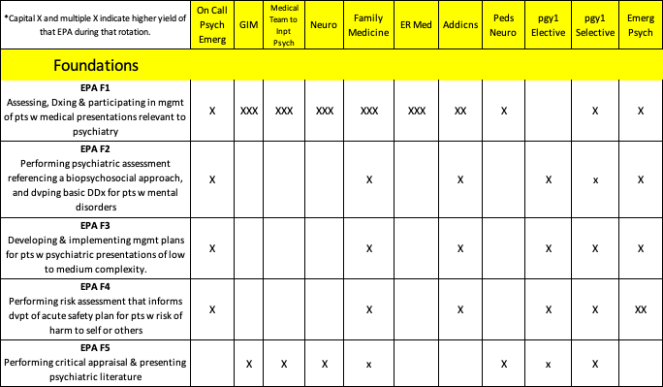
Mapping of EPAS onto Pgy-1 Rotations

Slide 26
Notes:
You can work ahead on EPAs, but you can’t go backwards. Must finish the Foundations EPAs by end of Pgy2

Slide 27
Suggested Foundations EPA Goals for pgy-1
Complete F1
(medical presentations)
Complete F4 if possible
(risk assessments)
Complete F5 if possible (critical appraisal)
Begin F2
(psych assessment & DDx)
Begin F3
(psychiatric management plan)

Slide 28
Tracking Your EPAs
MedSIS

Slide 29
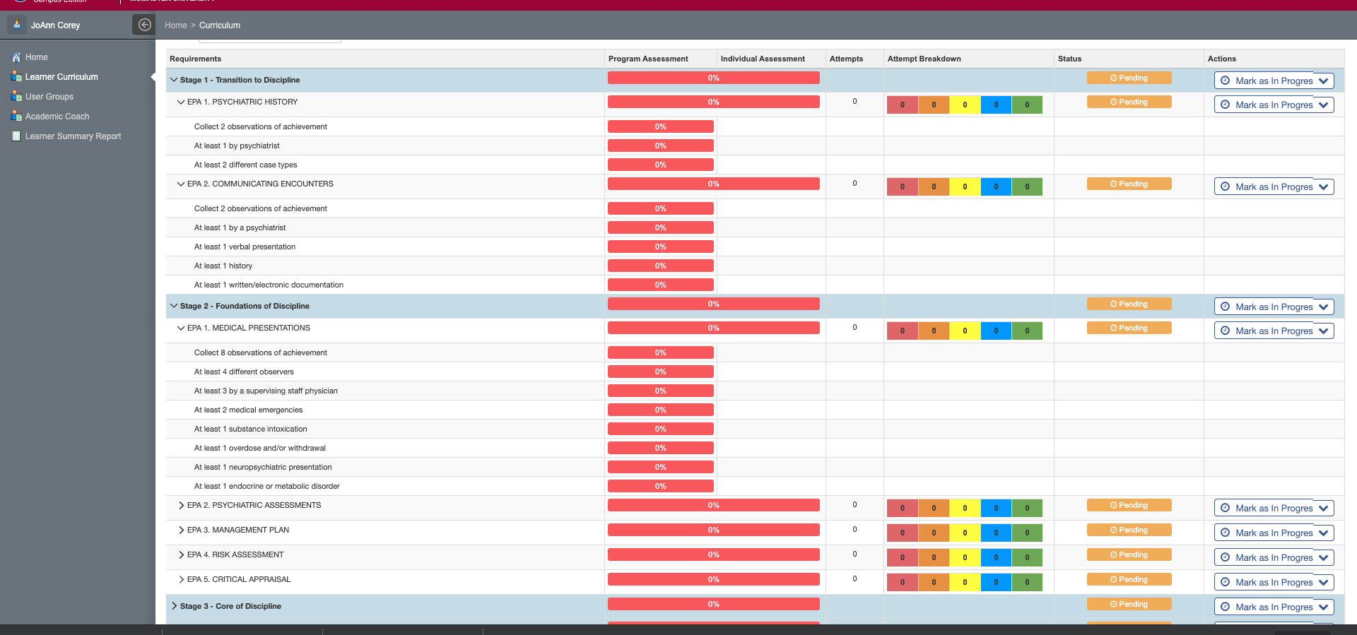

Slide 30
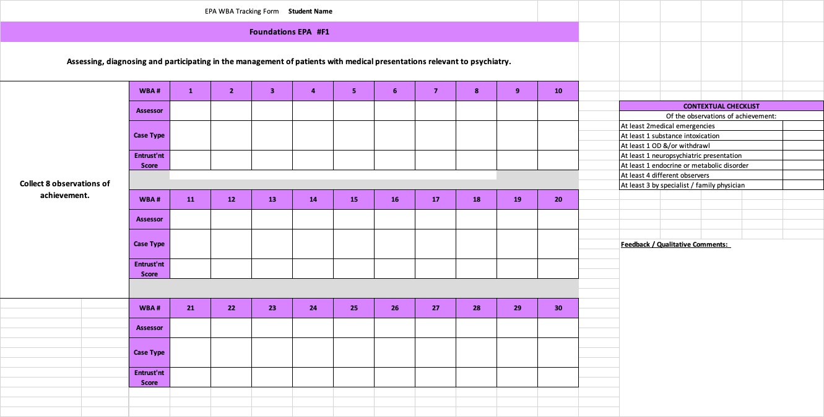
Tracking Your EPAs
MedSIS
Personal Tracking Forms

Slide 31
Ensuring epa assessments completed
Trigger it as soon as possible
Let observer know it has been triggered
Remind observer they won’t get a notification from MedSIS
Create an email template with a link to MedSIS Login page, that you could send to observers
JoAnn & Cheyenne will follow-up q2weeks on all pending assessments
Pull it up on your phone with mobile app

Slide 32
Competence Committee Reviews
August 17, 2020 (End of TtD)
Every Autumn (end of October)
Every Spring (end of April)

Slide 33
Questions?

Slide 34
Keys to Success in Pgy-1

Slide 35
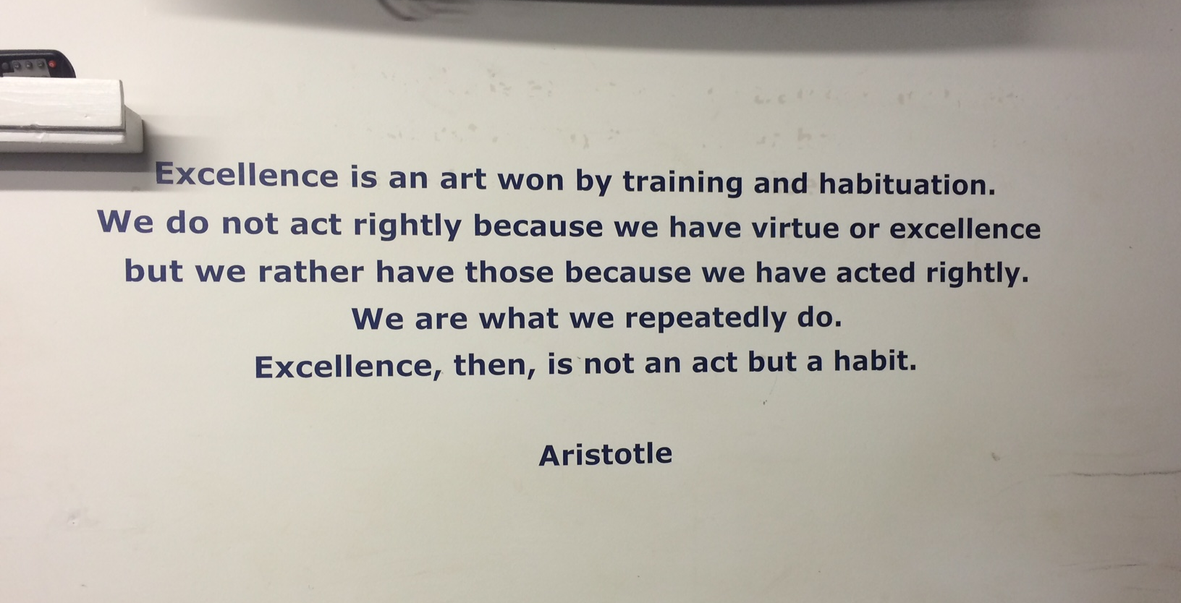

Slide 36
Excellence as a Resident
Interested
Engaged
Curious
Enthusiastic
Make mistakes
Learn from mistakes
Professional

Slide 37
Friendly Reminder:
Responsibility & Accountability
Respect for Others

Slide 38
It is not about grades anymore.
It is about learning with the goal of self-development
and always moving forward.
Reaction to Feedback
Openness to Learning
Notes:
Encourage them to seek out feedback. It is not about grades any more. It is about learning with the goal of moving forward.
Remind them about the growth mindset

Slide 39
Growth Mindset
Fixed Mindset | Growth Mindset
Believes that dedicated effort is not necessary. | Believes there is potential for growth and improvement
Desires to prove. Avoids looking unintelligent. | Desires to learn. Looks for opportunities to challenge current status.
Asks: Will I: Succeed or fail? Look smart or not? | Asks: Will I: Grow? Overcome challenges?
Questions the utility of effort.. | Recognizes that growth & learning require effort.
Ignores constructive criticism. | Learns from feedback & uses it to improve.
Dweck, 2006
Notes:
Will you see opportunities for improvement rather than opportunities for complaint
Do you classify patient care activities as educational opportunities or merely service?

Slide 40
Paradigm Shift for Learning
Assessment OF Learning
“Summative assessment”
Assessment FOR Learning (Observations)
“Formative assessment”
Embedded in learning process (frequent & ongoing)
Goal: judge/evaluate learning
At end of learning process
Low stakes, safe environment
High stakes
Goal: monitor progress & provide immediate feedback to improve (feedback loop)
Notes:
FACILITATOR TIP: This slide is illustrating a change in how we, residents and teachers, need to view and value observation and assessment. A shift in thinking to Assessment (Observation) FOR Learning is a big part of the change required for CBME to work. This is a paradigm shift that will take time.
To be truly successful, the CBD coaching model requires an important philosophical shift in thinking about assessment of residents and, particularly, the purpose of such assessment. In our current system, many of our commonly used assessment methods do not get at what a resident does on a typical clinical day. There needs to be more observation of residents doing their daily work, rather than performing in a “testing” environment/situation. Hence, the emphasis on Assessment FOR the purpose of Learning needs to be far greater than what currently exists. In other words, assessments (or observations) identify opportunities for learning.
Within a mindset of Assessment OF Learning (summative assessment), the predominant purpose for assessment is that of a judgement or evaluation of what a resident knows or can do at that particular instant in time (or sometimes even a judgement of what the resident doesn’t know or can’t do). This can create unease for the resident and often puts them in a position of performing – doing what they believe is on “a checklist” as opposed to doing what they would normally do, as they felt appropriate, in the real clinical environment.
With a shift in mindset, to the framing of Assessment FOR Learning (formative assessment), the purpose of assessment is to be part of a process to guide the resident to what they can do to improve their current understanding or practice. Formative assessment is lower stakes, frequent and ongoing and is embedded throughout the learning process rather than at the end. The goal is to monitor learning and provide immediate feedback that can be used to improve both teaching and learning and subsequent resident performance, thereby promoting a growth mindset.

Slide 41
Allow yourself to recover from mistakes

Slide 42
What Makes a great resident?
The Student Doctor Network:
https://forums.studentdoctor.net/threads/what-makes-a-great-resident.1357176/

Slide 43
Be Mindful of….
Personal Well-being

Slide 44
We are here to support you

Slide 45
Supports
JoAnn
Shuang (REL)
Academic Coach
Resident Buddies
Senior Residents
Resident Leaders
Faculty
Cheyenne, Menika & Ashley
Dockside / Riverside Chats
Meetings with Academic Coach
Resident Retreats
PRAM & PROW Meetings
Academic Half-Days
Yearly “Prepping for” Meetings
PARO Hotline
Each other

Slide 46
Questions?
Core Curriculum Reps?
CBME WG Rep?

