Slide 1
AGENDA
MORNING SESSION: OUR GOALS, THE CHALLENGES, THE SOLUTIONS
7:30 Breakfast
8:00 Welcome/Opening Remarks – Dr. Parveen Wasi, Associate Dean, PGME
Keynote/Discussion: Programmatic Assessment in CBME, Dr. Nancy Dudek
9:00 Presentation of CBME Champion Awards
9:10-9:35 Navigating the Messy Middle: What’s the Data Telling Us? L. Colizza, CBME Lead, Dr. Ranil Sonnadara, Chairs CBME Evaluation Committee
BREAK When you return, sit at a table with those who have the same colour sticker on their name badge.
Time with your colleagues - Issues, best practices, priorities, and strategies for CQI
9:45 – 10:45 Small group activity 1/Discussion *sit with those with same colour on name badge, max 5 per table
10:45 -11:45 Small group activity 2/Discussion *sit with those with different colour on name badge, max 5 per table
12:00 LUNCH
AFTERNOON SESSION: IMPROVING THE RESIDENT LEARNING EXPERIENCE
12:45 CBME Resident Experience Survey 2022: What are our residents telling us? Kestrel McNeil, Dr. Ranil Sonnadara
1:15 Rapid Program Evaluation and CQI Dr. Ranil Sonnadara, Dr. Enas. el Gouhary, Lisa Colizza
1:45-2:30 Small group activity: Program eval and CQI planning
2:30 Large Group Discussion/Wrap Up
3:00 End of Day

Slide 2
Navigating the MESSY MIDDLE
Roadmap
Leadership
Planning
Communication
Engagement
Participation
Transparency
Monitor and Measure
Perseverance
Perseverance
Perseverance
Perseverance
Perseverance
Perseverance
Perseverance
Lisa Colizza
CBME Lead, PGME
CBME Retreat
Nov. 9th, 2022
Perseverance
Perseverance!
CBME CHAMPIONS!

Slide 3
With gratitude…we recognize OUR CBME CHAMPIONS
Dr. Ereny Bassilious Dr. Spencer van Mil Mentors
Dr. David Callen Dr. Lori Whitehead Modelers
Dr. JoAnn Corey Dr. Anne Wong Communicators
Dr. Azim Gangii Dr. Ilun Yang Enablers
Dr. Som Mukherjee Dr. Teresa Chan Facilitators
Dr. Alim Pardhan Problem-solvers
Dr. Michael Parrish Innovators
Dr. Diane Reid Planners
Ms. Sarah Richardson Sharers
Dr. David Sands Techies
Ms. Julia Smerilli Pioneers
Dr. Ranil Sonnadara Presenters
Notes:
Honorable mention
Dr. Naveen Sidhu
Dr. Ronish Gupta
Dr. Blake Yarascavitch
Dr. Heather Whittingham
Dr. Catherine Munn
Dr. Julie Emerli

Slide 4
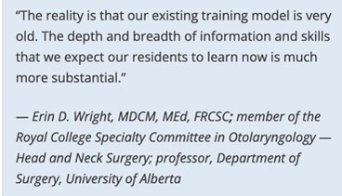
CBME: Why are we doing this?
We need a system that responds to specialists who..
graduate with knowledge gaps and feel unprepared for independent practice,
feel that existing methods of assessment and feedback are ineffectual,
lack a clear understanding of the learning objectives of their program,
lose needed clinical practice time to exam preparation, or
find it difficult to determine when new abilities/skills are needed in practice.
To graduate competent physicians who are ready for independent practice, who as life-long learners continually strive to meet the needs of their community.

Slide 6
We are building a system that enables educators/learners to…
identify the competencies needed at all stages of training and practice,
align teaching and learning with clear learning objectives,
set up/follow a transparent learning plan to achieve competencies,
adjust learning to individual needs and abilities and consistently track progress,
pinpoint areas where learners may be struggling and respond accordingly,
provide/receive meaningful assessments against competencies,
determine when and how new skills should be incorporated into practice,
ensure a national baseline of competence across all specialties in Canada.
… graduate competent physicians who are ready for independent practice, who as life-long learners continually strive to meet the needs of their community.

Slide 8
SYSTEM OF ASSESSMENT
Coaches^{n} Senior Residents
Academic
Coaches??

Slide 9
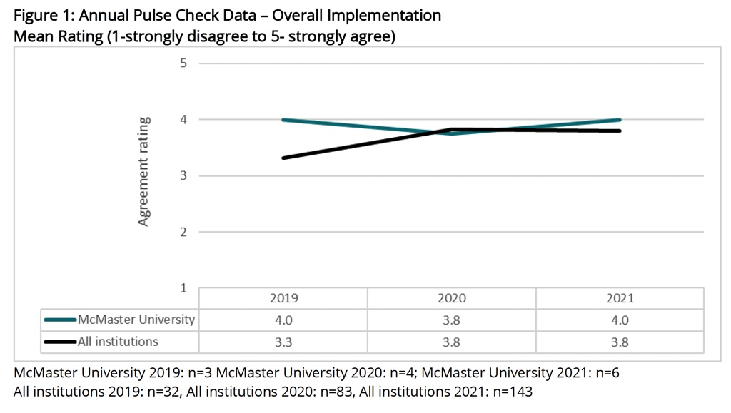

Slide 10
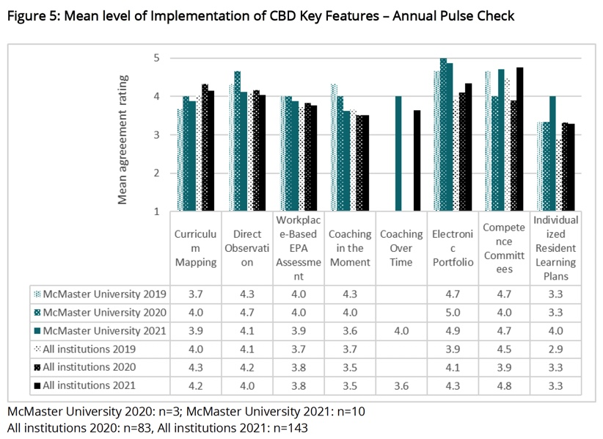

Slide 11
DIRECT OBSERVATION

Slide 12
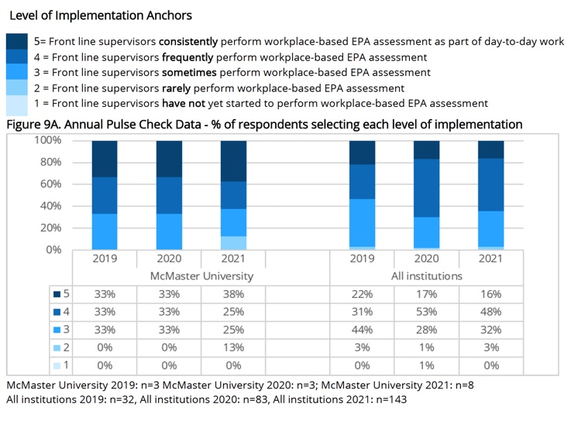
WORK-BASED EPA ASSESSMENT

Slide 13
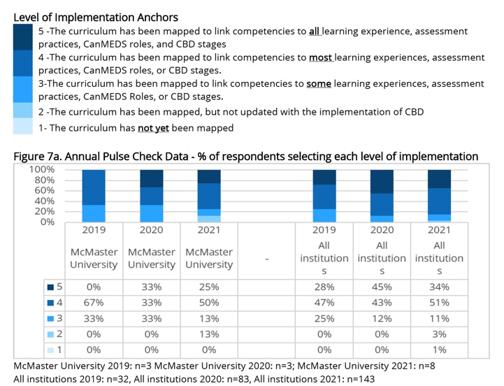
CURRICULUM MAPPING

Slide 14
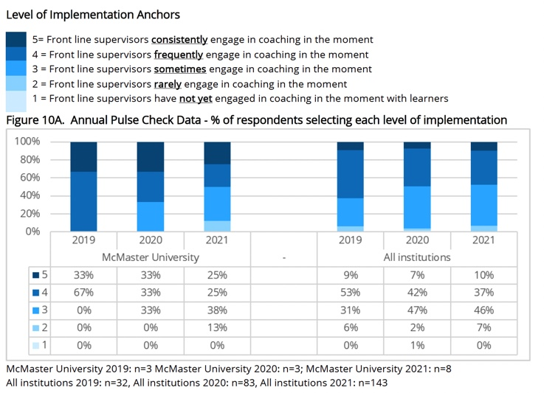
COACHING IN THE MOMENT

Slide 15
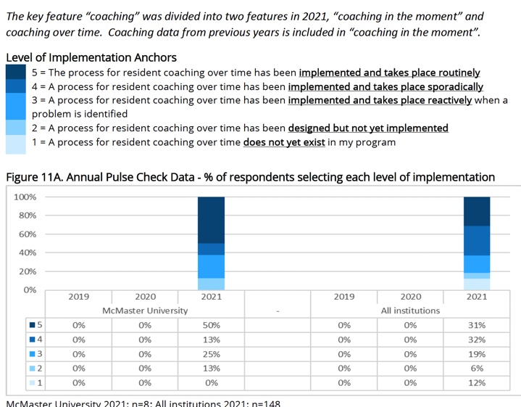
COACHING OVER TIME

Slide 16
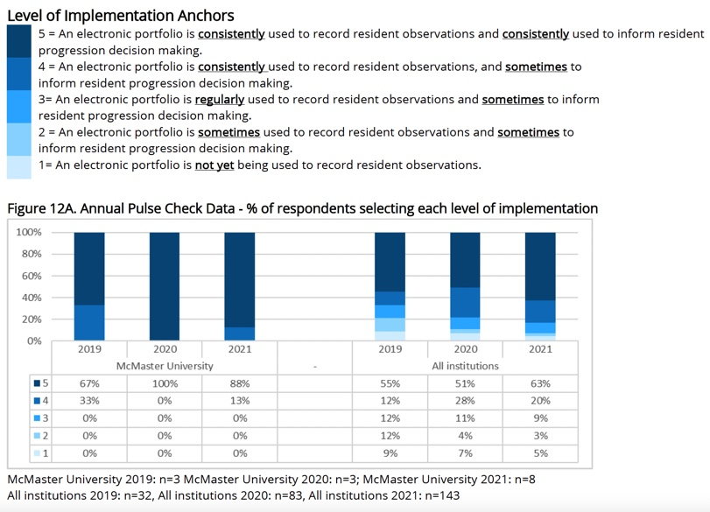
ELECTRONIC PORTFOLIO

Slide 17
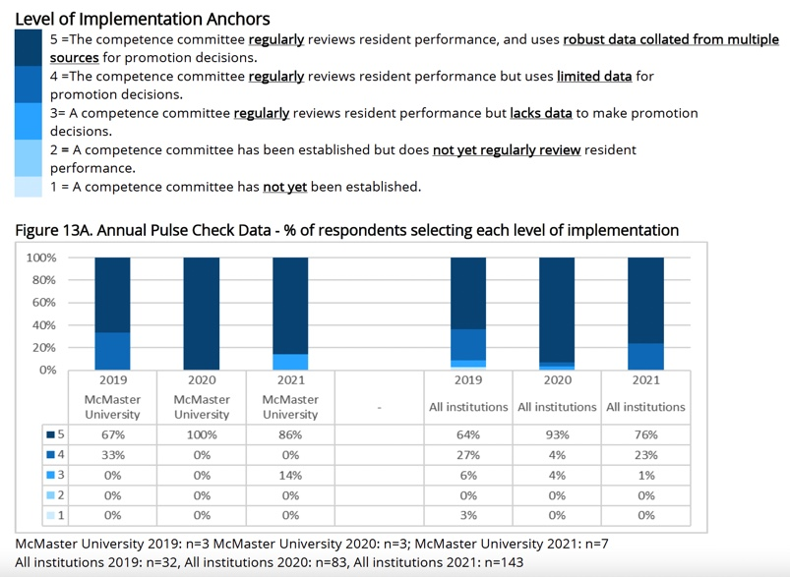
COMPETENCE COMMITTEES

Slide 18
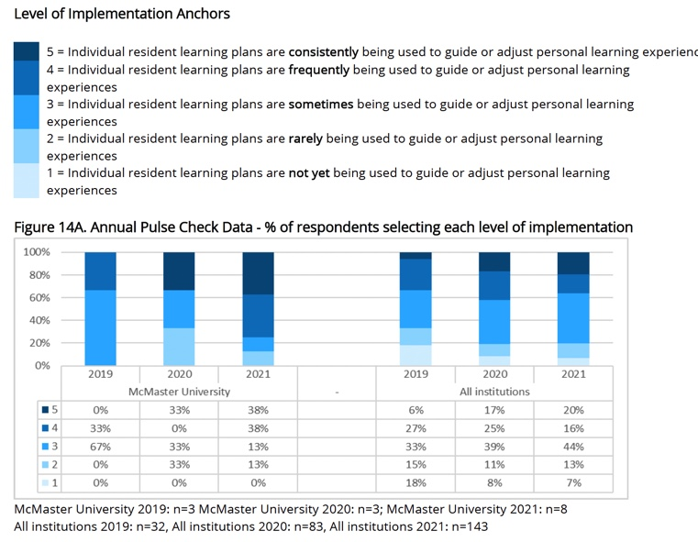
INDIVIDUALIZED LEARNING PLANS

Slide 19
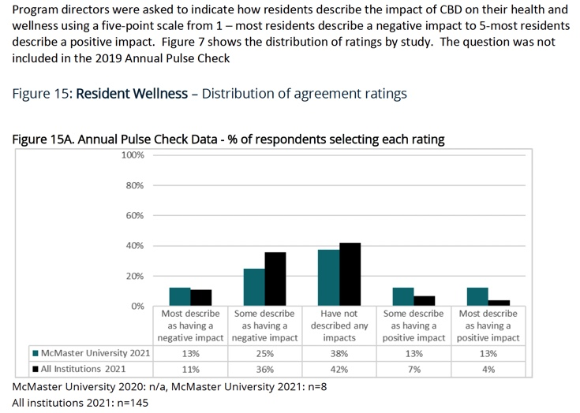
RESIDENT WELLNESS

Slide 22
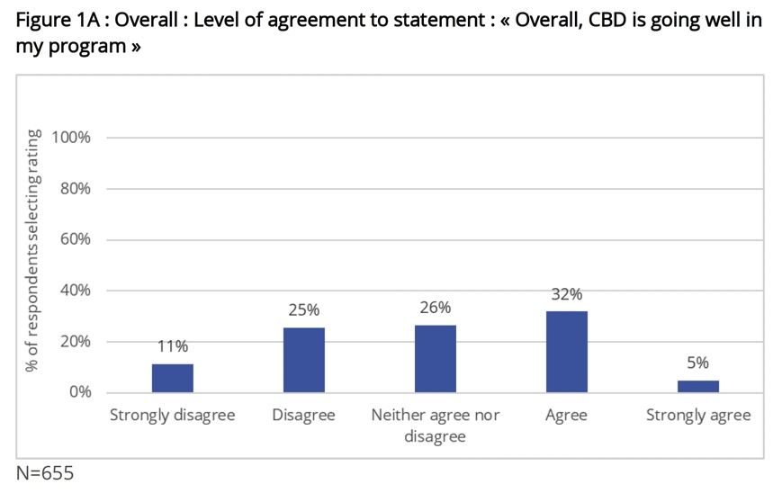
McMaster University | 67/414 of Residents in CBD | 16% Response Rate
Seven common themes identified as having the greatest negative impact on health and wellness:
● Stress from chasing staff to do EPA observations
● Administrative burden
● Concerns about achieving requirements
● Concerns around utility/validity of CBD/EPAs
● Cognitive load
● Evaluation/performance anxiety
● Preoccupation with EPAs

Slide 23
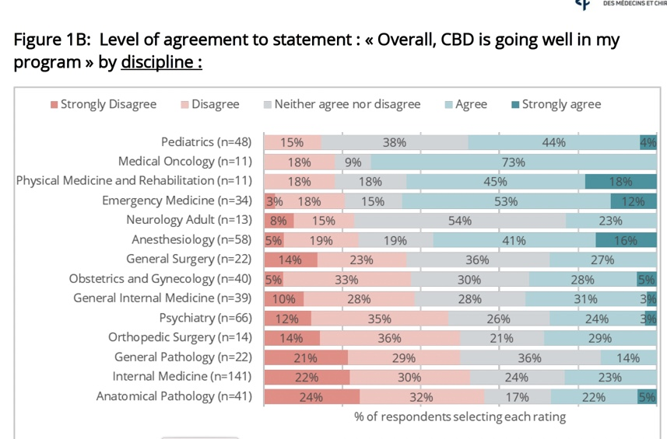

Slide 24
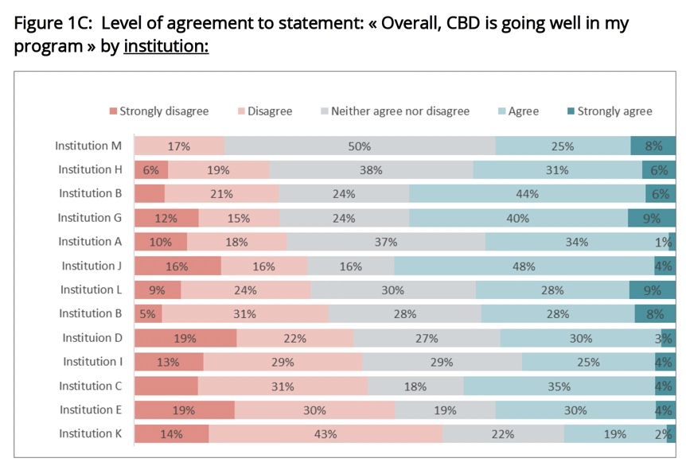
McMaster University | 67/414 of Residents in CBD | 16% Response Rate

Slide 25
The Positives | The Negatives
Residents value opportunities for formalized feedback An overview of the “milestones” they should be achieving is helpful for self-assessment The theoretical basis of CBME is something they value Residents appreciate knowing ahead what they need to work on - learning pathway | CBD has placed immense administrative burden on both staff and residents Numerous challenges/concerns are present around the use and implementation of EPAs Theoretical benefit of CBD must be considered in relation to the clinical realties faced by residents and staff
CBME RESIDENT EXPERIENCE SURVEY, 2022
Drs. Spencer van Mil, David Callen, Ranil Sonnadara and Kestrel McNeil, Lisa Colizza

Slide 26
EPA Assessment – Burden of WBA/EPAs, Threat to wellness, Impact on Training
Root Drivers of EPA Assessment Burden (RC) | Priority Areas for QI (104) URGENT | Fundamental Problems to be Addressed | PGME Interventions
Conceptual Design (EPA by stage…) | Focusing extensively on EPA and EPA assessment over coaching/feedback Struggle to understand the scores/scale/single obs Holding off for high O- scores Clinical supervisory set up does not facilitate expected EPAs Faculty and residents not effectively oriented by program leaders EPAs added on without refinement of program of assessment – added burden without value Residents concerned with wasting faculty time CCs attend to growth curve and use of narrative over numbers | EPA assessment is driving performance orientation rather than focus on growth/mastery mindset Refinement of program of assessment – added burden EPAs not used for teaching/coaching but for assessment Faculty struggle to interpret scale/use of single obs Clinical supervisory set up does not facilitate EPA assessment & coaching in the moment Design and functionality of eportfolio systems | Enhanced learner orientation Faculty development Added programmatic assessment and assessment mapping workshop ++resources, asynch. Added EPA Assessment in MedSIS - rationale & how-to demo workshop Added Communication Toolkit to support orientation Added prompts and changed O score anchors MedSIS: residents notified when EPA achieved/faculty prompted pre-expiry Enhanced data export CC Review Dashboard Data visualization dashboard Versioning technical solution CC working group
Orientation/Preparation for CBD (program, faculty, staff, resident) | -Holding off for high Oscores -clinical supervisory set up does not facilitate expected EPAs - Faculty not effectively oriented by program leaders | Clinical supervisory set up
EPAs/Program of Assessment | -Focusing extensively on EPAs -EPAs added on without refinement of program of assessment – added burden without value
Teaching/Coaching with trainee | -Wasting faculty time
Review of Data/ Access
Competence Committee | - Growth curve and use of narrative over numbers

Slide 27
Please return to your seats by 9:45 and sit with those who share the same role as you.
“Competency Based Medical Education (CBME) is an approach to preparing physicians for practice that is fundamentally oriented to graduate outcome abilities and organized around competencies. It deemphasizes time-based training and promises greater accountability, flexibility, and learner centerdness.”
To deliver on these promises, CBME must offer tailored training that promotes each learner’s individual professional development on a path of continual growth in competency.
Learners must be active agents in the process who surrender to a level of vulnerability that is not promoted by current systems of medical education. Whether in the moment or in a longitudinal manner – coaching is a critical element to implementing CBME with fidelity.
A BREAK!

Slide 28
EPA Assessment – Burden of WBA/EPAs, Threat to wellness, Impact on Training
Root Drivers of EPA Assessment Burden (RC) | Priority Areas for QI (104) URGENT | Fundamental Problems to be Addressed | PGME Interventions
Conceptual Design (EPA by stage…) | Focusing extensively on EPA and EPA assessment over coaching/feedback Struggle to understand the scores/scale/single obs Holding off for high O- scores Clinical supervisory set up does not facilitate expected EPAs Faculty and residents not effectively oriented by program leaders EPAs added on without refinement of program of assessment – added burden without value Residents concerned with wasting faculty time CCs attend to growth curve and use of narrative over numbers | EPA assessment is driving performance orientation rather than focus on growth/mastery mindset Refinement of program of assessment – added burden EPAs not used for teaching/coaching but for assessment Faculty struggle to interpret scale/use of single obs Clinical supervisory set up does not facilitate EPA assessment & coaching in the moment Design and functionality of eportfolio systems | Enhanced learner orientation Faculty development Added programmatic assessment and assessment mapping workshop ++resources, asynch. Added EPA Assessment in MedSIS - rationale & how-to demo Added Communication Toolkit to support orientation Added prompts and changed O score anchors MedSIS: residents notified when EPA achieved/faculty prompted pre-expiry Enhanced data export CC Review Dashboard Data visualization dashboard Versioning technical solution CC working group
Orientation/Preparation for CBD (program, faculty, staff, resident) | -Holding off for high Oscores -clinical supervisory set up does not facilitate expected EPAs - Faculty not effectively oriented by program leaders | Clinical supervisory set up
EPAs/Program of Assessment | -Focusing extensively on EPAs -EPAs added on without refinement of program of assessment – added burden without value
Teaching/Coaching with trainee | -Wasting faculty time
Review of Data/ Access
Competence Committee | - Growth curve and use of narrative over numbers

Slide 29
Small Group Activity #1 Sit in groups of 5 max. Sit with those who share your role in CBME. Follow the instructions on the worksheet.
Contrary to what many people think, the hardest step of problem-solving is not coming up with a solution or maintaining the gains that are made.
It is identifying the problem in the first place.

Slide 32
Small Group Activity #2 Sit in groups of 5 max. Sit with those who don’t share your role in CBME. Follow the instructions on the worksheet.
5 things to STOP doing in CBD.
5 things to START doing in CBD.

Slide 33
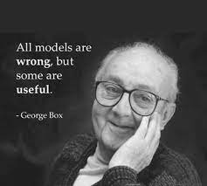
Rapid Evaluation and CQI in CBME
Dr. Ranil Sonnadara, Kestrel McNeil,
Dr. Enas el Gouhary, Lisa Colizza

Slide 37
>Dr. Enas el Gourhary – PDSA cycling for QI

Slide 39
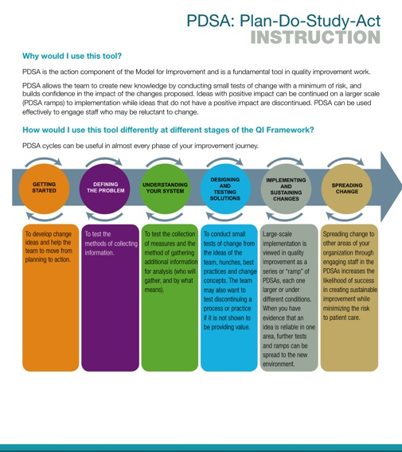
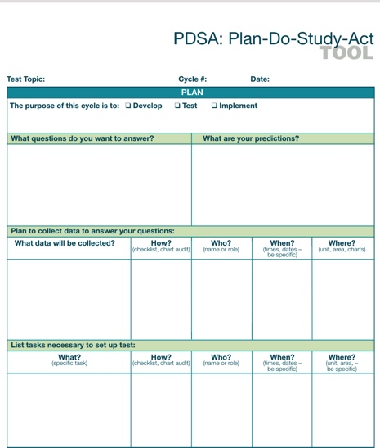
Notes:
Handout for QI planning

Slide 40
Group Discussion/Wrap Up ~ Thanks for participating ~
Hopefully a greater view of CBD implementation – being data informed is a priority.

Slide 42
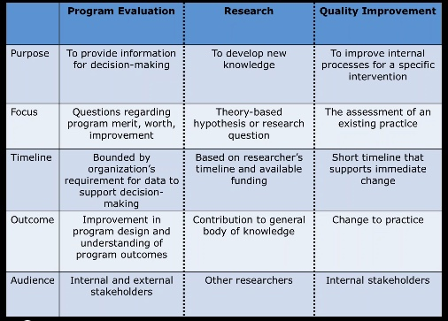
Notes:
Ranil – add or delete

Slide 44
CORE COMPONENTS/ Subcomponents | EXPECTED OUTCOMES | EMERGENT THEMES | ADAPTATIONS | TEST OF CHANGE/ PDSA | EMERGENT THEMES | ADAPTATIONS
1. Outcomes Competency Framework
-> Subcomponent
2. Progressive Sequencing of Competence
-> Curriculum Mapping | Discipline specific EPAs mapped to clinical and non-clinical learning experiences. Programs have discipline specific EPAs mapped across their four stages of learning/rotations. Variety of curriculum map templates available Program leads have a tool to communicate their competencies across their curriculum to faculty, staff, and residents | Curriculum mapping is a useful/essential process to transitioning to CBD. Refined/easy to use curriculum map templates would benefit PDs/programs. Residents benefit from knowing what EPAs they are working on across stages/rotations. | Curriculum mapping workshop to support PDs/CBD Leads with completing sample maps. Review/revise maps used by programs already transitioned, template. | A workshop developed for PDs/CBD Leads and evaluated. Review map templates and collect feedback on usefulness, format. | Rated ++effective by PDs. Follow up support to complete maps efficiently. Revise/reduce maps to 4 Assessment mapping required in follow up. Residents would benefit from receiving map. | - An additional assessment mapping workshop 4 months later, after EPAs are finalized. - Facilitators will offer support in the interim to PDs completing their maps. Map specific for resident reference. (Year at a Glance)
3. Tailored Learning Experiences
4. Competency-Focused Instruc.
5. Programmatic Assessment
-> EPA Assessment – Entrustment Scale | Use the EPA entrustment scale as intended so scores reflects a distribution across the scale 1,2>5 on an EPA observations Assess milestones observed to inform performance review/feedback. | Scores not distributed across the scale. Few 5 scores. Faculty find the anchors problematic “I did not need to be there.” | Modify anchors of the scale. Changed directly on CBD forms in medSIS. | Examine data from MedSIS 1 yr out. | Comparison of EPA score distributions pre/post anchor change – minimal effect at 1 year. Multiple strategies required to affect change. | New anchors to be communicated via faculty and learner development. Add EPA assessment/entrustment workshop.
-> Quality Narrative Feedback | Supervisors will provide actionable and timely written, narrative feedback for each EPA assessment. | Lack of actionable, written feedback entered on CBD Forms. | Add text prompt on CBD forms 1 and 2. | Monitor change in quality of narrative. | EPA assessment requires multiple strategies. | Add EPA assessment fac dev workshop .
-> Competence Committee Structure, Function, Process | CC are structured, function, and adopt processes aligned with RC guidelines. | High variability across CCs. Expectations unclear. | CC Checklist (Working group) | Feedback at CC Forum Pilot CC Checklist | Fall 2021
-> Comprehensive Resident Review – CC Dashboard | Comprehensive review of residents. | Fast access to all relevant performance data. Mtg time limitations challenging. | CC Dashboard (17 person working group) | Build in functionality/ medSIS and pilot. | Training on CC Dashboard promotes uptake. PAs essential | Hands on training in medSIS. PA Lunch ‘n Learns.
Notes:
Example of how our evaluation activities inform adaptations and support CQI. Table adapted from materials presented by Van Melle and Andrew Hall. PE Summit, 2020
Entrustment/scale as intended: O Score – 4/5 issue (anchor language problematic and the culture of assessment in medED – anchor change), add to table, CC Checklist, CC Dashboard/annual reporting,
Resident survey results: Communicated back to CBME committees, Implementation Committee and Eval Committee inform Fac Dev, Learner Dev, Resident Lead

Slide 45
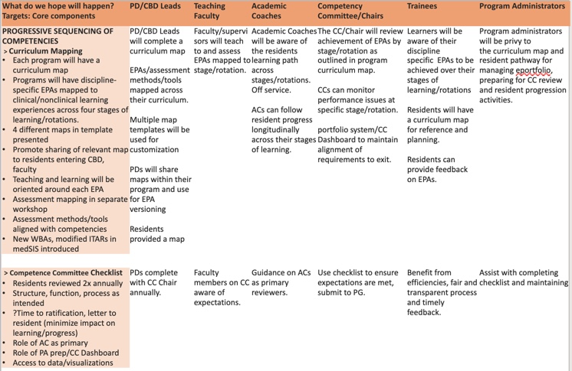

Slide 46
