Slide 1
This presentation has been developed for CBME leads and PGME offices, and provides information about the CBD Adaptations Plan (“CBD 2.0”)
You are free to edit these slides as needed to share the information with your constituent audiences
Key messages for residents are found on slides 26-29

Slide 2


CBD Adaptations Plan
Working together for success

Slide 3
Presentation overview
1 - Important program evaluation signals from the first 7 years of CBD in Canada
2 – The national CBD summit process and planned evolution of CBD
3 – Adaptations to CBD implementation

Slide 4
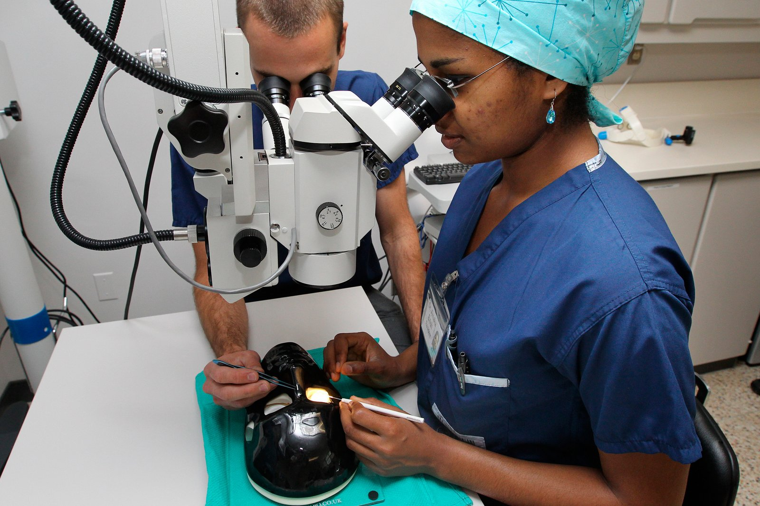
Competency-based medical education (CBME) is an approach to preparing physicians for practice that is based on a framework of competencies. Curriculum is organized around the outcomes expected of a resident.
It deemphasizes time-based training and promises greater accountability, flexibility, and learner centredness.

Slide 5
Competence by Design (CBD)
CBD is the Canadian national approach to CBME for specialist residency training
Transformation to CBD has been a multi-year national change initiative designed to enhance residency training and specialty practice in Canada
The first cohort of residents began training in Royal College-accredited CBD programs in 2017

Slide 6
CBD evaluation
Given the significant resource requirements and widespread impacts, a robust program evaluation plan facilitates learning and creates accountability within the medical education community
Ongoing evaluation of CBD is key to making course corrections and better understanding program outcomes:
National studies
Studies conducted at the national level on a continuous basis to better understand challenges and benefits of CBD and monitor if it is achieving its desired goals.
Community engagement
The CBME Program Evaluation Summit, held annually with ICRE, gathers people engaged in evaluation to discuss and learn about methods and approaches to program evaluation and share findings.
Notes:
To learn more about how we are evaluating Competence by Design and the full scope of work, explore the Competence by Design Program Evaluation Dashboard. https://app.powerbi.com/view?r=eyJrIjoiNjc0ZmZlNTItMjgyNS00YTA2LWIzNDMtNjk2YWMyNjNlZDg1IiwidCI6ImM0OGUxZTJhLTljZjAtNGNkZC04MjIxLWRkZGM5MWRlMDgzNCJ9
From the dashboard, you can access reports, presentations, or do deep dives into CBD program evaluation data.

Slide 7
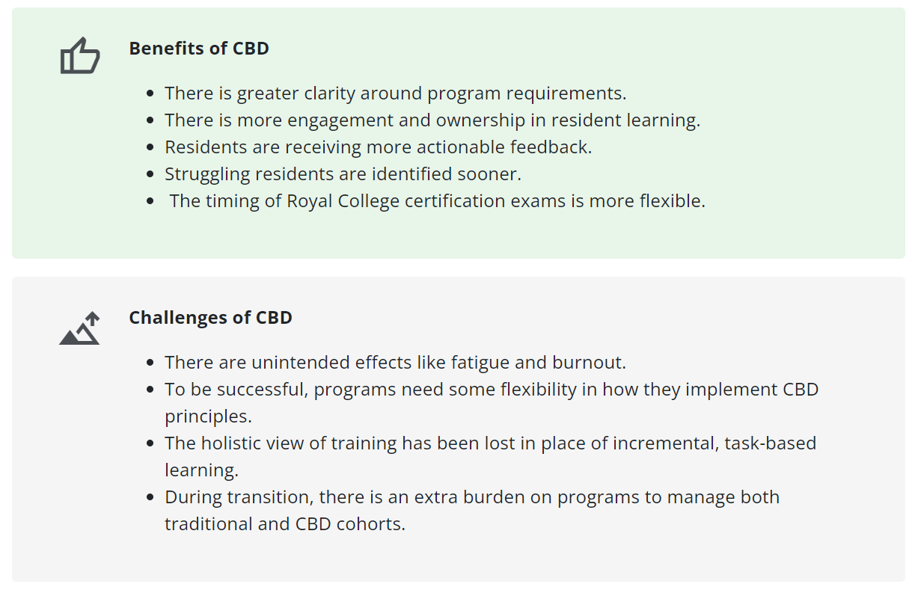
What have we learned through CBD evaluation?
Notes:
References:
Program Directors Annual Pulse Check Survey (2019,2020,2021,2022)
Program Directors Interviews (2019, 2020, 2021, 2022)
Resident Pulse Check Survey (2021)
Learn more here: https://app.powerbi.com/view?r=eyJrIjoiNjc0ZmZlNTItMjgyNS00YTA2LWIzNDMtNjk2YWMyNjNlZDg1IiwidCI6ImM0OGUxZTJhLTljZjAtNGNkZC04MjIxLWRkZGM5MWRlMDgzNCJ9

Slide 8
Residency education is complex
Heterogeneity of disciplines, institutions, and resident cohorts
Residency is a hybrid of training and employment
There are multiple factors at play in a program’s success
Key take-away: Complexity and heterogeneity of experience requires flexibility in CBD implementation

Slide 9
Taking action
Commitment to Action
May 2023
CBD Summit #1
June 2023
CBD Summit #2
September 2023
CBD Summit #3
March 2024
Approval by Royal College Council
June 2024
Outcome: Draft adaptations table
Outcome: Prioritized adaptations
Outcome: Refinement of adaptations
Consultation on proposed adaptations
Notes:
In May 2023, the Royal College Committee on Specialty Education approved the Commitment to Action, which reflected on the challenges of CBD as evidenced by program evaluation work. https://www.royalcollege.ca/en/newsroom/posts/commitment-to-action-statement-on-enhanced-flexibility-for-cbd-program-implementation.html
The commitment statement was accompanied by The Essential Requirements of CBD Implementation, which outlines the flexibility available to postgraduate institutions and programs in implementing CBD. https://www.royalcollege.ca/content/dam/pending-assets/documents/2EF%20CBD%20Essential%20Requirements.pdf
Following this was a 12-month collaborative process that brought together the medical education community to discuss and develop proposed adaptations to CBD which could ameliorate the issues and challenges faced by schools, programs, faculty, and residents. Three “CBD Summits” were hosted by the Royal College and the outcome was a proposal for change that was approved by Royal College Council in June 2024.
Frequently Asked Question
Who participated in the CBD Summits?
CBD Summit participants included PGME Deans, CBME Leads, Program Directors, Resident Doctors of Canada, Fédération de médecins résidents du Québec, Collège des Médecins du Québec, Royal College CBD Steering Group, CBD National Advisory Board, Specialty Committee Chairs, and Scholars, with representation from all 17 Canadian medical schools.

Slide 10
Priorities
Reducing the burden of assessment
Increasing opportunities for authentic feedback and coaching
Providing clear and consistent communication about CBD
Revising and reconceptualizing the Royal College approach to evaluation of CBD
Optimizing electronic portfolio use
Notes:
Participants in the CBD Summits agreed that there were 5 high-level priorities to tackle.

Slide 11
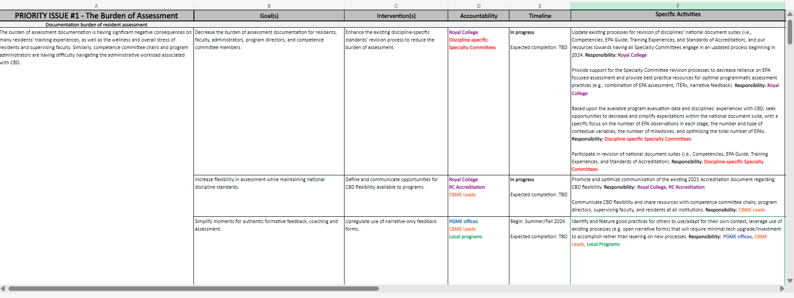
Outcome – CBD Adaptations Plan
LOGIC MODEL
Priority Issue > Goals > Interventions > Accountability >Timeline > Specific Activities
Notes:
The final approved CBD Adaptations Plan was shared on July 3, 2024, with accompanying Executive Summary and FAQ documents. The plan itself lays out the specific activities for the evolution of CBD, indicating the accountability for those activities and anticipated timelines (for activities assigned to the Royal College). For copies of the plan and accompanying documents, email cbdsecretariat@royalcollege.ca
For activities assigned to PGME audiences, specific activities represent suggestions or ideas for what can be changed, within your locus of control. Institutions do not have to implement all of the adaptations but can focus on those that they feel would have the greatest impact for their programs.
Frequently Asked Question
What immediate change is required for my program? My institution?
Schools and programs are encouraged to consider the interventions assigned to Institutions in the CBD Adaptations Plan and any actions that can be taken to respond to local challenges in new and effective ways.

Slide 12
CBD Adaptations Plan
The fundamental design of CBD has not changed:
  Stages of training
  Training requirements (competencies, training experiences, and EPAs)
  Robust program of assessment
  Competence committees
Planned adaptations impact how CBD is implemented, at the Royal College, institution, and program levels
Notes:
The model of CBD has not changed. The CBD Adaptations Plan is focused on changes to implementation of CBD, with roles for the Royal College, institutions, and programs to make changes within their respective spans of control.
Frequently asked question
Have the accreditation standards changed as part of the CBD Adaptations plan?
Updates to the General Standards of Accreditation for Residency Programs were released on July 1, 2024. The new program-level standards include modifications aimed at ensuring resident portfolios are consistently used and assessment data is presented in a way that supports decision-making processes, while still allowing flexibility for local needs and context. These changes were informed by discussions initiated by the CBD Steering Group. As per the standard practice for version applicability, the new standards will apply immediately to applications for accreditation of new programs and 12 months later (July 1, 2025) for all other types of Royal College accreditation reviews.
Should there be a need for any additional revisions to accreditation standards, identified through the implementation of the CBD Adaptations Plan (see Interventions 1.5, 1.8 and 2.1), those changes will be considered for incorporation in a future version of the accreditation standards.

Slide 13
Role clarity
The Royal College:
Sets national accreditation standards
Identifies the required competencies, training experiences, and EPAs for each discipline (through the Specialty Committee)
Sets and delivers national examinations
Confers certification
PGME offices and programs:
Develop program curriculum based on the required competencies, training experiences and EPAs for the discipline
Determine the assessment strategy for each program, including the methods, tools, and forms to be used
Determine the type and amount of evidence required to make progression decisions about each resident
Communicate with residents regarding program expectations
Notes:
More detail on the decision-making available to PGME offices can be found in The Essential Requirements of CBD Implementation.
Frequently Asked Questions
Programs determine the assessment strategy – Does this mean THEY can choose to stop using EPAs?
No, they may not. EPAs are part of the training requirements, and therefore remain a mandatory element of residency training in Canada.
EPAs are authentic tasks of a discipline as defined by the specialty committee for that discipline and form the basis of training curriculum and the certification exam. The language or wording of an EPA and its associated milestones cannot be changed, other than by the discipline's specialty committee. Demonstration of competence in the EPAs of the discipline is required for certification.
How the EPA is assessed is at the discretion of the program. Direct observation of an EPA and completion of a form is only one way of assessing that EPA. Other tools of assessment can be used to infer that a learner has the knowledge-skills-attitudes (KSA) encompassed within an EPA. Assessment tools should be multimodal and capture the full range of resident learning across various learning experiences.
Competence committees must have evidence, based on both direct and indirect observation, to support decision making about resident entrustment for the EPAs. To get this evidence, a program, with the oversight of their PGME office, may modify the EPA assessment forms and/or identify their preferred method of assessment to obtain evidence of achievement for any given EPA. The chosen assessment methods must be documented and accessible to residents.
For accreditation, programs are expected to show a curriculum plan that links assessment strategies with expected stage-specific competencies, including EPAs.
What happens if a program tries to operationalize a “minimalist approach” to CBD assessment (e.g., minimum EPA observations, return to ITERs, no use of milestones, etc.)?
While ITERs/ITARs (summative records of performance over time) add value, relying solely on these for promotion decisions is not compatible with CBME principles or the CBD design. Programs must ensure that their assessment program is based on multiple assessments of residents' competencies across various educational experiences, over time, by multiple assessors, and in multiple contexts.

Slide 14

Assessment burden
Amount and type of documentation
Hyper-focus on EPAs
Competence Committee processes
Faculty support
Notes:
The burden of assessment documentation is having significant negative consequences on many residents' training experiences, as well as the wellness and overall stress of residents and supervising faculty. Similarly, competence committee chairs and program administrators are having difficulty navigating the administrative workload associated with CBD.
EPAs and their associated workplace-based assessment have become a focal point that has overshadowed other important types of assessment. This has translated into programs of assessment that are too heavily weighted toward EPA observation forms and too narrow in scope to meet the goals of programmatic assessment.
There has been variable practices of competence committees related to expectations of how flexible they can be with respect to signing off on EPAs, creating learning plans, and making progression decisions based on the national discipline specific standards.
Faculty need additional support for completion of EPA assessments. There continues to be problems related to forms not being completed and/or not being completed in a timely fashion which limits residents in their ability to meet assessment expectations. In addition, the lack of timely feedback affects the residents' ability to receive feedback "in the moment" and utilize this to improve and work towards competence.

Slide 15
Reducing the assessment burden
Institutions can
Adapt assessment tools and methods (e.g., increase use of narrative-only forms)
The Royal College will
Engage all Specialty Committees in review of their EPAs and discipline-specific standards
Communicate broadly about adjustments that can be made to improve CBD implementation
Adjust number of EPA observations required
Support faculty to initiate assessments more frequently and complete assessments quickly
Notes:
Let’s take a closer look at the CBD Adaptations Plan and some of the specific activities:
Priority 1: Assessment burden
National Specialty Committees set the EPAs and standards for their disciplines. The Royal College will engage every Specialty Committee in a process to review their EPAs and other specialty-specific CBD documents, with particular focus on ways to reduce assessment burden.
Institutions can make adjustments to their program of assessment by changing methods, tools, and forms used. Competence Committees can also consider adjusting the number of required EPA observations needed to make informed progression and promotion decisions.
See the full CBD Adaptations Plan for suggestions of ways your institution can reduce assessment burden. If you don’t have a copy of the Plan, please email cbdsecretariat@royalcollege.ca
Please note that you do not have to take action in all 5 of the priority areas – focus on what is most important to your institution at this time.

Slide 16
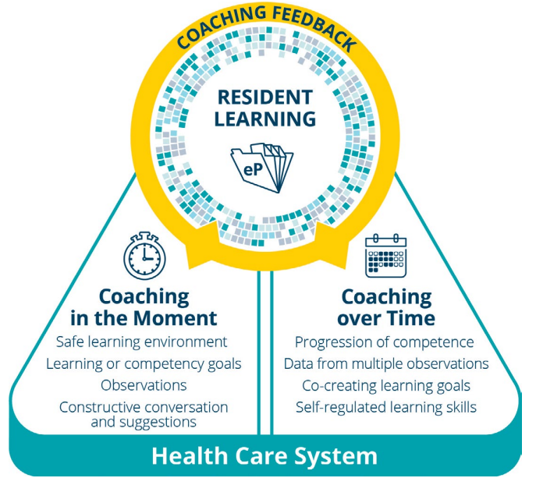
Feedback and coaching
Too much focus on assessment
Perceived loss of longitudinal coaching (“coaching over time”)
Notes:
The assessment focus on EPAs and their associated required workplace-based assessment within disciplines and across competence committees has caused an overall perceived loss of teaching and learning in-the-moment.
Residents have had variable experiences throughout their training with faculty coaches/academic advisors/mentors.

Slide 17
Increasing opportunity for feedback and coaching
Identify coaching ‘champions’
The Royal College will
Include ‘feedback only’ (i.e., undocumented) moments during teaching
Solicit resident and faculty input on how to improve coaching culture
Institutions can
  Reinforce the importance of coaching through communication, educational resources, and accreditation standards
Notes:
Priority 2: Feedback and coaching
The Royal College will clarify expectations with respect to feedback and coaching culture and will update existing resources on coaching to support institutions and programs. Updates to accreditation standards may also be made, as needed.
Institutions can identify champions to drive local change, identify opportunities to enhance coaching (e.g., by including times for non-documented feedback), soliciting resident input, and capturing faculty feedback.
See the full CBD Adaptations Plan for suggestions of ways your institution can increase feedback and coaching. If you don’t have a copy of the Plan, please email cbdsecretariat@royalcollege.ca
Please note that you do not have to take action in all 5 of the priority areas – focus on what is most important to your institution at this time.

Slide 18
Communication
Variable understanding of CBD across audiences
Misconceptions and myths
Out-of-date information
Notes:
Residents, faculty, competence committee members, PGME offices, and other invested groups have variable understanding of the intended implementation and processes of the CBD model in its current form. There are also misconceptions regarding the intentions and impact of the CBD 2.0 process.

Slide 19

Clear and consistent communication
The Royal College will
Provide updated resources to enhance understanding, expectations, and evolution of CBD
Institutions are asked to
  Share updated resources and messaging with program leadership, competence committee members, faculty, and residents
Notes:
Priority 3: Communication
The Royal College will improve its communication processes with all invested groups so that all system partners have a shared understanding of CBD.
Institutions are asked to share the updated communication resources with their constituents, including program leadership, competence committee members, faculty, and residents.
See the full CBD Adaptations Plan for suggestions of ways your institution can improve communication. If you don’t have a copy of the Plan, please email cbdsecretariat@royalcollege.ca
Please note that you do not have to take action in all 5 of the priority areas – focus on what is most important to your institution at this time.

Slide 20

CBD evaluation
Working in silos
Lack of knowledge sharing and translation
Notes:
Most of the CBD evaluation efforts have been conducted in silos with limited opportunities for synthesis and dissemination. The lack of knowledge translation has hindered CBD implementation and adaptation efforts, and resulted in mixed messages, misconceptions, and challenges.

Slide 21
CBD evaluation
Royal College will
  Implement the new framework for CBD evaluation, focusing on experiences, outcomes, and value
  Create grants for CBD evaluation projects by educational leaders and scholars outside of the Royal College
Notes:
Priority 4: Evaluation
The Royal College has restructured its evaluation work on CBD, emphasizing the “value proposition;” increase dissemination of CBD evaluation findings; and encourage more non-Royal College studies of CBD.
Note: There are no activities assigned to institutions under the priority area of CBD evaluation

Slide 22

Electronic portfolios
Multiple electronic portfolio platforms in use
Issues of functionality and ease of use
Costs and time to make changes
Notes:
The challenges experienced by residents, faculty, competence committee members, administrators and others has been significant with respect to time, functionality, ease of use, and costs. The existence of multiple IT portfolio platforms creates challenges when aiming to find solutions that can work for all end-users.

Slide 23
Optimizing electronic portfolio use
Institutions can
Connect with technical leads at other institutions to share best practices
The Royal College will
Implement CQI opportunities from user feedback
Explore options to increase use of smartphones and iPads for in-the-moment documentation of assessment
  Work to minimize the impact of changes on institutions’ electronic portfolios
Notes:
Priority 5: Electronic portfolios
Institutions can connect with other institutions using the same electronic portfolio for information sharing, make improvements to their systems based on feedback from end-users, implement and monitor metrics on resident and faculty use, explore ways to use smartphones or iPads to enhance in-the-moment documentation, and continue to share technical challenges and needs with the Royal College.
The Royal College will critically examine the implications of any changes to CBD on electronic portfolios used by the institutions, and minimize the impact of changes, wherever possible.
See the full CBD Adaptations Plan for suggestions of ways your institution can optimize electronic portfolio use. If you don’t have a copy of the Plan, please email cbdsecretariat@royalcollege.ca
Please note that you do not have to take action in all 5 of the priority areas – focus on what is most important to your institution at this time.

Slide 24

Launching the plan
Notes:
Now that the CBD Adaptations Plan has been approved, published, and shared, we are moving into the implementation phase.

Slide 25
Timeline
  Anticipated timelines for activities are provided in the CBD Adaptations Plan
    Note that some of the interventions will have long timelines (lasting months or years) – for example, revision of discipline standards and EPAs
  Institutions are encouraged to move forward with adaptations as soon as they are able
Notes:
Planned timing for Royal College activities are noted in the CBD Adaptations Plan. The plan includes many longer-term projects, for example, revision of discipline standards and EPAs, will take several years to complete.

Slide 26
Key messages for residents

Slide 27

What have we learned about CBD?
There is greater clarity around program requirements, more engagement and ownership in resident learning, and struggling residents are identified sooner
BUT
There are unintended effects like fatigue and burnout
The holistic view of training has been lost in place of task-based learning
Focus on EPAs has overshadowed other important aspects of CBD and residency education

Slide 28
Priorities
Reducing the burden of assessment
Increasing opportunities for authentic feedback and coaching
Providing clear and consistent communication about CBD
Revising and reconceptualizing the Royal College approach to evaluation of CBD
Optimizing electronic portfolio use
Notes:
Members of the CBME community came together to identity priorities for CBD improvement.

Slide 29
What changes can you expect?
[add or delete items depending on the adaptations your program/institution plans to undertake]
Reduced number of required EPA observations
Increased feedback and coaching
Changes to assessment methods
Changes to assessment forms
Clearer expectations for faculty initiation and completion of assessment forms

