Slide 1
Welcome to Competency Based Medical Education

Slide 2
Official CBME Launch
July 1, 2020

Slide 3
Notes:
Sometimes people have good ideas. Things that could make the way we are currently doing things, a little better.
But as humans, we are very resistant to change.
Why would we want to change something if it seems to be working ok?

Slide 4
Why Move to CBME?
Feedback.
Exposure to experiences.

Slide 5
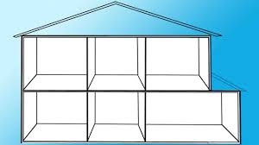
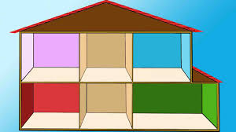
Why move to Competency Based Medical Education?

Slide 6
Why move to Competency Based Medical Education?
An effort to educate even better
Better prepared graduates
More fulfilled educators
Improved patient care
Notes:
Because we want to work to educate even better.
To better prepare our graduates
To feel more fulfilled as educators
And most importantly, to provide even better patient care moving forward

Slide 7
MANY THINGS STILL THE SAME
Defined Rotations
Psychotherapy
Rotation Evaluations
(ITARs)

Slide 8
What is different ab0ut Competency Based Medical Education?

Slide 9
What is Competency Based Medical Education?
CBME:
Rotations will still be defined times
Emphasize acquisition of knowledge & skills
Organized around outcomes expected of a resident
Advancement dependent on achieving those expected outcomes
Foster more effective, more frequent feedback:

Slide 10
CBME: Paradigm Shift
Assessment OF Learning
“Summative assessment”
Assessment FOR Learning (Observations)
“Formative assessment”
Embedded in learning process (frequent & ongoing)
Goal: judge/evaluate learning
At end of learning process
Low stakes, safe environment
High stakes
Goal: monitor progress & provide immediate feedback to improve (feedback loop)
Notes:
FACILITATOR TIP: This slide is illustrating a change in how we, residents and teachers, need to view and value observation and assessment. A shift in thinking to Assessment (Observation) FOR Learning is a big part of the change required for CBME to work. This is a paradigm shift that will take time.
To be truly successful, the CBD coaching model requires an important philosophical shift in thinking about assessment of residents and, particularly, the purpose of such assessment. In our current system, many of our commonly used assessment methods do not get at what a resident does on a typical clinical day. There needs to be more observation of residents doing their daily work, rather than performing in a “testing” environment/situation. Hence, the emphasis on Assessment FOR the purpose of Learning needs to be far greater than what currently exists. In other words, assessments (or observations) identify opportunities for learning.
Within a mindset of Assessment OF Learning (summative assessment), the predominant purpose for assessment is that of a judgement or evaluation of what a resident knows or can do at that particular instant in time (or sometimes even a judgement of what the resident doesn’t know or can’t do). This can create unease for the resident and often puts them in a position of performing – doing what they believe is on “a checklist” as opposed to doing what they would normally do, as they felt appropriate, in the real clinical environment.
With a shift in mindset, to the framing of Assessment FOR Learning (formative assessment), the purpose of assessment is to be part of a process to guide the resident to what they can do to improve their current understanding or practice. Formative assessment is lower stakes, frequent and ongoing and is embedded throughout the learning process rather than at the end. The goal is to monitor learning and provide immediate feedback that can be used to improve both teaching and learning and subsequent resident performance, thereby promoting a growth mindset.

Slide 11
Paradigm Shift for Learning
Feedback for Learning

Slide 12
Growth Mindset
Growth Mindsets
Believes there is potential for growth and improvement
Desires to learn. Looks for opportunities to challenge current status.
Asks: Will I: Grow? Overcome challenges?
Not focused on: Proving self-worth Will I look intelligent?
Recognizes that growth & learning require effort.
Learns from feedback & uses it to improve.
Dweck, 2006
Notes:
Carol Dweck is Psychology professor, at Stanford University, in California, and she has been doing research on achievement and success of students for the last several decades. She coined the terms “Growth Mindset” and “Fixed Mindset” to describe peoples beliefs about and therefore their approach to learning.
The Growth Mindset, is one in which it is believed that there is potential for an individual’s growth and improvement and this very much aligns with coaching as a teaching and learning method to promote development.
Whereas someone who ascribes to the Fixed mindset (example features of which are in the yellow column) believes the level of achievement is predetermined, and effort dedicated toward learning will not promote greater achievement.
According to Dweck, someone with a Growth mindset has:
a high DESIRE to learn, looks for opportunities to challenge their current status & grow as a result of taking on challenges,
learns from feedback and wants to know how to improve, while recognising that the improvement will require practice and effort.
In contrast, someone with a Fixed Mindset perspective:
approaches situations with a judgement lens, wondering “how will I look – smart or not?” Individuals who are of a Fixed Mindset don’t value challenging situations as learning opportunities
because effort is pointless as is responding to feedback
If we consider this in the context of clinical teaching, from the residents’ perspective – someone who is aligned with a Fixed Mindset would view observation done by a coach as an assessment at that point in time for what they know, and that judgements and decisions about my future will be made based on this point in time status. This could be called an “assessment OF the learning” that has taken place.
Someone holding a Growth mindset, would see an opportunity to have an expert coach observe their work at any point in time as an opportunity to get expert input and feedback on what they could improve. This could be called an “assessment FOR learning”
Dweck, C. S. (2006). Mindset: The new psychology of success. New York: Random House.

Slide 13
What is this going to look like?

Slide 14
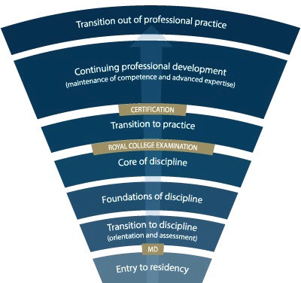
Competence Continuum -Stages of Training-
PGY-5
PGY-4
PGY-3
PGY-2
PGY-1
Notes:
*for general program
Need to understand how this will look for Subspecialty Programs
Explain the stages of training.
-RC will outline what needs to be accomplished within each Stage of training and give a range of time that stage may last
-Programs will then decide the duration of each stage (within the RC parameters) and what rotations will be included in each stage
-RC is also going to outline what skills & knowledge must be accomplished by a resident before they are to be allowed to progress to the next stage of training. Those required skills & knowledge are packaged into what is called the EPAs and Milestones (which I will explain in a minute)
-Programs will then map which EPAs should be accomplished in which rotations for their residents

Slide 15
Key Points
Residents will progress thro’
Stages of Training
along the Competence Continuum.
There will be defined
Required Training Experiences
in each stage of training.
Its all about Feedback & Assessment
Quality
Acceptance & Incorporation

Slide 16
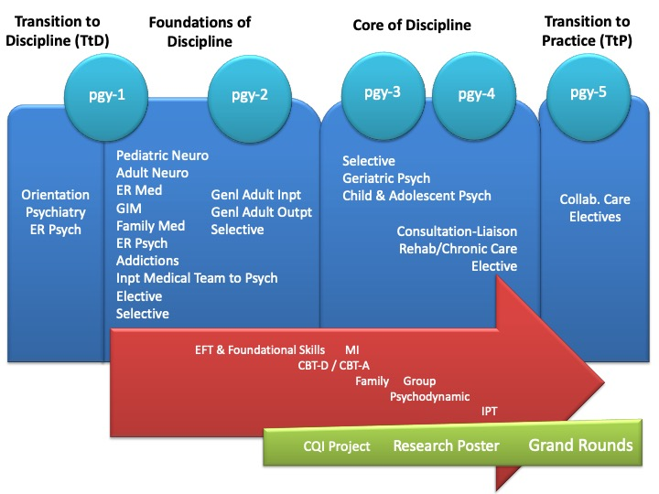
Training Requirements

Slide 17
Competence Continuum -Stages of Training-
PGY-5
PGY-4
PGY-3
PGY-2
PGY-1
Notes:
*for general program
Need to understand how this will look for Subspecialty Programs
Explain the stages of training.
-RC will outline what needs to be accomplished within each Stage of training and give a range of time that stage may last
-Programs will then decide the duration of each stage (within the RC parameters) and what rotations will be included in each stage
-RC is also going to outline what skills & knowledge must be accomplished by a resident before they are to be allowed to progress to the next stage of training. Those required skills & knowledge are packaged into what is called the EPAs and Milestones (which I will explain in a minute)
-Programs will then map which EPAs should be accomplished in which rotations for their residents

Slide 18
During each stage of training there will be defined Competencies (i.e. knowledge & skills) that a resident must acquire

Slide 19
Entrustable Professional Activities (EPAs)
These competencies are called

Slide 20
Entrustable Professional Activities (EPAs)
Key tasks that an individual can be trusted to perform in a given health care context
Example:
Obtaining a psychiatric history to inform the preliminary diagnostic impression for patients presenting with mental disorders.

Slide 21
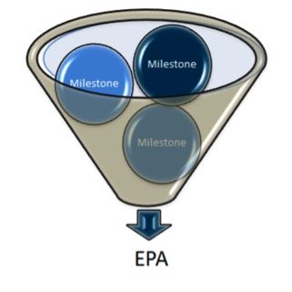
Developmental Milestones
EPAs can be broken down into smaller, component parts called

Slide 22
Developmental Milestones
The smaller, defined components that are needed to complete the full EPA
Examples: Conduct a mental status exam
Respect professional boundaries
Observable markers of an individual’s ability
Reference the CanMEDS roles applicable to that EPA

Slide 23
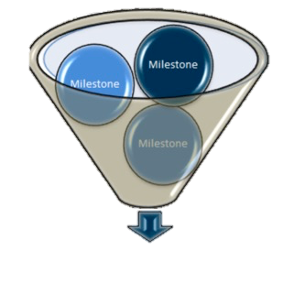
The Royal College has defined which EPAs a resident must acquire before they can advance to the next Stage of Training.
Transition to Practice
Core of Discipline
Foundations of Discipline
Transition to Discipline

Slide 24
Transition to Discipline EPAs
EPA TtD-1
EPA TtD-2
Obtaining a psychiatric history to inform the preliminary diagnostic impression for patients presenting with mental disorders.
Communicating clinical encounters in oral and written/electronic form.

Slide 25
Opportunities for Observation & Feedback on an EPA

Slide 26
How will this work?

Slide 27
https://drive.google.com/drive/u/0/folders/1H5KFLRud_3UxTBZlD9TbY7nX41Nbfr9F
Resident
Supported by technology

Slide 28
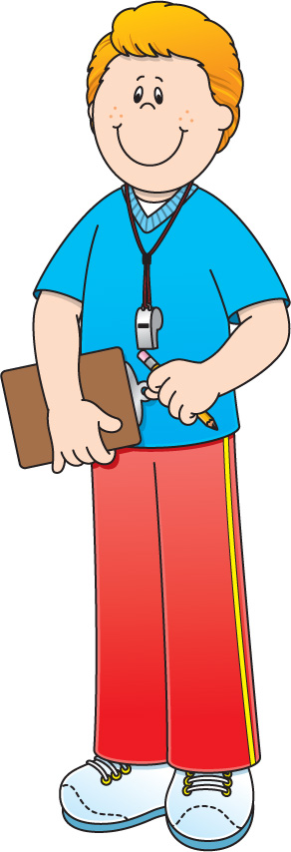
Academic Coach
Plans their learning
Views Curriculum Map
Know what EPAs working on
Develops a Personal Learning Plan
Resident
Supported by technology

Slide 29
Academic Coaches
Residents will be assisted by

Slide 30
Academic Coaches
Help facilitate resident’s learning & development over time
Help resident navigate curriculum map
Longitudinal relationship with resident

Slide 31
Academic Coach
Plans their learning
Views Curriculum Map
Know what EPAs working on
Develops a Personal Learning Plan
Supervisor
Resident
Sets Objectives for Rotation
Based on Curriculum Map
Based on Personal Learning Plan
Supported by technology

Slide 32
Faculty Development
Faculty are learning too
They may need reminders
Large Group Sessions
Small Group & Individual Sessions
Psychiatry Digest Updates
CBME Newsflashes
Department Website
Royal College Website
Notes:
Reminder about tracking form
Use this as MoCOMP credit

Slide 33
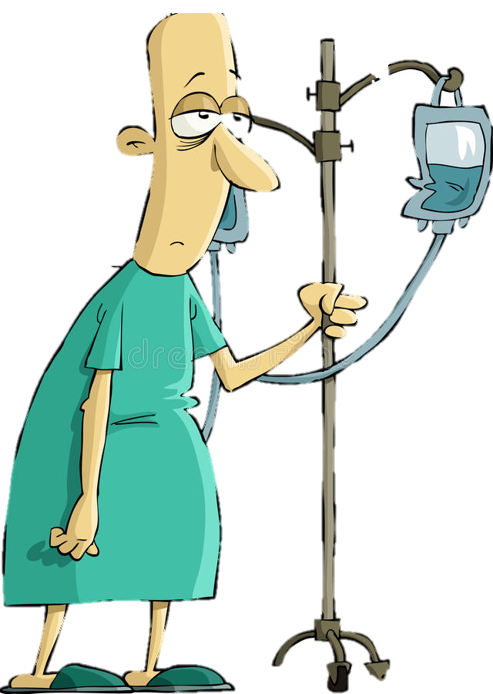
Program
Director
Academic
Coach
Competence Committee
Regional
Education Lead
Notes:
Resident and faculty identify an opportunity for an EPA assessment. Supervisor might review expectations and remind resident of feedback to build on from a previous encounter.
Resident goes to do the EPA activity. Supervisor supervises either directly or indirectly depending on the EPA
Supervisor provides verbal feedback to the resident, giving 1 or 2 specific, actionable pieces of feedback
Supervisor documents the assessment on MedSIS.
They cycle repeats itself, resulting in multiple assessments of the same EPA over time, by different observers.
These get collated on MedSIS, with the data being available to the resident, the Program Director, the REL, the resident’s academic coach and the Competence Committee (formerly the Evaluation Committee)
It is the Competence Committee that makes decisions around progression, promotion

Slide 34
Competence Committee
Assess overall achievement & progress of residents
Regularly review learner EPAs/milestones as well as other evaluations
Approve changes to learner status:
Monitor overall progress of learner
Confirm acquisition of EPAs
Promote to next stage of training
Identify any concerns
Modify learning plan
Develop & monitor specialized learning plans
Request Royal College certification

Slide 35
Forms for EPA Observations

Slide 36
EPA Assessment Form

Slide 37
Entrustment Scale
Resident demonstrates sound knowledge & skill but needed help with unexpected challenges. A few things you needed to f/u on. No significant concerns.
Learner required
constant direction
1 | 2 | 3 | 4 | 5
I had to do. | I had to talk them through. | I needed to prompt. | I had to provide minor direction. | No direction required for safe, indpt care.
Learner didn’t do task or
Needed complete hands on guidance
Some independence but required intermittent direction
Complete independence. Understands risks. Performs safely. Practice ready.
**If any concerns with risk assessment or safety, should not score above 3.
Notes:
Level 1 – the supervisor had to perform the clinical activity while the resident observed. This may apply if resident has never done the task before, or they started but situation became too challenging so supervisor elected to complete the task. Ideally, the supervisor would provide direction and teaching afterwards.
Level 2 – self-explanatory
Level 3 – The resident required frequent direction, requiring occasional prompting and guidance, particularly with more complex aspects of the encounter OR the encounter required supervisor to follow-up on a number of important aspects not completed by the resident
Level 4 – Previously “I needed to be there just in case”. Now Changed to: “I had to provide minor direction.“ Resident demonstrates sound technique but you were not confident that their knowledge base or skill was sufficient to ensure that if they had run into an unexpected challenge or complication, they would have been able to manage this. Examples might include: when you posed questions as to how they would handle a complication of the situation, they were not able to explain; they completed the assessment adequately but there were nuances that made it more akward or less effective; resident completed the assessment thoroughly but it took them a much longer than normal time.
Level 5: Previously”I did not need to be there”. Now changed to: “I did not need to provide direction for safe, independent care” or “No direction required for safe, independent care”. Resident able to complete all aspects of the assessment independently and safely including troubleshooting unexpected challenges; completed in sufficient time frame (may not have been as fast as experienced staff person). Any teaching you provided was more to enrich a competenct knowledge base. Any prompts given were not necessary for resident to complete the task safely and independently.

Slide 38
EPA Assessment Form

Slide 39
Assessment of EPAs
may involve direct
or
indirect observation
Complete WBA even if task rated less than a 4 or 5, to promote knowledge & skill development
it may take 2-3 attempts before You achieve a successful assessment.

Slide 40
Other Evals Will Still Matter
ITARs
Scholarly Projects
Longitudinal F/U
Mid- & end- rotation Evaluations
Grand Rounds
Poster presentation
Logs

Slide 41
Transition to Discipline EPAs

Slide 42
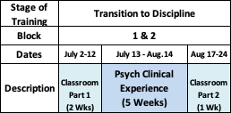
Pgy1 Transition to Discipline Stage

Slide 43
Transition to Discipline EPAs
EPA TtD-1
EPA TtD-2
Obtaining a psychiatric history to inform the preliminary diagnostic impression for patients presenting with mental disorders.
Communicating clinical encounters in oral and written/electronic form.
2 SUCCESSFUL observations
2 different case types
2 SUCCESSFUL observations
At least:
1 written
1 verbal
1 must be of observed interview

Slide 44
Assessment of EPAs during Transition to Discipline
Expected to have at least 5 opportunities of assessment & feedback for each EPA.
Score of 3 or higher is considered an observation “of achievement”
**Once in Foundations Stage of Training, 4 or 5 is considered an observation of “achievement”
5
3
4

Slide 45
Heads Up for Additional EPAs during TtD Curriculum
EBM
Presentation
= Opportunity
for
EPA O&F
EPA F-5
Performing critical appraisal & presenting psychiatric literature.
2 Observations of Achievement
Notes:
Evaluations during soft launch, at least at beginning, may be paper based.

Slide 46
Heads Up for Additional EPAs during TtD Curriculum
Hx of Psychiatry
Presentation
= Opportunity
for
EPA O&F
EPA C-10
Providing Teaching for students, residents, the public and other health care professionals.
Notes:
Evaluations during soft launch, at least at beginning, may be paper based.

Slide 47
Questions?

Slide 48
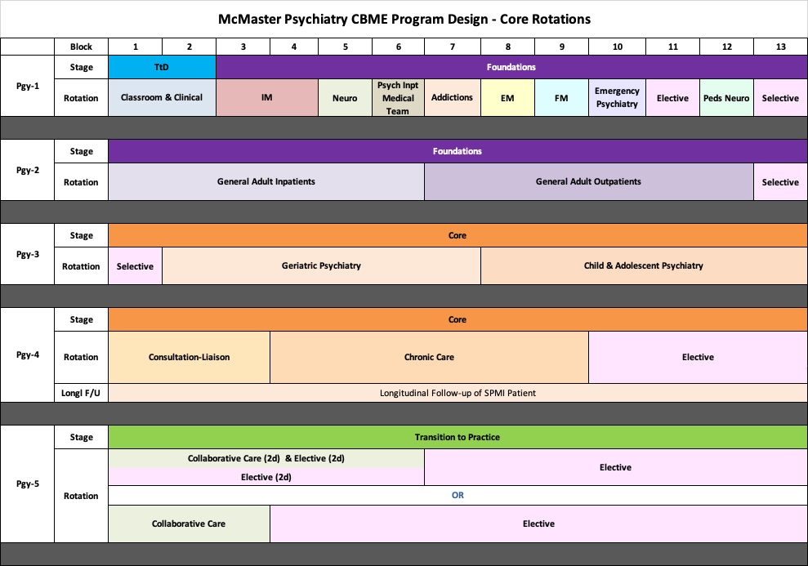
Notes:
This only shows the core rotations.
They will still be completing psychotherapy, Resident as Educator training, Call and have required scholarly projects. Those are not reflected in this diagram for simplicity, to focus on core rotations.
Note that the Soft Launch Cohort will remain on the Block System as they move through the years. Pgy1s have been on blocks for the last 8 years (i.e 13 four-week blocks, instead of months for Pgy2 to 5)
TtD = Transition to Discipline Stage of Training. Reviewed in the intro to CBME from last year. If not familiar or want a refresher/update for this year, after we review Pgy2, for those who want to stay on I will go back to review this.
New rotation in Pgy1 = Medical Team to Inpatient Psychiatry = working with the medical team that provides the medical care to psychiatry inpatients (Hamilton = West 5th; WRC = Homewood)
Pgy2: Note that Longitudinal f/u of SPMI patient has been moved from Pgy2 to Pgy4 for official CBME residents. (for residents of traditional program, it is in Pgy2)
Anchored Selective in Block 13 – because residents must have opportunities to work with “special populations” – Vulnerable, Marginalized Populations; Dual Dx, WHCC, Addictions, Forensics. So rather than doing longitudinally, going to try this as a block.
Pgy3: Also an anchored selective in Block 1, so in fact, have 2 months in a row of the selective with special populations
Pgy4: Remember, exam will be at the end of Pgy4. And, for CBME residents, Collaborative Care is recommended but not required. In our program, we feel experience with Collaborative Care is important, so moved Collaborative Care to Pgy5 and created 4 months of elective in Pgy4. Likely most residents will do telective through the exam time.
Pgy5: Minimum 3 blocks total of collaborative care (can be done as 3 blocks FT or 6 blocks PT combined with elective) + 10 more months of elective

Slide 49
CBME Pgy2 & 3 Anchored Selective Options
Dual Diagnosis
Addictions
Forensics
ACT
Shelter Health
Women’s Health Concerns
Other
Schizophrenia Services
Indigenous Health
HIV Psychiatry

Slide 50
Notes:
This only shows the core rotations.
They will still be completing psychotherapy, Resident as Educator training, Call and have required scholarly projects. Those are not reflected in this diagram for simplicity, to focus on core rotations.
Note that the Soft Launch Cohort will remain on the Block System as they move through the years. Pgy1s have been on blocks for the last 8 years (i.e 13 four-week blocks, instead of months for Pgy2 to 5)
TtD = Transition to Discipline Stage of Training. Reviewed in the intro to CBME from last year. If not familiar or want a refresher/update for this year, after we review Pgy2, for those who want to stay on I will go back to review this.
New rotation in Pgy1 = Medical Team to Inpatient Psychiatry = working with the medical team that provides the medical care to psychiatry inpatients (Hamilton = West 5th; WRC = Homewood)
Pgy2: Note that Longitudinal f/u of SPMI patient has been moved from Pgy2 to Pgy4 for official CBME residents. (for residents of traditional program, it is in Pgy2)
Anchored Selective in Block 13 – because residents must have opportunities to work with “special populations” – Vulnerable, Marginalized Populations; Dual Dx, WHCC, Addictions, Forensics. So rather than doing longitudinally, going to try this as a block.
Pgy3: Also an anchored selective in Block 1, so in fact, have 2 months in a row of the selective with special populations
Pgy4: Remember, exam will be at the end of Pgy4. And, for CBME residents, Collaborative Care is recommended but not required. In our program, we feel experience with Collaborative Care is important, so moved Collaborative Care to Pgy5 and created 4 months of elective in Pgy4. Likely most residents will do telective through the exam time.
Pgy5: Minimum 3 blocks total of collaborative care (can be done as 3 blocks FT or 6 blocks PT combined with elective) + 10 more months of elective

Slide 52
Pgy1 Transition to Discipline Stage

Slide 53
Planning for Pgy1
Friday, August 21
1 – 3 pm

Slide 54
Questions?

Slide 55
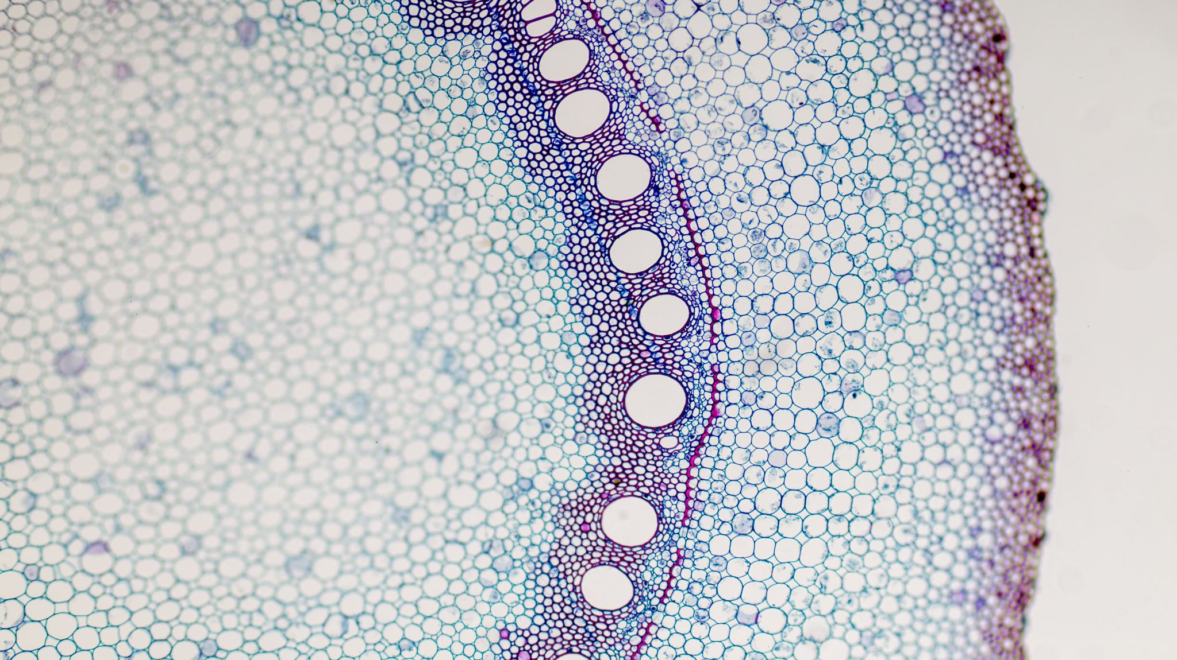
Extra Slides

Slide 56
Foundations EPAs
EPA F-1
8 Observations of Achievement
At least:
2 initial mgmt. urgent medical presentations
1 substance intoxication
1 OD &/or withdrawl
1 neuropsychiatric presentation
1 endocrine or metabolic disorder
4 different observers
3 by specialist or family doc
Assessing, diagnosing & participating in the management of medical presentations relevant to Psychiatry.
Pgy1
pgy2
Notes:
Evaluations during soft launch, at least at beginning, may be paper based.

Slide 57
Foundations EPAs
EPA F-2
6 Observations of Achievement
At least:
3 different case types
1 psychiatric emergency
2 inpatient settings
2 outpatient settings
2 by psychiatrist
3 different observers
At most:
2 child/adolescent patients
2 older adult patients
Performing a psychiatric assessment referencing a biopsychosocial approach, and developing a basic differential diagnoses for all psychiatric patients.
pgy2
Notes:
Evaluations during soft launch, at least at beginning, may be paper based.

Slide 58
Foundations EPAs
EPA F-3
6 Observations of Achievement
At least:
1 mood disorder
1 psychosis
1 personality disorder
1 substance use disorder
1 anxiety or trauma or OCD
2 by psychiatrist
3 different observers
At most:
2 child/adolescent patients
2 older adult patients
Developing & implementing management plans for patients with psychiatric presentations of low to medium complexity.
pgy2
Notes:
Evaluations during soft launch, at least at beginning, may be paper based.

Slide 59
Foundations EPA
EPA F-4
5 Observations of Achievement
At least:
1 w active SI or behaviour
1 w active HI / violence
1 w non-suicidal self-injury
1 substance use disorder
1 anxiety or trauma or OCD
3 by psychiatrist
3 different observers
At most:
1 child/adolescent patients
1 older adult patients
Performing a risk assessment that informs the development of an acute safety plan for patients posing risk of harm to self or others.
Pgy1
Pgy2
Notes:
Evaluations during soft launch, at least at beginning, may be paper based.

Slide 60
Foundations EPA
EPA F-5
Performing critical appraisal & presenting psychiatric literature.
2 Observations of Achievement
At least:
2 different observers
Pgy1
Pgy2
Notes:
Evaluations during soft launch, at least at beginning, may be paper based.

