Slide 1
Work Based Assessments
Teresa Vallera
Program Manager
Emergency Medicine
Julia Smerilli
Program Assistant
Emergency Medicine

Slide 2
Objectives
What is an EPA
What is a work based assessment (WBA)
How to prepare for CBD/WBA
WBA – “Emergency Medicine Style”

Slide 3
Entrustable Professional Activities (EPA)
Authentic tasks of a discipline
Related to each stage of training (transition to discipline, foundations of discipline, core of disciple, transition to practice)
Go from smaller tasks to bigger tasks as trainees progress
HOW IS THIS EVALUATED?

Slide 4
WBA
Not “Know How” – “Show How”
Task-based assessments
Captures real-time resident progress, measuring competence over time
Resident-driven
Notes:
In CBD, competency involves more than “know how” – the resident needs to “show how”
The resident is being observed by the front-line teacher on a specific task on regular basis in real time and the WBA is being completed at this time. In the old system the resident is evaluated at the end of the block.
By having frequent observations over time, this guides the resident on their learning, progress and improvement.
These multiple observations also give the Competency Committee a clear picture of how the resident is performing and progressing.

Slide 6
New
1 – “I had to do”
2 – “I had to talk them through”
3 – “I had to direct them from time to time”
4 – “I needed to be available just in case”
5 – “I did not need to be there”

Slide 7
How to Prepare
Be Proactive
Discuss extensively at REC
Circulate Infographics
Hold workshops for faculty and residents
Develop a Competency Committee
Develop Near-Peer Coaching
Notes:
Be prepared to change the system until you find something that works for your program.
We initially started out using paper for our WBA and Competency Committee meetings. We are now paperless for both.
We developed our own system, called McMap. This went through many stages of changes up until the version we are currently using.
Infographics on display in all emerge departments across Hamilton
We don’t want our residency program to be fully focused on EPAs – our concern is EPA exhaustion amongst residents.
Developing academic curriculum to assess those “hard” EPAs – i.e. Simulation curriculum. Most recently had a SIM OSCE, that assessed the EPAs that are hard to acquire.

Slide 8
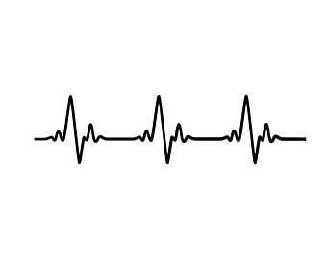
OUR APPROACH TO WBAs

Slide 9
Type of Assessments
EPA Assessment
Assessment is based on the specific EPA
Assesses a resident’s performance of a specific task while on rotation
Global Shift Assessment
general feedback on the residents’ performance while on each emerg shift
Mandatory to use when an EPA is not being assessed on a shift
EPA + Global
Option to do both; EPA task assessed and overall performance assessed.
Resident-driven
Captures narrative feedback
Notes:
Review/select EPAs for evaluation

Slide 10
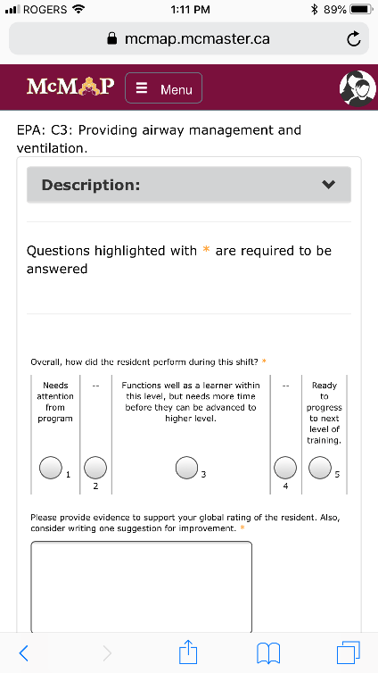
Global Shift Assessment
general feedback on the residents’ performance while on each emerg shift
Mandatory to use when an EPA is not being assessed on a shift
Notes:
Review/select EPAs for evaluation

Slide 11
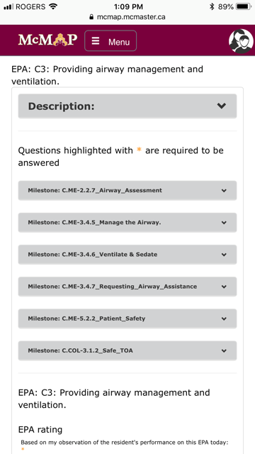
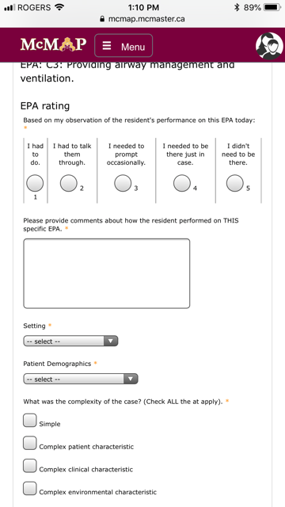
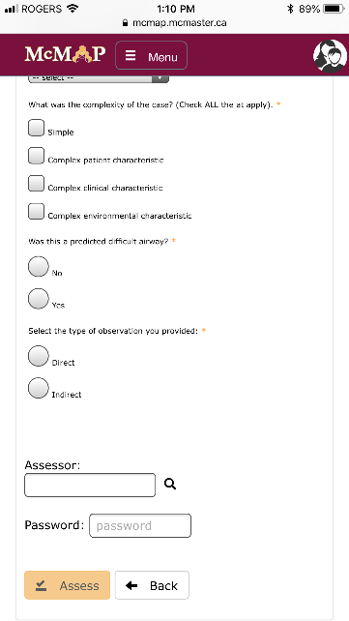
EMERG - EPA Assessment
Notes:
EPA ASSESSMENTS: The evaluations consist of four levels: Transition to Discipline; Foundations of Discipline; Core of Discipline; and Transition to Practice. In each of these levels there are a number of entrustable professional activities (EPAs), which we have already discussed. These EPAs are the focus of each Work Based Assessment – you must complete a certain number of assessments for each EPA to complete said level- which will differ program to program, and is determined by the Royal College Specialty Committee, for your program.
Each EPA is further divided into milestones – these are to focus your evaluation on more discrete clinical tasks and skills. There are no minimum number requirements for each milestone, only for the overall EPAs themselves. The milestones help guide the residents and the faculty that are evaluating. For an example if a resident is being assessed on an EPA, but performs poorly, the milestone drop down list (which I will show you) allows both the resident and faculty member to pinpoint the exact area the resident can improve.
In addition to EPA assessments, there are ‘Global’ shift assessments which should be completed daily. This is an opportunity for staff to provide more general feedback for the shift they worked, with the resident. These are completed on EM blocks, however off-service rotations will supplement specific necessary EM skills and our assessments should be completed where relevant.

Slide 12
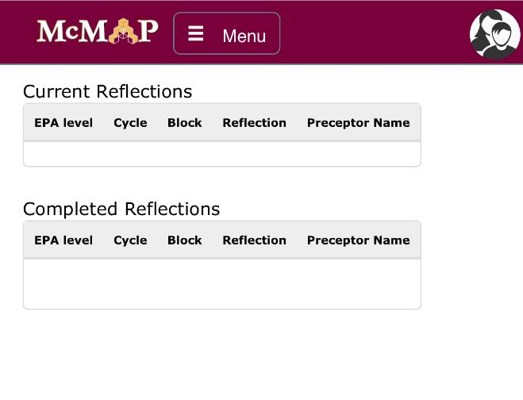
Resident Reflection
In most cases, not mandatory
Provides the resident the opportunity to self-reflect on their performance
Notes:
Resident Reflection is a free text space for residents to self-reflect on their performance, outlining strengths and weakness and noting what they can improve on. These are optional to complete, however if a resident is flagged as “Poor Performance” the Competency Committee may mandate this as a tool for the resident to use to promote improvement.

Slide 13
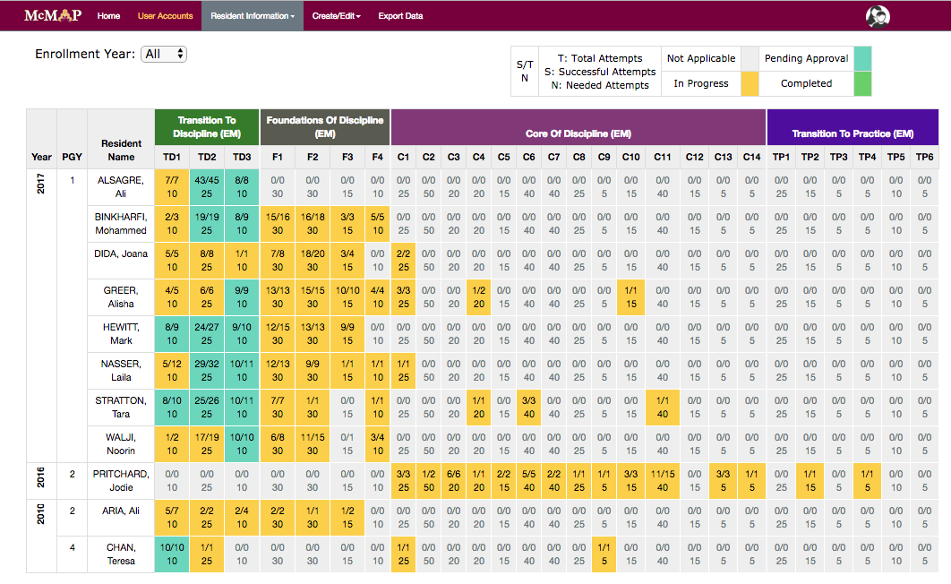
Notes:
EPA Progress

Slide 14
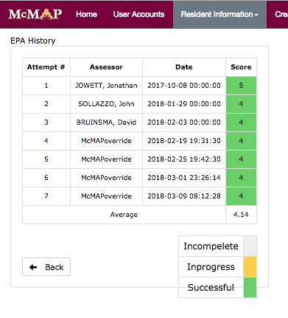
Notes:
Drill down to EPA history

Slide 15
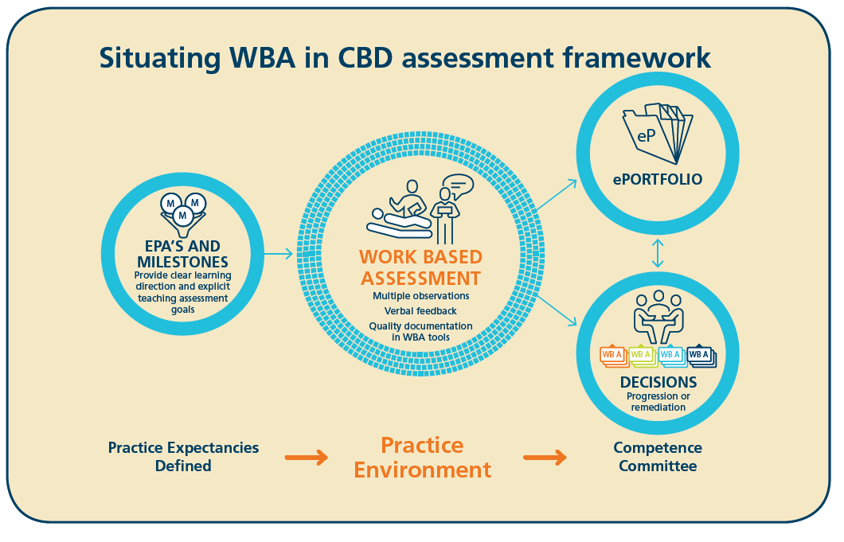
Notes:
Our program director and the competency committee chair have access to all WBAs within our system. At the end of each rotation we compile a report, which we call a score report . This report is a summary of all WBAs that were completed while a resident was on a rotation (i.e. each shift ,etc.). The competency committee meets quarterly to assess the effectiveness of the system, bring forth any concerns and to discuss residents who have been flagged as “poor performance”. It is during this meeting that a resident’s progress is shared and proactive plans put into place to ensure all residents are moving forward at their appropriate levels.

