Slide 1
Lunch and Learn April 2, 2019 Work Based Assessments
Wendy Clark
Program Coordinator, Adult Nephrology Program

Slide 2
Jotform App
Program entered a soft launch one year prior to going live, in July 2017
Initial WBA platform tool: Jot Form
Mobile App which collected EPAs
Functionality to add new evaluators such as interprofessionals
Option to provide professionalism feedback to Competence Committee that is not associated with an EPA

Slide 3
Platform Selection
Program entered live phase of CBD in July 2018 with both PGY4 and PGY5 cohorts
To ensure accreditation standards were met the Competence Committee considered two platforms:
McMaps, locally developed
Mainport, Royal College

Slide 4
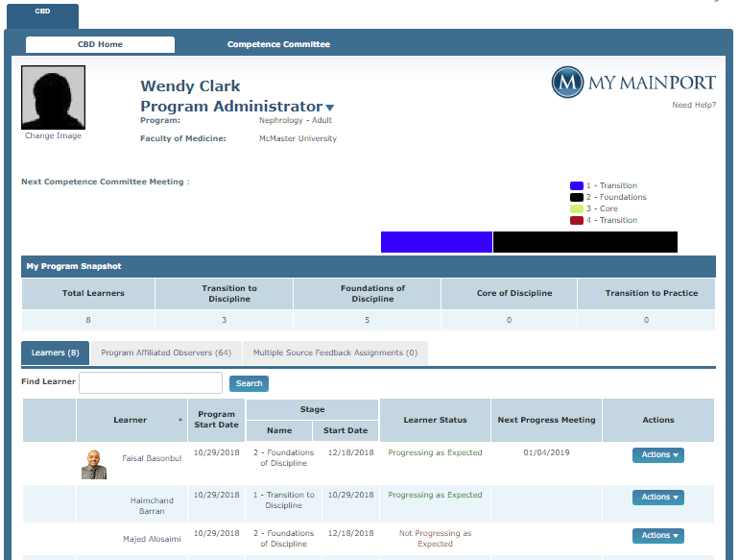
Mainport Dashboard

Slide 5
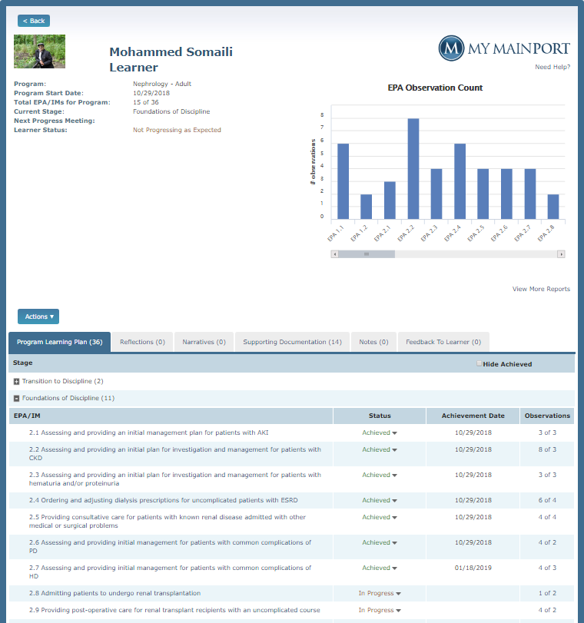
Resident Profile
Bar graph representation of EPA observations
Navigation tabs

Slide 6
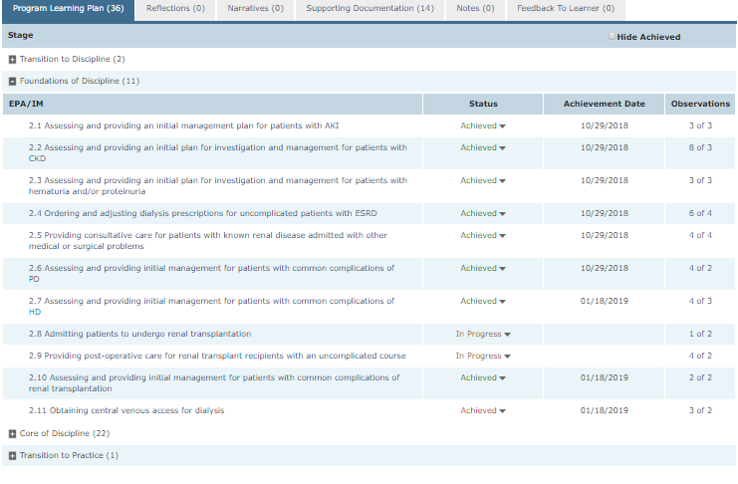
Program Learning Plan

Slide 7
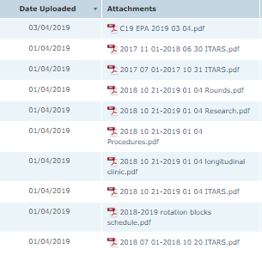
Supporting Documentation
C19 EPA is multisource feedback, tool currently not available in Mainport – Jotform used and uploaded as PDF
Files arranged by date to ensure most current information is at top of list for review

Slide 8
File Review
Standardized process for file review developed
Checklist identifies EPAs to be reviewed
File reviewer identifies these EPAs as either achieved or needing further assessments completed
Following CCC meeting this information is approved at the RPC, I then update Mainport with EPAs with designation “achieved”
This allows the learner to see progress and track next steps

Slide 9
Any Questions?

