Slide 1
CBME Prep: Tips and Tricks
Dr. Lori Whitehead
Director, Internal Medicine Residency Program
April 3, 2019

Slide 2
Objectives
Setting the Stage
Faculty and Resident Development
Running an Efficient Competence Committee meeting
Summary

Slide 3
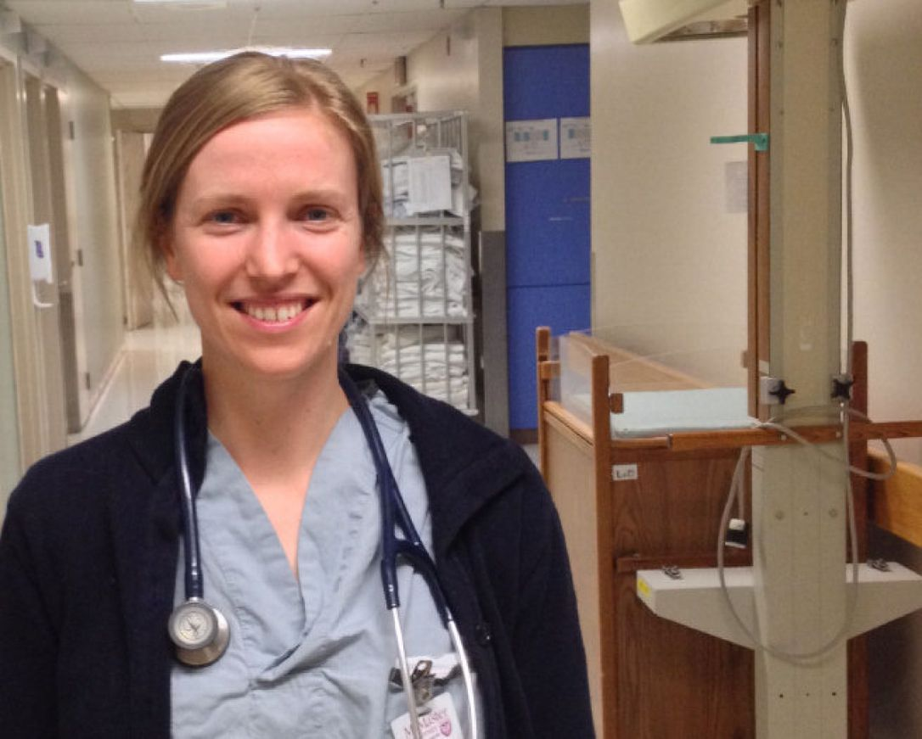
Admin Navigator
Setting the Stage
Primary Reviewer
Competence Committee Chair
Residency Program Committee
Info Highway EPAs
ITARs
Exam Scores
360
Proc Logs
Attendance
Research
Professionalism
Learning Continuum
Other
Academic Coach
Competence Committee Members
Program Director
e platform
Chair of Assessment
MEDSIS

Slide 4
Role Descriptors
Setting the Stage
Terms of Reference
CBME Program Competence Committee Positions: Chair and Member
Introduction:
The CBME Competence Committee is a subcommittee of the Residency Education Committee. The Competence Committee will meet regularly to review all resident progress and make decisions about promotion and the need for enhanced learning plans, remediation and probation for those residents whose progress has been flagged. Performance indicators to be reviewed for the decision-making process will include, but are not limited to, all documented performance information and written recommendations from Academic Advisors. The Competence Committee is an independent decision-making subcommittee of the Residency Education Committee and their primary focus is to make decisions on resident progress and promotion.
Composition:
The Competence Committee will be chaired by a member of the clinical teaching faculty affiliated with a Royal College accredited residency program. For larger programs, the position may be shared by two Co-chairs. Its membership includes the Program Director and at least two other departmental faculty members. A program may consider, but is not mandated, to include a resident member from the program, and/or external faculty members from another Department/Division. The size of the Committee should reflect the number of residents in the program with a minimum size of three faculty members. In addition, Academic Advisors may, on an ad hoc basis, present a recommendation of a resident to the Competence Committee. The decision to have a resident member on the Competence Committee should be made by the Residency Education Committee. Members of the Committee are normally from either the Residency Education Committee or clinical supervisors associated with the program, including any external faculty members.
Qualifications:
All faculty CBME Competency Committee members must have a demonstrated interest in education, assessment, and/or administration.
Resource Requirements:
The suggested guideline for meeting is once quarterly or as required to make timely decisions about resident progress and promotion. Each trainee in the program must be discussed a minimum of twice per year, however greater frequency of monitoring is desirable. Secure document storage in a confidential location, including minutes of each meeting from a program administrator, are mandatory
Accountabilities:
The CBME Competency Committee will be responsible for all resident training decisions for progress and/or promotion, and are accountable to the Residency Education Committee. It is recommended the Residency Program Director not be the Chair of the Competency Committee.
Appointment and Review Process:
A recommendation for the position of CBME Competence Committee Chair (or Co-Chair) is made by the Program Director and presented to the Chair of Medicine for approval. The CBME Competence Committee membership should be selected by the Residency Education Committee in consultation with the Department/Division Head or delegate. A committee appointment will normally be for two or three years with the possibility for multiple renewable terms.
Internal Medicine Competence Subcommittee for Resident Development
Core Membership:
Co-Chairs – Dr. Leslie Martin and Dr. Lori Whitehead
PGY1 Members
CBD Executive Committee PGY1 Representatives (Dr. Malik Farooqi & Dr. Elliott Hepworth)
Appointees (Dr. Hugh Traquir & Dr. Shohinee Sarma)
PGY2 Members
CBD Executive Committee PGY2 Representatives (Dr. Rachel Gow & Dr. Lakshman Vasanthamohan)
Appointees (Dr. Lisa Kim, TBD)
PGY3 Members
CBD Executive Committee PGY3 Representative (Dr. Seth Stern)
Appointees (Dr. Conor Cox & Dr. Adam Mazzetti)
Waterloo Regional Campus Members
CBD Executive Committee Regional Campus Representative (Dr. Sheryl Hodgson)
Appointees (TBD)
Clinical Clerk Members
Two McMaster clinical clerk appointees - TBD after 2017 CaRMS match
Working Groups:
Resident Liaison (one for each PGY year and distributed site)
Learner Development / Education of Residents
Scholarship
Assessment (Development, Implementation & Feedback of Tools)
Quality assurance (QA)
Reporting Structure:
This committee is a sub-committee of the Internal Medicine Executive Competence Committee and therefore reports directly to its parent committee.
Primary Function:
For the resident committee members to learn about principles of Competency Based Medical

Slide 5
Setting the Stage
Templates
Resident Self Reflection Coach’s Resident Report
Competence Committee proceedings
Summary of discussion and consensus of committee’s decision
Use form letters/emails for resident notification of status and/or need for modified learning plan
Support from Division Director and DEC
Faculty engagement and rewards/recognition
Collaboration in appointing/posting CBME roles
Protected time

Slide 6
Faculty and Resident Development
Dedicated leaders – both faculty lead and resident champions
Start early
Repetition
Multiple methods
Repeated venues
Use existing learning resources – Royal College, MAC-CBME, other programs, national colleagues
Quick frequent sessions work best

Slide 7
Resident Development: AHD Sessions
#1: Introduction to CBME
#2: EPA Exercise with Role Play
#3: Coach and Competence Committee (CC) Role Play
Power Point Primer on CBME
Q & A
EPA refresher
Review of e platform
Break out role play groups
3 rotating EPAs stations
1 facilitator/group
Resident #1 – patient
Resident #2 – resident in hotseat
Other residents – coach
Debrief with Q&A
Residents and faculty participate in skit to illustrate continuum
2 resident cases presented
Part #1 – Resident and Coach pre CC meeting
Part #2 – Review of both cases at CC meeting
Part #3 – Resident and PD debrief post CC meeting
Q&A

Slide 8
Running an Efficient Competence Committee (CC) Meeting
Pre CC meeting
Timing of Resident/Coach meeting – coordinated to occur before CC meeting
Coach report to capture all specific assessment parameters
During CC meeting
Consent agenda
Timekeeper
Recorder
Zoom or video conferencing
Post CC meeting
Outcomes communicated to resident, coaches, Chair of Assessment
Follow up items/interim resident check-ins added to next CC agenda

Slide 9
Sample Resident Agenda for Competence Committee (CC) Meeting
Agenda List #1
Agenda List #2
Agenda List # 3
Residents: Red Flags | Min
Calvin Cool | 10
Sally Sad | 10
Total Time | 20
Residents: On Track | Min
George Goodfellow | 3
Richard Reliable | 3
Nancy Nice | 3
Edgar Efficient | 3
Sally Sharp | 3
Walter Worker | 3
Total Time | 18
Residents: Mastery | Min
Shannon Smart | 2
Wes Wise | 2
Total Time | 4
Assign a timekeeper!

Slide 10
Summary
Internal communications is critical and highly dependent on reliable electronic support and dedicated CBME navigator admin support
All roles are to be well defined with expectations for reliable performances and accountability
Borrow and reconfigure templates for documentation and transfer of information
Resident engagement is pivotal for faculty development
Higher yield for learning with faculty and resident participation
Organize CC agenda to dedicate time to the residents who need it most

