Slide 1
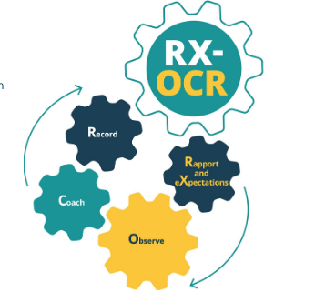
The Academic Coach and CBD

Slide 2
Workshop Development Team
Ereny Bassilious
Lisa Colizza
Mike Parrish
Naveen Sidhu
Heather Whittingham
Ronish Gupta
Mary Zachos
Blake Yarascavitch
2020

Slide 3
What is Academic Coaching?
“Top athletes and singers have coaches. Should you?”
A. Gawande, 2011,
The New Yorker

Slide 4
“a one-to-one conversation focused on the enhancement of learning and development through increasing self-awareness and a sense of personal responsibility, where the coach facilitates the self-directed learning of the [learner] through questioning, active listening, and appropriate challenge in a supportive and encouraging climate.”
Van Niewerburgh C, 2012 (cited in RSCPC )
Notes:
Coaching is a form of teaching or competency focused instruction.
Within education, coaching has been defined as “a one-to-one conversation focused on the enhancement of learning and development through increasing self-awareness and a sense of personal responsibility, where the coach facilitates the self-directed learning of the [learner] through questioning, active listening, and appropriate challenge in a supportive and encouraging climate.”
Coaching may also be inquiries being deliberately asked by the “coach” (front line clinician) to stimulate thinking of other factors or alternatives. It is an exchange between the coach and the resident. The resident may clarify what is being offered.
Ref - Van Niewerburgh C: Coaching in Education: Getting Better Results for Students, Educators and Parents. London, Karnac Books, 2012.
[learner] replaced coachee in verbatim definition.

Slide 5
 | Teaching (“Traditional”) | Mentoring | Coaching
Purpose | To transmit a specified body of knowledge and skills to learners | To guide mentees in achieving performance and career growth | To facilitate skills needed to achieve performance enhancement and growth
Notes:
It is important to distinguish some overlapping concepts – frequently confused both in the literature and in practice.
Coaching requires the observation of performance and is heavily focused on facilitating the learner’s own learning process (self regulated learning) through observation, feedback and goal setting.
Coaches need to be able to help the resident break down what is required to achieve the best possible performance and facilitate actions to achieve it. We are familiar with the concept of coaches with less skill than the “coachee” in performance (sports, music etc) and the same holds true in medicine. It is the ability to help the learner grow and develop that is key.

Slide 6
Growth Mindset
Fixed Mindset | Growth Mindset
Believes that level of achievement is predetermined, and that effort dedicated toward learning will not promote greater achievement. | Believes there is potential for an individual’s growth and improvement .
Desires to prove and avoid looking unintelligent. | Desires to learn, and looks for opportunities to challenge current status.
Asks: Will I succeed or fail? Look smart or not? | Asks: Will I grow? Will I overcome challenges?
Questions the effort of bothering. | Believes that growth and learning require effort.
Ignores constructive criticism. | Learns from feedback and uses it to improve.

Slide 7
Paradigm Shifts in CBME Assessors > Learning Coaches
Assessment OF Learning
“Summative assessment”
Observation FOR Learning
“Formative assessment”
Embedded in the learning process (frequent and ongoing)
Goal: judge/evaluate learning at that particular instance in time
Happens at the end of the learning process
Low stakes, safe environment
High stakes
Goal: monitor learning/progress and provide immediate feedback that can be used to improve teaching/learning (feedback loop)
Notes:
Boud, D (2012)- repositioning input and suggestions for improvement as a positive experience….moving to growth mindset
An important philosophical shift in thinking.
In our current system, many of our commonly used assessment methods do not get at what a resident does on a typical clinical day. There needs to be more observation of residents doing their daily work, rather than performing in a “testing” environment.
In CBE the emphasis on Observation FOR the purpose of Learning needs to be far greater than what currently exists. - observations to identify opportunities for learning and development
So a shift away from a mindset of Assessment OF Learning (summative assessment), where the predominant purpose for faculty –resident interaction is for assessment- a judgment or evaluation of what a resident knows or can do at that particular instant in time (or doesn’t know or can’t do).
The shift in mindset is to the framing of Observation FOR Learning (formative assessment), where the purpose of the observed work is to be part of a learning process to guide the resident to what they can do to improve their current understanding or practice.

Slide 8
Competence by Design
Improve patient care by assuring our residency programs facilitate the developmental acquisition of competencies
Competency Focused Instruction
Workplace-Based Assessment (WBA)
Notes:
Competence by Design (CBD) is the RC’s CBME initiative. An important goal of CBD is to assure our residency programs facilitate residents’ progress along a continuum of competency acquisition, so that ultimately the best care is delivered to our patients.
A Coaching model is critical to 2 key components of the CBD Model:
competency focused instruction and
workplace-based assessment.

Slide 9
What do we mean by “Coaching to Competence”?

Slide 10
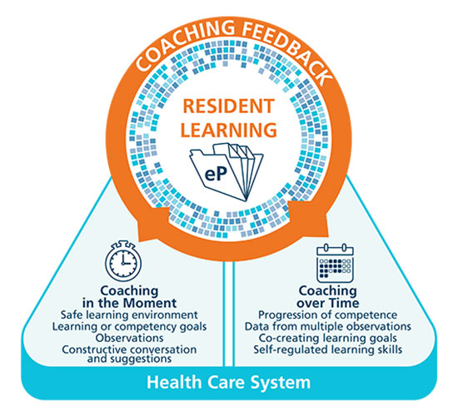
Resident learning is a learner-centered developmental approach to acquire competence.
Royal College of Physicians and Surgeons of Canada

Slide 11
Coaching Feedback
A conversation between resident and clinical teacher to enable learners to enhance their performance.
Identifies what was observed.
Encourages learner self-reflection and goal-setting.
Focuses on specific actions for improvement.
Coaching feedback for learning not assessment.
Notes:
DISCUSSION
Feedback in its purest meaning is simply information about past performance. Coaching incorporates this into a conversation/ dialogue focused on future performance.
Learner reflection and goal setting is a key component and residents often require assistance in doing this in a way that is useful in identifying specific actions for improvement.
The academic coaches scaffold their support to residents in goal setting and action planning in order that they move to becoming increasingly adept and independent in doing this.

Slide 12
Coaching in the Moment is…
A key part of normal learning activities in the clinical environment (Workplace-based learning).
Low stakes and frequent.
Involves establishing rapport with resident (educational alliance).
Setting learning goals and expectations.
Frequent observation (direct or indirect).
Coaching on what was observed during that encounter.
Providing suggestions for improvement.
Develop an actionable plan.
Notes:
FACILITATOR TIP: The series of slides on Coaching in the Moment is broadly applicable to all clinical teachers b/c the Coaching in the Moment concept is expected to have the most direct impact on their day-to-day work. We suggest you emphasize these slides when presenting to front-line clinical teachers. Note: if your program already does these things well then you can “shrink the change” for your colleagues and simply tell them to keep up the good work. If, however, there isn’t a lot of coaching in the moment already, then encourage your colleagues to set realistic goals and targets for incorporating this process into their work.
Coaching in the Moment is foundational to competency focused instruction and workplace-based learning.
It is a process that is to occur “in the moment”, close to the time the observation occurred and in a clinical environment.
Clinicians observe residents doing their daily work . The observations are shared with residents in a way that guides learning and improvement and then the observations and feedback is documented for the resident learning portfolio.
Reinforcing that the observations done as part of Coaching in the Moment are low stakes daily assessments and that the feedback given is part of the learning process to facilitate development toward competent practice should help to reassure the resident. This is part of establishing a safe environment for learning.

Slide 13
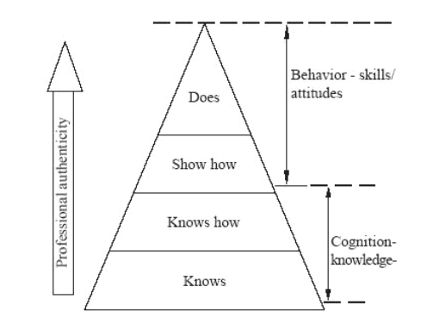
Triangle of clinical competence
Notes:
Miller triangle of clinical competence
It is only in the “does” triangle that the physician truly performs, and observing the resident in the “real world” is the only way to measure this ability to perform.

Slide 14
Observation
Direct Observation
a clinician watching a resident doing work
in real time or asynchronously (i.e. videotaped)
Indirect Observation
review of products of the resident’s work
clinical notes, presentations, or written reflections
observations from secondary sources
Notes:
FACILITATOR TIP: Your colleagues may have doubts about the practicality of “directly observing” everything all of the time for CBD. This slide is meant to reassure them that they don’t have to: indirect observation is ok too.
Direct observation of performance (i.e. when a clinician is watching the work being done – in real time or asynchronously, for example via video recording) is of paramount importance and needs to make up a substantive proportion of the observation of work that takes place.
However, this is not to say it is the only form of observation of work.
On some occasions, some observation may occur indirectly. An example of an indirect observation of work includes review of products of the learner’s work. For example, a review of clinical notes, presentations, or written reflections would be indirect observations of a learner’s work. Additionally, another form of an indirect observation would be observations from secondary sources, In this case, the observation of performance or work is done by someone else: another clinician, staff, patient or family but communicated back to the clinician working directly with the resident. Multi-source feedback process is an example of observations from other sources but getting comments and observations from admin staff or other healthcare professionals informally.

Slide 15
Coaching Over Time involves…
A longitudinal educational relationship between faculty and resident over time beyond a single clinical encounter.
Regular review, synthesizing multiple sources of data in order to provide feedback on resident’s progress.
Helps residents reflect on progress based on feedback and set specific learning goals and plans.
Follow up on action plans and progress.
Facilitating resident’s understanding of ways of improving performance through development of guided self-regulated learning skills.
Notes:
In many programs this role has been labelled as “advisor”, and/or may have been taken on in its entirety by the program director. By articulating the actions involved, programs may decide how to best assign this role. This session is going to focus on coaching over time and what is involved.

Slide 16
A coach’s priority is to promote improvement
Notes:
Simply defined, a coach is a person who:
is guiding another through a process, leading to performance enhancement. Coaching is beneficial for anyone who is pursuing optimal performance.
Coaches can help an individual to do a task better, develop a skill they don't yet possess or achieve a specific goal.
Coaching helps a learner understand what adjustments and modifications will allow them to progress to the next level of capability/proficiency.
Coaching is giving actionable concrete suggestions for improvement.
In CBD, the role of clinical teacher is evolving from supervisor to observer and coach. When clinical teachers directly or indirectly observe the work residents do, these observations provide learning opportunities.
Judgment is NOT the purpose of the observation (Assessment). Of course, a coach will make decisions about the quality of the task performed but a coach’s priority is to promote improvement.
A coach always has the best interests and goal of performance improvement of the resident as their primary concerns. Beneficence of the learner!
Although coaching does involve observing the task, the purpose of observation is for the coach and resident to identify learning opportunities.
Coaching is a form of teaching or instruction focused on future performance or practice and is developmental.

Slide 17
Discussion
Break-out groups
Notes:
Ensure that the participants understand the difference between coaching in the moment and coaching over time.
They may wish to discuss the reasons why CBD has articulated the coaching over time role and what it means for them
What points would you bring up and wish to discuss with the resident.
STRAIGHTFORWARD CASE

Slide 18
Alex Liu: Internal Medicine
What are your thoughts and interpretations regarding the quality of assessment data presented (number observations/EPA, trend of scores over time, absolute ratings)?
Do you have any concerns about her progress?
How would you engage with the learner around her progress and can you recommend an education plan of action?
Notes:
Participants review Alex Liu’s portfolio and discuss these questions.

Slide 19
Responsibilities of Academic Coaches
How can it work in your program?
Notes:
Using the handout listing 10 questions, participants will select several questions for discussion. Each program will enact this role slightly differently, depending on the resources and context of residency training.
The following are a few questions you could use as a guide.
Should there be any pre-requisite qualifications for an academic coach? If so, which qualifications?
How are academic coaches selected? Appointed vs nominated and elected?
Is there a maximum number of that the academic coach should coach at any given time?
Does the academic coach follow the resident for the duration of their residency or could a resident have multiple coaches at different points of their residency?
How long is the academic coach’s term?
Can the program director be an academic coach?
What are the responsibilities of the academic coach?
How often would the academic coach meet with the resident? What should the coach discuss at these meetings?
How often would the academic coach present the resident(s) to the competence committee?
Would this job description differ for a small, medium, or large sized residency program?
The goal of the discussion is for participants to work on the development of what is most appropriate in their program.
If there is already a clear description of the responsibilities, they can be outlined at this point.

Slide 20
Examples of responsibilities of ACs
Same coach for the duration of training versus alternatives
Academic coach versus academic advisor
Larger programs versus smaller programs
Notes:
1. Same coach vs not: PCCU has one coach (PD) for first stage, then “matched” to a coach for duration of training.
Some programs have a different coach for each stage of training (i.e. longer-duration programs may choose this). Some choose to be with the same coach throughout.
2. Academic coach versus academic advisor: Peds anesthesia uses the term ”academic advisor”. They see the “coaching” as a collective responsibility of all faculty and that the role of the advisor is for the longitudinal relationship-building and advising re: personal learning plans, etc.
3. Larger programs have enough faculty, but more trainees. Often faculty members end up coaching multiple trainees. Smaller programs have the issue of having to wear multiple hats. Often times someone may be the CC chair and coach, PD and coach, etc. Some programs will reach outside of their program/division for some of these roles to be fulfilled. Each small program must be creative to meet their individual needs.

Slide 21
Effective Academic Coaching
Notes:
How do we build such relationships with learners?
How do we recognize and ameliorate relationships which are troubled?

Slide 22
It is a Process!!
“… can help learners reflect on where their performance stands and how to improve.”
Deiorio, N., 2016
Notes:
A coach is a person who “… can help learners reflect on where their performance stands and how to improve” (Deiorio, 2016). Coaching is beneficial for anyone who is pursuing optimal performance.
Coaches can help an individual to do a task better, develop a skill they don't yet possess or achieve a specific goal.
Coaching helps a learner understand what adjustments and modifications will allow them to progress to the next level of capability/proficiency.
Coaching is giving actionable concrete suggestions for improvement.
In CBD, the role of clinical teacher is evolving from supervisor to observer and coach. When clinical teachers directly or indirectly observe the work residents do, these observations provide learning opportunities.

Slide 24
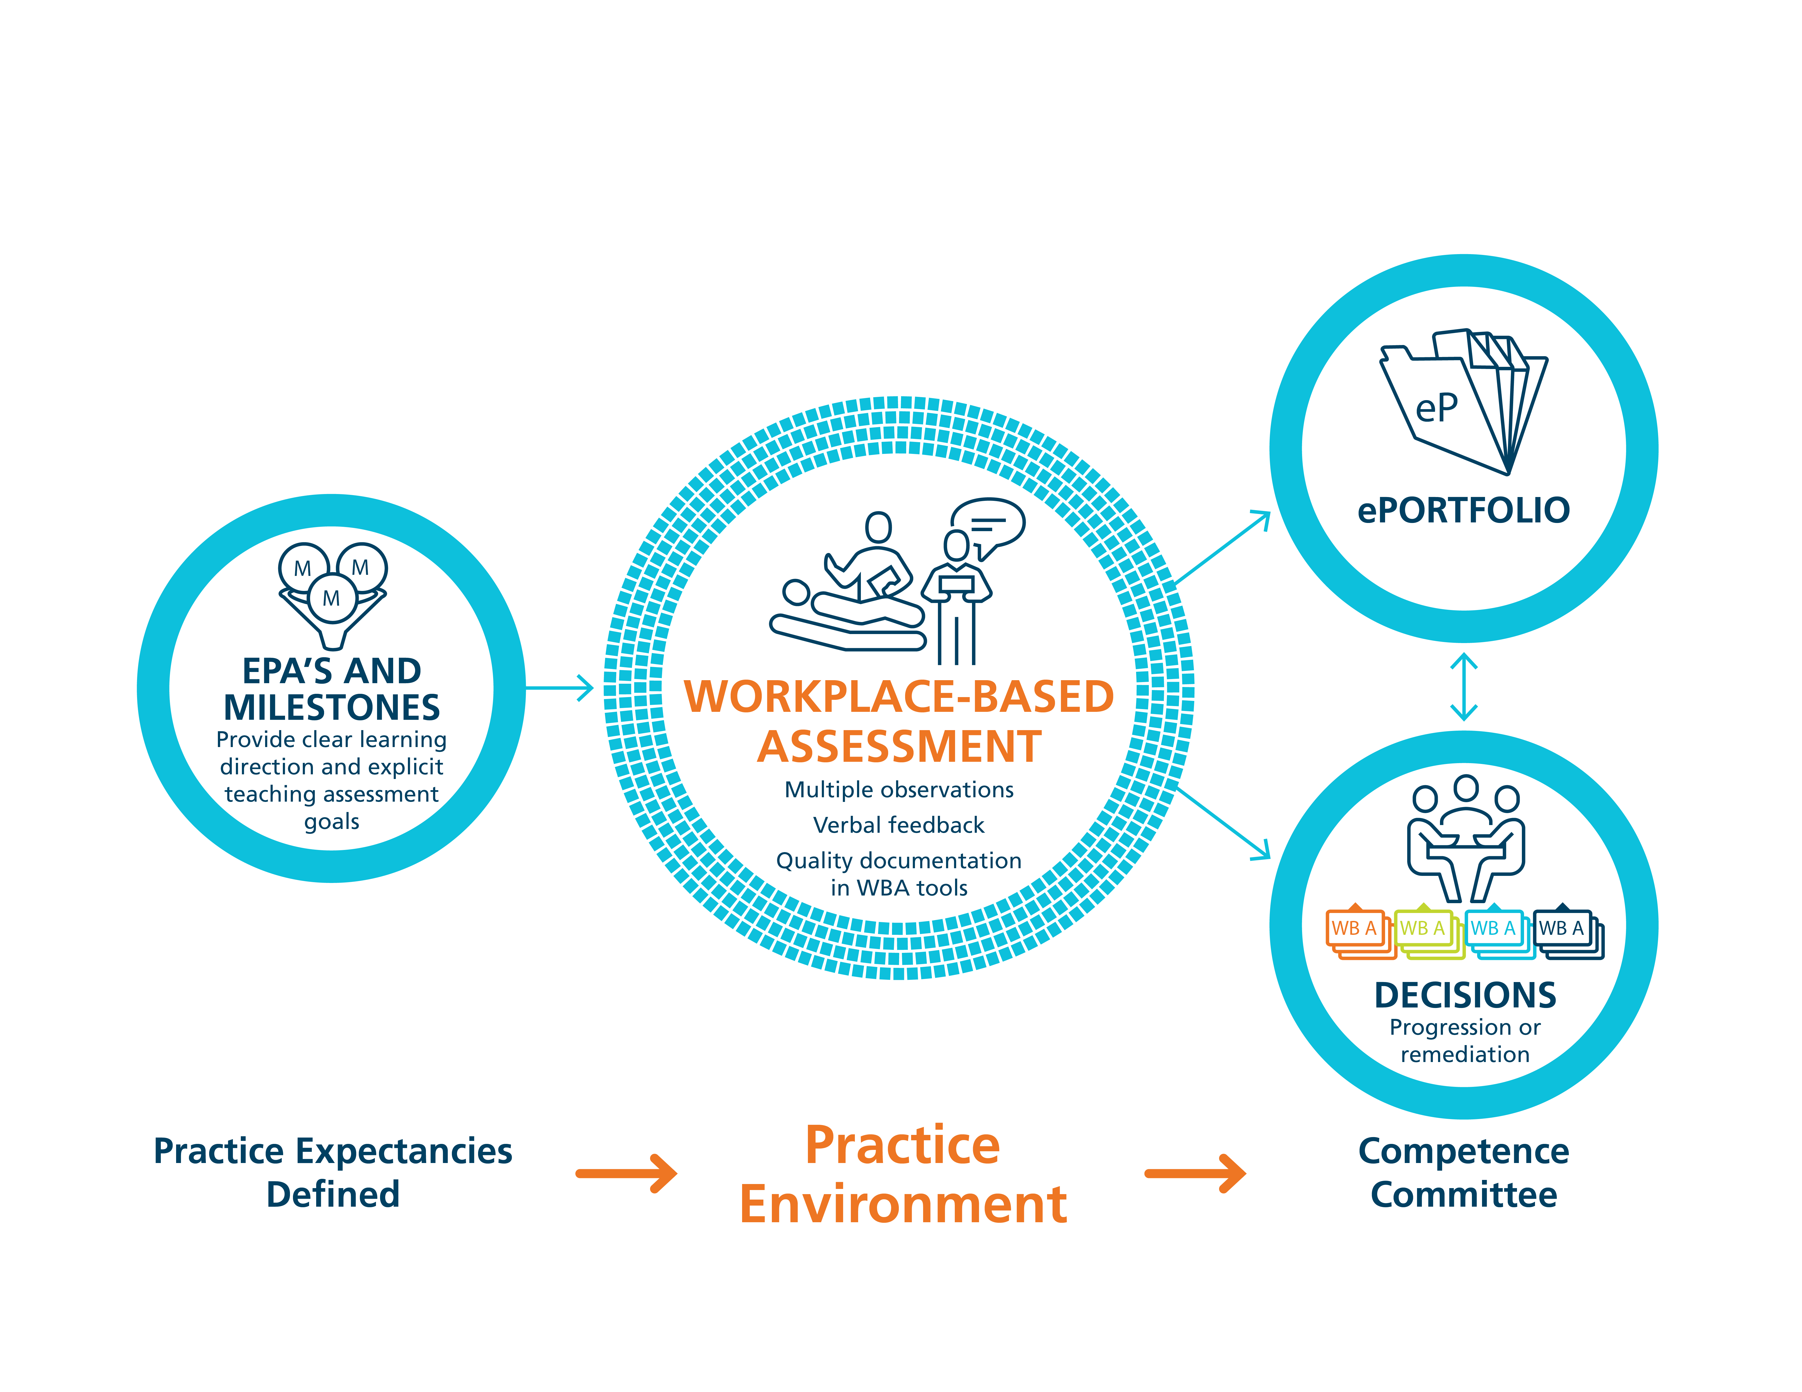
Workplace-Based Assessment in CBD
Notes:
FACILITATOR TIP: One of the most notable changes for clinical teachers as they transition to Competence by Design (CBD) is the need for more frequent observation, allowing coaching feedback and documentation. In some cases, your colleagues are already doing this, which is a bonus for your program. In those cases where observation and feedback is less common, though, you may find it helpful to introduce these concepts using a slide deck like this one and then reinforce the messages and behaviours using resources like the 2 page Coaching Model handout, Coaching Snippets and even the WBA resources. Help them see the value in the aforementioned philosophical shift and, more specifically, the distinction between Assessment OF versus FOR Learning. How deeply you cover this content will depend on your group readiness.
Coaching as a method of teaching and learning for competency progression.
From the coaching standpoint, the purpose of workplace-based assessment , which occurs in the practice environment, must be understood and accepted as formative, in other words, for the purpose of informing learning. The goal of WBA is to provide specific feedback to enable resident development.
The documentation of the feedback and coaching suggestions (kept in the resident’s ePortfolio) will however, be part of what the competence committee uses to make decisions about EPA achievement.
Coaching is about learning and improving performance, not assessment and judgement!

Slide 25
Educational Alliance
Having established clinical credibility, residents then consider:
Resident perception of teacher’s interest, commitment to their learning and development.
Mutual understanding of learner’s goals and how to achieve them.
Resident perception of being liked.
Telio et al 2015, 2016
Notes:
The educational alliance is built on resident perception.
How can we demonstrate our interest and commitment to their learning and professional development?
How can we genuinely LIKE all residents that we are working with?

Slide 26
How Do Coaches Build This Alliance?
Invest time in knowing the resident’s story – past experiences, life situation, interests, goals.
Provide clarity about your role, expectations (yours and the program’s), and your hopes for the relationship.
Be available, accessible, affable (the Triple A).

Slide 27
Coaching Over Time
Assist in interpreting data and setting goals
Facilitate development of goals
Adjust learning goals
Plan strategies/actions
Implement plans
Monitor progress & collect data
Assess achievement
Provide periodic progress review
Guidance suggestions facilitation
Relationship building
Notes:
This diagram reflects the self regulated learning cycle (the coloured boxes). Effective learning involves moving through each of these steps. However it is not easy to do this on our own and the grey boxes reflect actions that the academic coach can to to facilitate each step. Relationship building underlies the entire process
Most of us who have had a goal setting discussion with learners recognize that many, particularly early in their training, have difficulty in setting concrete and specific goals (SMART goals). As coaches we can lead them through this process, and help ensure that these goals are appropriate to the training program. Similarly, identifying appropriate strategies for achieving them may require our help. Collecting external sources of information and monitoring progress towards achieving the goal is also necessary. Help residents to recognize that none of us can depend on our own sense of how we are doing. Coaches also meet with residents to review progress and to interpret and provide assessment.
As residents mature professionally, they should need less guidance with these steps.

Slide 28
Toolbox for Academic Coaches
R2C2 model.
GROW model of coaching.
Coaching feedback grid.
Educational plan with reflection.

Slide 29
R2C2 model
Step | Examples
Rapport/Relationship Building | Tell me about your experience
Explore Reaction | What were your initial reactions? Any surprises? Anything we should focus on?
Explore Content | Anything you’re unclear about? Do you recognize a pattern?
Coach for Change | What action might you take? What would you like to see in 6 months?
Sargeant et al 2015
Notes:
The R2C2 model was originally described as a guide to discussing an ITAR with a resident. It is adaptable for any coaching conversation that follows the resident’s receipt of feedback information. Note that the relationship building piece underlies to the specific actions.

Slide 30
GROW Model of Coaching
 | Description | Examples
G-Goal | Ask for goals | What would you like to achieve? What would success look like?
R- Reality | Discuss present realities. | What has worked in the past? What didn’t? What are the limitations?
0- Options | Identify & assess options | What possible options/solutions do you have? What haven’t you tried yet?
W- Way forward | Assist in determining next steps/action plan | What is the most important thing to do next? Who might support you?
Whitmore 1980’s
Notes:
The GROW model of coaching is used in many fields beside medicine. It is a useful acronym to guide a coaching conversation. The focus is on the resident and the residents ideas – although of course they coach may have supplemental ideas

Slide 31
Coaching Feedback Grid
Continue What was effective, and what was the impact? | Start or do more What would be beneficial and what specific actions could be taken?
Consider Reflection on themes, future actions, goals | Stop or do less What is not helpful and needs to be changed?
Modified from the Coaching Feedback Format, Bayer Institute for Health Care Communication
Notes:
This commonly used model for feedback deliver may also be useful in a coaching conversation. The focus is again on the resident, with a comparison of the resident’s perception with that of the coach or teachers.

Slide 32
Education Plan & Reflection
Notes:
McMaster’s CBME guide includes this page (appendix 2). It is intended to be a guide for residents to set their educational plan, together with their academic coach.

Slide 33
Discussion
Break-out groups
Notes:
Ensure that the participants understand the difference between coaching in the moment and coaching over time.
They may wish to discuss the reasons why CBD has articulated the coaching over time role and what it means for them
What points would you bring up and wish to discuss with the resident.
STRAIGHTFORWARD CASE

Slide 34
Joey Hamilton: Anesthesiology
Can you identify the issues that are keeping Joey from progressing?
Can you help him develop an education plan / strategies that will assist him?
How would you proceed to provide Joey with some coaching that will help him progress?
Notes:
Participants review Joey’s portfolio and discuss these questions.
Later, they will have an opportunity to practice having a discussion with “Joey” (enacted by a facilitator)

Slide 35
Coaching in the Moment
Same process!
Notes:
Same process, in a small timeframe

Slide 36
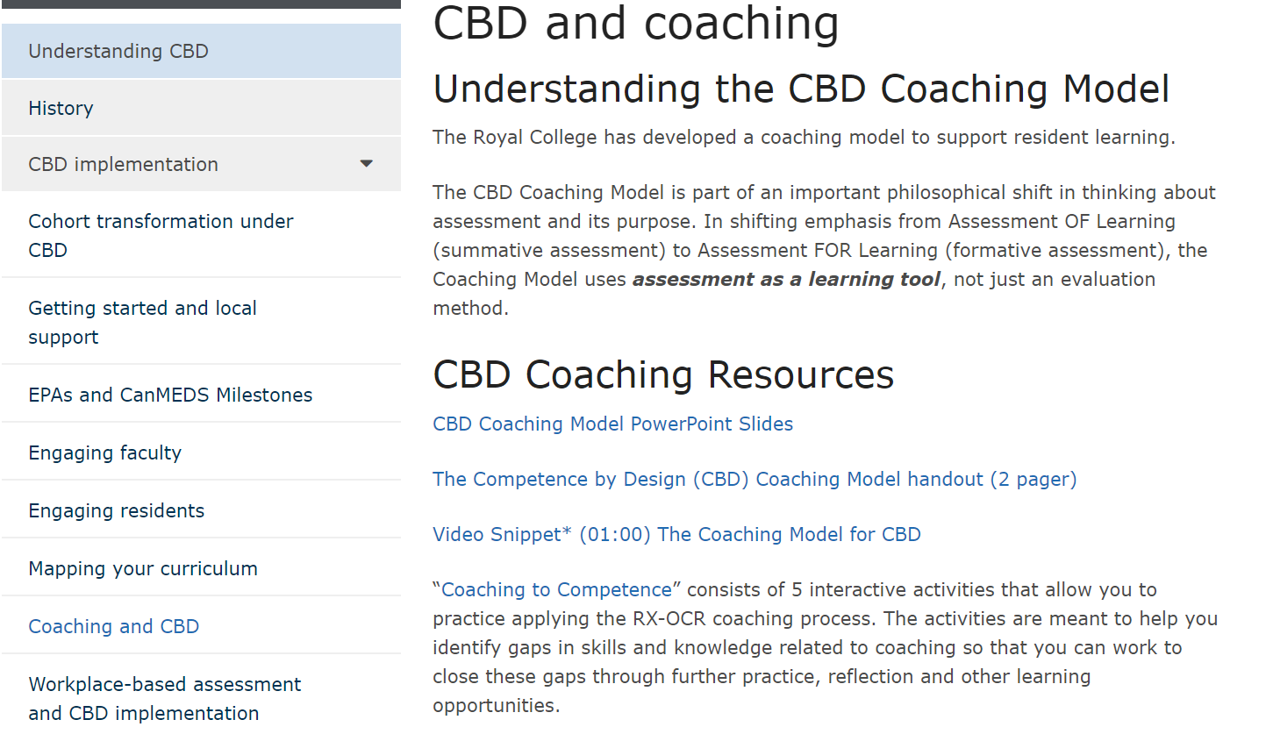
Online Modules for Coaches
http://www.royalcollege.ca/rcsite/cbd/implementation/wbas/coaching-and-cbd-e

Slide 37
Online Modules for Coaches
http://www.royalcollege.ca/mssites/rxocr/en/story_html5.html

Slide 38
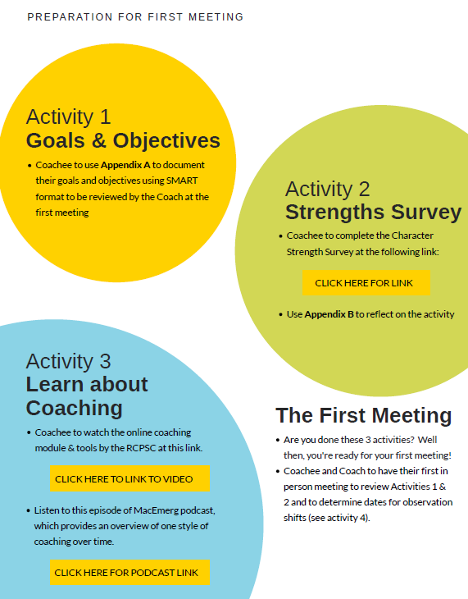
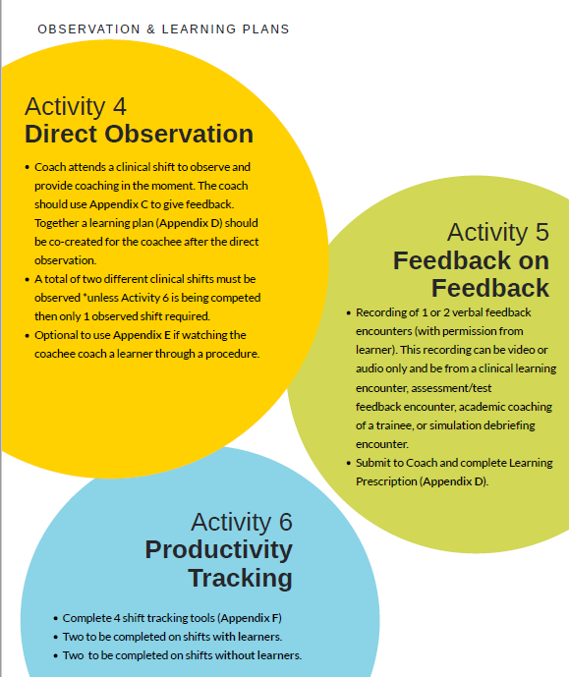
Online Modules for Coaches
Interested in coaching or being a coachee? Sign up for the Faculty Coaching Program to be enrolled for the initial roll out of the coaching program.
Questions? Contact Dr. Robin Mackin (robin.mackin@medportal.ca).
https://docs.google.com/forms/d/e/1FAIpQLScBVXTb93NgRD2bTIMCdavTFUEY10F314m8FYPgPOchsuO9kQ/viewform

Slide 39
In the Moment Academic Coach – Summary
Assessment OF Learning
“Summative assessment”
Observation FOR Learning
“Formative assessment”
Embedded in the learning process (frequent and ongoing)
Goal: judge/evaluate learning at that particular instant in time
Happens at the end of the learning process
Low stakes, safe environment
High stakes
Goal: monitor learning/progress and provide immediate feedback that can be used to improve teaching/learning (feedback loop)
Notes:
Boud, D (2012)- repositioning input and suggestions for improvement as a positive experience….moving to growth mindset
An important philosophical shift in thinking.
In our current system, many of our commonly used assessment methods do not get at what a resident does on a typical clinical day. There needs to be more observation of residents doing their daily work, rather than performing in a “testing” environment.
In CBE the emphasis on Observation FOR the purpose of Learning needs to be far greater than what currently exists. - observations to identify opportunities for learning and development
So a shift away from a mindset of Assessment OF Learning (summative assessment), where the predominant purpose for faculty –resident interaction is for assessment- a judgment or evaluation of what a resident knows or can do at that particular instant in time (or doesn’t know or can’t do).
The shift in mindset is to the framing of Observation FOR Learning (formative assessment), where the purpose of the observed work is to be part of a learning process to guide the resident to what they can do to improve their current understanding or practice.

Slide 40
Coaching over time – Summary
- Begin establishing “educational alliance”
- Create short & long term objectives with strategies
- Reinforce “educational alliance”
- Review progress, introduce/ modify strategies PRN
- Reinforce
- Review
- Re-strategize

Slide 41
Academic Coach – Summary
 | In the Moment | Over Time
Similarities | Coaching to competence | Coaching to competence
Differences | Formative Assessment (low stakes) | No assessment (relationship building) Longitudinal academic support

Slide 42
References
Deiorio N, et al. Coaching: a new model for academic and career achievement. Medical education online. 2016 Jan 1;21(1):33480.
Sargeant J,et al. Facilitated reflective performance feedback: developing an evidence-and theory-based model that builds relationship, explores reactions and content, and coaches for performance change (R2C2). Academic Medicine. 2015 Dec 1;90(12):1698-706.
Telio S, et al. The “educational alliance” as a framework for reconceptualizing feedback in medical education. Academic Medicine. 2015 May 1;90(5):609-14.
Lovelli, B. What do we know about coaching in medical education? A literature review. Med Educ 2018; 52: 376-390
Van Niewerburgh C . (ed). Coaching in Education: Getting Better Results for Students, Educators and Parents. 2012; Karnac Books: London, UK.
Royal College of Physicians and Surgeons of Canada http://www.royalcollege.ca
Notes:
Additional readings are available on request

