Slide 1
Competence by Design
An Overview
Nov. 18, 2018

Slide 2
We are doing well…
Why would we change anything?

Slide 3
Notes:
Sometimes people have good ideas. Things that could make the way we are currently doing things, even better.
But as humans, we are very resistant to change.
Why would we want to change something if it seems to be working ok?

Slide 4
Why move to Competency Based Medical Education (CBME)?
An effort to educate even better
Better prepared graduates
More fulfilled educators
Improved patient care
Notes:
Because we want to work to educate even better.
To better prepare our graduates
To feel more fulfilled as educators
And most importantly, to provide even better patient care moving forward

Slide 5
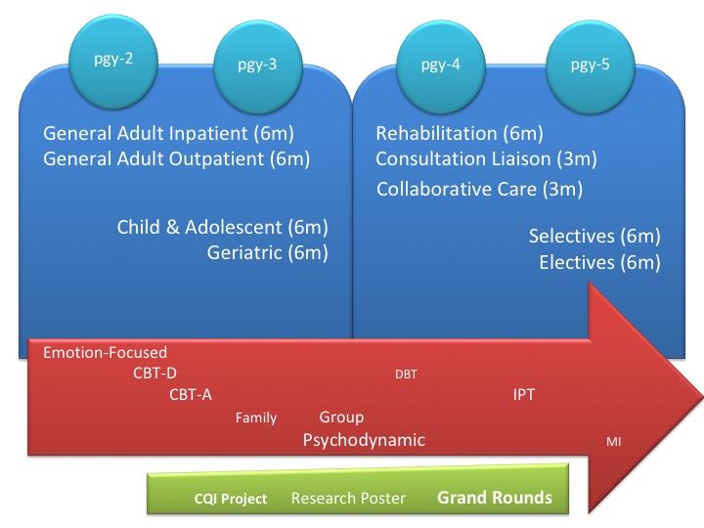
What is Competency Based Medical Education?
Current System: time is emphasized as a marker of resident having required knowledge & skills
Notes:
The current system is mainly based on residents spending a certain amount of time in prescribed experiences.
Generally, as long as there are no significant issues, they move to the next time-based experience

Slide 6
What is Competency Based Medical Education?
Current System: time is emphasized as a marker of resident having required knowledge & skills
: evaluations are not always useful
-inter-evaluator inconsistency
-don’t always ensure useful feedback
-less effective at promoting development
-not capturing concerns early
Notes:
BUT! This is not necessarily leading to the BEST outcomes we could help our residents achieve.
In particular, our evaluations are not always useful, there is a great deal of inter-evaluator inconsistency, our feedback is not always most useful and residents are not always able
To accept feedback. With this, we are often not capturing concerns early on. Additionally, our system for deciding on promotion of residents is then based on evaluations with the aforementioned difficulties.
Competency Based Medical Education strives to change these things.

Slide 7
Competency Based Medical Education (CBME)
Organized around outcomes expected of a resident
A resident’s advancement is dependent on having achieved those expected outcomes
Allows more frequent, low-stakes
opportunities for assessment & feedback
Fosters frequent, effective feedback
Allows residents to be more
open to feedback
Time
will still matter.
Early completion will be exception.
Notes:
Time will still matter; early completion will be the exception.
However, the focus will be moreso on Outcomes expected of a resident at each stage of training
There will be more frequent yet low-stakes assessments, thus giving more opportunities for feedback and making it easier for residents to be open to that feedback.
Stay tuned for more information on assessment tools and “entrustment scales” that will be used in evaluations.

Slide 8
Competency Based Medical Education (CBME)
Its all about
Assessment & Feedback
Quality of Evaluation/Feedback
Ability for residents to accept & incorporate feedback
Notes:
For

Slide 9
Competence by Design (CBD)
CBD is the Canadian Version of CBME
“Involves systematically designing a learner’s journey through their career in medicine”
Notes:
Involves systematically THINKING ABOUT i.e. designing a learner’s journey through their career in medicine

Slide 10
Goals of CBD
Embed continuous assessment throughout training
Increase the authenticity of feedback
Increase transparency of educational standards

Slide 11
What is this going to look like?

Slide 12
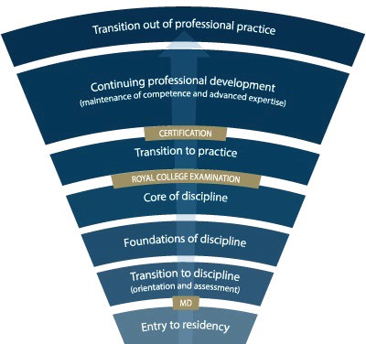
Competence Continuum -Stages of Training-
PGY-5
PGY-4
PGY-3
PGY-2
PGY-1
Notes:
There will be much less emphasis on pgy-year. Instead, residents will transition through Stages of Training, along the Competence Continuum.
-The Royal College will outline what Outcomes need to be accomplished within each Stage of training and give a range of time that stage may last
-Programs will then decide the duration of each stage (within the RC parameters) and what rotations will be included in each stage to accomplish those Outcomes
-The Royal College will also outline what skills & knowledge must be accomplished by a resident before they are to be allowed to progress to the next stage of training. Those required skills & knowledge are packaged into what is called the EPAs and Milestones (see next slide)
-Programs will then map which EPAs should be accomplished in which rotations for their residents

Slide 13
Competence Continuum & Stages of Training
Less emphasis on pgy-year. Residents transition through Stages of Training, along the Competence Continuum.
Royal College will outline what Outcomes need to be accomplished within each Stage of training and give a range of duration for each stage
Programs will then decide the duration of each stage & what rotations will be included in each stage to accomplish those Outcomes
Royal College will outline what outcomes must be accomplished before a resident progresses to the next stage of training. Those required outcomes are packaged into EPAs and Milestones
Programs will then map which EPAs should be accomplished in which rotations for their residents

Slide 14
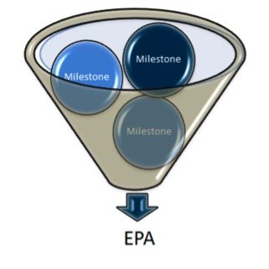
EPAs & Milestones
An Entrustable Professional Activity (EPA) is a key task that an individual can be trusted to perform in a given health care context.
Example: Performing a basic psychiatric assessment for patients presenting with common mental health concerns.
Milestones are the smaller units of ability required to complete the full EPA. They are observable markers of an individual’s ability.
Examples:
Safe set up of room
Introducing self
Key components of psychiatric assessment
Basic Risk Assessment
Use of patient-centered interview skills

Slide 15
How will this work?

Slide 16
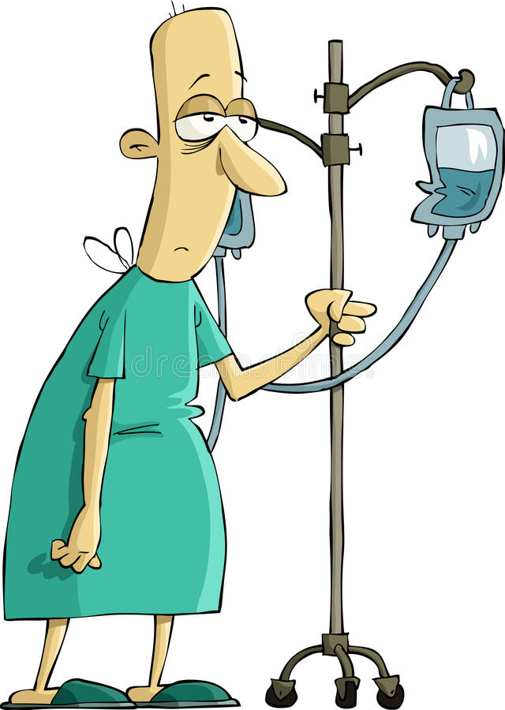
How Will it Work? - Learner
Plans their learning
Views Learning Plan EPAs & milestones
Selects training activity
Requests observation from Observer
Participates in learning
Works with Observer
Participates in observation encounter
Receives specific, constructive feedback
Record observation
Learner
Reflects on observations
& learnings
Supported by technology
Notes:
For a learner, assessment will flow as follows:
Plan learning
This occurs in a macro (rotational) view and micro (daily) view.
Views Learning Plan EPAs & milestones as part of the day or rotation.
Selects observation opportunities.
Works with supervisor to find opportunities.
Participates in the encounter
Works with supervisor, peers, and often, the patient.
Exchange feedback
The resident self-assesses (i.e., reflects on learning).
The supervisor provides specific constructive feedback for learning based on evidence from the encounter and the design of the RCEPA.
Record observation
Not all observations are recorded.
This could be in an ePortfolio or other means of technology.

Slide 17
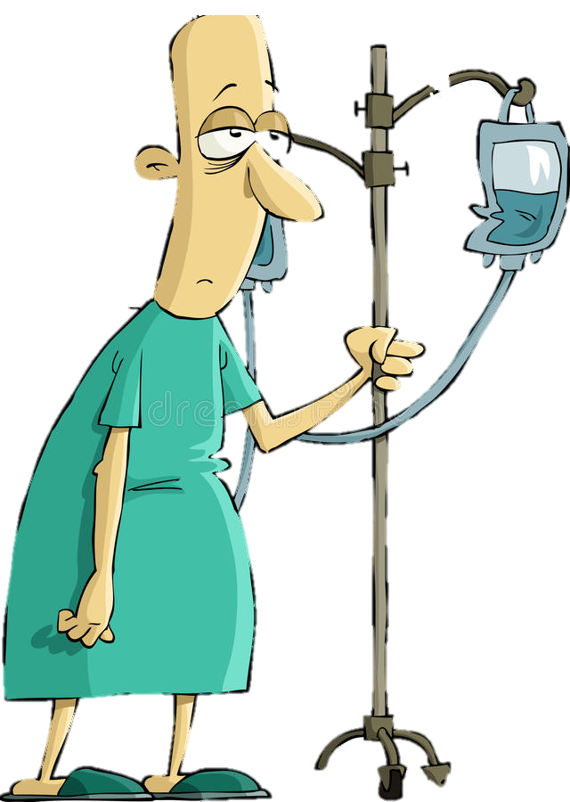
Program
Director
Academic
Coach
Competence Committee
Regional
Education Lead
Notes:
Resident and faculty identify an opportunity for an EPA assessment. Supervisor might review expectations and remind resident of feedback to build on from a previous encounter.
Resident goes to do the EPA activity. Supervisor supervises either directly or indirectly depending on the EPA
Supervisor provides verbal feedback to the resident, giving 1 or 2 specific, actionable pieces of feedback
Supervisor documents the assessment on MedSIS.
They cycle repeats itself, resulting in multiple assessments of the same EPA over time, by different observers.
These get collated on MedSIS, with the data being available to the resident, the Program Director, the REL, the resident’s academic coach and the Competence Committee (formerly the Evaluation Committee)
It is the Competence Committee that makes decisions around progression, promotion

Slide 18
What Happens to the Observation Data?
Assess overall achievement of EPAs & milestones
Regularly review learner EPAs/milestones
Approve changes to learner status:
Confirm acquisition of EPAs
Promote to next stage of training
Identify any concerns
Modify learning Plan
Develop specialized learning plans
Monitor specialized learning plans
Modify learner’s Program Plan
Monitor overall progress of learner
Request Royal College certification
Provides group decision process rather than single summative assessment
Competence Committee
Supported by technology
Notes:
Now I’m sure many of you are asking what happens to the data that is collected by the Observer
the evaluation data, evidence of learning and learner reflections will recorded electronically by both the learner and the supervisor
As I mentioned earlier, the Competence Committee is the group responsible for assessing the progress of trainees in achieving the milestones and EPAs.
While observations in a clinical setting are document and reviewed by both the Observer and the program director, the decision about the progress of each learner take place at the CC
Overall the CC will receive evaluations reports about each learner – this data will support a group assessment process rather than a single summative assessment and will allow the CC to collectively determine if the learner should move on to the next stage of training

Slide 19
Proposed Timeline
How is this all going to roll-out?

Slide 20
July 1
2020
Notes:
Go Live Date July 1, 2020, for residents entering that year, in the General Program, Forensic Subspecialty, and Child & Adolescent Subspecialty.
The Geriatric Subspecialty Program likely to Go Live July 1, 2021

Slide 21
Project Timeline
July to Dec. 2018
Implementation of Competence Committees
Decision about Coaches
Aug. 2018 to Feb. 2019
Review & Modification of Current Evals to CBD format
March 2019 to Sept. 2019
Receive RC EPAs, Milestones, STRs, OTRs
Begin Program Revision
Begin Evaluation Revision & Development
July 2018 through to rollout and beyond...
Sept 2019 – June 2020
Faculty Development
Pilot aspects of program
Preparations for full roll-out
Notes:
Dates for initiating each of the items described are indicated
Reason arrows ongoing is because we may find need to revise things as we go along

Slide 22
Getting Ready for the Roll-Out
Competence Committees
General Program CC
Chair - Dr. Joe Ferencz
First meeting held Oct. 29, 2018!
Subspecialty Program CC
Chair – Dr. Kola Kolawale
Planning meetings underway

Slide 23
Getting Ready for the Roll-Out
Mac PGME electronic platform (Medsis)
To be fully running July 1, 2019
Will collate data!
Will provide e-portfolio
We should be able to run pilots in 2019

Slide 24
Getting Ready for the Roll-Out
Faculty Development Planning
Education Committees & Leaders
Department Meetings
Education Day – Nov. 21, 2018
News blasts in Psychiatry Digest
Online modules
Workshops
Small Group Info Sessions

Slide 25
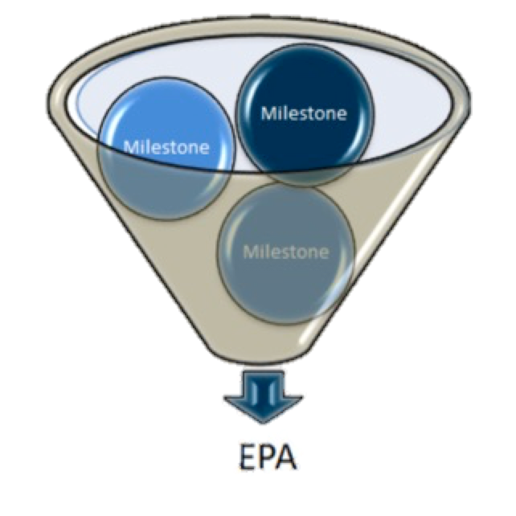
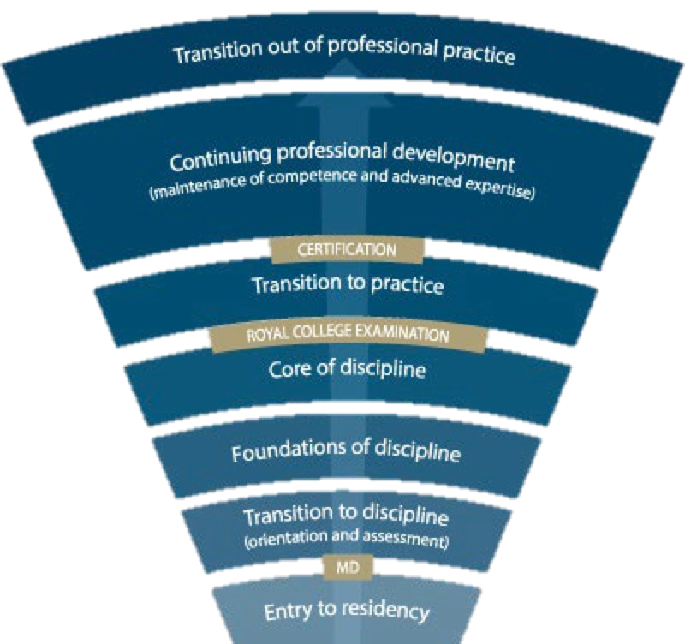
Getting Ready for the Roll-Out
Program & Assessment Tools Revision
Awaiting EPAs, Milestones & other details from RC (due March 2019)
Consideration of Curriculum Changes in process

Slide 26
Questions? Contact CBD Lead, JoAnn Corey at jcorey@stjoes.ca
Notes:
Any Questions?
Feel free to contact JoAnn Corey, CBD Lead for the Dept. of Psychiatry & Behavioural Neurosciences at jcorey@stjoes.ca

