Slide 1
Competence by Design
An Overview
August 22, 2018

Slide 2
Competence by Design (CBD)
CBD is the Canadian Version of CBME
Involves systematically designing a learner’s journey through their career in medicine
Notes:
Involves systematically THINKING ABOUT i.e. designing a learner’s journey through their career in medicine

Slide 3
What is this going to look like?

Slide 4
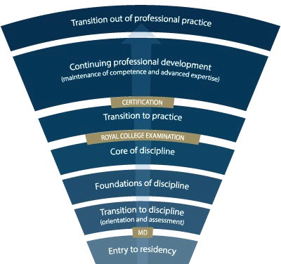
Competence Continuum -Stages of Training-
Notes:
*for general program
Need to understand how this will look for Subspecialty Programs
Explain the stages of training.
-RC will outline what needs to be accomplished within each Stage of training and give a range of time that stage may last
-Programs will then decide the duration of each stage (within the RC parameters) and what rotations will be included in each stage
-RC is also going to outline what skills & knowledge must be accomplished by a resident before they are to be allowed to progress to the next stage of training. Those required skills & knowledge are packaged into what is called the EPAs and Milestones (which I will explain in a minute)
-Programs will then map which EPAs should be accomplished in which rotations for their residents

Slide 5
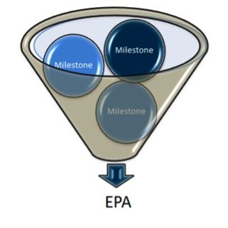
EPAs & Milestones
An Entrustable Professional Activity (EPA) is a key task of a discipline that an individual can be trusted to perform in a given health care context, once sufficient competence has been demonstrated.
Example: Performing a basic psychiatric assessment for patients presenting with common mental health concerns.
Milestones are the smaller units of ability required to complete the full EPA. They are observable markers of an individual’s ability.
Safe set up of room
Introducing self
Key components of psychiatric assessment
Basic Risk Assessment
Use of patient-centered interview skills

Slide 6
How will this work?

Slide 7
Program
Director
Academic
Coach
Competence Committee
Regional
Education Lead
Notes:
Resident and faculty identify an opportunity for an EPA assessment. Supervisor might review expectations and remind resident of feedback to build on from a previous encounter.
Resident goes to do the EPA activity. Supervisor supervises either directly or indirectly depending on the EPA
Supervisor provides verbal feedback to the resident, giving 1 or 2 specific, actionable pieces of feedback
Supervisor documents the assessment on MedSIS.
They cycle repeats itself, resulting in multiple assessments of the same EPA over time, by different observers.
These get collated on MedSIS, with the data being available to the resident, the Program Director, the REL, the resident’s academic coach and the Competence Committee (formerly the Evaluation Committee)
It is the Competence Committee that makes decisions around progression, promotion

Slide 8
What Happens to the Observation Data?
Assess overall achievement of EPAs & milestones
Regularly review learner EPAs/milestones
Approve changes to learner status:
Confirm acquisition of EPAs
Promote to next stage of training
Identify any concerns
Modify learning Plan
Develop specialized learning plans
Monitor specialized learning plans
Modify learner’s Program Plan
Monitor overall progress of learner
Request Royal College certification
Provides group decision process rather than single summative assessment
Competence Committee
Supported by technology
Notes:
Now I’m sure many of you are asking what happens to the data that is collected by the Observer
the evaluation data, evidence of learning and learner reflections will recorded electronically by both the learner and the supervisor
As I mentioned earlier, the Competence Committee is the group responsible for assessing the progress of trainees in achieving the milestones and EPAs.
While observations in a clinical setting are document and reviewed by both the Observer and the program director, the decision about the progress of each learner take place at the CC
Overall the CC will receive evaluations reports about each learner – this data will support a group assessment process rather than a single summative assessment and will allow the CC to collectively determine if the learner should move on to the next stage of training

Slide 9
Additional Supports
Help facilitate resident’s learning & development over time.
Longitudinal relationship with resident
Academic Coaches
Notes:
It is clear both from the RC and from Mac PGME that use of Academic Coaches, while suggested, is at the discretion of the program. This includes the exact role of the coach.

Slide 10
Notes:
Process of Learner Evaluation and Review of their Progress – follow diagram.
Role of Competence Committee:
Regularly review learner EPAs/milestones
Approve changes to learner status:
Confirm acquisition of EPAs
Promote to next stage of training
Identify any concerns
Modify learning Plan
Develop specialized learning plans
Monitor specialized learning plans
Modify learner’s Program Plan
Monitor overall progress of learner
Request Royal College certification
Provides group decision process rather than single summative assessment

Slide 11
What we are waiting to know
EPAs & Milestones from our Specialty/Subspecialty Working Groups
Revised Specialty Training Requirements
Revised Objectives of Training
Revised Accreditation Requirements
Anticipated Spring 2019

Slide 12
What we do know
Roll-out of C/A & Forensics - 2020 (starting with the residents entering that year)
Geriatrics may be 2020 or more likely 2021
Mac PGME is going to provide the electronic platform (Medsis) for us – scheduled to be in place 2019
This will collate all the data!
This will provide e-portfolio
We should be able to run pilots in 2019

Slide 13
What we do know
Guidelines for Competence Committees
Examples of the Evaluation Documents
Notes:
So this means….

Slide 14
So We Can Get Started!
Notes:
We can get started!

Slide 15
Proposed Timeline

Slide 16
Project Timeline
Aug. to Dec. 2018
Implementation of Competence Committees
Decision about Coaches
Sept. 2018 to Feb. 2019
Review & Modification of Current Evals to CBD format
March 2019 to Sept. 2019
Receive RC EPAs, Milestones, STRs, OTRs
Begin Program Revision
Begin Evaluation Revision & Development
Now through to rollout and beyond...
Sept 2019 – June 2020
Faculty Development
Pilot aspects of program
Preparations for full roll-out
Notes:
Dates for initiating each of the items described are indicated
Reason arrows ongoing is because we may find need to revise things as we go along

