Slide 1
Competence by Design
Overview for Transition to Competence Committee
August 8, 2018

Slide 2
Competency Based Medical Education (CBME)
Outcomes based
Organized around outcomes expected of a resident
A resident’s advancement is dependent on having achieved those expected outcomes
Allows more frequent, low-stakes
opportunities for assessment & feedback
Fosters frequent, effective feedback
Time
will still matter.
Early completion will be exception.

Slide 3
Competence by Design (CBD)
CBD is the Canadian Version of CBME
Involves systematically designing a learner’s journey through their career in medicine
Notes:
Involves systematically THINKING ABOUT i.e. designing a learner’s journey through their career in medicine

Slide 4
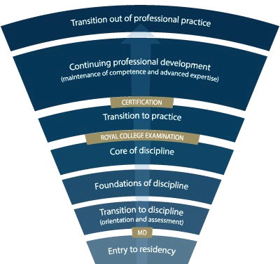
Competence Continuum -Stages of Training-
PGY-5
PGY-4
PGY-3
PGY-2
PGY-1
Notes:
*for general program
Need to understand how this will look for Subspecialty Programs
Explain the stages of training.
-RC will outline what needs to be accomplished within each Stage of training and give a range of time that stage may last
-Programs will then decide the duration of each stage (within the RC parameters) and what rotations will be included in each stage
-RC is also going to outline what skills & knowledge must be accomplished by a resident before they are to be allowed to progress to the next stage of training. Those required skills & knowledge are packaged into what is called the EPAs and Milestones (which I will explain in a minute)
-Programs will then map which EPAs should be accomplished in which rotations for their residents

Slide 5
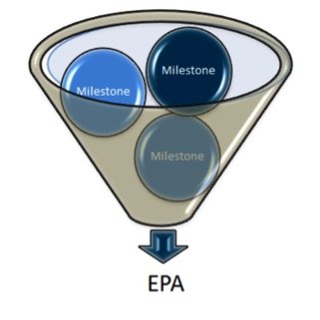
EPAs & Milestones
An Entrustable Professional Activity (EPA) is a key task of a discipline that an individual can be trusted to perform in a given health care context, once sufficient competence has been demonstrated.
Example: Performing a basic psychiatric assessment for patients presenting with common mental health concerns.
Milestones are the smaller units of ability required to complete the full EPA. They are observable markers of an individual’s ability.
Safe set up of room
Introducing self
Key components of psychiatric assessment
Basic Risk Assessment
Use of patient-centered interview skills

Slide 6
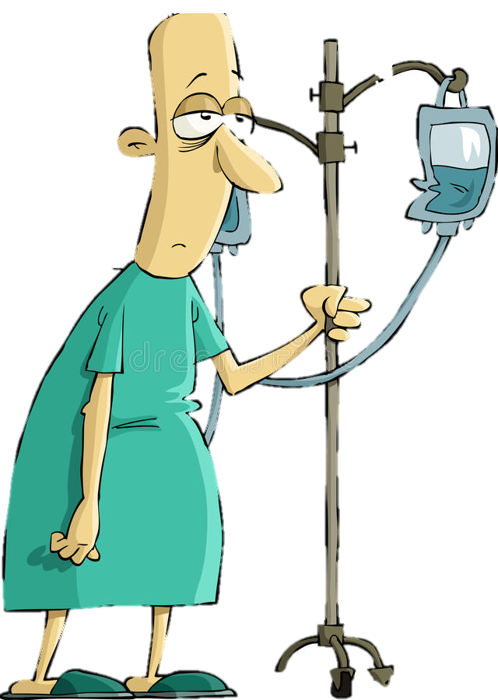
Program
Director
Academic
Coach
Competence Committee
Regional
Education Lead
Notes:
Resident and faculty identify an opportunity for an EPA assessment. Supervisor might review expectations and remind resident of feedback to build on from a previous encounter.
Resident goes to do the EPA activity. Supervisor supervises either directly or indirectly depending on the EPA
Supervisor provides verbal feedback to the resident, giving 1 or 2 specific, actionable pieces of feedback
Supervisor documents the assessment on MedSIS.
They cycle repeats itself, resulting in multiple assessments of the same EPA over time, by different observers.
These get collated on MedSIS, with the data being available to the resident, the Program Director, the REL, the resident’s academic coach and the Competence Committee (formerly the Evaluation Committee)
It is the Competence Committee that makes decisions around progression, promotion

Slide 7
What Happens to the Observation Data?
Assess overall achievement of EPAs & milestones
Regularly review learner EPAs/milestones
Approve changes to learner status:
Confirm acquisition of EPAs
Promote to next stage of training
Identify any concerns
Modify learning Plan
Develop specialized learning plans
Monitor specialized learning plans
Modify learner’s Program Plan
Monitor overall progress of learner
Request Royal College certification
Provides group decision process rather than single summative assessment
Competence Committee
Supported by technology
Notes:
Now I’m sure many of you are asking what happens to the data that is collected by the Observer
the evaluation data, evidence of learning and learner reflections will recorded electronically by both the learner and the supervisor
As I mentioned earlier, the Competence Committee is the group responsible for assessing the progress of trainees in achieving the milestones and EPAs.
While observations in a clinical setting are document and reviewed by both the Observer and the program director, the decision about the progress of each learner take place at the CC
Overall the CC will receive evaluations reports about each learner – this data will support a group assessment process rather than a single summative assessment and will allow the CC to collectively determine if the learner should move on to the next stage of training

Slide 8
Project Timeline
Aug. to Dec. 2018
Implementation of Competence Committees
Decision about Coaches
Sept. 2018 to Feb. 2019
Review & Modification of Current Evals to CBD format
March 2019 to Sept. 2019
Receive RC EPAs, Milestones, STRs, OTRs
Begin Program Revision
Begin Evaluation Revision & Development
Now through to rollout and beyond...
Sept 2019 – June 2020
Faculty Development
Implementation of Competence Committees
Decision about Coaches
Pilot aspects of program
Preparations for full roll-out
Notes:
First set of residents in CBD Stream July 1, 2020.
Dates for initiating each of the items described are indicated
Reason arrows ongoing is because we may find need to revise things as we go along

Slide 9
Implementation of
Competence Committee

Slide 10
Additional Slides

Slide 11
Preparing for CBD
First set of residents in CBD: July 1, 2020
Revisions of all Royal College documents expected Spring 2019, including EPAs & Milestones
Medsis (electronic platform) will:
Collate all the data!
Be the e-portfolio
Be available for us to run pilots in 2019

Slide 12
Additional Supports
Help facilitate resident’s learning & development over time.
Longitudinal relationship with resident
Academic Coaches
Notes:
It is clear both from the RC and from Mac PGME that use of Academic Coaches, while suggested, is at the discretion of the program. This includes the exact role of the coach.

Slide 13
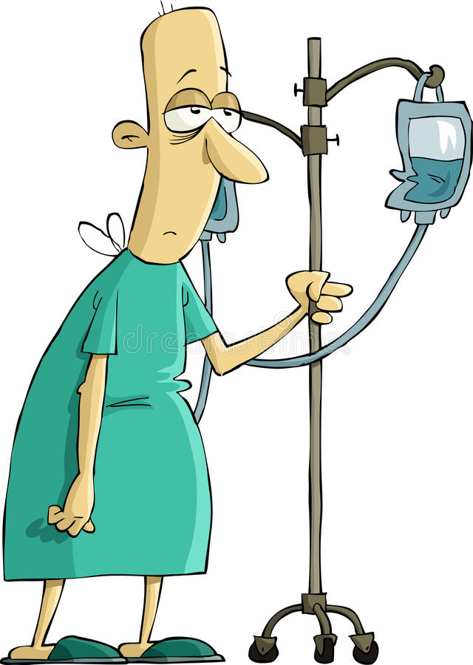
Notes:
Process of Learner Evaluation and Review of their Progress – follow diagram.
Role of Competence Committee:
Regularly review learner EPAs/milestones
Approve changes to learner status:
Confirm acquisition of EPAs
Promote to next stage of training
Identify any concerns
Modify learning Plan
Develop specialized learning plans
Monitor specialized learning plans
Modify learner’s Program Plan
Monitor overall progress of learner
Request Royal College certification
Provides group decision process rather than single summative assessment

Slide 14
How Will it Work? - Learner
Plans their learning
Views Learning Plan EPAs & milestones
Selects training activity
Requests observation from Observer
Participates in learning
Works with Observer
Participates in observation encounter
Receives specific, constructive feedback
Record observation
Learner
Reflects on observations
& learnings
Supported by technology
Notes:
For a learner, assessment will flow as follows:
Plan learning
This occurs in a macro (rotational) view and micro (daily) view.
Views Learning Plan EPAs & milestones as part of the day or rotation.
Selects observation opportunities.
Works with supervisor to find opportunities.
Participates in the encounter
Works with supervisor, peers, and often, the patient.
Exchange feedback
The resident self-assesses (i.e., reflects on learning).
The supervisor provides specific constructive feedback for learning based on evidence from the encounter and the design of the RCEPA.
Record observation
Not all observations are recorded.
This could be in an ePortfolio or other means of technology.

Slide 15
How Will it Work? - Observer
Supports learning
Works with learner
Contributes to narrative
Prepares for observation
Accepts requests for observation
Reviews EPAs & milestones
Observer
Participates in observation encounter
Supported by technology
Provides Feedback
Specific, constructive based on evidence from encounter
Evaluates EPA/milestones
Records data via technology
Notes:
Further details on role of the “Observer” in an encounter. In our program this would most often refer to a supervisor but could be an observer/evaluator in other circumstances.
For the observer assessment will flow like this
Supports learning
Works with learners
Contributes to narrative
Review evidence of learning
Prepares for observation
Reviews and accepts observation requests
Reviews EPAs and milestones
Participates in observation encounter
Works with learner, and often, the patient.
Provides feedback
The observer provides specific constructive feedback for learning based on evidence from the encounter and the design of the RCEPA.
Record observation
Not all observations are recorded.
This could be in an ePortfolio or other means of technology.

Slide 16
Additional Supports
Guides learning
Meets with learners regularly
Reviews with learner their learning plan
Assigns EPAs
Reviews learner progress
Participates on Competence Committee
Reviews program status
Reviews program data & investigates issues
Provides program information to Residency Program Committee
Program Director
Supported by technology
Notes:
Further details on role of PD in CBD

Slide 17
First Steps...

