Slide 1

CBME Check-in for Supervisors of the Foundations Stage
JoAnn Corey
Program Director &
CBME Lead
Fall 2020
Notes:
Will get a Section 1 CME Credit
Menika will be sending an eval form

Slide 2
Objectives
Check-in:
  supervisory experience level of participants
  questions of principles & mechanics of CBME
Discussion of Entrustment Scale for high yield EPAs during Pgy1 & 2
Discussion of Quality Feedback

Slide 3




Key Point
Its all about regular observation & feedback day to day.
Quality
1 – 2 Specific, Actionable Points to improve the next time they do it
Acceptance & Incorporation

Slide 4


CBME:
Paradigm Shift
Assessment
OF Learning
“Summative assessment”
Assessment FOR Learning (Observations)
“Formative assessment”
Embedded in learning process (frequent & ongoing)
Goal: judge/evaluate learning
At end of learning process
Low stakes, safe environment
High stakes
Goal: monitor progress & provide immediate feedback to improve (feedback loop)
Notes:
FACILITATOR TIP: This slide is illustrating a change in how we, residents and teachers, need to view and value observation and assessment. A shift in thinking to Assessment (Observation) FOR Learning is a big part of the change required for CBME to work. This is a paradigm shift that will take time.
To be truly successful, the CBD coaching model requires an important philosophical shift in thinking about assessment of residents and, particularly, the purpose of such assessment. In our current system, many of our commonly used assessment methods do not get at what a resident does on a typical clinical day. There needs to be more observation of residents doing their daily work, rather than performing in a “testing” environment/situation. Hence, the emphasis on Assessment FOR the purpose of Learning needs to be far greater than what currently exists. In other words, assessments (or observations) identify opportunities for learning.
Within a mindset of Assessment OF Learning (summative assessment), the predominant purpose for assessment is that of a judgement or evaluation of what a resident knows or can do at that particular instant in time (or sometimes even a judgement of what the resident doesn’t know or can’t do). This can create unease for the resident and often puts them in a position of performing – doing what they believe is on “a checklist” as opposed to doing what they would normally do, as they felt appropriate, in the real clinical environment.
With a shift in mindset, to the framing of Assessment FOR Learning (formative assessment), the purpose of assessment is to be part of a process to guide the resident to what they can do to improve their current understanding or practice. Formative assessment is lower stakes, frequent and ongoing and is embedded throughout the learning process rather than at the end. The goal is to monitor learning and provide immediate feedback that can be used to improve both teaching and learning and subsequent resident performance, thereby promoting a growth mindset.

Slide 5
FEEDBACK
COACHING FEEDBACK
Coaching Feedback
Feedback
Observation of Work
Focuses on what has already occurred
Can increase self-awareness
Emphasis on external insight about what occurred
Focus is the learning potential
Provides guidance to improve future practice
Emphasis on specific, actionable advice to strengthen a competency

Slide 6
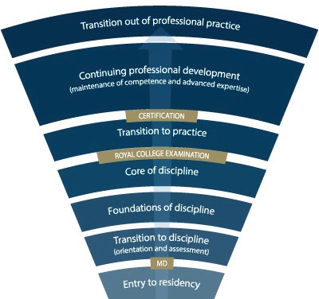
Stage of Supervision?
PGY-5
PGY-4
PGY-3
PGY-2
PGY-1
Notes:
-Royal College outlines what needs to be accomplished within each Stage of training and give a range of time for min & max duration of that stage
-Programs will then decide the duration of each stage (within the RC parameters) and what rotations will be included in each stage
-RC is also going to outline what skills & knowledge must be accomplished by a resident before they are to be allowed to progress to the next stage of training. Those required skills & knowledge are packaged into what is called the EPAs and Milestones (which I will explain in a minute)
-Programs then map which EPAs should be accomplished in which rotations for their residents

Slide 7

Mechanical Questions?

Slide 8
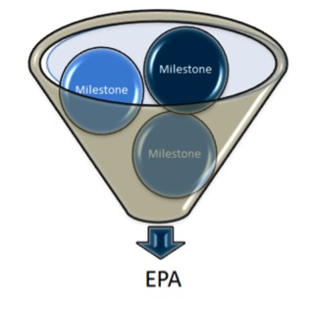


EPA Basics?
(Entrustable Professional Activities)

Slide 9
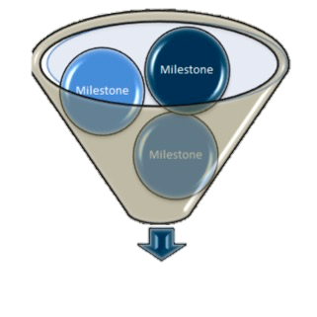
The Royal College has defined which EPAs a resident must acquire before they can advance to the next Stage of Training.
Transition to Practice
Core of Discipline
Foundations of Discipline
Transition to Discipline

Slide 10
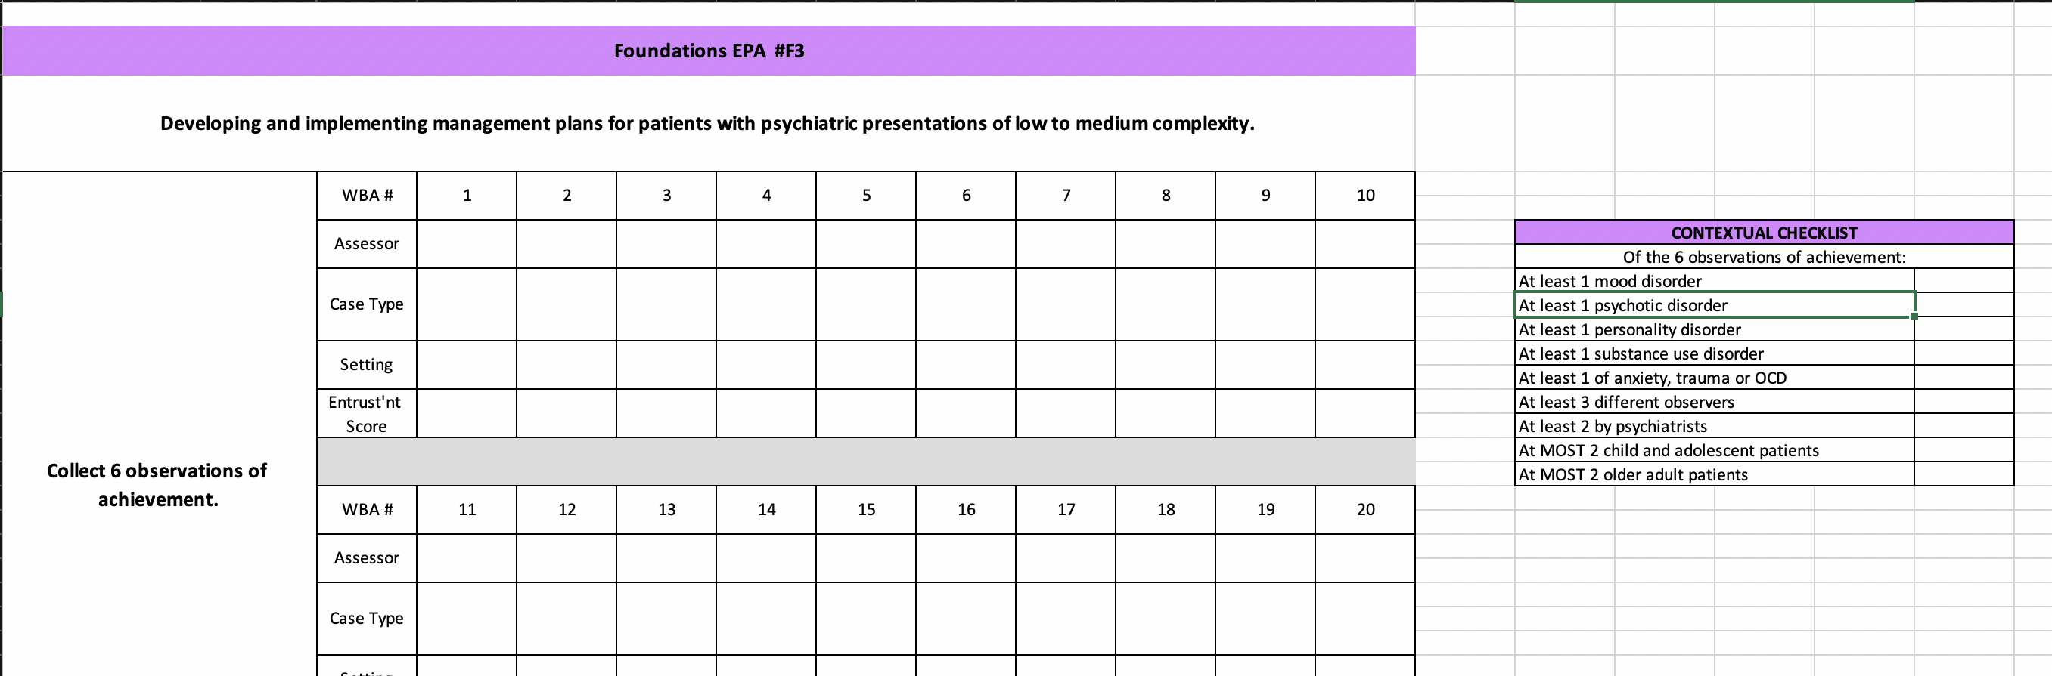
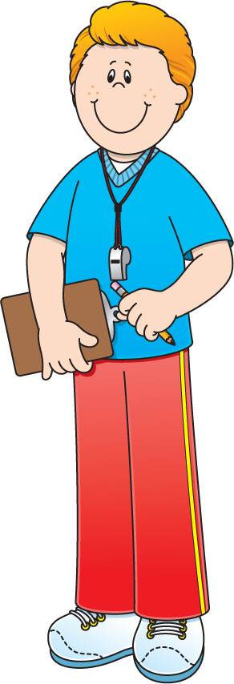

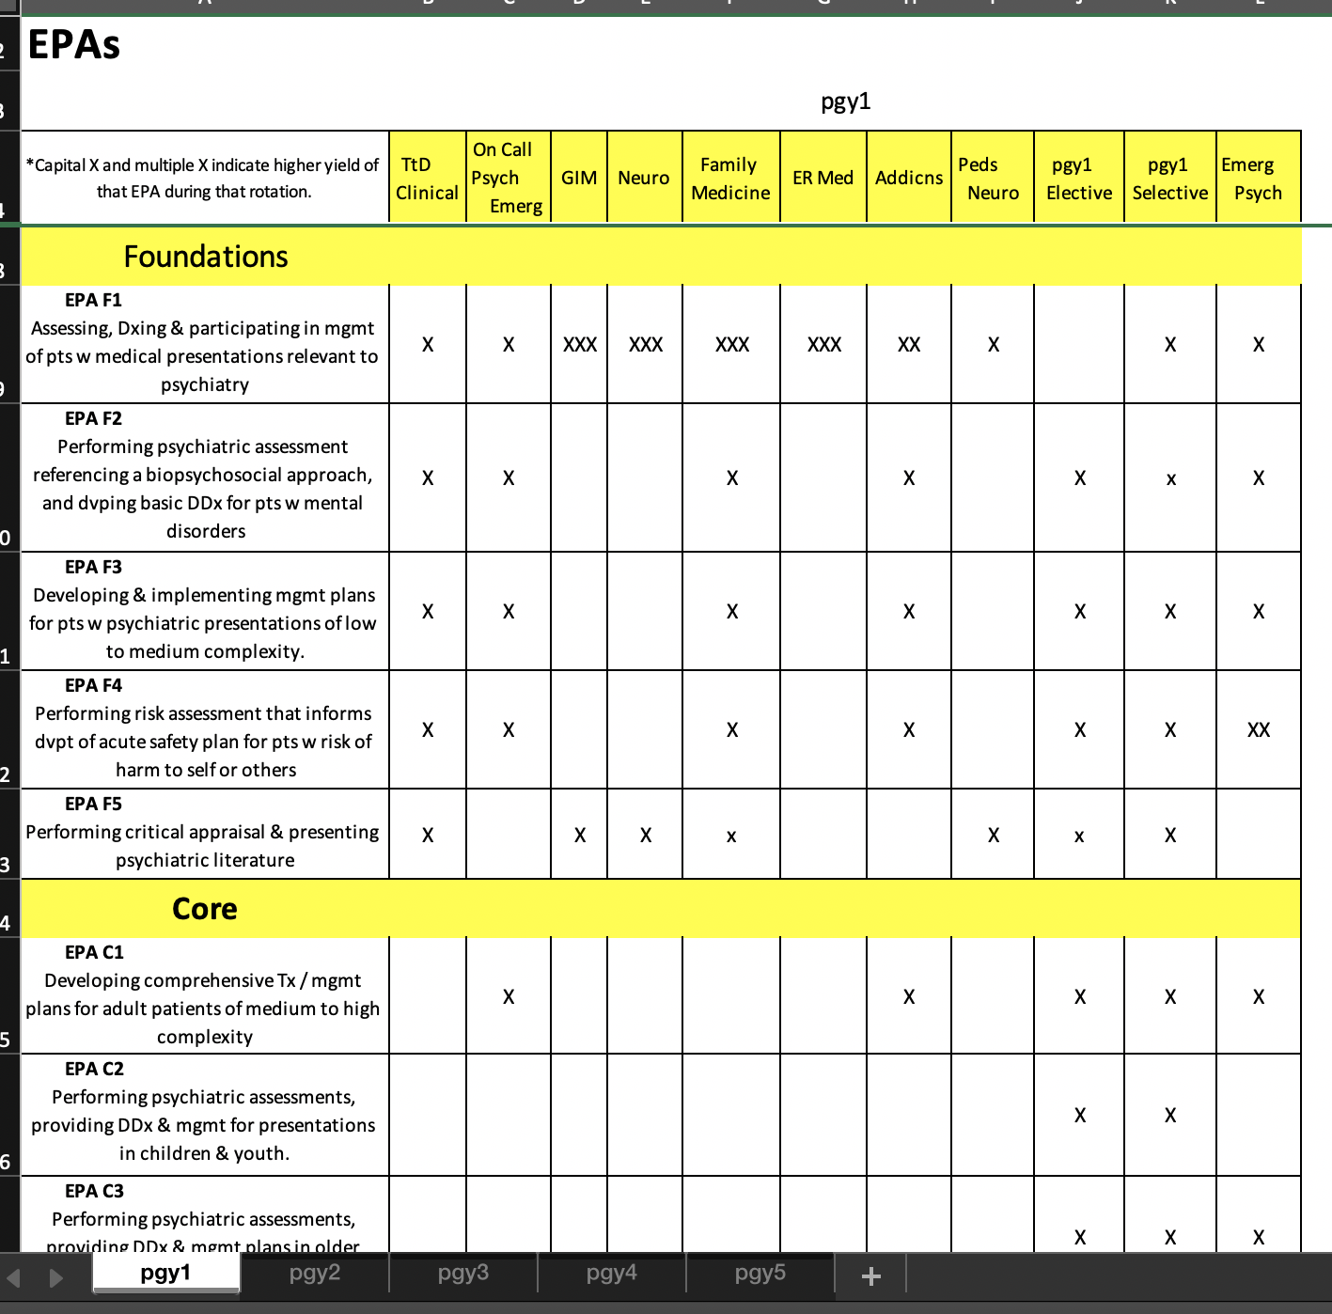
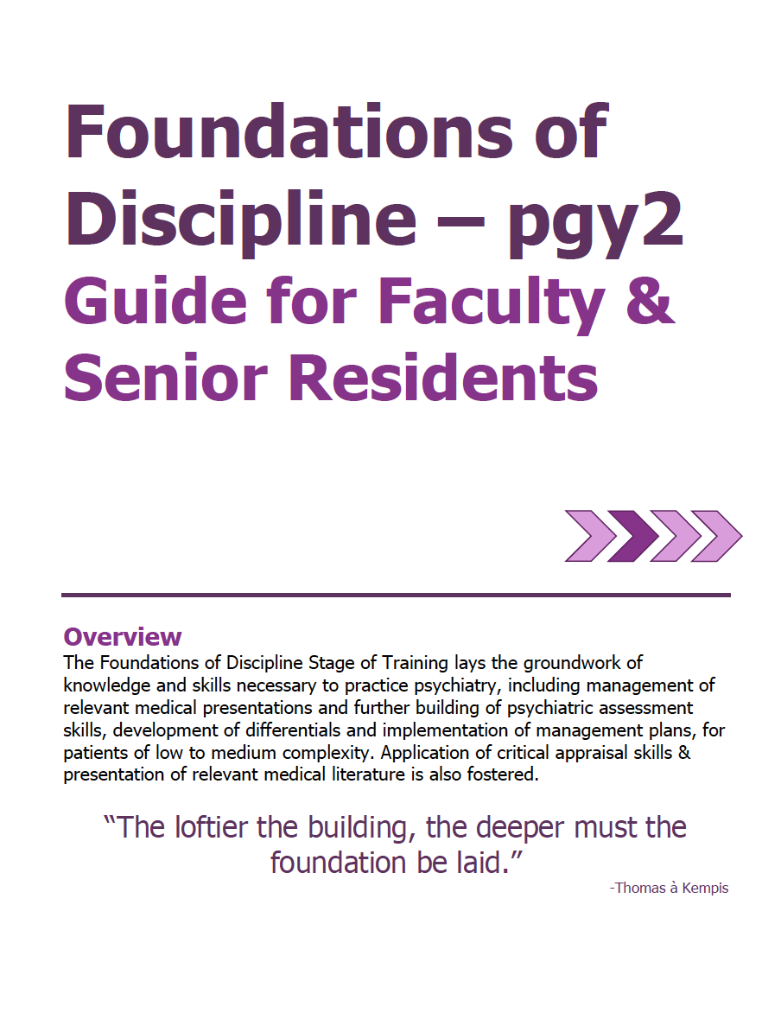
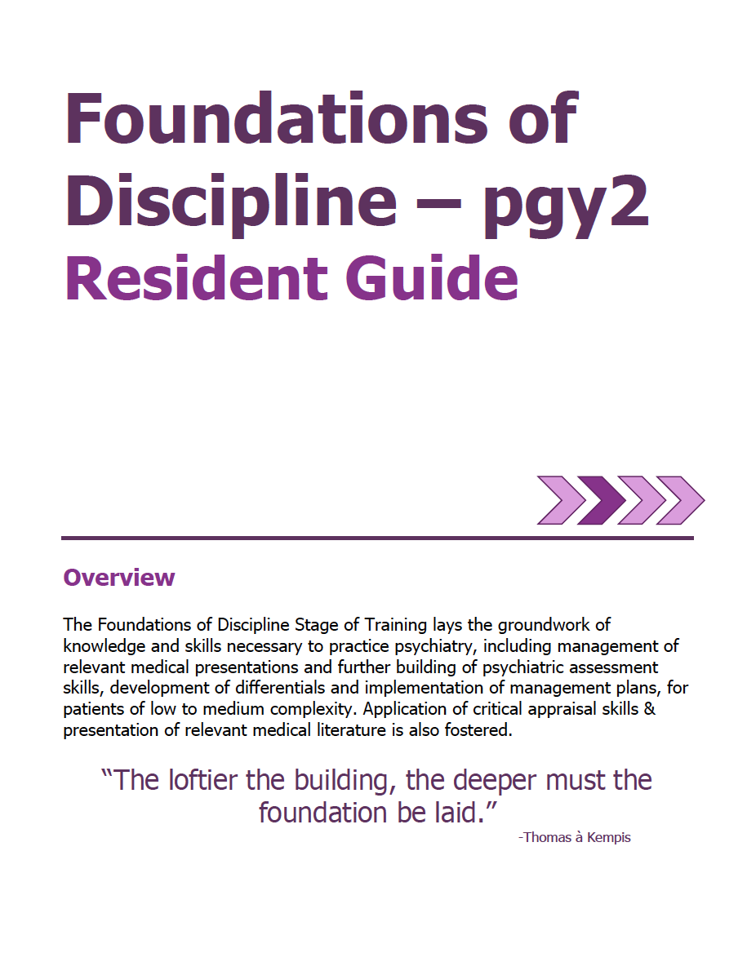

Academic Coach
Plans their learning
Views Curriculum Map
Know what EPAs working on
Develops a Personal Learning Plan
Supervisor
Resident
Sets Objectives for Rotation
Based on Curriculum Map
Based on Personal Learning Plan
Supported
by technology

Slide 11
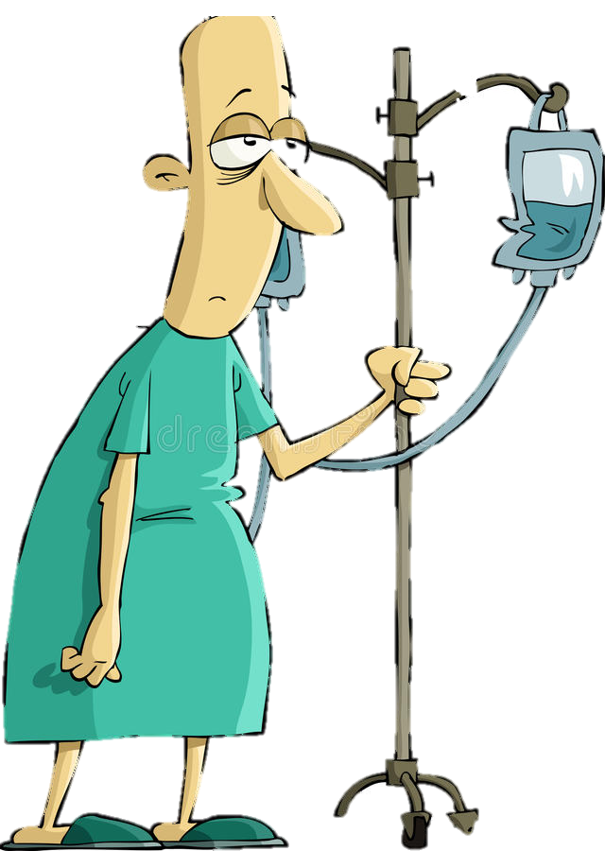


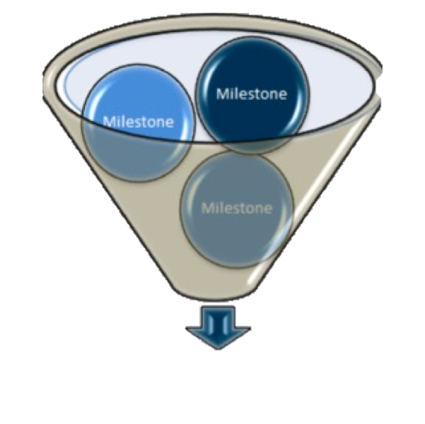





Program
Director
Academic
Coach
Competence Committee
Regional
Education Lead
Notes:
Resident and faculty identify an opportunity for an EPA assessment. Supervisor might review expectations and remind resident of feedback to build on from a previous encounter.
Resident goes to do the EPA activity. Supervisor supervises either directly or indirectly depending on the EPA
Supervisor provides verbal feedback to the resident, giving 1 or 2 specific, actionable pieces of feedback
Supervisor documents the assessment on MedSIS.
They cycle repeats itself, resulting in multiple assessments of the same EPA over time, by different observers.
These get collated on MedSIS, with the data being available to the resident, the Program Director, the REL, the resident’s academic coach and the Competence Committee (formerly the Evaluation Committee)
It is the Competence Committee that makes decisions around progression, promotion

Slide 12

Assessment of EPAs
Aiming for 2 – 3 EPA assessments a week, between daytime rotation & on-call experiences

Slide 13

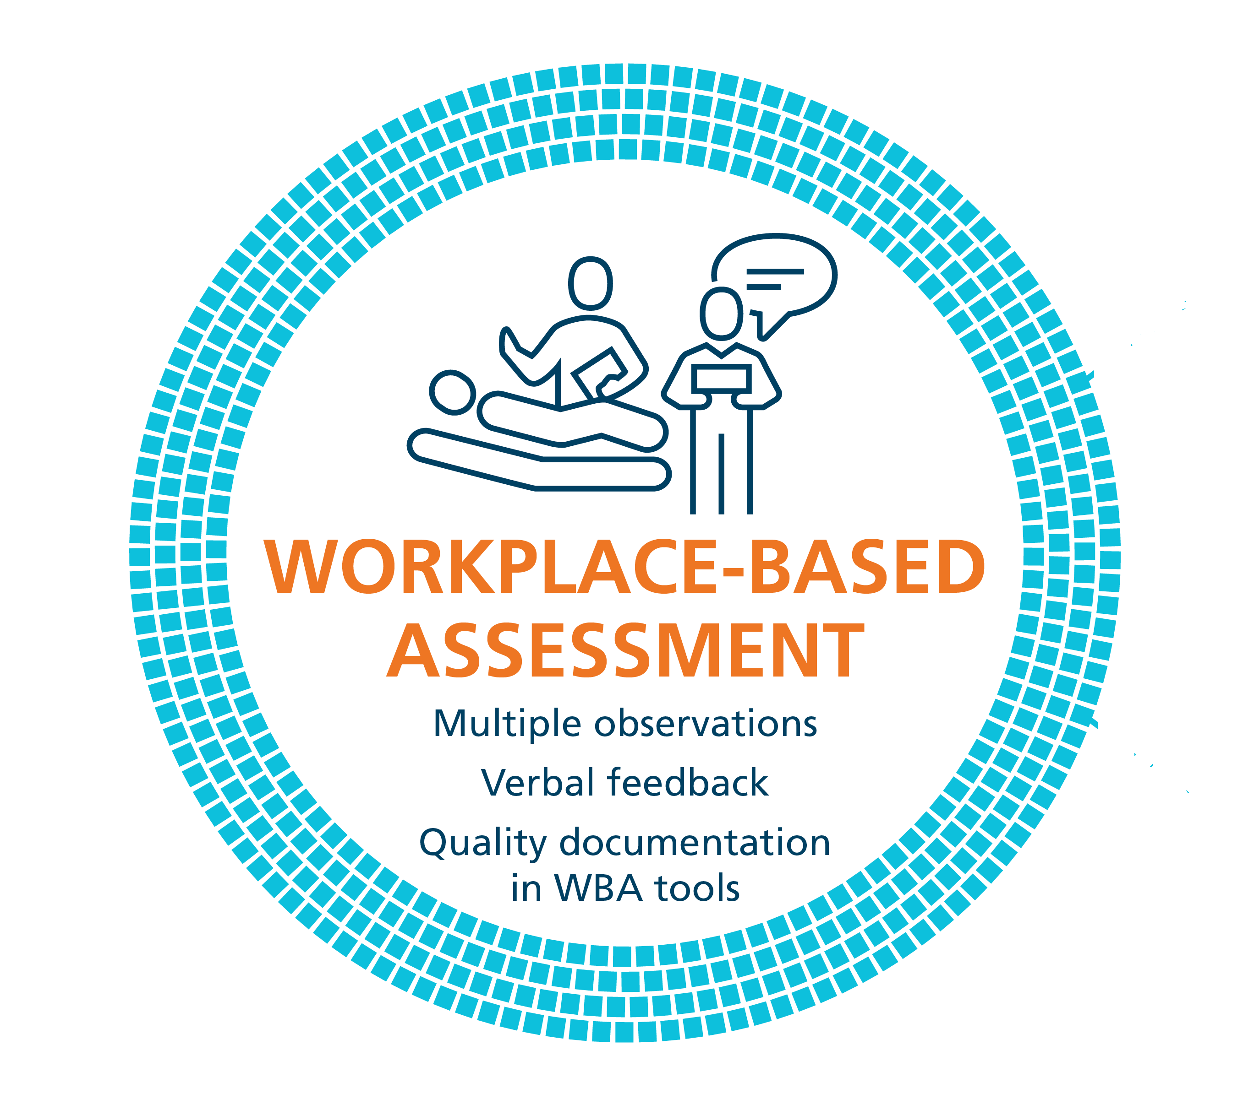
Making the most of an EPA observation
RX-OC&D
RAPPORT
EXPECTATIONS
OBSERVE
CONVERSATION
DOCUMENT
Notes:
Coaching in the Moment follows a process,
This process has been coined as the RX-OCD coaching process between the clinician coach and the resident.
The steps in the process are:
R: Establishing educational “Rapport” between the resident and the clinician. Set up safe envt for learning
X: Setting “eXpectations” for the particular clinical time period; hear what they are working on / previous feedback was
These initial 2 steps need not take longer than a few minutes.
3) O: “Observing” some type of work that the resident does
4) C: Engaging in a “Conversation” for the purpose of improvement of that work (“coaching”);
5) D: “Documenting” a summary of the dialogue that occurred so that the resident can build a portfolio of observations demonstrating progress and areas to be improved.

Slide 14
Helpful Words in
Giving Feedback
Because
Next time…
Try…
Recommend…
Consider….
I suggest…

Slide 15
Assessment Form Questions?

Slide 16
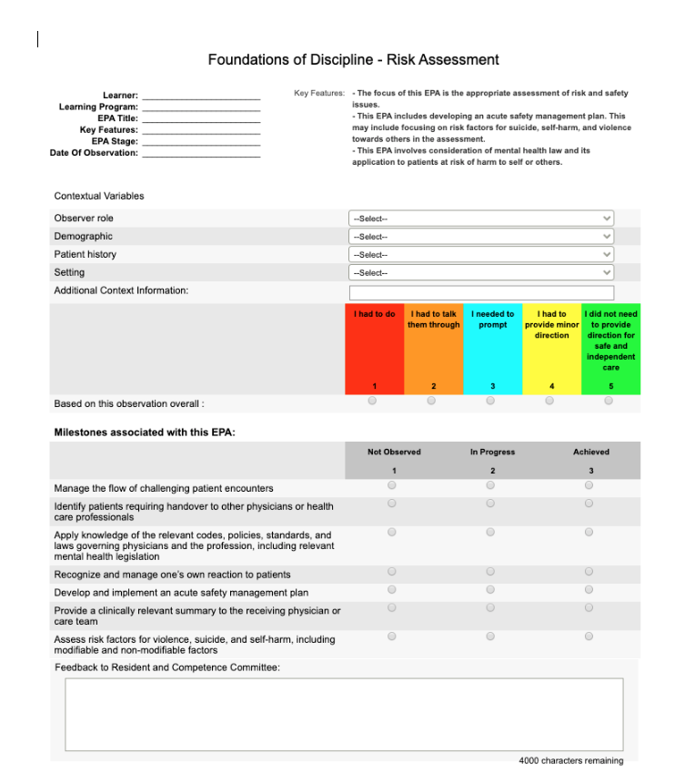
Assessment Form

Slide 17
Entrustment
Scale
*not based on
Pgy-level, but how they did with the task
Resident demonstrates sound knowledge & skill but needed help with unexpected challenges. A few things you needed to f/u on. No significant concerns.
Learner required
constant direction
1 | 2 | 3 | 4 | 5
I had to do. | I had to talk them through. | I needed to prompt. | I had to provide minor direction. | No direction required for safe, indpt care.
Learner didn’t do task or
Needed complete hands on guidance
Some independence but required intermittent direction
Complete independence. Understands risks. Performs safely. Practice ready.
**If any concerns with risk assessment or safety, should not score above 3.
Notes:
Level 1 – the supervisor had to perform the clinical activity while the resident observed. This may apply if resident has never done the task before, or they started but situation became too challenging so supervisor elected to complete the task. Ideally, the supervisor would provide direction and teaching afterwards.
Level 2 – self-explanatory
Level 3 – The resident required frequent direction, requiring occasional prompting and guidance, particularly with more complex aspects of the encounter OR the encounter required supervisor to follow-up on a number of important aspects not completed by the resident
Level 4 – Previously “I needed to be there just in case”. Now Changed to: “I had to provide minor direction.“ Resident demonstrates sound technique but you were not confident that their knowledge base or skill was sufficient to ensure that if they had run into an unexpected challenge or complication, they would have been able to manage this. Examples might include: when you posed questions as to how they would handle a complication of the situation, they were not able to explain; they completed the assessment adequately but there were nuances that made it more akward or less effective; resident completed the assessment thoroughly but it took them a much longer than normal time.
Level 5: Previously”I did not need to be there”. Now changed to: “I did not need to provide direction for safe, independent care” or “No direction required for safe, independent care”. Resident able to complete all aspects of the assessment independently and safely including troubleshooting unexpected challenges; completed in sufficient time frame (may not have been as fast as experienced staff person). Any teaching you provided was more to enrich a competenct knowledge base. Any prompts given were not necessary for resident to complete the task safely and independently.

Slide 18

EPA Dilemmas Discussion

Slide 19

Foundations EPAs
Notes:
Here are the EPAs that residents must complete by the end of the Foundations of Discipline Stage of Training. Ie. by the end of Pgy2
There are five EPAs that must be achieved during the Foundations Stage of training
Remember – Foundations runs through 2/3 of Pgy1 and all of Pgy2
They must successfully complete all 5 of them by the end of Pgy2

Slide 20

Assessing, diagnosing & participating in the management of Medical Presentations relevant to Psychiatry.
EPA F-1
8 Observations of Achievement
At least:
2 Medical Emergencies
1 Substance Intoxication
1 OD &/or Withdrawal
1 Neuropsychiatric Presentation
1 Endocrine or Metabolic Disorder
Notes:
Many of the residents will have fully completed this EPA by the end of Pgy1
Due to the pandemic, depending on the timing of some of their rotations such as GIM, FM and Neurology, some of our residents have not yet completed this EPA this year.

Slide 21

Performing Psychiatric Assessments referencing a biopsychosocial approach & developing basic DDx for patients with mental disorders.
EPA F-2
6 Observations of Achievement
At least:
1 Emergency Setting
2 Inpatient Settings
2 Outpatient Settings
3 Different Case Types
1 | 2 | 3 | 4 | 5
I had to do | I had to talk them through. | I needed to prompt. | I had to provide minor direction. | No direction required for safe, independent care.
Notes:
Tailor to setting – so an emerg assessment will be different than an inpatient admission assessment.
What if they are way too detailed in an emerg assessment?
What if they they get to the correct DDx, but it was a clunky interview?
What if the resident is scattered? What if the patient is scattered / really difficult?

Slide 22

Developing & implementing Management Plans for patients with psychiatric presentations of low to medium complexity.
6 Observations of Achievement
At least:
1 Mood Disorder
1 Psychotic Disorder
1 Personality Disorder
1 Substance Use Disorder
1 Anxiety or Trauma or OCD
EPA F-3
1 | 2 | 3 | 4 | 5
I had to do | I had to talk them through. | I needed to prompt. | I had to provide minor direction. | No direction required for safe, independent care.
Notes:
Do they need to know doses? What if they know the Mx but aren’t sure of doses?
What if they get status, admit/don’t admit/ initial Tx right, but forget about non-pharmacologic approaches. What if you have to cue them to it, and then they get it
What if they forget about capacity considerations?

Slide 23

Performing Risk Assessments that inform the development of an acute safety plan for patients posing risk of harm to self or others.
EPA F-4
5 Observations of Achievement
At least:
1 Non-suicidal self-injury
1 Active SI or Suicidal Behaviour
1 Active HI or Violent Ideation/Behaviour
1 | 2 | 3 | 4 | 5
I had to do | I had to talk them through. | I needed to prompt. | I had to provide minor direction. | No direction required for safe, independent care.
Notes:
What if the resident doesn’t check enough or check using varying questions for the same thing
What if resident takes what patient says at face value
What if the patient speaks of a number of people they are angry at; then when checking HI, they say no but resident doesn’t ask about specific people prev. mentioned

Slide 24

Performing Critical Appraisal and presenting psychiatric literature.
2 Observations of Achievement
At least:
2 Different Observers
EPA F-5
1 | 2 | 3 | 4 | 5
I had to do | I had to talk them through. | I needed to prompt. | I had to provide minor direction. | No direction required for safe, independent care.

Slide 25
The Royal College has defined which EPAs a resident must acquire before they can advance to the next Stage of Training.
Transition to Practice
Core of Discipline
Foundations of Discipline
Transition to Discipline

Slide 26

Core EPAs relevant in Pgy2

Slide 27

Providing Teaching for students, residents, the public and other health care professionals.
EPA C-10
Soft Launch & CBME Residents
use EPA C10
to assess Resident as Educator activities
Teaching to patient or family
Other teaching encounter (often medical students)
1 | 2 | 3 | 4 | 5
I had to do | I had to talk them through. | I needed to prompt. | I had to provide minor direction. | No direction required for safe, independent care.
Notes:
What if the patient or family gets upset?
What if they don’t say all the possible side effects?
What if they don’t periodically check in to see if the patient/family/student has questions
What if they don’t correct a student who says something completely incorrect?

Slide 28

EPA C-8
Integrating the principles & skills of Psychopharmacology into patient care.
12 Observations of Achievement
At least:
1 starting & monitoring LAI
1 starting & monitoring Oral Antipsychotic
2 starting & monitoring 2 different classes Antidepressants
1 starting & monitoring Sedative / Hypnotic
1 starting and/or monitoring Lithium
1 starting and/or monitoring Clozapine
1 managing Benzodiazepine
1 managing Opioid Agonist Therapy
1 Mood Stabilizer Other Than Lithium
12 Observations of Achievement
1 agent to treat Mx-induced SEs
1 patient on multiple psychiatric medications
2 patients in C/L setting
2 Child/Adolescent including starting & managing 1 stimulant
2 Older Adults, including 1 w cognitive enhancer
1 Pregnant or Breastfeeding patient
5 Different Observers
3 by Psychiatrist Observers
1 | 2 | 3 | 4 | 5
I had to do | I had to talk them through. | I needed to prompt. | I had to provide minor direction. | No direction required for safe, independent care.

Slide 29





High Yield
Core EPAs during Pgy-2:
C8
(psychopharmacology)
C9
(legislation)
C10
(teaching others)
C7:
(neurostimulation)
C5:
(emergent situations)

Slide 30

Key Points
This Photo by Unknown Author is licensed under CC BY-NC-ND

Slide 31
Key Point
Its all about regular observation & feedback day to day.
Quality
1 – 2 Specific, Actionable Points for improvement
Acceptance & Incorporation

Slide 32
Entrustment
Scale
*not based on
Pgy-level, but how they did with the task
Resident demonstrates sound knowledge & skill but needed help with unexpected challenges. A few things you needed to f/u on. No significant concerns.
Learner required
constant direction
1 | 2 | 3 | 4 | 5
I had to do. | I had to talk them through. | I needed to prompt. | I had to provide minor direction. | No direction required for safe, indpt care.
Learner didn’t do task or
Needed complete hands on guidance
Some independence but required intermittent direction
Complete independence. Understands risks. Performs safely. Practice ready.
**If any concerns with risk assessment or safety, should not score above 3.
Notes:
Level 1 – the supervisor had to perform the clinical activity while the resident observed. This may apply if resident has never done the task before, or they started but situation became too challenging so supervisor elected to complete the task. Ideally, the supervisor would provide direction and teaching afterwards.
Level 2 – self-explanatory
Level 3 – The resident required frequent direction, requiring occasional prompting and guidance, particularly with more complex aspects of the encounter OR the encounter required supervisor to follow-up on a number of important aspects not completed by the resident
Level 4 – Previously “I needed to be there just in case”. Now Changed to: “I had to provide minor direction.“ Resident demonstrates sound technique but you were not confident that their knowledge base or skill was sufficient to ensure that if they had run into an unexpected challenge or complication, they would have been able to manage this. Examples might include: when you posed questions as to how they would handle a complication of the situation, they were not able to explain; they completed the assessment adequately but there were nuances that made it more akward or less effective; resident completed the assessment thoroughly but it took them a much longer than normal time.
Level 5: Previously”I did not need to be there”. Now changed to: “I did not need to provide direction for safe, independent care” or “No direction required for safe, independent care”. Resident able to complete all aspects of the assessment independently and safely including troubleshooting unexpected challenges; completed in sufficient time frame (may not have been as fast as experienced staff person). Any teaching you provided was more to enrich a competenct knowledge base. Any prompts given were not necessary for resident to complete the task safely and independently.

Slide 33

Making the most of an EPA observation
RX-OC&D
RAPPORT
EXPECTATIONS
OBSERVE
CONVERSATION
DOCUMENT
Notes:
Coaching in the Moment follows a process,
This process has been coined as the RX-OCD coaching process between the clinician coach and the resident.
The steps in the process are:
R: Establishing educational “Rapport” between the resident and the clinician. Set up safe envt for learning
X: Setting “eXpectations” for the particular clinical time period; hear what they are working on / previous feedback was
These initial 2 steps need not take longer than a few minutes.
3) O: “Observing” some type of work that the resident does
4) C: Engaging in a “Conversation” for the purpose of improvement of that work (“coaching”);
5) D: “Documenting” a summary of the dialogue that occurred so that the resident can build a portfolio of observations demonstrating progress and areas to be improved.

Slide 34
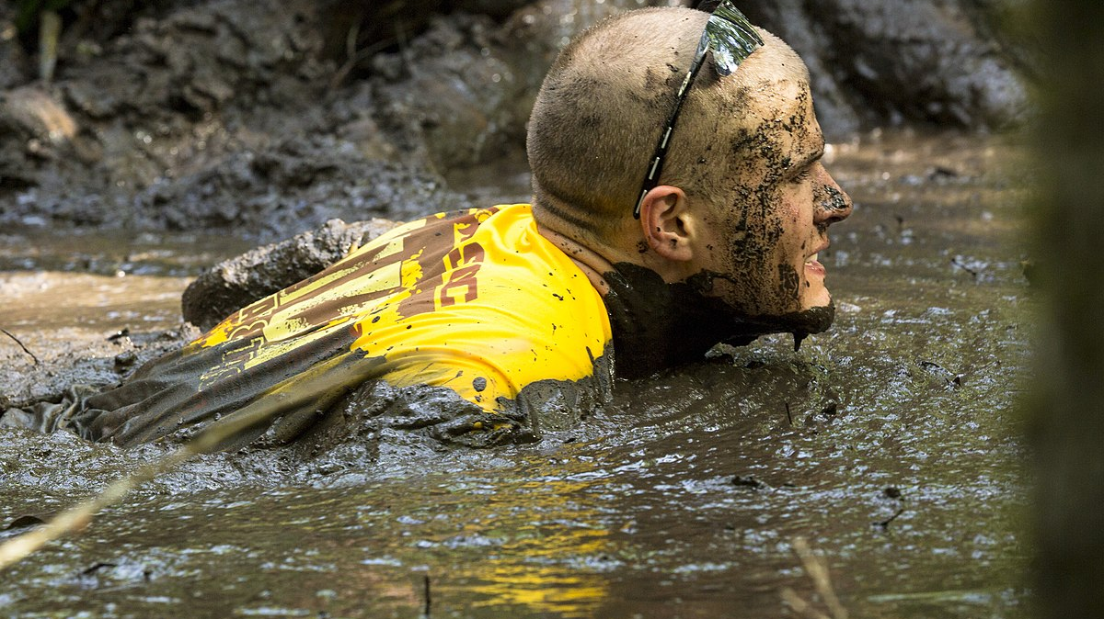
Muddiest Moment:
What still feels unclear?

Slide 35

S’MORE SLIDES

Slide 36






Key Points
Need to achieve the 5 Foundations EPAs by the end of the Foundations Stage of Training
F1: Medical Presentations Relevant to Psych
F2: Ass’t & DDx; low to medium complexity
F3: Mgmt Plans; low to medium complexity
F4: Risk Assts & Safety Plans
F5: Critical Appraisal of Psych Literature

Slide 37






Key Points
C8: Psychopharmacology
C9: Legislation
C10: Teaching others
C5: Emergency Situations
C7: Neurostimulation
May work ahead on EPAs listed for Core Stage of Training
(but focus on Foundations EPAs)

Slide 38

Identifying, assessing, and managing Emergent Situations in psychiatric care across the lifespan.
EPA C-5
8 Observations of Achievement
At least:
2 patients with acute agitation & aggression
2 patients with active suicidal ideation
1 patient with homicidal/violent ideation or risk of harm to others
2 patients with medical emergencies related to delirium
1 patient with acute dystonic reaction, catatonia, serotonin syndrome or NMS

Slide 39

Applying relevant Legislation & Legal Principles to patient care and clinical practice.
EPA C-9
6 Observations of Achievement
At least:
2 Capacity to Consent to Tx in Complex Patients.
2 Restricting/Limiting Rights with Due Process Protections
1 Evaluation for Restrictions/Limitations re: Disability
1 Mandatory or Discretionary Reporting
4 by Psychiatrists
2 Different Psychiatrist Observers

Slide 40

Integrating the principles & skills of Neurostimulation into patient care.
EPA C-7
Part A: Suitability for Neurostimulation
3 Observations of Achievement:
1 older adult
1 adult
At least:
2 for ECT
Part B: Delivery of Neurostimulation
3 Observations of Achievement:
At least:
2 for ECT

Slide 41
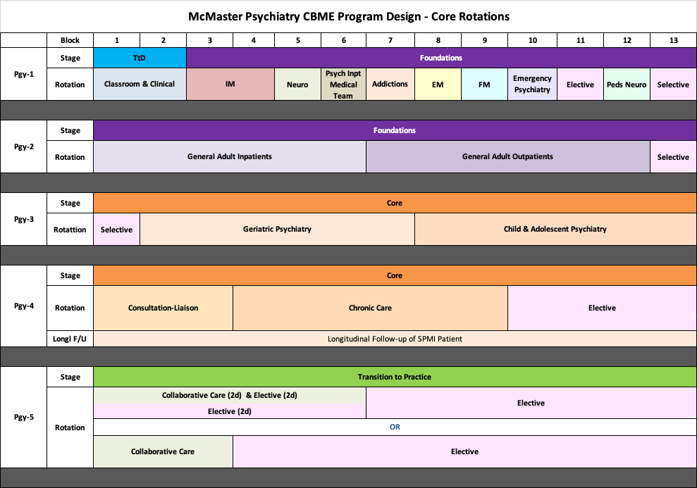

Notes:
This only shows the core rotations.
They will still be completing psychotherapy, Resident as Educator training, Call and have required scholarly projects. Those are not reflected in this diagram for simplicity, to focus on core rotations.
Note that the Soft Launch Cohort will remain on the Block System as they move through the years. Pgy1s have been on blocks for the last 8 years (i.e 13 four-week blocks, instead of months for Pgy2 to 5)
TtD = Transition to Discipline Stage of Training. Reviewed in the intro to CBME from last year. If not familiar or want a refresher/update for this year, after we review Pgy2, for those who want to stay on I will go back to review this.
New rotation in Pgy1 = Medical Team to Inpatient Psychiatry = working with the medical team that provides the medical care to psychiatry inpatients (Hamilton = West 5th; WRC = Homewood)
Pgy2: Note that Longitudinal f/u of SPMI patient has been moved from Pgy2 to Pgy4 for official CBME residents. (for residents of traditional program, it is in Pgy2)
Anchored Selective in Block 13 – because residents must have opportunities to work with “special populations” – Vulnerable, Marginalized Populations; Dual Dx, WHCC, Addictions, Forensics. So rather than doing longitudinally, going to try this as a block.
Pgy3: Also an anchored selective in Block 1, so in fact, have 2 months in a row of the selective with special populations
Pgy4: Remember, exam will be at the end of Pgy4. And, for CBME residents, Collaborative Care is recommended but not required. In our program, we feel experience with Collaborative Care is important, so moved Collaborative Care to Pgy5 and created 4 months of elective in Pgy4. Likely most residents will do telective through the exam time.
Pgy5: Minimum 3 blocks total of collaborative care (can be done as 3 blocks FT or 6 blocks PT combined with elective) + 10 more months of elective

Slide 42
CBME
Pgy2 & 3
Anchored Selective Options
Dual Diagnosis
Addictions
Forensics
ACT
Shelter Health
Women’s Health Concerns
Other
Schizophrenia Services
Indigenous Health
HIV Psychiatry

Slide 43

Soft Launch Cohort
2020-21 Pgy2 Residents
Modified Rotation Schedule & Doing EPAs
Notes:
For this cohort of residents, they must still meet the old requirements for their core requirements, etc, so we have modified their rotations to get them as close as possible to the CBME required training experiences while still meeting the ”former” requirements.
This cohort is also completing the Entrustable Professional Acts.

Slide 44
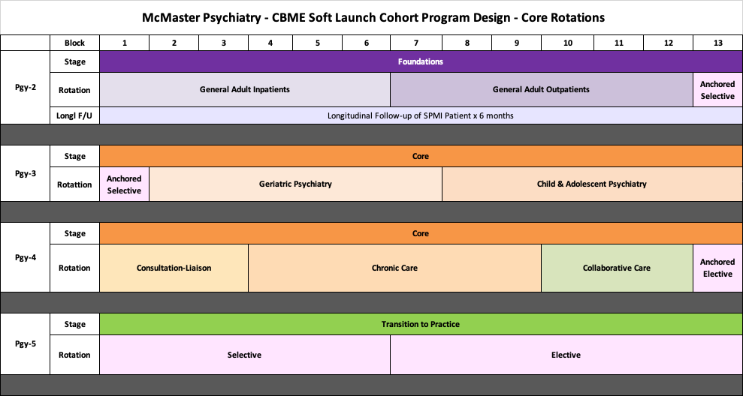

Slide 45

More Challenging Situations

Slide 46

What if…
The resident does not do well

Slide 47
What if…
The interview is not well nuanced.

Slide 48
What if…
You feel they didn’t double check enough, so you do.

Slide 49
What if…
Resident disagrees with your assessment

Slide 50
What if…
Patient presentation changes or is above resident skill level

Slide 51
What if…
Other situations you have encountered…

Slide 52
Still going to do…
ITARs
Mid-unit
End-unit
StACERs
Mid-unit
End-unit
RaEs using EPA C10
Pt/Family
Other

Slide 53
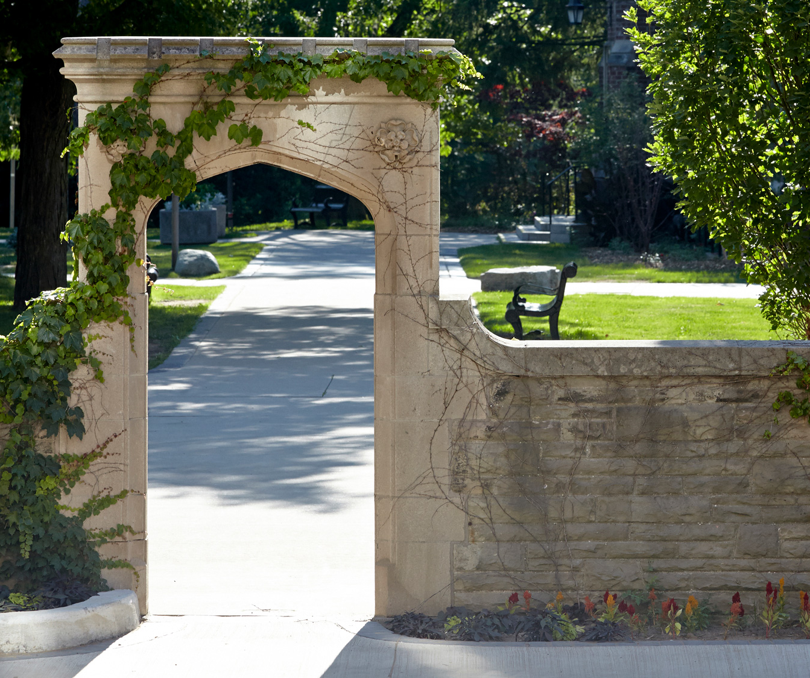
Transition to Discipline 2020

Slide 54
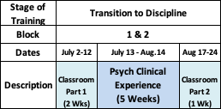
Official Launch - Pgy1s - July 2020

Slide 55

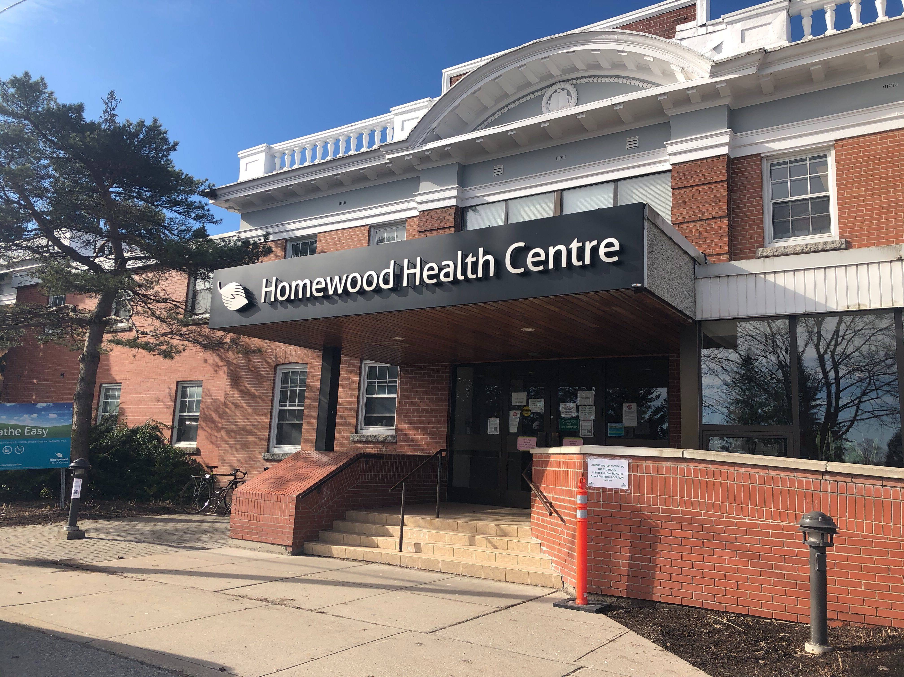
Transition to Discipline
Design of Clinical Experiences
Hamilton Campus
Waterloo Regional Campus
Inpt & Outpt experiences
One 3-week placement
One 2-week placement
½ day/ wk in PES
Begin call only after 2 PES day shifts
Adjustments to support them on call & to support new seniors
No post-call days away
4 weeks Inpatient experience
1 week Psych Emerg
3 On-Call shifts in Psych Emerg, buddied with senior, until 11pm
No On-Call Shifts during classroom weeks

Slide 56
Transition to Discipline
EPAs
EPA TtD-1
EPA TtD-2
Obtaining a psychiatric history to inform the preliminary diagnostic impression for patients presenting with mental disorders.
Communicating clinical encounters in oral and written/electronic form.
2 SUCCESSFUL observations
  2 different case types
2 SUCCESSFUL observations
  At least:
    1 written
    1 verbal
    1 must be of observed interview

Slide 57
RX-OC&D
OBSERVE
Indirect Observation
Review of products of the resident’s work
  clinical notes, presentations, written reflections
Observations from secondary sources
Direct Observation
Watching a resident doing work
  in real time or asynchronously (i.e. videotaped)
Notes:
Discussing specific learning goals and objectives, particularly as related to milestones, competencies and EPAs (Entrustable Professional Activities) that the resident is currently working toward, while considering the particular expectations of the clinical setting, will assure that both the resident and clinician have a shared understanding and agreement from the outset.
Again, this discussion need not take longer than a few minutes at the beginning of a clinic or a day or week working together.

Slide 58
RX-OC&D
CONVERSATION
Related to the task that was observed
To ensure the resident understands how improvements could be made
Notes:
Critical to the process is the dialogue that must occur between the clinician and the resident once the clinician has observed the resident or the resident’s work.
The purpose of this conversation is to ensure the resident understands how improvements could be made. This is “coaching feedback”.
This type of coaching conversation would happen, most often, after the particular work task was completed but still “in the moment” of that clinical experience.
In some instances, this feedback may be offered as the work is being done with the clinician providing real time coaching in the moment. This, of course, needs to be agreed upon by the resident and the clinician prior to the observation occurring and is dependent on the context.

Slide 59
RX-OC&D
DOCUMENT
Summarize feedback & actionable suggestions for improvement
It is important to document outlier performances because they could be rare but important
Notes:
A final but essential step to the CinM process is for the clinician to take a few minutes to document a summary of the coaching feedback dialogue that takes place (at least some of the time) in the resident portfolio.
Every coaching interaction might not be documented in clinical experiences of longer duration, but a representative sample of the observations during that clinical time period is essential. For short duration clinical experiences (i.e. a resident spending only one half day clinic with a particular staff clinician) the goal should be for at least one coaching conversation to be recorded. In some instances, more than one observation of work and coaching opportunity might occur in one clinic and could be documented.
It is not critical that the clinician know whether what was observed is a representative performance of a task for a particular learner. Documenting observations and suggestions for improvement, whether representative or an outlier execution of a task, helps create a comprehensive illustration of competence. Any one observation leading to Coaching in the Moment is not high stakes and will not lead to grave consequences, but is part of the process to support resident development and progress.
Whether or not a clinician documents an encounter does not restrict the resident from making their own record of the feedback and suggestions given, including their personal reflections on how it was helpful for and/or integrated into their practice performance.
DOCUMENT is the ‘D’ in RX-OCD

Slide 60
Questions?

