Slide 1
Introduction to CBME in Psychiatry Residency Training
For Supervisors of the Psychiatry Pgy-1
Adolescent Medicine Rotation
JoAnn Corey
Program Director
January 22, 2021

Slide 2
Design of the Pgy-1 Year
Notes:
There are the rotations the Psychiatry Pgy1s will do this year. So when each comes to you, they will have completed some combination of some of these.
TTD = transition to discipline, during which they practiced basic psychiatric assessments, interviewing and developing basic management plans.

Slide 3
Goals & Objectives of this Rotation
Notes:
Reference G&O Document

Slide 4
Goals & Objectives
Learn
Knowledge in understanding, assessing & initiating Tx of presentations commonly seen in Adolescent Medicine, including psychiatric presentations.
Experience
Gain experience in the assessment, investigation & treatment options for adolescents.
Appreciate
Gain appreciation for the work of those working with adolescents & develop an understanding of the collaboration that can occur between Adolescent Medicine and Psychiatry.

Slide 5
Assessment

Slide 6
CBME: Paradigm Shift
Assessment OF Learning
“Summative assessment”
Assessment FOR Learning (Observations)
“Formative assessment”
Embedded in learning process (frequent & ongoing)
Goal: judge/evaluate learning
At end of learning process
Low stakes, safe environment
High stakes
Goal: monitor progress & provide immediate feedback to improve (feedback loop)
Notes:
FACILITATOR TIP: This slide is illustrating a change in how we, residents and teachers, need to view and value observation and assessment. A shift in thinking to Assessment (Observation) FOR Learning is a big part of the change required for CBME to work. This is a paradigm shift that will take time.
To be truly successful, the CBD coaching model requires an important philosophical shift in thinking about assessment of residents and, particularly, the purpose of such assessment. In our current system, many of our commonly used assessment methods do not get at what a resident does on a typical clinical day. There needs to be more observation of residents doing their daily work, rather than performing in a “testing” environment/situation. Hence, the emphasis on Assessment FOR the purpose of Learning needs to be far greater than what currently exists. In other words, assessments (or observations) identify opportunities for learning.
Within a mindset of Assessment OF Learning (summative assessment), the predominant purpose for assessment is that of a judgement or evaluation of what a resident knows or can do at that particular instant in time (or sometimes even a judgement of what the resident doesn’t know or can’t do). This can create unease for the resident and often puts them in a position of performing – doing what they believe is on “a checklist” as opposed to doing what they would normally do, as they felt appropriate, in the real clinical environment.
With a shift in mindset, to the framing of Assessment FOR Learning (formative assessment), the purpose of assessment is to be part of a process to guide the resident to what they can do to improve their current understanding or practice. Formative assessment is lower stakes, frequent and ongoing and is embedded throughout the learning process rather than at the end. The goal is to monitor learning and provide immediate feedback that can be used to improve both teaching and learning and subsequent resident performance, thereby promoting a growth mindset.

Slide 7
Assessments for this Rotation
End of Rotation Evaluation = In-Training Assessment Report (ITAR)
Competency Evaluations (EPAs)
Notes:
ITARs – same as previous
Competency Evaluations – new component. (now, our Pgy1s last year, were doing these as part of a soft launch)

Slide 8
During each stage of training there will be defined Competencies (i.e. knowledge & skills) that a resident must acquire

Slide 9
Entrustable Professional Activities (EPAs)
These competencies are called

Slide 10
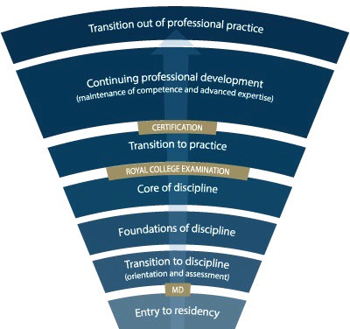
Stages of Training
PGY-5
PGY-4
PGY-3
PGY-2
Ad Med Rotation
PGY-1
Notes:
-Royal College outlines what needs to be accomplished within each Stage of training and give a range of time for min & max duration of that stage
-Programs will then decide the duration of each stage (within the RC parameters) and what rotations will be included in each stage
-RC is also going to outline what skills & knowledge must be accomplished by a resident before they are to be allowed to progress to the next stage of training. Those required skills & knowledge are packaged into what is called the EPAs and Milestones (which I will explain in a minute)
-Programs then map which EPAs should be accomplished in which rotations for their residents

Slide 11
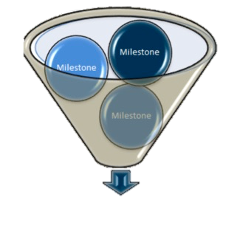
The Royal College has defined which EPAs a resident must acquire before they can advance to the next Stage of Training.
Transition to Practice
Core of Discipline
Foundations of Discipline
Transition to Discipline

Slide 12
How will this work?

Slide 13
Assessing, diagnosing & participating in the management of Medical Presentations relevant to Psychiatry.
EPA F-1
Notes:
We will use this EPA as an example to work from.

Slide 14
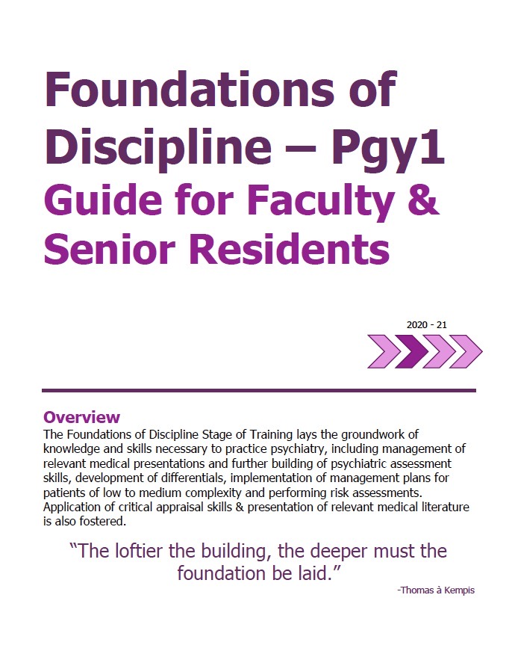
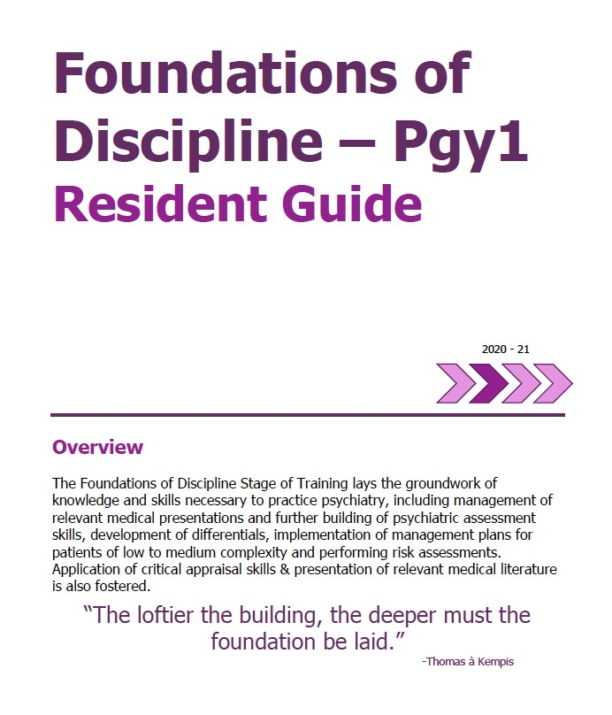
Plans their learning
Views Curriculum Map
Know what EPAs working on
Develops a Personal Learning Plan
Supervisor
Resident
Sets Objectives for Rotation
Based on Curriculum Map
Based on Personal Learning Plan
Supported by technology
Notes:
Residents have been provided with curriculum maps indicating which EPAs are of likely high yield on each rotion.
They have also been given orientation guides.
Supervisors and residents should discuss at the beginning of the rotation, their personal learning objectives as well as the goals of the rotation and the EPAs at are of likely high yield in that clinical environment.

Slide 15
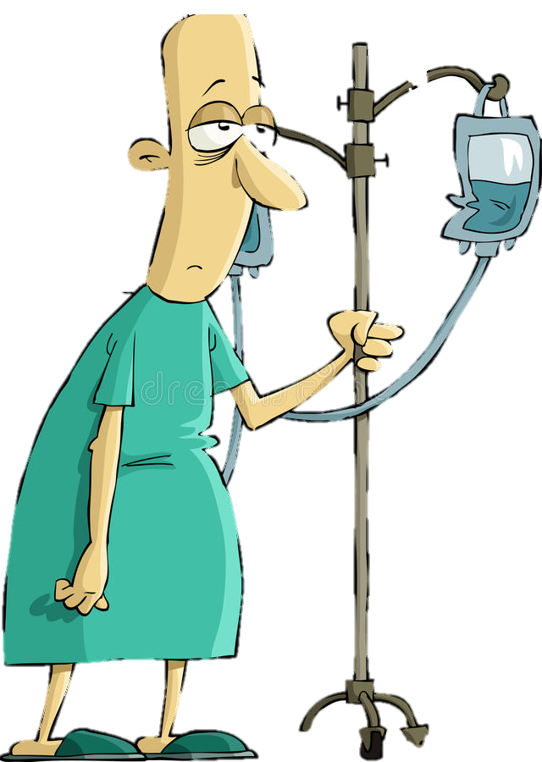
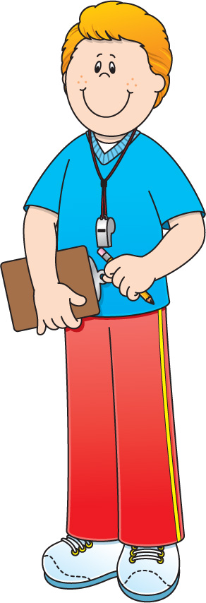
Program
Director
Academic
Coach
Competence Committee
Regional
Education Lead
Notes:
Resident and faculty identify an opportunity for an EPA assessment. Supervisor might review expectations and remind resident of feedback to build on from a previous encounter.
Resident goes to do the EPA activity. Supervisor supervises either directly or indirectly depending on the EPA
Supervisor provides verbal feedback to the resident, giving 1 or 2 specific, actionable pieces of feedback
Supervisor documents the assessment on MedSIS.
They cycle repeats itself, resulting in multiple assessments of the same EPA over time, by different observers.
These get collated on MedSIS, with the data being available to the resident, the Program Director, the REL, the resident’s academic coach and the Competence Committee (formerly the Evaluation Committee)
It is the Competence Committee that makes decisions around progression, promotion

Slide 16
Assessment of EPAs
Aiming for 2 – 3 EPA assessments a week, between daytime rotation & on-call experiences

Slide 17
CBME Assessment Form
EPAs will be assessed using a

Slide 18
CBME Assessment Form
Notes:
Top portion will be filled in automatically by MedSIS
Select the contextual variables from the drop down screens

Slide 19
Assessing, diagnosing & participating in the management of Medical Presentations relevant to Psychiatry.
EPA F-1
8 Observations of Achievement
At least:
2 Medical Emergencies
1 Substance Intoxication
1 OD &/or Withdrawal
1 Neuropsychiatric Presentation
1 Endocrine or Metabolic Disorder
4 Different Observers
3 by Supervising Staff MD
Notes:
Contextual variables can be seen here.
The resident, REL, PD, Academic Coach and Competence Committee track resident’s progress with each contextual variable – not the supervisor. But good for supervisor to have awareness of contextual variables so they can flag to resident if such a situation arises.
EPAs should be assessed even outside of those contextual variables listed – these are only the minimum.
N

Slide 20
CBME Assessment Form
Notes:
Back to the assessment form:
Middle section is the Entrustment Scale

Slide 21
Entrustment Scale
Resident demonstrates sound knowledge & skill but needed help with unexpected challenges. A few things you needed to f/u on. No significant concerns.
Learner required
constant direction
1 | 2 | 3 | 4 | 5
I had to do. | I had to talk them through. | I needed to prompt. | I had to provide minor direction. | No direction required for safe, indpt care.
Learner didn’t do task or
Needed complete hands on guidance
Some independence but required intermittent direction
Complete independence. Understands risks. Performs safely. Practice ready.
**If any concerns with risk assessment or safety, should not score above 3.
Notes:
Level 1 – the supervisor had to perform the clinical activity while the resident observed. This may apply if resident has never done the task before, or they started but situation became too challenging so supervisor elected to complete the task. Ideally, the supervisor would provide direction and teaching afterwards.
Level 2 – self-explanatory
Level 3 – The resident required frequent direction, requiring occasional prompting and guidance, particularly with more complex aspects of the encounter OR the encounter required supervisor to follow-up on a number of important aspects not completed by the resident
Level 4 – Previously “I needed to be there just in case”. Now Changed to: “I had to provide minor direction.“ Resident demonstrates sound technique but you were not confident that their knowledge base or skill was sufficient to ensure that if they had run into an unexpected challenge or complication, they would have been able to manage this. Examples might include: when you posed questions as to how they would handle a complication of the situation, they were not able to explain; they completed the assessment adequately but there were nuances that made it more akward or less effective; resident completed the assessment thoroughly but it took them a much longer than normal time.
Level 5: Previously”I did not need to be there”. Now changed to: “I did not need to provide direction for safe, independent care” or “No direction required for safe, independent care”. Resident able to complete all aspects of the assessment independently and safely including troubleshooting unexpected challenges; completed in sufficient time frame (may not have been as fast as experienced staff person). Any teaching you provided was more to enrich a competenct knowledge base. Any prompts given were not necessary for resident to complete the task safely and independently.

Slide 22
Assessment of EPAs
Complete EPA Assessment even if task rated less than a 4 or 5, to promote knowledge & skill development
it may take 2-3 attempts before a resident achieves a successful assessment.
A Score of
4 or 5
Is considered an "Observation of Achievement”

Slide 23
CBME Assessment Form
Notes:
Milestones – again, just a guide. There is no algorithm for how many milestones = entrustment score
Then the most important section – area for feedback.
Please give the resident 1 or 2 specific, actionable items to work on. These could be homework, items to look up or things to do in next interview

Slide 24
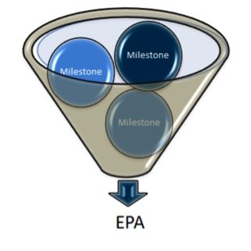
Developmental Milestones
EPAs can be broken down into smaller, component parts called
Notes:
Milestones can be seen in the write up of each EPA as provided in the accompanying reference documents.
The milestones are not an exhaustive list but a guide for faculty and for residents as to some of the important component parts.
When assessing a resident and giving feedback, still trust your clinical and educational expertise – if there is something you feel was important to note to the resident, that was not listed as a milestone, please do so. The milestones are not an exhaustive list.

Slide 25
CBME Assessment Form
Notes:
Milestones – again, just a guide. There is no algorithm for how many milestones = entrustment score
Then the most important section – area for feedback.
Please give the resident 1 or 2 specific, actionable items to work on. These could be homework, items to look up or things to do in next interview

Slide 26
FEEDBACK
COACHING FEEDBACK
Coaching Feedback
Feedback
Observation of Work
Focuses on what has already occurred
Can increase self-awareness
Emphasis on external insight about what occurred
Focus is the learning potential
Provides guidance to improve future practice
Emphasis on specific, actionable advice to strengthen a competency

Slide 27
EPAs of High Likelihood during Pgy-1 Adolescent Medicine Rotation

Slide 28
Performing psychiatric assessments and providing differential diagnoses & management plans for Children and Youth.
6 Observations of Achievement
At least:
1 mood disorder, anxiety disorder, or OCD
1 ADHD
1 abuse, neglect, or trauma
1 intellectual disability/ASD comorbidity
2 children 4 – 12 years
4 direct observations with review of document’n
3 different observers
2 adolescents 13 - 18 years
2 by child & adolescent psychiatrist
EPA C-2

Slide 29
Assessing, diagnosing & participating in the management of Medical Presentations relevant to Psychiatry.
EPA F-1
8 Observations of Achievement
At least:
2 Medical Emergencies
1 Substance Intoxication
1 OD &/or Withdrawal
1 Neuropsychiatric Presentation
1 Endocrine or Metabolic Disorder
4 Different Observers
3 by Supervising Staff MD

Slide 30
Performing Psychiatric Assessments referencing a biopsychosocial approach & developing basic DDx for patients with mental disorders.
EPA F-2
6 Observations of Achievement
At least:
1 Emergency Setting
2 Inpatient Settings
2 Outpatient Settings
3 Different Case Types

Slide 31
Developing & implementing Management Plans for patients with psychiatric presentations of low to medium complexity.
EPA F-3
6 Observations of Achievement
At least:
1 Mood Disorder
1 Psychotic Disorder
1 Personality Disorder
1 Substance Use Disorder
1 Anxiety or Trauma or OCD

Slide 32
Additional EPAs that May Come Up

Slide 33
Performing Risk Assessments that inform the development of an acute safety plan for patients posing risk of harm to self or others.
EPA F-4
5 Observations of Achievement
At least:
1 with Non-Suicidal Self-Injury
1 with Active Suicidal Ideation or Behaviour
1 with Active Homicidal / Violent Ideation or Behaviour
3 by Psychiatrist Observers
3 Different Observers

Slide 34
EPA F-5
Performing Critical Appraisal and presenting psychiatric literature.
Notes:
This could include presenting an article to the treatment team, inspired by a clinical case. Does not have to be a large scale rounds.

Slide 35
EPA C-8
Integrating the principles & skills of Psychopharmacology into patient care.
12 Observations of Achievement
At least:
1 starting & monitoring LAI
1 starting & monitoring Oral Antipsychotic
2 starting & monitoring 2 different classes Antidepressants
1 starting & monitoring Sedative / Hypnotic
1 starting and/or monitoring Lithium
1 starting and/or monitoring Clozapine
1 managing Benzodiazepine
1 managing Opioid Agonist Therapy
1 Mood Stabilizer Other Than Lithium
12 Observations of Achievement
1 agent to treat Mx-induced SEs
1 patient on multiple psychiatric medications
2 patients in C/L setting
2 Child/Adolescent including starting & managing 1 stimulant
2 Older Adults, including 1 w cognitive enhancer
1 Pregnant or Breastfeeding patient
5 Different Observers
3 by Psychiatrist Observers
Notes:
Just to be aware of this one

Slide 36
Applying relevant Legislation & Legal Principles to patient care and clinical practice.
EPA C-9
6 Observations of Achievement
At least:
2 Capacity to Consent to Tx in Complex Patients.
2 Restricting/Limiting Rights with Due Process Protections
1 Evaluation for Restrictions/Limitations re: Disability
1 Mandatory or Discretionary Reporting

Slide 37
Questions?

Slide 38
Thank you for Working with our Residents!

Slide 39
Extra Slides

Slide 40
Performing Risk Assessments that inform the development of an acute safety plan for patients posing risk of harm to self or others.
EPA F-4
5 Observations of Achievement
At least:
1 Non-suicidal self-injury
1 Active SI or Suicidal Behaviour
1 Active HI or Violent Ideation/Behaviour

