Slide 1

CBME Requirements for the Pgy2 Year
What you need to know for the Soft Launch of CBME in
General Inpatients, General Outpatients & Emergency Psychiatry
JoAnn Corey
Program Director &
CBME Lead
Spring 2020

Slide 2

Participant Particulars
This Photo by Unknown Author is licensed under CC BY-SA
Notes:
In order to know who is in the audience, going to start with just a few questions.
The responses are anonymous and will be collated, so please answer honestly. I will not be able to see what you answered
Read the question
Give instructions on how they complete the poll.
Show the responses

Slide 3
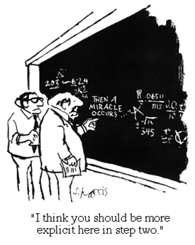
Notes:
CBME may have felt like a mystery to you.
It did to me when I first heard about it.
It still may feel like a mystery to some.

Slide 4
Quick Review of CBME on the Ground Basics
EPAs relevant to the Pgy2 Year
New CBME Program Design
Transition to Discipline Design & EPAs

Slide 5



Many things still the same…
ITARs
Scholarly Projects
Psychotherapy
StACERs
CQI Project
Grand Rounds
Poster presentation
Longitudinal training
Reduced # Modules
Mid- & end- rotation

Slide 6

Still have defined rotations

Slide 7
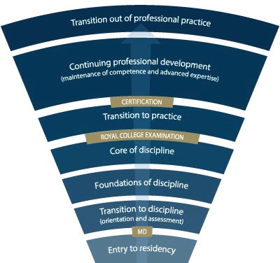
Competence Continuum
-Stages of Training-
PGY-5
PGY-4
PGY-3
PGY-2
PGY-1
Notes:
-Royal College outlines what needs to be accomplished within each Stage of training and give a range of time for min & max duration of that stage
-Programs will then decide the duration of each stage (within the RC parameters) and what rotations will be included in each stage
-RC is also going to outline what skills & knowledge must be accomplished by a resident before they are to be allowed to progress to the next stage of training. Those required skills & knowledge are packaged into what is called the EPAs and Milestones (which I will explain in a minute)
-Programs then map which EPAs should be accomplished in which rotations for their residents

Slide 8


Key Points
Residents will progress thro’
Stages of Training
along the Competence Continuum.
There will be defined
Required Training Experiences
in each stage of training.
Its all about Feedback & Assessment
Quality
Acceptance & Incorporation

Slide 9

During each stage of training there will be defined Competencies
(i.e. knowledge & skills) that a resident must acquire

Slide 10
Entrustable
Professional
Activities (EPAs)
These competencies are called

Slide 11
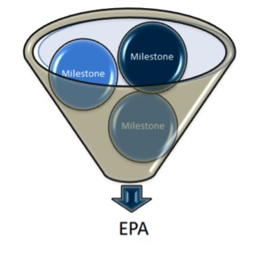
Developmental
Milestones
EPAs can be broken down into smaller, component parts called

Slide 12
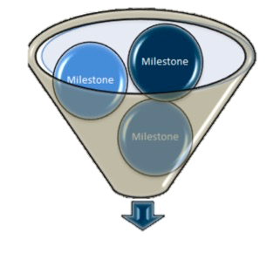
The Royal College has defined which EPAs a resident must acquire before they can advance to the next Stage of Training.
Transition to Practice
Core of Discipline
Foundations of Discipline
Transition to Discipline

Slide 13


Audience
Check-in

Slide 14

How will this work?

Slide 15
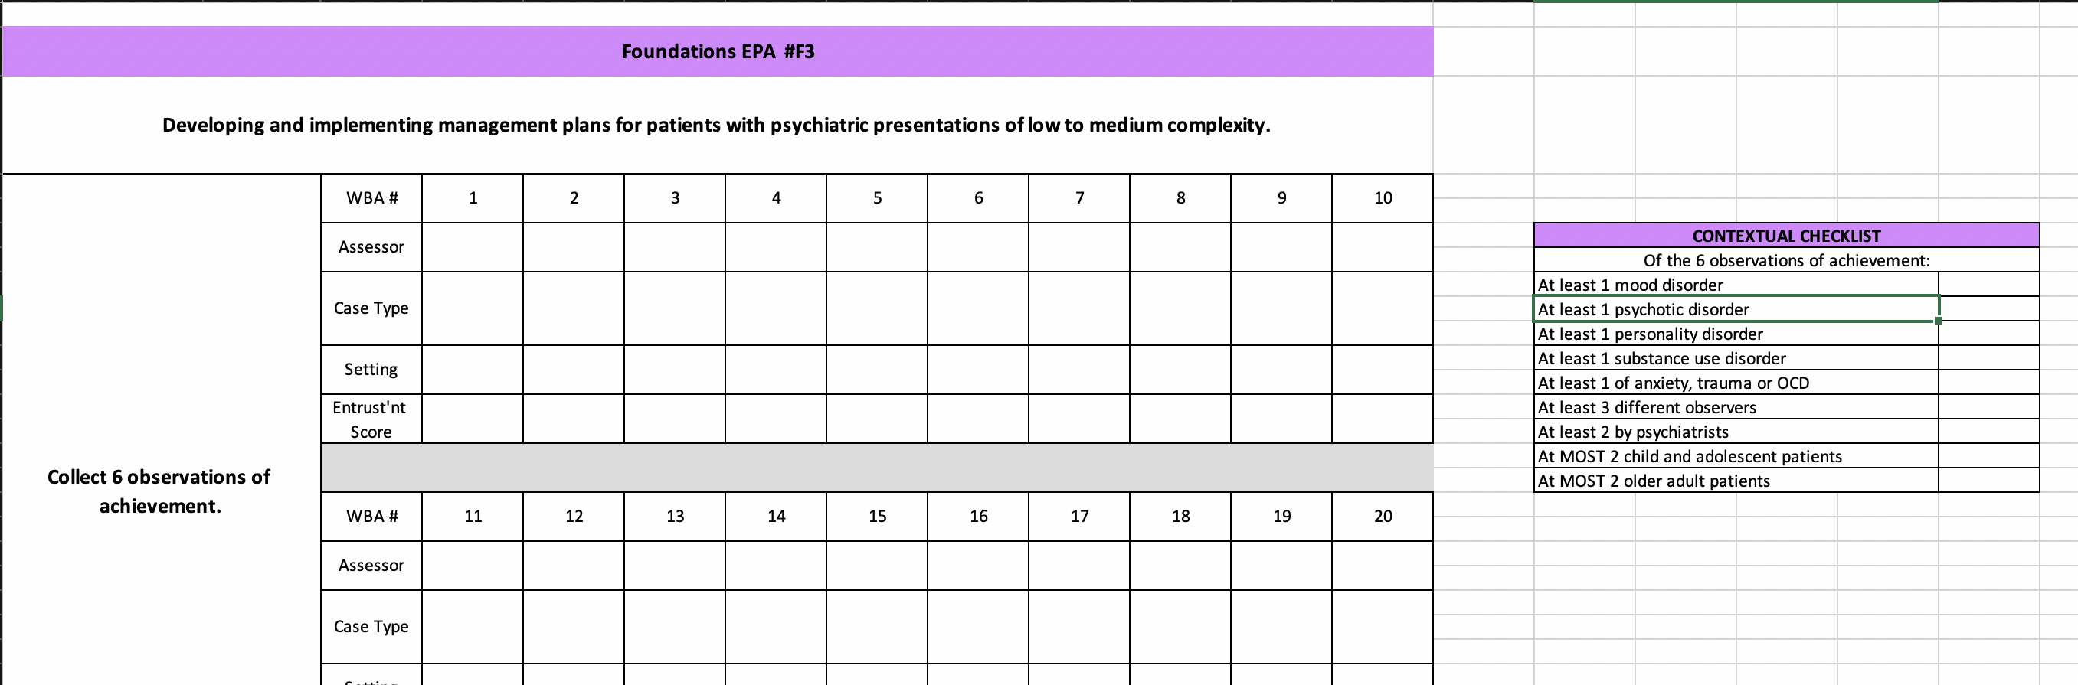
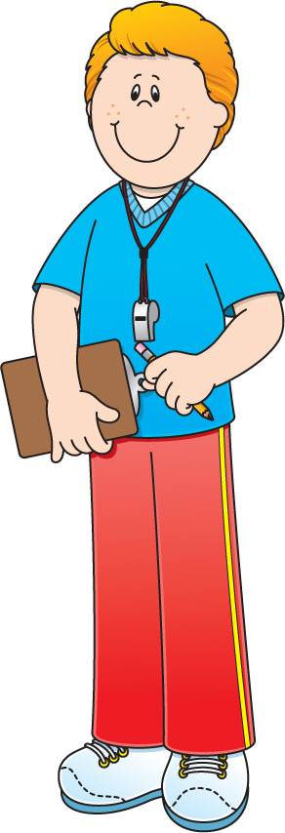

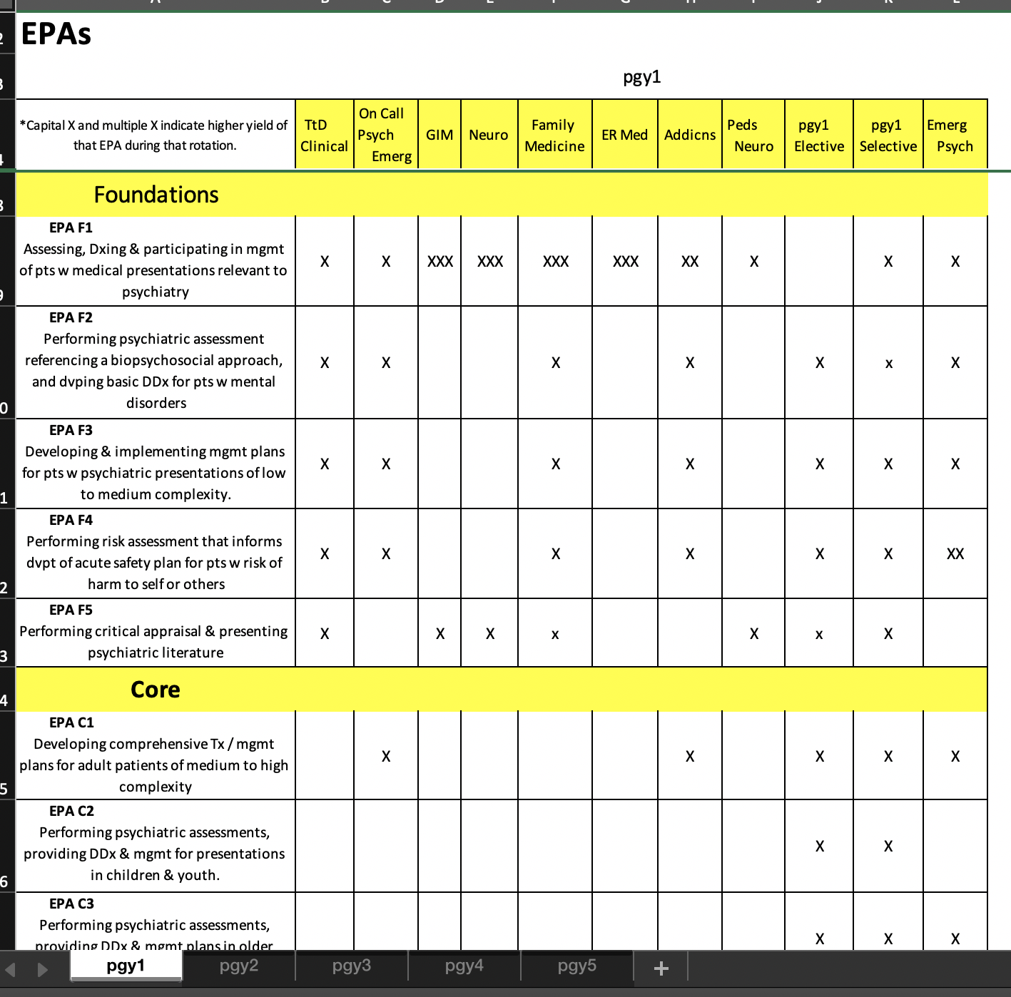
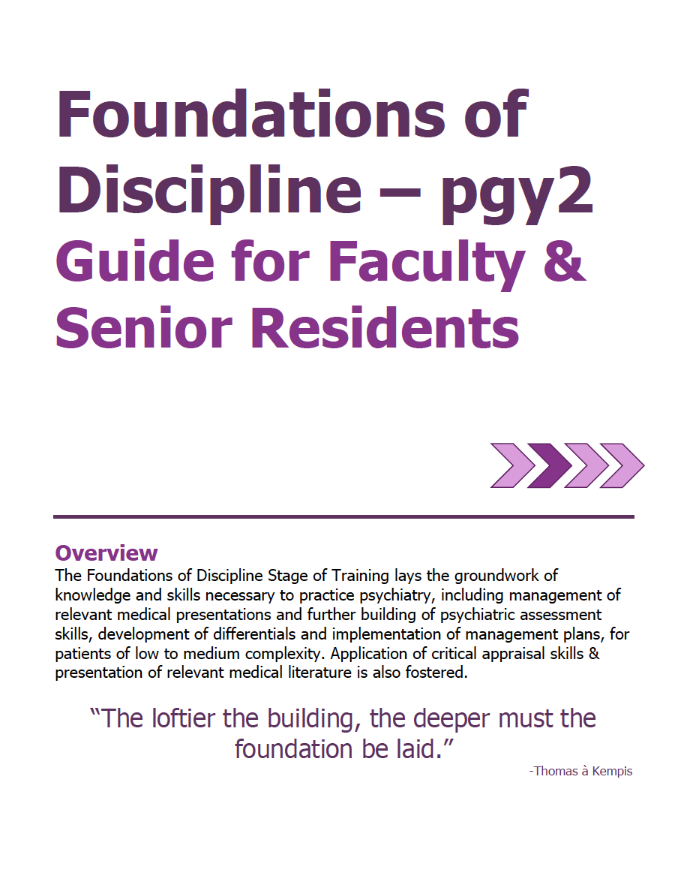

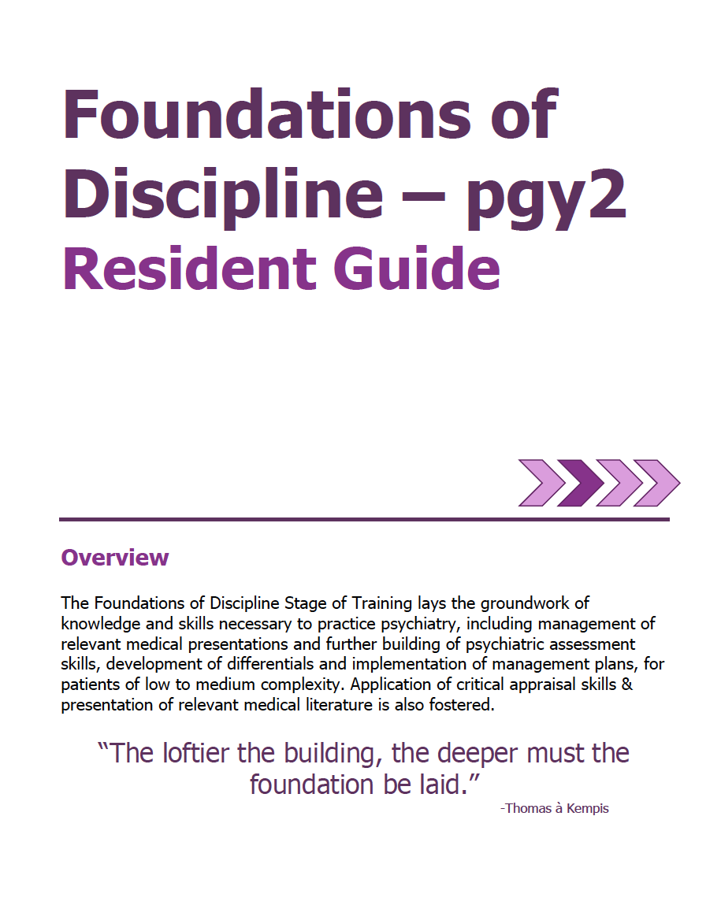


Academic Coach
Plans their learning
Views Curriculum Map
Know what EPAs working on
Develops a Personal Learning Plan
Supervisor
Resident
Sets Objectives for Rotation
Based on Curriculum Map
Based on Personal Learning Plan
Supported
by technology

Slide 16
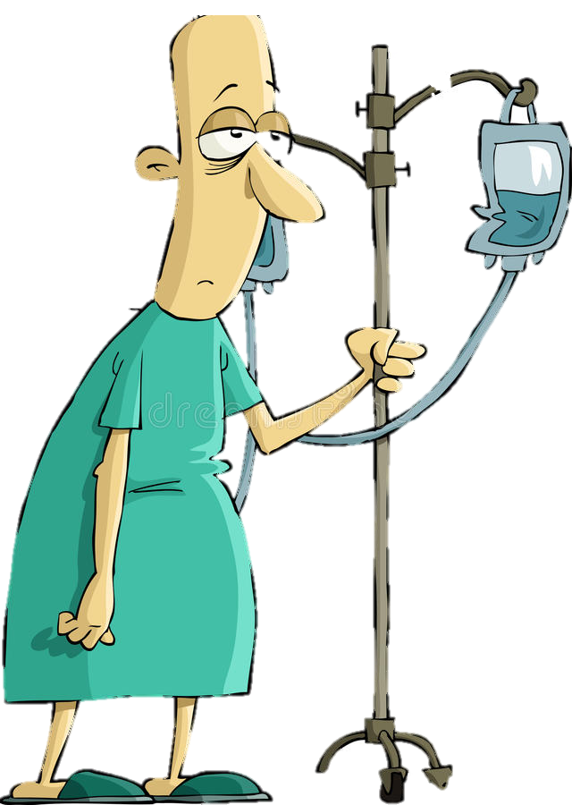


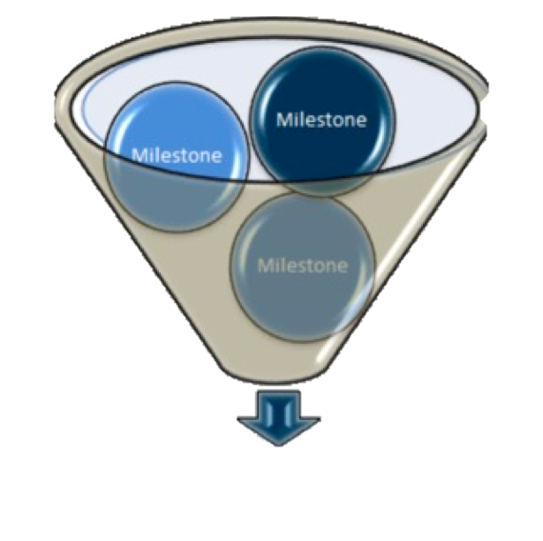





Program
Director
Academic
Coach
Competence Committee
Regional
Education Lead
Notes:
Resident and faculty identify an opportunity for an EPA assessment. Supervisor might review expectations and remind resident of feedback to build on from a previous encounter.
Resident goes to do the EPA activity. Supervisor supervises either directly or indirectly depending on the EPA
Supervisor provides verbal feedback to the resident, giving 1 or 2 specific, actionable pieces of feedback
Supervisor documents the assessment on MedSIS.
They cycle repeats itself, resulting in multiple assessments of the same EPA over time, by different observers.
These get collated on MedSIS, with the data being available to the resident, the Program Director, the REL, the resident’s academic coach and the Competence Committee (formerly the Evaluation Committee)
It is the Competence Committee that makes decisions around progression, promotion

Slide 17

Assessment of EPAs
Aiming for 2 – 3 EPA assessments a week, between daytime rotation & on-call experiences

Slide 18
Audience
Check-in

Slide 19

CBME
Assessment
Form
EPAs will be assessed using a

Slide 20
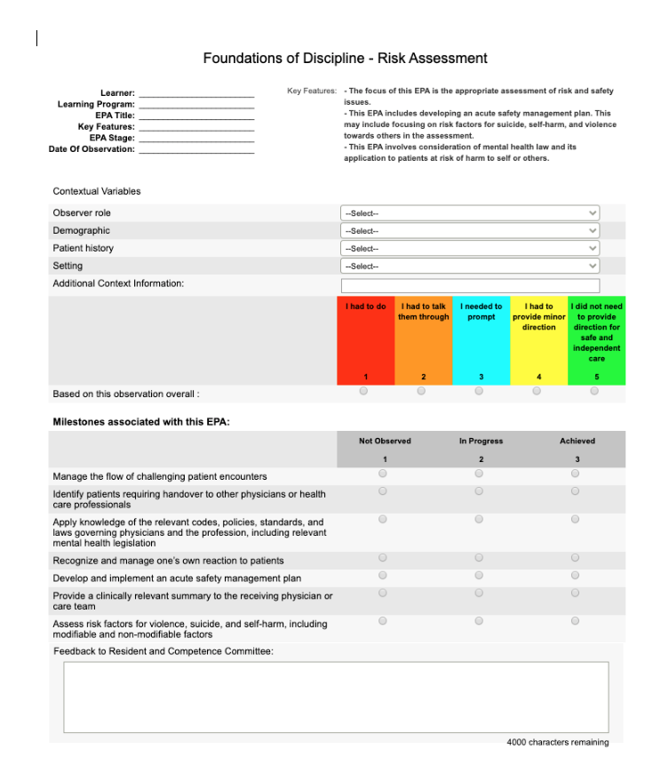
Work-Based
Assessment
(WBA)

Slide 21
Entrustment
Scale
Resident demonstrates sound knowledge & skill but needed help with unexpected challenges. A few things you needed to f/u on. No significant concerns.
Learner required
constant direction
1 | 2 | 3 | 4 | 5
I had to do. | I had to talk them through. | I needed to prompt. | I had to provide minor direction. | No direction required for safe, indpt care.
Learner didn’t do task or
Needed complete hands on guidance
Some independence but required intermittent direction
Complete independence. Understands risks. Performs safely. Practice ready.
**If any concerns with risk assessment or safety, should not score above 3.
Notes:
Level 1 – the supervisor had to perform the clinical activity while the resident observed. This may apply if resident has never done the task before, or they started but situation became too challenging so supervisor elected to complete the task. Ideally, the supervisor would provide direction and teaching afterwards.
Level 2 – self-explanatory
Level 3 – The resident required frequent direction, requiring occasional prompting and guidance, particularly with more complex aspects of the encounter OR the encounter required supervisor to follow-up on a number of important aspects not completed by the resident
Level 4 – Previously “I needed to be there just in case”. Now Changed to: “I had to provide minor direction.“ Resident demonstrates sound technique but you were not confident that their knowledge base or skill was sufficient to ensure that if they had run into an unexpected challenge or complication, they would have been able to manage this. Examples might include: when you posed questions as to how they would handle a complication of the situation, they were not able to explain; they completed the assessment adequately but there were nuances that made it more akward or less effective; resident completed the assessment thoroughly but it took them a much longer than normal time.
Level 5: Previously”I did not need to be there”. Now changed to: “I did not need to provide direction for safe, independent care” or “No direction required for safe, independent care”. Resident able to complete all aspects of the assessment independently and safely including troubleshooting unexpected challenges; completed in sufficient time frame (may not have been as fast as experienced staff person). Any teaching you provided was more to enrich a competenct knowledge base. Any prompts given were not necessary for resident to complete the task safely and independently.

Slide 22
Work-Based
Assessment
(WBA)

Slide 23
Assessment of EPAs
may involve direct or indirect observation
Complete WBAs even if task rated less than a 4 or 5, to promote knowledge & skill development
it may take 2-3 attempts before a resident achieves a successful assessment.

Slide 24
Audience
Check-in

Slide 25
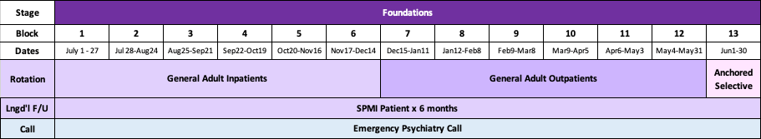
Core Clinical Rotations for Soft Launch Cohort Pgy-2 Year

Slide 26

EPAs during Pgy2 Year

Slide 27

Foundations EPAs
Notes:
Here are the EPAs that residents must complete by the end of the Foundations of Discipline Stage of Training. Ie. by the end of Pgy2
There are five EPAs that must be achieved during the Foundations Stage of training
Remember – Foundations runs through 2/3 of Pgy1 and all of Pgy2
They must successfully complete all 5 of them by the end of Pgy2

Slide 28

Assessing, diagnosing & participating in the management of Medical Presentations relevant to Psychiatry.
EPA F-1
8 Observations of Achievement
At least:
2 Medical Emergencies
1 Substance Intoxication
1 OD &/or Withdrawal
1 Neuropsychiatric Presentation
1 Endocrine or Metabolic Disorder
4 Different Observers
3 by Supervising Staff MD
Notes:
Many of the residents will have fully completed this EPA by the end of Pgy1
Due to the pandemic, depending on the timing of some of their rotations such as GIM, FM and Neurology, some of our residents have not yet completed this EPA this year.

Slide 29

Performing Psychiatric Assessments referencing a biopsychosocial approach & developing basic DDx for patients with mental disorders.
EPA F-2
6 Observations of Achievement
At least:
1 Emergency Setting
2 Inpatient Settings
2 Outpatient Settings
3 Different Case Types
2 by Psychiatrist Observer
3 Different Observers
At most:
2 Child/Adolescent Patients
2 Older Adult patients

Slide 30

Developing & implementing Management Plans for patients with psychiatric presentations of low to medium complexity.
EPA F-3
6 Observations of Achievement
At least:
1 Mood Disorder
1 Psychotic Disorder
1 Personality Disorder
1 Substance Use Disorder
1 Anxiety or Trauma or OCD
3 Different Observers
2 by Psychiatrist Observers
At most:
2 Child/Adolescent Patients
2 Older Adult Patients

Slide 31

Performing Risk Assessments that inform the development of an acute safety plan for patients posing risk of harm to self or others.
EPA F-4
5 Observations of Achievement
At least:
1 with Non-Suicidal Self-Injury
1 with Active Suicidal Ideation or Behaviour
1 with Active Homicidal / Violent Ideation or Behaviour
3 by Psychiatrist Observers
3 Different Observers

Slide 32

Performing Critical Appraisal and presenting psychiatric literature.
EPA F-5
2 Observations of Achievement
At least:
2 Different Observers

Slide 33
Audience
Check-in

Slide 34

What if…?
The resident does not do well

Slide 35
What if…?
Patient presentation is not in line with the EPA task

Slide 36
What if…?
Patient presentation changes or is above resident skill level

Slide 37
The Royal College has defined which EPAs a resident must acquire before they can advance to the next Stage of Training.
Transition to Practice
Core of Discipline
Foundations of Discipline
Transition to Discipline

Slide 38

Core of Discipline EPAs

Slide 39





High Yield
Core EPAs during Pgy-2:
C8
(psychopharmacology)
C9
(legislation)
C10
(teaching others)
C7:
(neurostimulation)
C5:
(emergent situations)

Slide 40

Identifying, assessing, and managing Emergent Situations in psychiatric care across the lifespan.
EPA C-5
8 Observations of Achievement
At least:
2 patients with acute agitation & aggression
2 patients with active suicidal ideation
1 patient with homicidal/violent ideation or risk of harm to others
2 patients with medical emergencies related to delirium
1 patient with acute dystonic reaction, catatonia, serotonin syndrome or NMS
3 by psychiatrist / psychiatric subspecialist

Slide 41

Integrating the principles & skills of Neurostimulation into patient care.
EPA C-7
Part A: Suitability for Neurostimulation
3 Observations of Achievement:
1 older adult
1 adult
At least:
2 for ECT
Part B: Delivery of Neurostimulation
3 Observations of Achievement:
At least:
2 for ECT

Slide 42

EPA C-8
Integrating the principles & skills of Psychopharmacology into patient care.
12 Observations of Achievement
At least:
1 starting & monitoring LAI
1 starting & monitoring Oral Antipsychotic
2 starting & monitoring 2 different classes Antidepressants
1 starting & monitoring Sedative / Hypnotic
1 starting and/or monitoring Lithium
1 starting and/or monitoring Clozapine
1 managing Benzodiazepine
1 managing Opioid Agonist Therapy
1 Mood Stabilizer Other Than Lithium
12 Observations of Achievement
1 agent to treat Mx-induced SEs
1 patient on multiple psychiatric medications
2 patients in C/L setting
2 Child/Adolescent including starting & managing 1 stimulant
2 Older Adults, including 1 w cognitive enhancer
1 Pregnant or Breastfeeding patient
5 Different Observers
3 by Psychiatrist Observers

Slide 43

Applying relevant Legislation & Legal Principles to patient care and clinical practice.
EPA C-9
6 Observations of Achievement
At least:
2 Capacity to Consent to Tx in Complex Patients.
2 Restricting/Limiting Rights with Due Process Protections
1 Evaluation for Restrictions/Limitations re: Disability
1 Mandatory or Discretionary Reporting
4 by Psychiatrists
2 Different Psychiatrist Observers

Slide 44

Providing Teaching for students, residents, the public and other health care professionals.
EPA C-10
4 Observations of Achievement
At least:
2 Different Audiences
2 Different Psychiatrist Observers
Soft Launch Residents use EPA C10
to assess Resident as Educator activities

Slide 45
Audience
Check-in

Slide 46

Key Points
This Photo by Unknown Author is licensed under CC BY-NC-ND

Slide 47
Still going to do…
ITARs
Mid-unit
End-unit
StACERs
Mid-unit
End-unit
RaEs using EPA C10
Pt/Family
Other

Slide 48






Key Points
Need to achieve the 5 Foundations EPAs by the end of the Foundations Stage of Training
F1: Medical Presentations Relevant to Psych
F2: Ass’t & DDx; low to medium complexity
F3: Mgmt Plans; low to medium complexity
F4: Risk Assts & Safety Plans
F5: Critical Appraisal of Psych Literature

Slide 49






Key Points
C8: Psychopharmacology
C9: Legislation
C10: Teaching others
C5: Emergency Situations
C7: Neurostimulation
May work ahead on EPAs listed for Core Stage of Training
(but focus on Foundations EPAs)

Slide 50
Key Points
Its all about regular assessment & feedback day to day.
Quality
Acceptance & Incorporation

Slide 51
Questions?

Slide 52




Official CBME Launch
July 1, 2020
Incoming Pgy1 Cohort

Slide 53
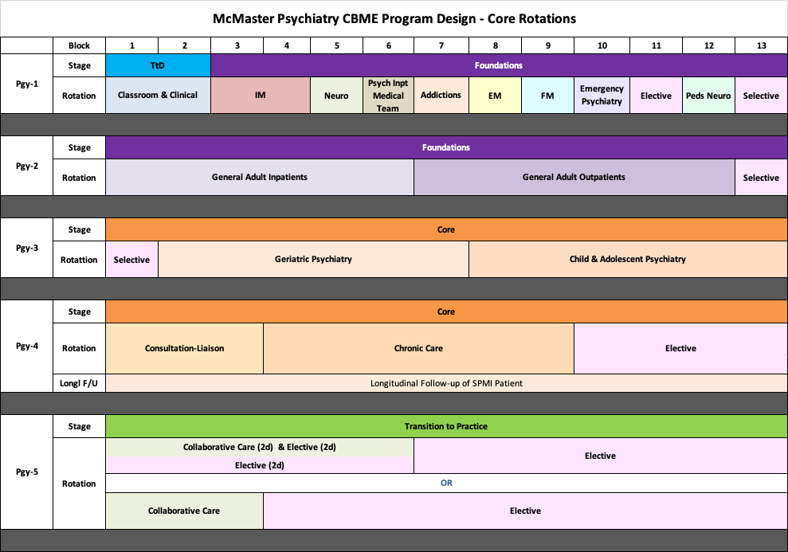
Notes:
This only shows the core rotations.
They will still be completing psychotherapy, Resident as Educator training, Call and have required scholarly projects. Those are not reflected in this diagram for simplicity, to focus on core rotations.
Note that the Soft Launch Cohort will remain on the Block System as they move through the years. Pgy1s have been on blocks for the last 8 years (i.e 13 four-week blocks, instead of months for Pgy2 to 5)
TtD = Transition to Discipline Stage of Training. Reviewed in the intro to CBME from last year. If not familiar or want a refresher/update for this year, after we review Pgy2, for those who want to stay on I will go back to review this.
New rotation in Pgy1 = Medical Team to Inpatient Psychiatry = working with the medical team that provides the medical care to psychiatry inpatients (Hamilton = West 5th; WRC = Homewood)
Pgy2: Note that Longitudinal f/u of SPMI patient has been moved from Pgy2 to Pgy4 for official CBME residents. (for residents of traditional program, it is in Pgy2)
Anchored Selective in Block 13 – because residents must have opportunities to work with “special populations” – Vulnerable, Marginalized Populations; Dual Dx, WHCC, Addictions, Forensics. So rather than doing longitudinally, going to try this as a block.
Pgy3: Also an anchored selective in Block 1, so in fact, have 2 months in a row of the selective with special populations
Pgy4: Remember, exam will be at the end of Pgy4. And, for CBME residents, Collaborative Care is recommended but not required. In our program, we feel experience with Collaborative Care is important, so moved Collaborative Care to Pgy5 and created 4 months of elective in Pgy4. Likely most residents will do telective through the exam time.
Pgy5: Minimum 3 blocks total of collaborative care (can be done as 3 blocks FT or 6 blocks PT combined with elective) + 10 more months of elective

Slide 54
CBME
Pgy2 & 3
Anchored Selective Options
Dual Diagnosis
Addictions
Forensics
ACT
Shelter Health
Women’s Health Concerns
Other
Schizophrenia Services
Indigenous Health
HIV Psychiatry

Slide 55

Notes:
This only shows the core rotations.
They will still be completing psychotherapy, Resident as Educator training, Call and have required scholarly projects. Those are not reflected in this diagram for simplicity, to focus on core rotations.
Note that the Soft Launch Cohort will remain on the Block System as they move through the years. Pgy1s have been on blocks for the last 8 years (i.e 13 four-week blocks, instead of months for Pgy2 to 5)
TtD = Transition to Discipline Stage of Training. Reviewed in the intro to CBME from last year. If not familiar or want a refresher/update for this year, after we review Pgy2, for those who want to stay on I will go back to review this.
New rotation in Pgy1 = Medical Team to Inpatient Psychiatry = working with the medical team that provides the medical care to psychiatry inpatients (Hamilton = West 5th; WRC = Homewood)
Pgy2: Note that Longitudinal f/u of SPMI patient has been moved from Pgy2 to Pgy4 for official CBME residents. (for residents of traditional program, it is in Pgy2)
Anchored Selective in Block 13 – because residents must have opportunities to work with “special populations” – Vulnerable, Marginalized Populations; Dual Dx, WHCC, Addictions, Forensics. So rather than doing longitudinally, going to try this as a block.
Pgy3: Also an anchored selective in Block 1, so in fact, have 2 months in a row of the selective with special populations
Pgy4: Remember, exam will be at the end of Pgy4. And, for CBME residents, Collaborative Care is recommended but not required. In our program, we feel experience with Collaborative Care is important, so moved Collaborative Care to Pgy5 and created 4 months of elective in Pgy4. Likely most residents will do telective through the exam time.
Pgy5: Minimum 3 blocks total of collaborative care (can be done as 3 blocks FT or 6 blocks PT combined with elective) + 10 more months of elective

Slide 56

Soft Launch Cohort
2020-21 Pgy2 Residents
Modified Rotation Schedule & Doing EPAs
Notes:
For this cohort of residents, they must still meet the old requirements for their core requirements, etc, so we have modified their rotations to get them as close as possible to the CBME required training experiences while still meeting the ”former” requirements.
This cohort is also completing the Entrustable Professional Acts.

Slide 57
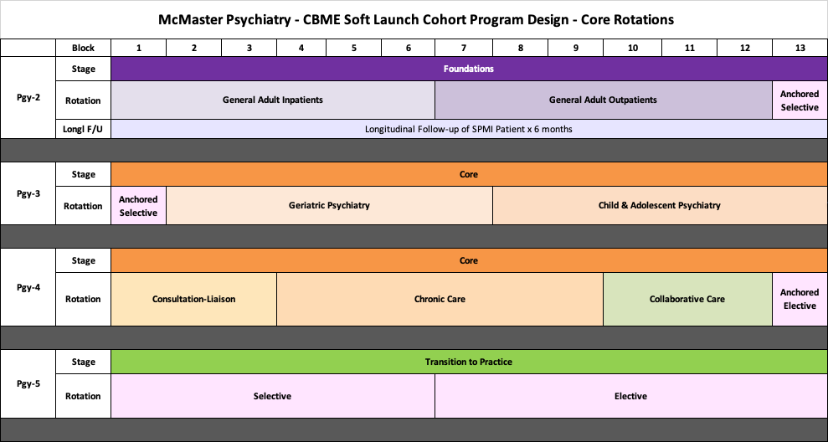

Slide 58
Audience
Check-in

Slide 59

Transition to Discipline 2020

Slide 60
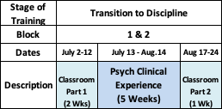
Official Launch - Pgy1s - July 2020

Slide 61

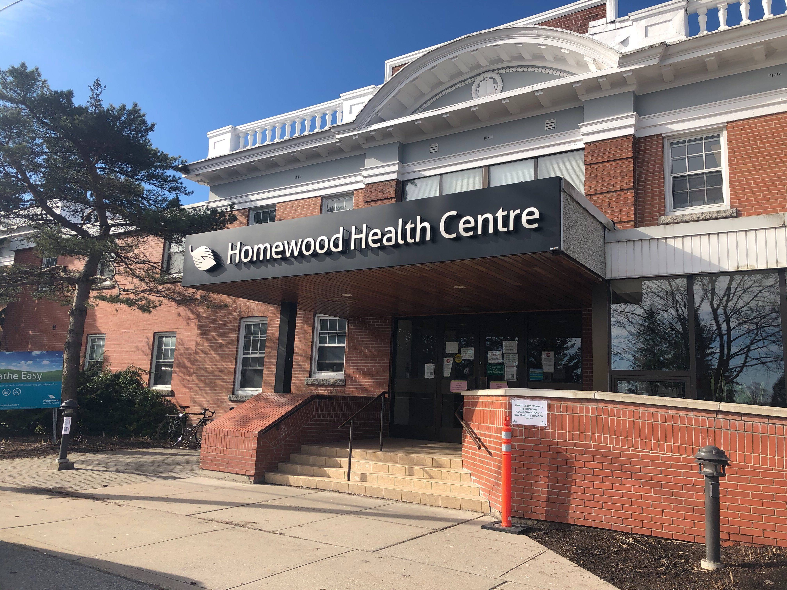
Transition to Discipline
Design of Clinical Experiences
Hamilton Campus
Waterloo Regional Campus
Inpt & Outpt experiences
One 3-week placement
One 2-week placement
½ day/ wk in PES
Begin call only after 2 PES day shifts
Adjustments to support them on call & to support new seniors
No post-call days away
4 weeks Inpatient experience
1 week Psych Emerg
3 On-Call shifts in Psych Emerg, buddied with senior, until 11pm
No On-Call Shifts during classroom weeks

Slide 62
Transition to Discipline
EPAs
EPA TtD-1
EPA TtD-2
Obtaining a psychiatric history to inform the preliminary diagnostic impression for patients presenting with mental disorders.
Communicating clinical encounters in oral and written/electronic form.
2 SUCCESSFUL observations
  2 different case types
2 SUCCESSFUL observations
  At least:
    1 written
    1 verbal
    1 must be of observed interview

Slide 63
Questions?

Slide 64
Pops! Reflection:
What popped out for you today?

Slide 65
Muddiest Moment:
What still feels unclear?

Slide 66
Questions?

Slide 67
EXTRA SLIDES

Slide 68
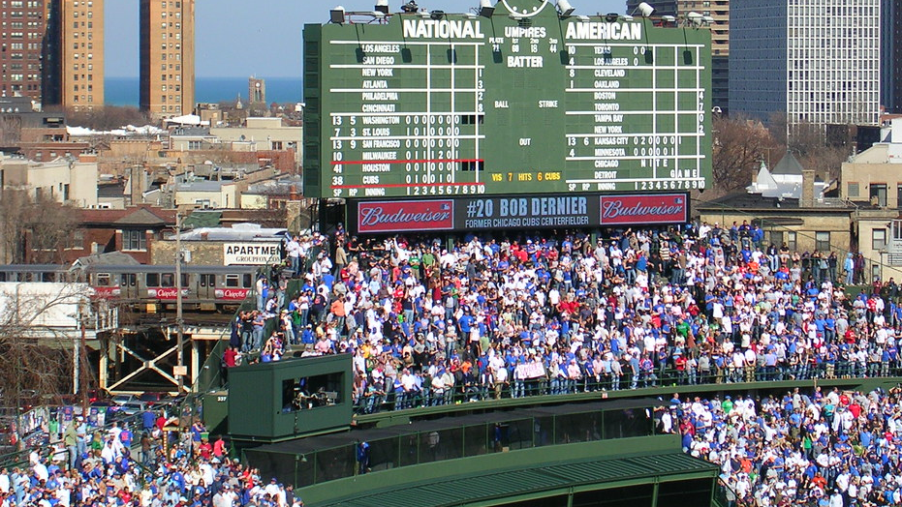
7th Inning Stretch
This Photo by Unknown Author is licensed under CC BY-NC-ND

Slide 69




Medium Yield Core EPAs during Pgy-2:
C1
(comprehensive management plans)
C3
(assessment, DDx & mgmt plans in older adults)
C5
(assessing & managing emergent situations)
C7
(neurostimulation)

Slide 70

Medium Yield Core EPAs during Pgy-2:
C1
(comprehensive management plans)
C3
(assessment, DDx & mgmt plans in older adults)
C5
(assessing & managing emergent situations)
C7
(neurostimulation)
Does this fit a Foundations EPA?
If so, & resident has not completed that Foundations EPA, apply the encounter to those EPAs first

Slide 71
EPA C-1
Developing comprehensive treatment / management plans for adult patients (of medium to high complexity)
8 Observations of Achievement
At least:
2 emergency setting
2 inpatient setting
2 outpatient setting
2 consultation-liaison setting
2 psychotic disorders
1 substance use disorder
1 anxiety disorder
1 history of trauma
1 major depressive disorder
8 Observations of Achievement
1 bipolar disorder
1 personality disorder
1 intellectual disability / autism spectrum comorbidity
3 high complexity
5 direct observations with review of documentation
4 different observers
3 by psychiatrists

Slide 72

Performing psychiatric assessments and providing differential diagnoses & management plans for older adults.
6 Observations of Achievement
At least:
3 neurocognitive disorders, including 1 BPSD
1 major depressive disorder and/or bereavement
1 anxiety disorder
1 case with rationalization of polypharmacy
2 different observers
4 direct observations including review of documentation
2 by geriatric psychiatrist or psychiatrist with special interest in older adult patients
EPA C-3

