Slide 1
What about ME in CBME?
What to Expect as a Supervisor in the Age of Competency Based Medical Education
How This is Going to Affect Me as a Supervisor
JoAnn Corey, MD, FRCPC
Oct. 9,2019
PGR Code: 1202
Notes:
Introduce Self
PGR Code
So we have all been hearing about CBME for a long time.
We knew it was coming.
And now, the day has come - its here.
While we are all invested in our residents, I think if we are honest with ourselves, no matter how dedicated we are, at some point, for most of us, the thought that crossed our mind was "Sigh, so what is this going to mean for me."

Slide 2


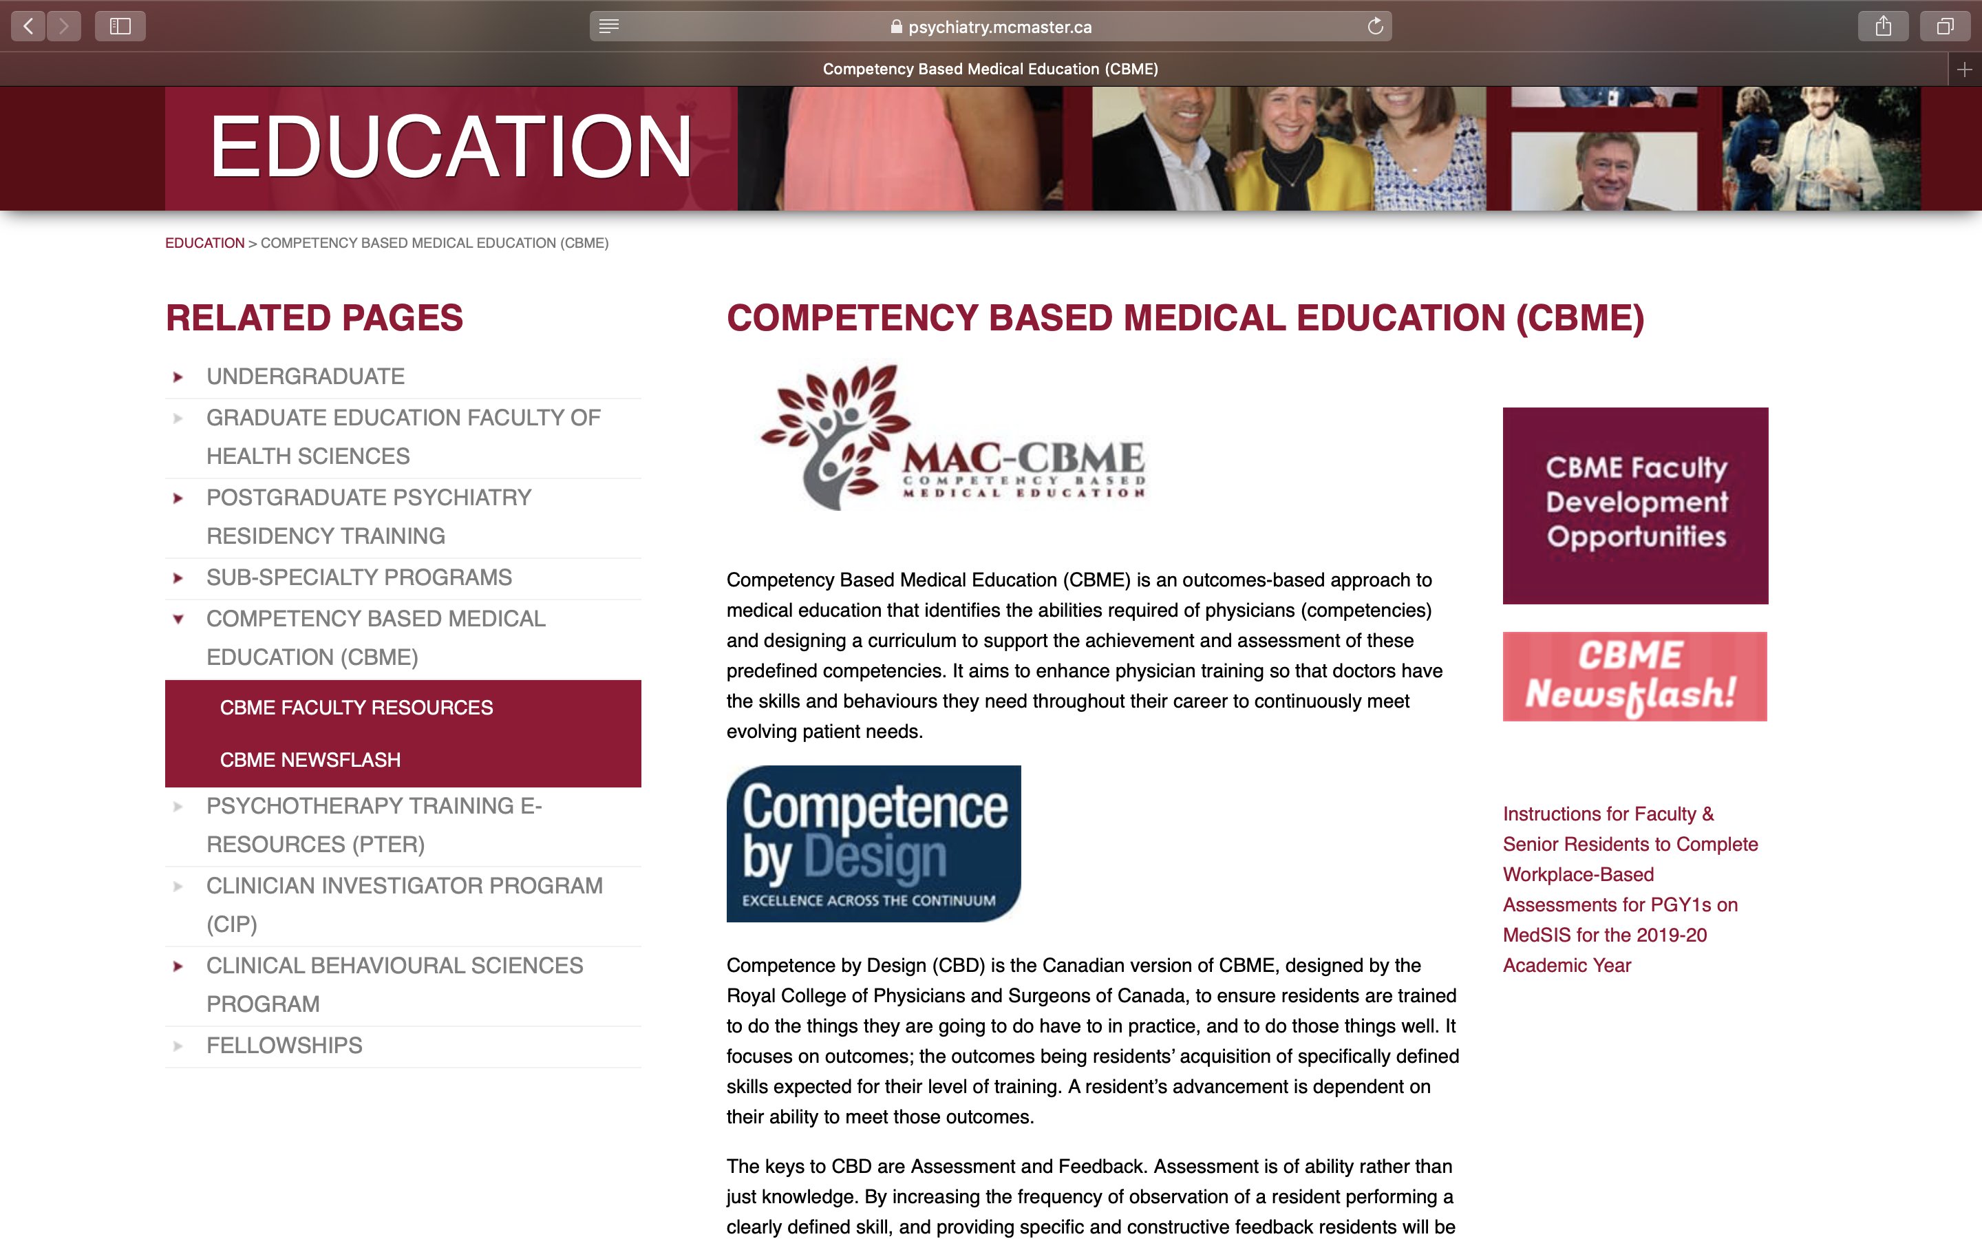
Notes:
Now, I know we are all a little busy this spring,
So, if you weren't able to...

Slide 3
The Basics of CBME
A 5 Minute Refresher

Slide 4
Required Training Experiences
Mandatory experiences residents must have during each stage of their training, as outlined by the Royal College
Notes:
Talk about up to programs to decide how those RTEs are designed in their program

Slide 5
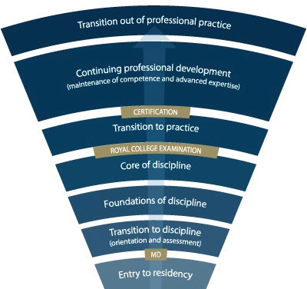
PGY-5
PGY-4
PGY-6
PGY-5
PGY-3
PGY-2
PGY-1
PGY-5
PGY-5
Child/Adolescent
Geriatric
Forensic
Notes:
*for general program
Need to understand how this will look for Subspecialty Programs
Explain the stages of training.
-RC will outline what needs to be accomplished within each Stage of training and give a range of time that stage may last
-Programs will then decide the duration of each stage (within the RC parameters) and what rotations will be included in each stage
-RC is also going to outline what skills & knowledge must be accomplished by a resident before they are to be allowed to progress to the next stage of training. Those required skills & knowledge are packaged into what is called the EPAs and Milestones (which I will explain in a minute)
-Programs will then map which EPAs should be accomplished in which rotations for their residents

Slide 6
Required Training Experiences
Scholarly Projects
Clinical Experiences
Topics of Formal Instruction
Foundations of Discipline
Other Experiences
Core of Discipline
Transition to Discipline
Transition to Practice
4
1
3
2

Slide 7
Entrustable Professional Activities (EPAs)
The defined knowledge and skills a resident must acquire during each stage of training
Notes:
Talk about up to programs to decide how those RTEs are designed in their program

Slide 8
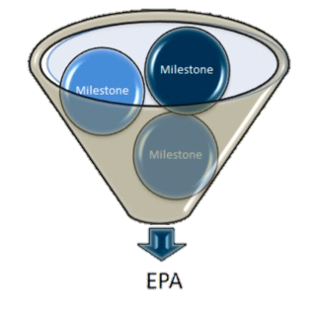
Entrustable Professional Activities (EPAs)
Can be broken down into smaller, component parts, called Developmental Milestones
  written in CanMEDS language

Slide 9
EPA F3:
EPA F3: Developing and implementing management plans for patients with psychiatric presentations of low to medium complexity.
Developmental Milestones:
ME: Develop & implement management plans that consider all of the patient’s health problems and context.
ME: Describe the indications, contraindications, risks, and alternatives for a given treatment plan.
COM: Document clinical encounters to adequately convey clinical reasoning and the rationale for decisions.
COL: Consult as needed with other health care professionals, including other physicians.
HA: Demonstrate an approach to working with patients to advocate for health services or resources
P: Integrate appropriate components and aspects of mental health law into practice.

Slide 10
Assessment of the EPAs
Workplace Based Assessment form (WBA)
Rated on the Entrustment Scale
1 | 2 | 3 | 4 | 5
I had to do. | I had to talk them through. | I needed to prompt. | I had to provide minor direction. | No direction required for safe, indpt care.

Slide 11
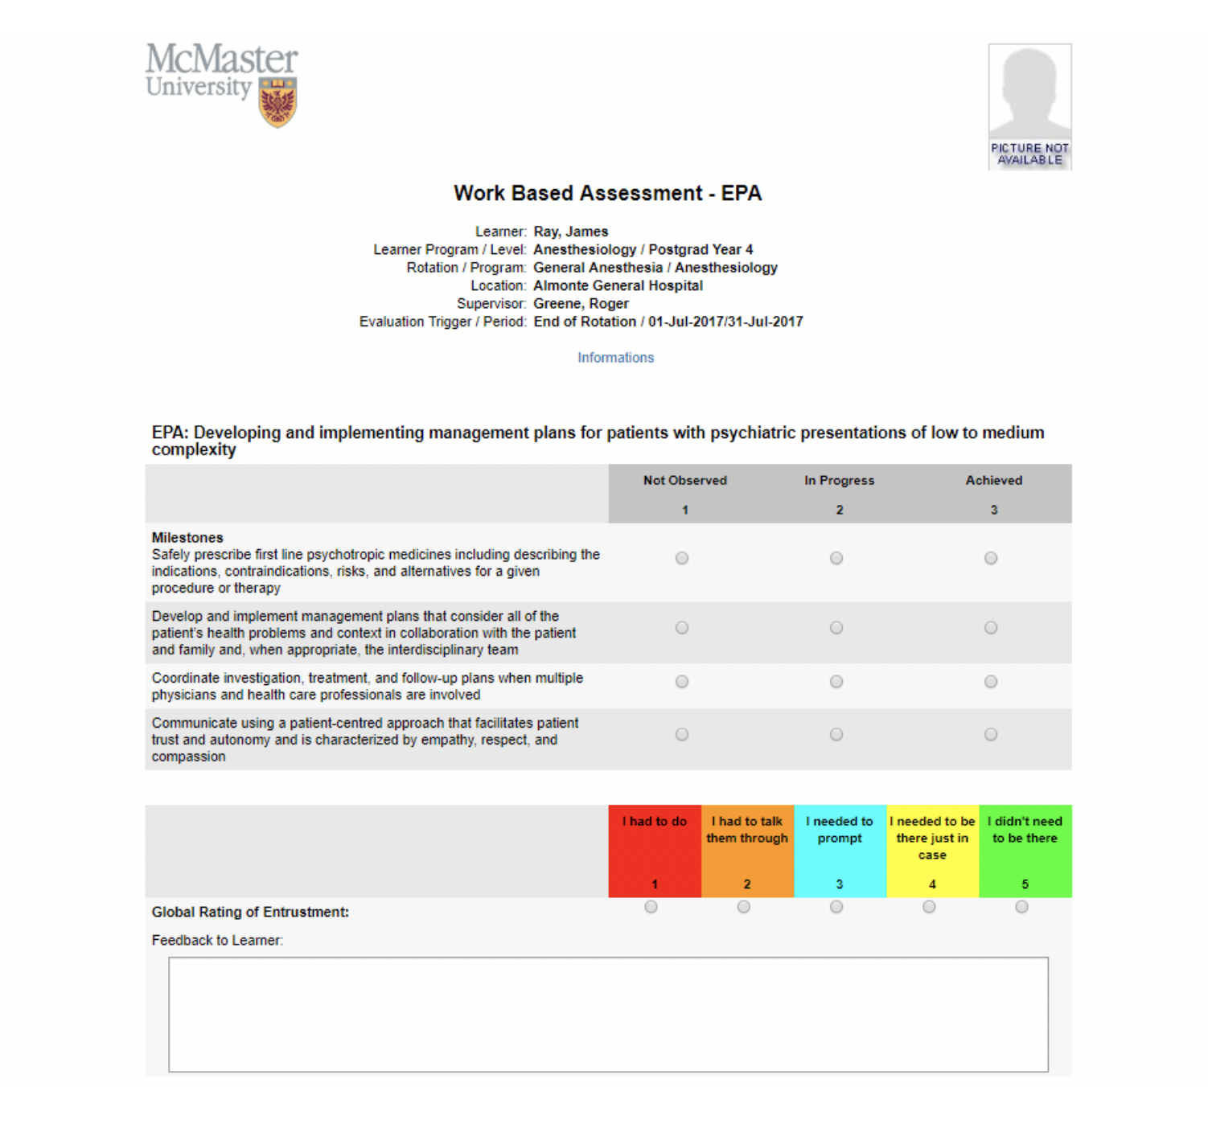

Slide 12
So, you are going to be supervising a resident…
What you need to know.
What you need to do.

Slide 13



Supervisors’ Steps
01
Keep doing what you are doing
02
Become familiar with the EPAs on which you may be asked to assess a resident.
Faculty Development sessions
for clinical supervisors of rotations,
prior to the cohort beginning that rotation.
Orientation Guides
Newsflashes

Slide 14
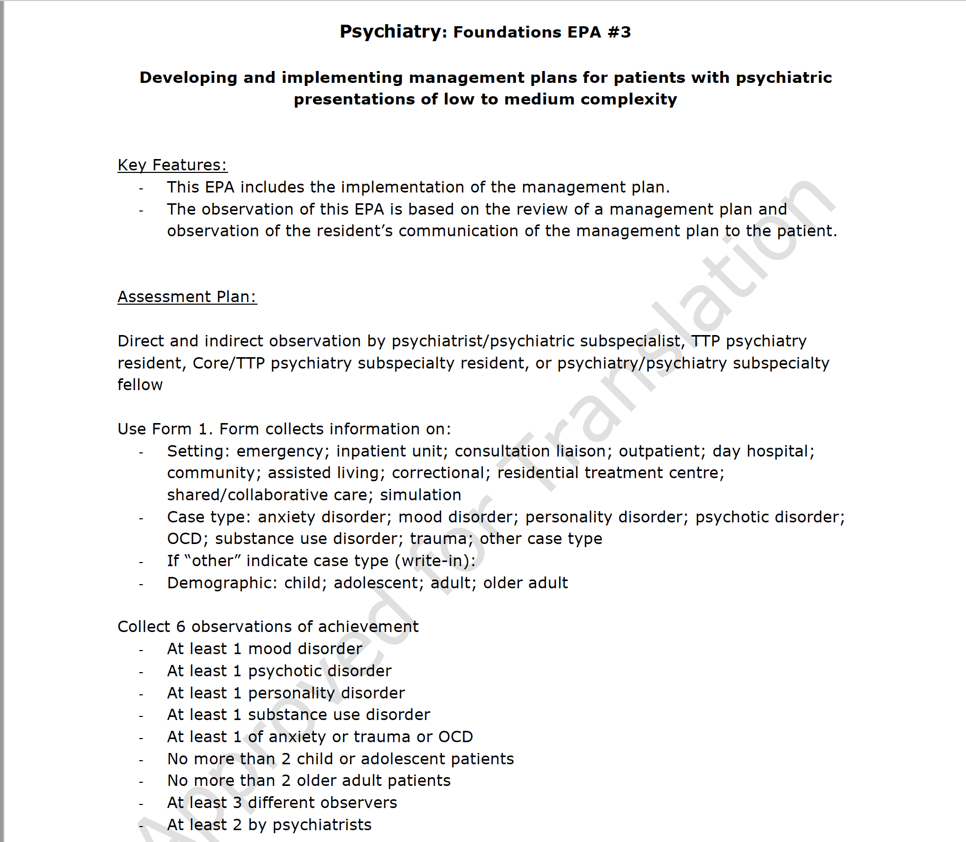

Slide 15
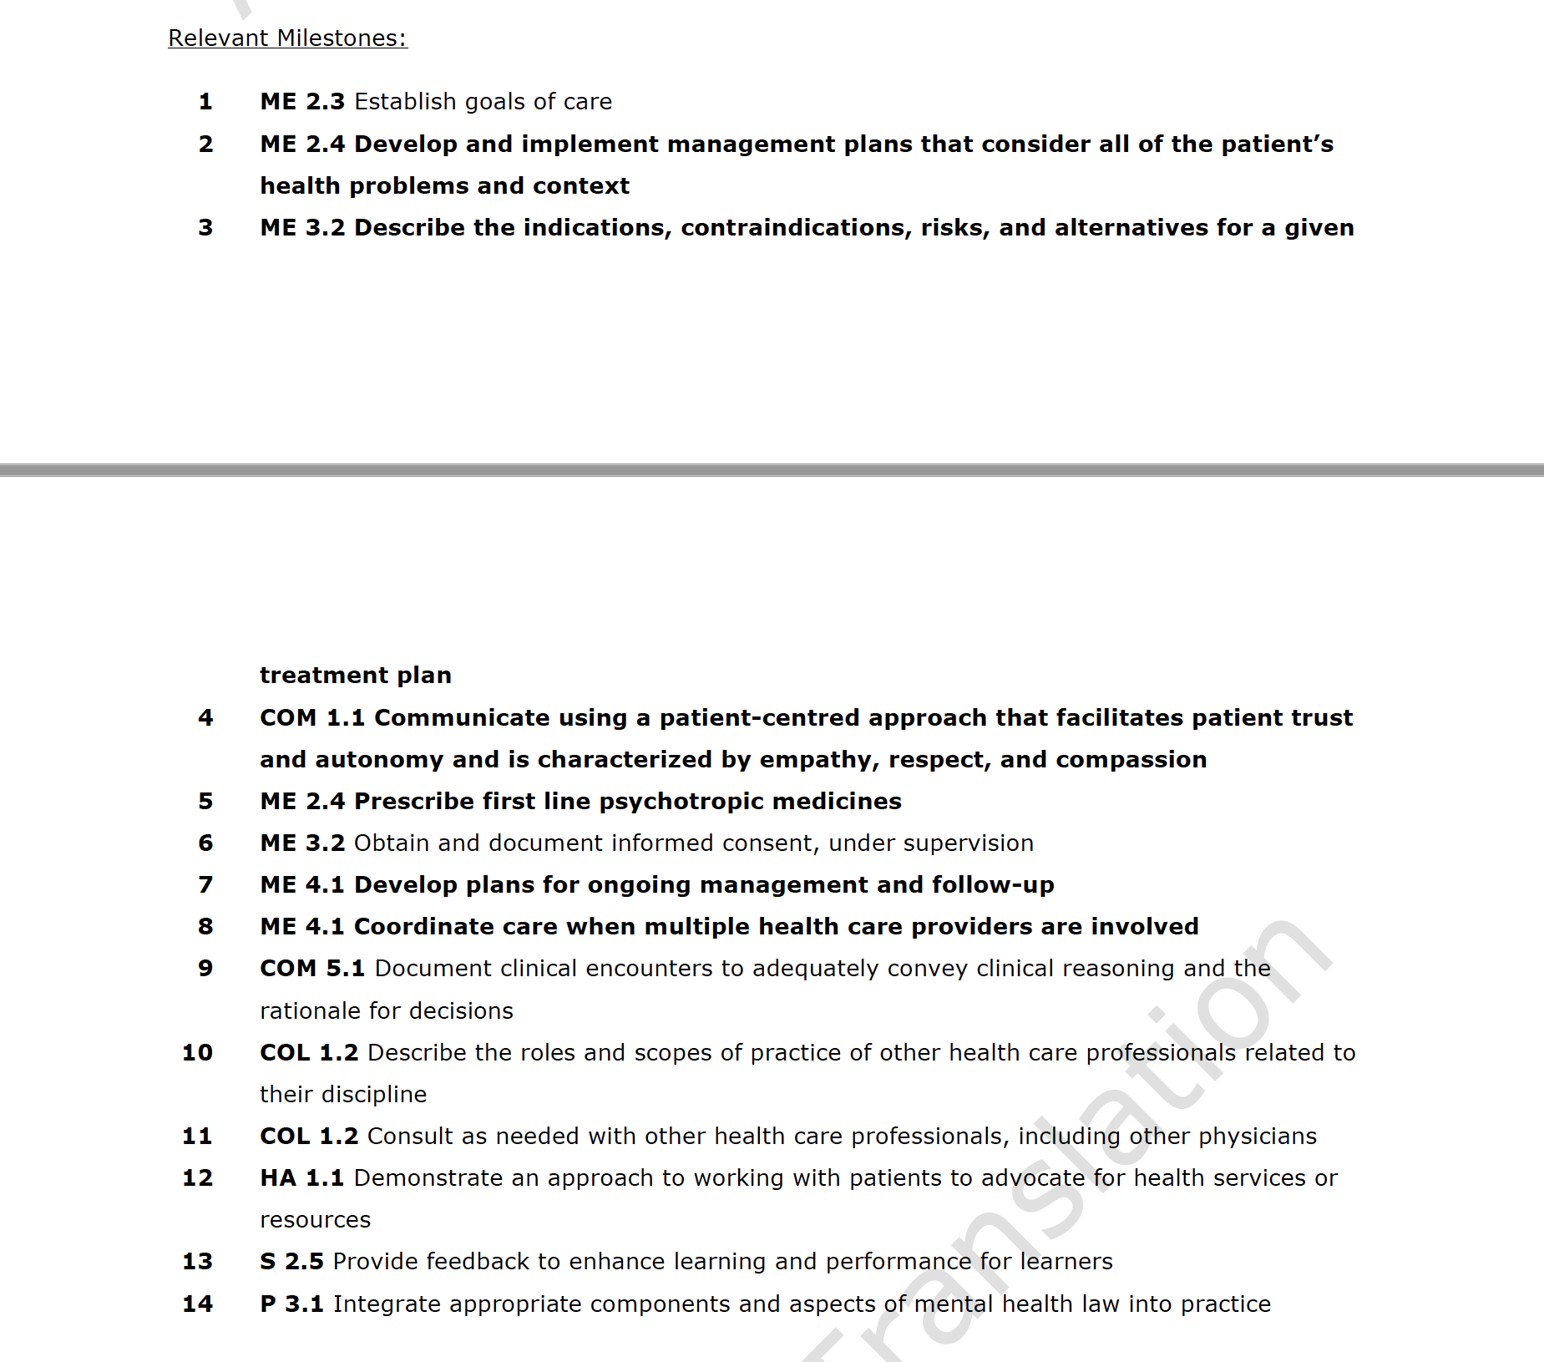

Slide 16


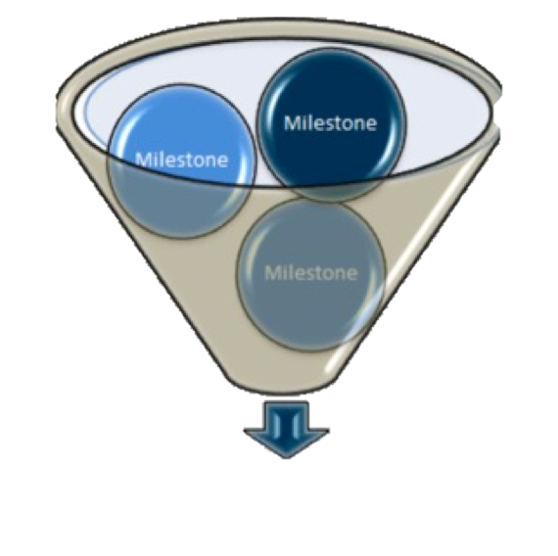

Supervisor’s Steps
01
Keep doing what you are doing
02
Become familiar with the EPAs on which you may be asked to assess a resident.
03
When scenario arises that would fit one of the EPAs, discuss with the resident if this might be a chance to assess that EPA.
Encourage resident to take initiative to identify the EPAs they’d like observed
Set expectations for the encounter (yours & theirs)
Patient care & assessments should coincide

Slide 17
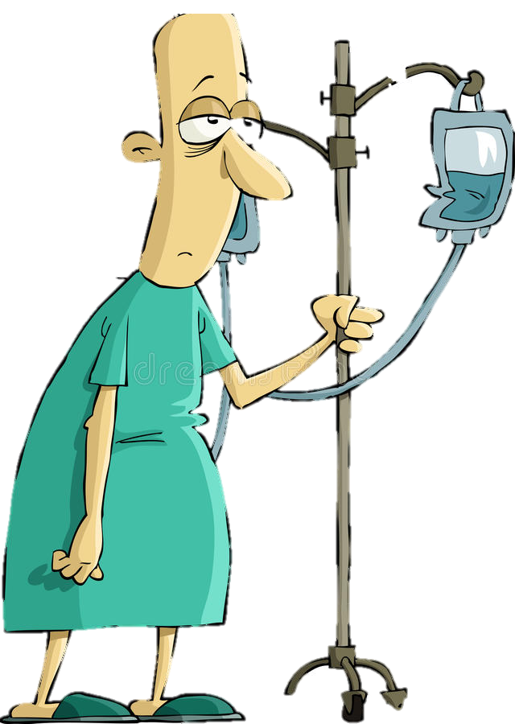
Supervisor’s Steps
01
Keep doing what you are doing
02
Become familiar with the EPAs on which you may be asked to assess a resident.
03
When scenario arises that would fit one of the EPAs, discuss with the resident if this might be a chance to assess that EPA.
04
Observe the resident doing the task of the EPA
Direct or Indirect Observation, depending on EPA
Consider jotting a few notes for yourself

Slide 18
Supervisor’s Steps
01
Keep doing what you are doing
02
Become familiar with the EPAs on which you may be asked to assess a resident.
03
When scenario arises that would fit one of the EPAs, discuss with the resident if this might be a chance to assess that EPA.
04
Observe the resident doing the task of the EPA
05
Provide the resident with verbal feedback (just like you do now)
Feedback for the purpose of improvement (”Coaching”)

Slide 19


Supervisor’s Steps
01
Keep doing what you are doing
02
Become familiar with the EPAs on which you may be asked to assess a resident.
03
When scenario arises that would fit one of the EPAs, discuss with the resident if this might be a chance to assess that EPA.
04
Observe the resident doing the task of the EPA
05
Provide the resident with verbal feedback (just like you do now)
06
Complete the WBA on MedSIS
5-10 min

Slide 20
Completing the WBA on MedSIS
This Year (’19 – ‘20)
Next Year (‘20 – ’21)
Resident will trigger it
THEN observer can go in to complete it
Only on computer
Observer OR Resident can trigger it
If resident triggers it, an email link will be sent that will not require a sign-in
Will be Mobile App
Must be completed within 7 days!

Slide 21

What if the unexpected happens?
Resident does not do well
  Please still complete the assessment
Patient presentation changes to above resident skill level or not in line with EPA task
  Agree not to use as assessment
  or
  Could still assess & give feedback
Your day gets really busy

Slide 22

Let’s not throw the baby out with the bathwater

Slide 23
Supervisors’ Steps
Don’t assess every time
Start with modelling
Start with observations that are not assessed
Still doing ITARs (end unit evals)
Still using other eval forms until deemed redundant*

Slide 24
Example One:
Foundations EPA F3:
Developing & implementing management plans for patients with psychiatric presentations of low to medium complexity
EPA Descriptors indicate:
  Direct and Indirect Observation
  Patient Presentations:
    Mood Disorder
    Psychotic Disorder
    Personality Disorder
    Substance Use Disorder
    Anxiety, Trauma, OCD
General Outpt / Inpt Psychiatry

Slide 25
Example Two:
Foundations EPA F4: Performing risk assessments that inform the development of an acute safety plan for patients posing risk for harm to self or others.
Emergency Psychiatry

Slide 26
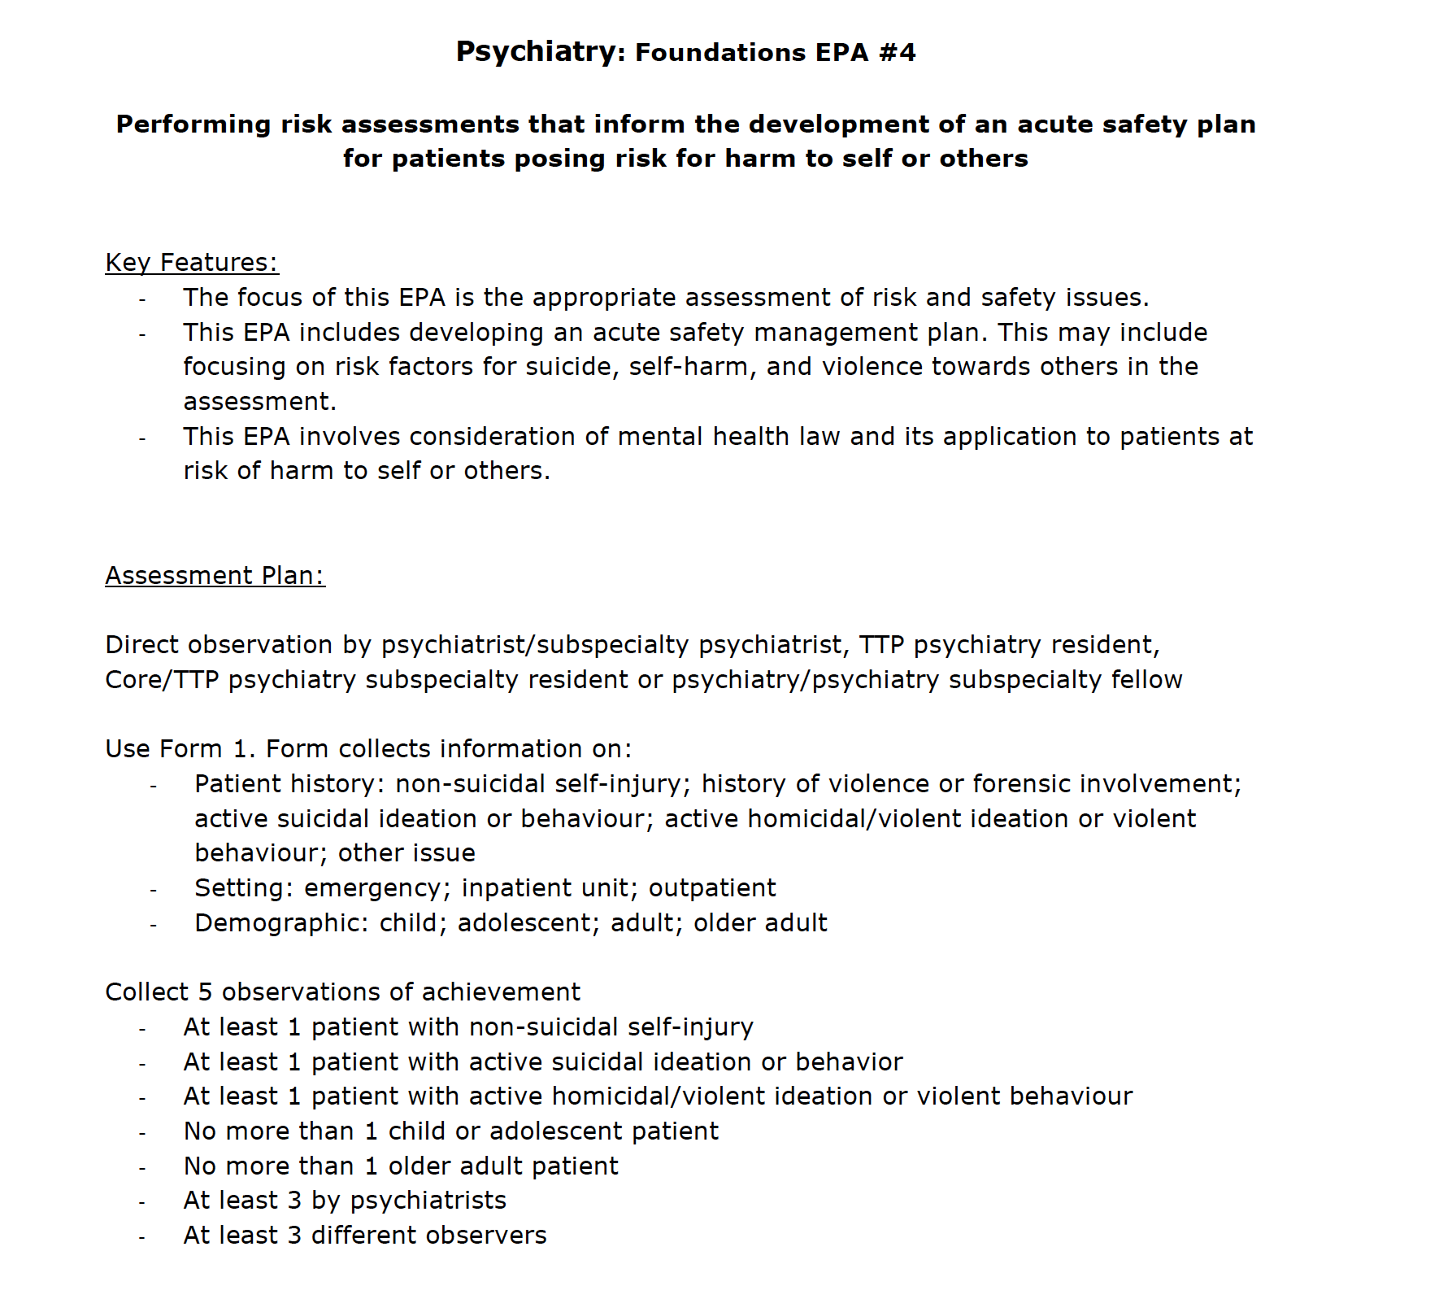

Slide 27
Example Three:
Core EPA C8
Integrating the principles and skills of psychopharmacology into patient care.
EPA Descriptors Indicate:
  Direct or Indirect Observation
  Listing of types of psychopharmacologic Mx, the use of which resident must acquire observations of achievement
Any Psychiatry Clinical Rotation

Slide 28
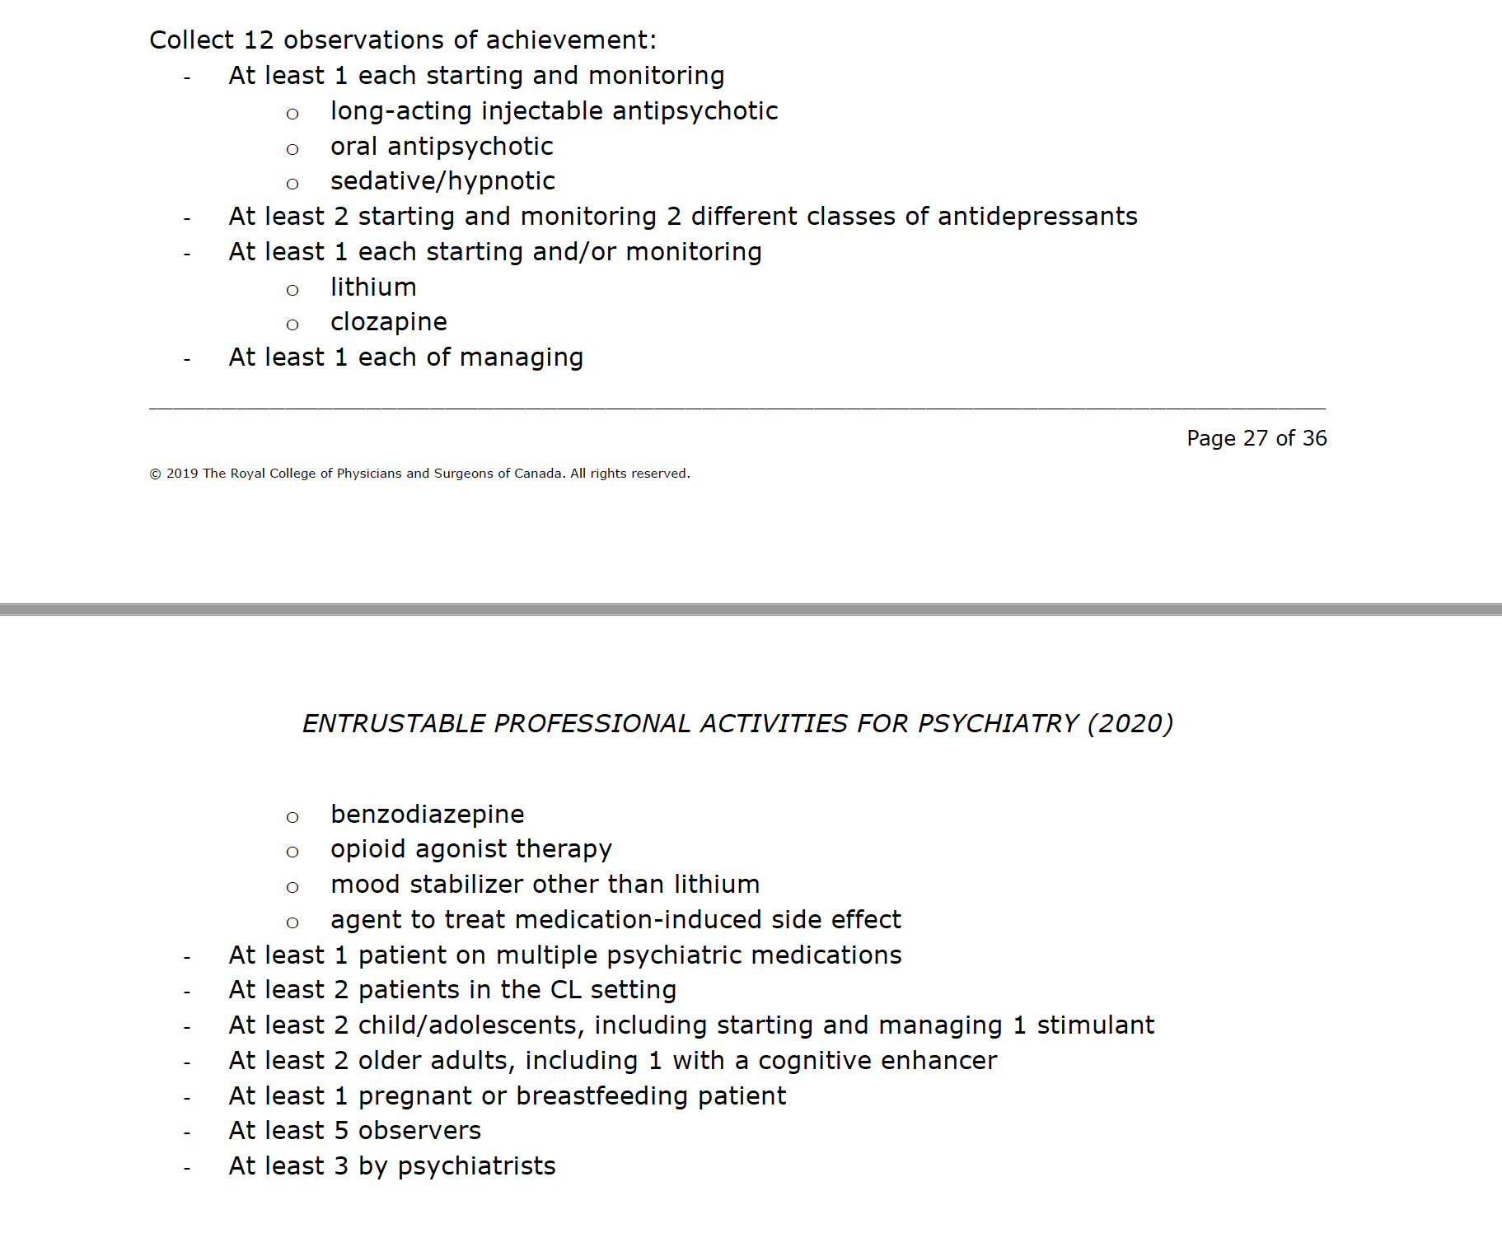

Slide 29
Where do the residents come in?
What’s in the residents’ toolkits?
Notes:
Need a new title on this

Slide 30
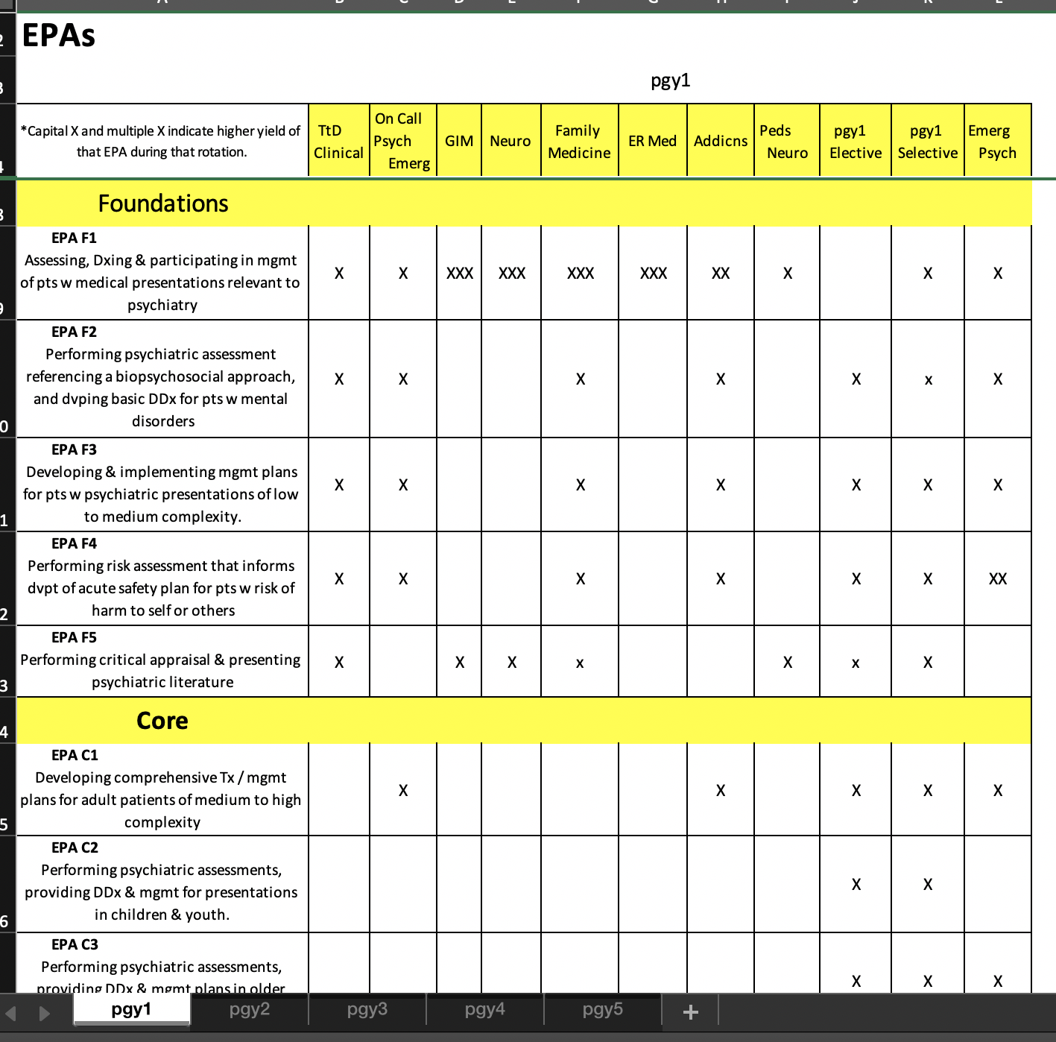
Residents’ Toolkits
All the EPAs
Curriculum Maps

Slide 31
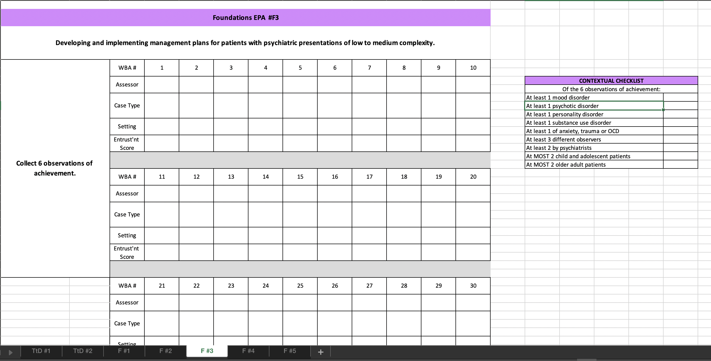
Residents’ Toolkits
All the EPAs
Curriculum Maps
Tracking Documents

Slide 32
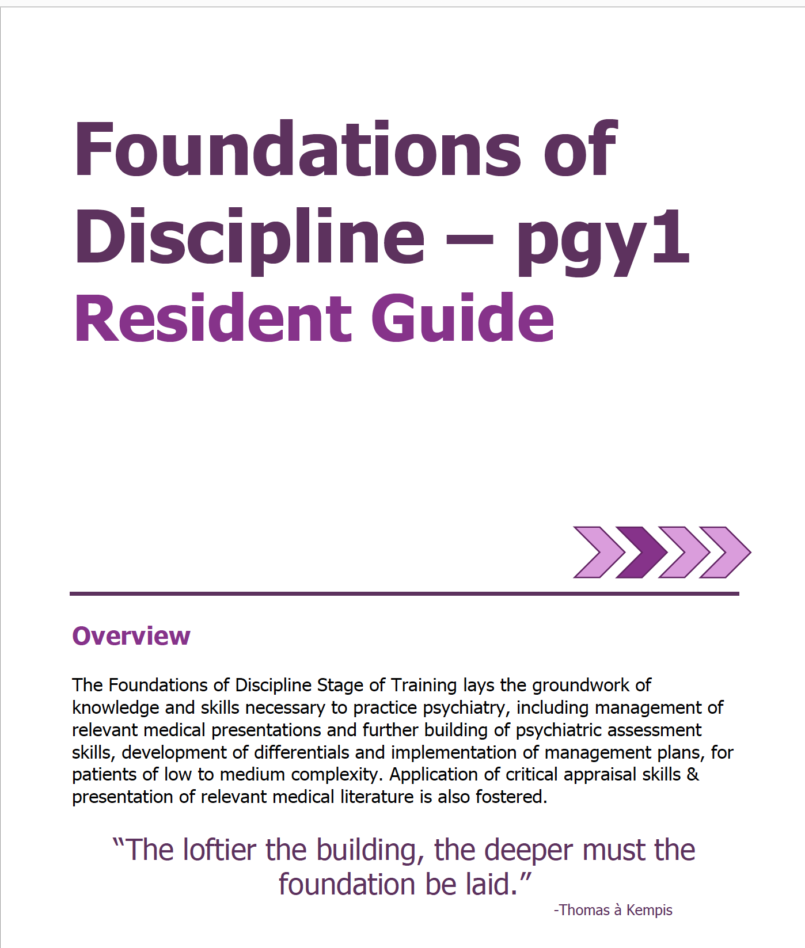
Residents’ Toolkits
All the EPAs
Curriculum Maps
Tracking Documents
Orientation Guides

Slide 33

Residents’ Toolkits
All the EPAs
Curriculum Maps
Tracking Documents
Orientation Guides
Academic Coaches

Slide 34
What happens with the assessments?

Slide 35
Notes:
Explain contextual factors

Slide 36
Notes:
Resident is tracking these
Our program is tracking these too.
By July 1, 2020, MedSIS will track this for us

Slide 37

Competence Committee Reviews
Biannual Review of all residents
Review prior to end of Stage
Determines promotion to next stage
Identifies any concerns
Suggestions for Personal Learning Plans
Develops specialized learning plans
  Enhanced Educational Plans
  Remedial Plans

Slide 38

Questions?
PGR Code: 1202

Slide 39
Extra Slides

Slide 40
Example Four:
Core EPA C6
Integrating the principles and skills of psychotherapy into patient care
EPA Descriptors Indicate:
  The different types of therapy on which residents must have some assessments
  Direct observation or review of tape
  By supervisor trained in modality
  Residents must keep a logbook
Psychotherapy Supervision

Slide 41
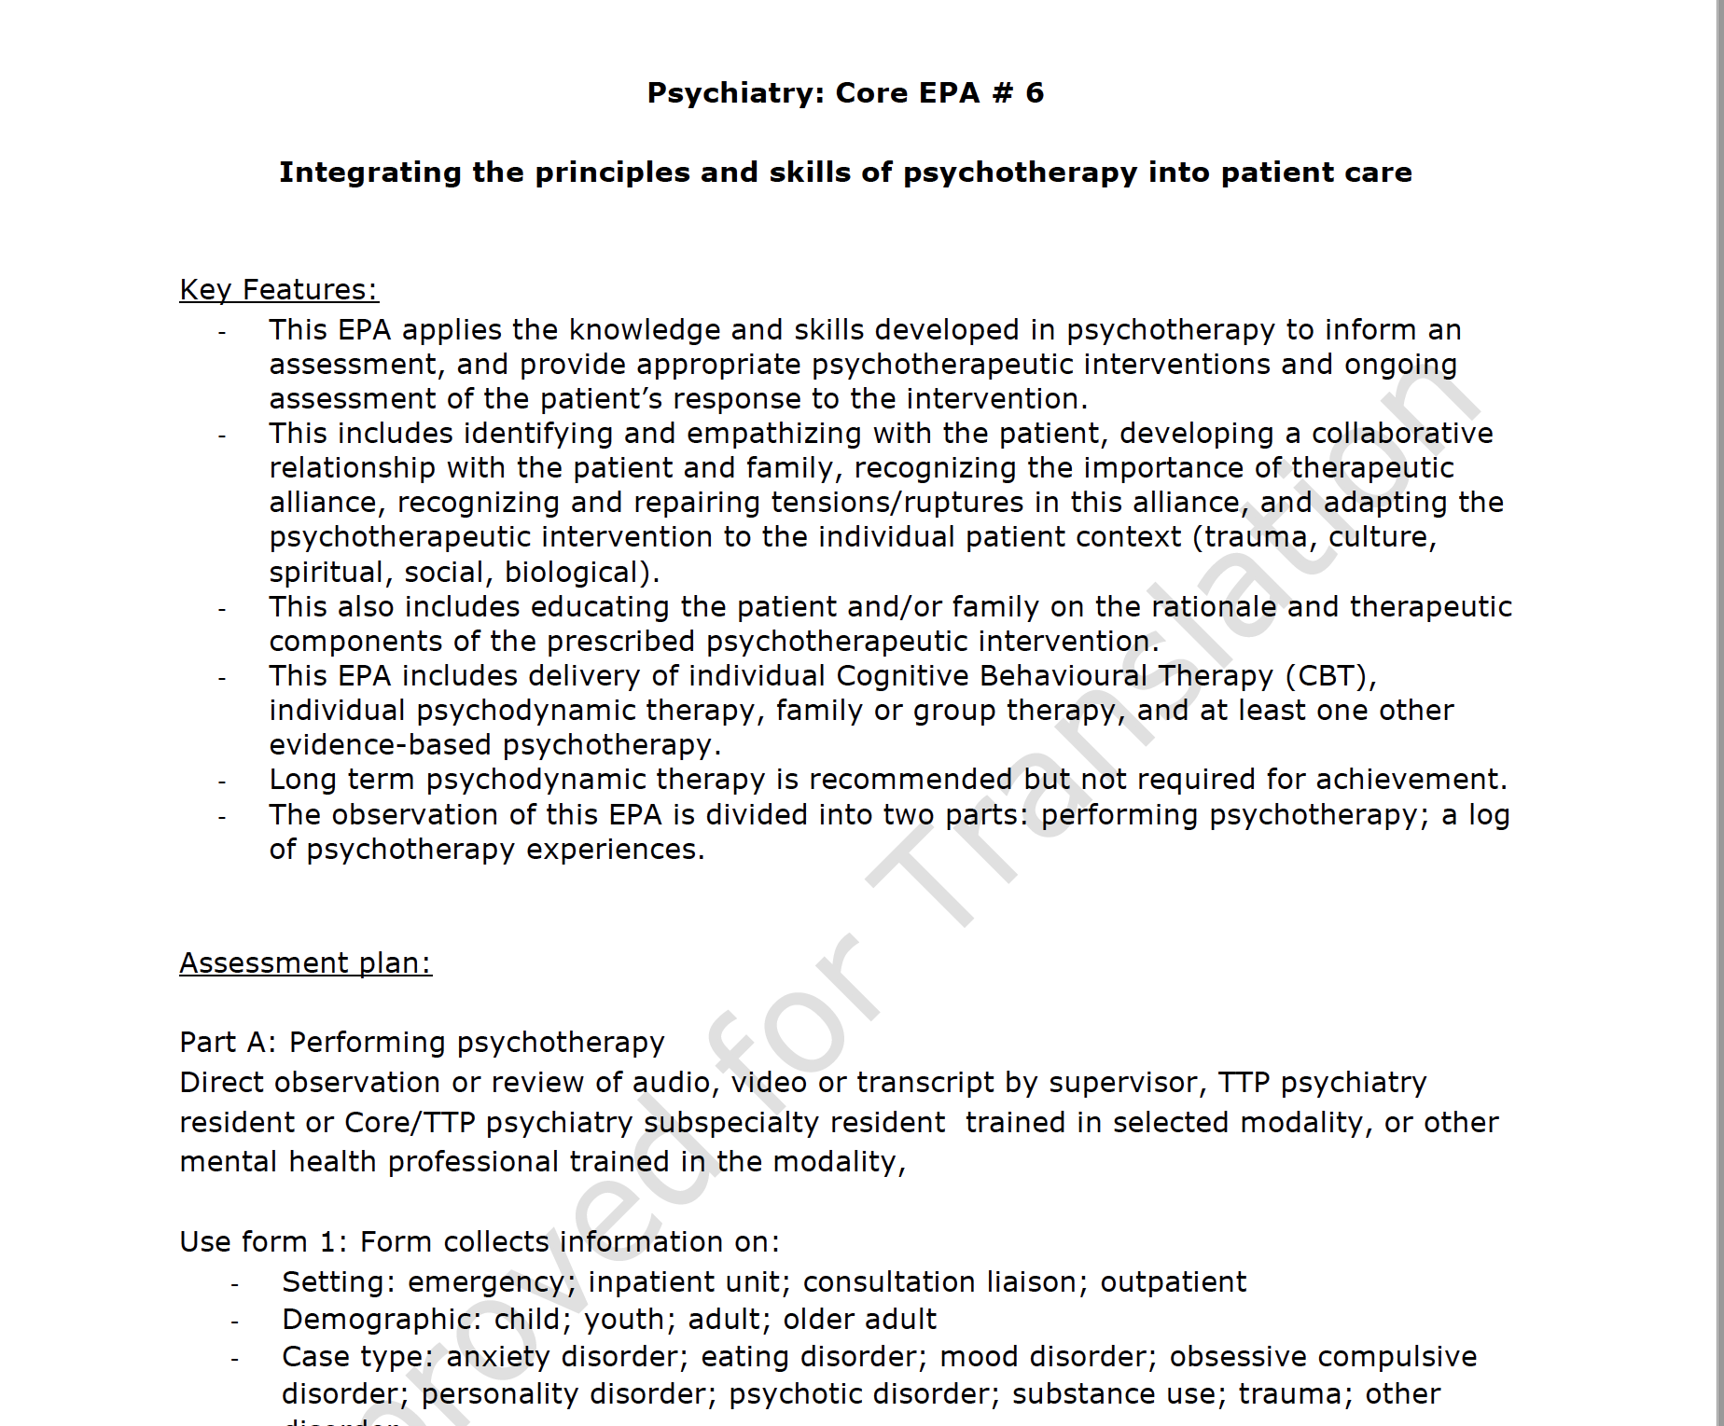

Slide 42
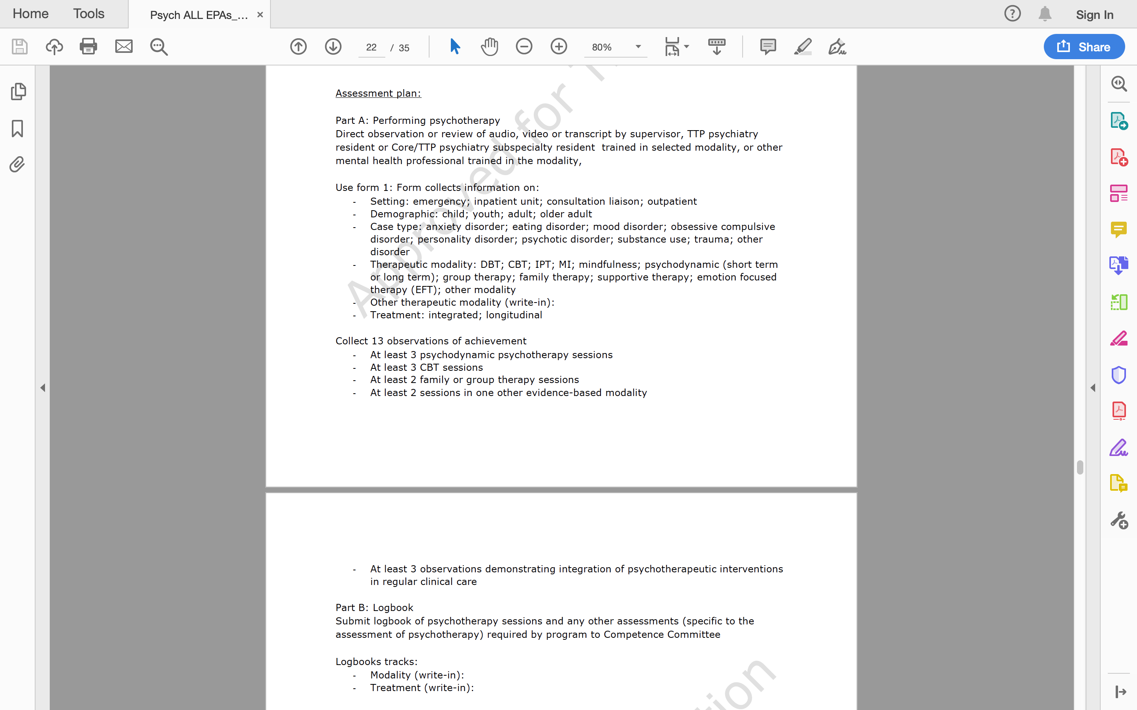

Slide 43
