Slide 1
On the Road to Competency Based Medical Education!
JoAnn Corey, CBME Lead
Dept. of Psychiatry, McMaster University

Slide 2
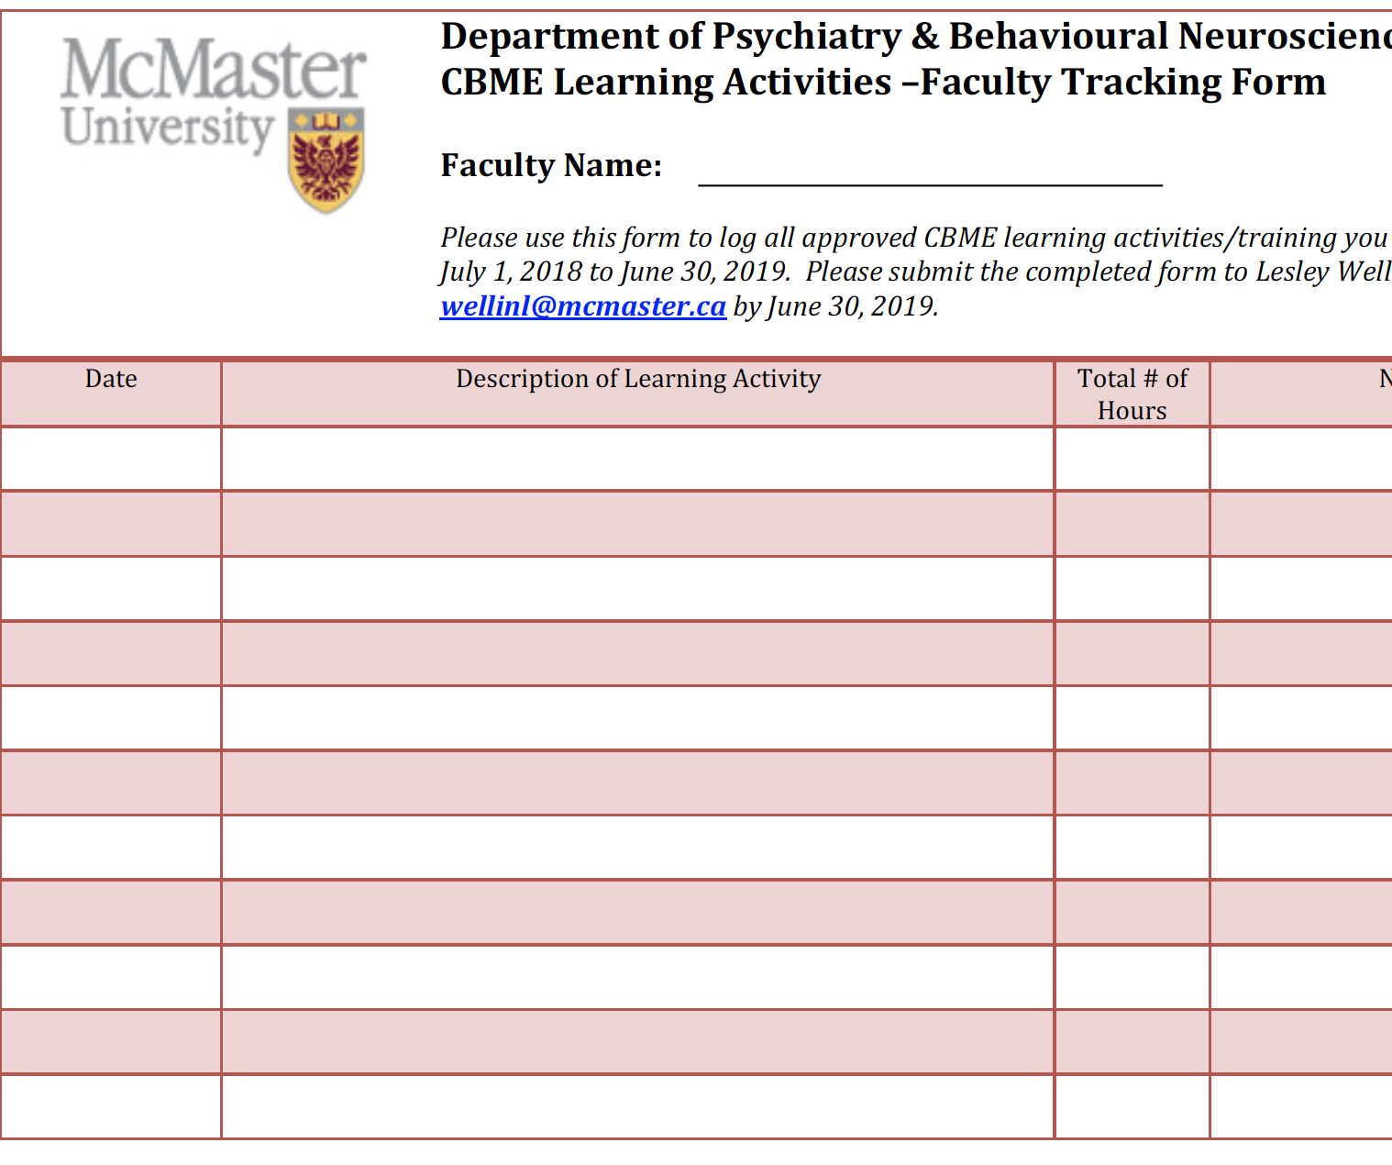
2 hours Dept. CBME Learning Requirement & Two Section 1 Royal College MoCOMP credits
CREDITS for TODAY

Slide 3
Go-Live for General Program
July 1
2020
Only applies to the incoming residents!
Notes:
Go Live Date July 1, 2020, for residents entering that year. So we will have two cohorts of residents for 4 years (likely 5 given mat leaves, etc)

Slide 4
General Program Soft Launch
July 1
2019
Only applies to the incoming residents!
Notes:
Go Live Date July 1, 2020, for residents entering that year. So we will have two cohorts of residents for 4 years (likely 5 given mat leaves, etc)

Slide 5
Go-Live for Forensic Subspecialty Program
July 1
2021 ?
Only applies to the incoming residents!
Notes:
Go Live Date July 1, 2020, for residents entering that year. So we will have two cohorts of residents for 4 years (likely 5 given mat leaves, etc)

Slide 6
We are doing well…
Why would we change anything?

Slide 7
Notes:
Sometimes people have good ideas. Things that could make the way we are currently doing things, a little better.
But as humans, we are very resistant to change.
Why would we want to change something if it seems to be working ok?

Slide 8
Why Move to CBME?
Feedback.
Exposure to experiences.

Slide 9
Why move to Competency Based Medical Education?

Slide 10
Why move to Competency Based Medical Education?
An effort to educate even better
Better prepared graduates
More fulfilled educators
Improved patient care
Notes:
Because we want to work to educate even better.
To better prepare our graduates
To feel more fulfilled as educators
And most importantly, to provide even better patient care moving forward

Slide 11
MANY THINGS STILL THE SAME
Defined Rotations
Psychotherapy
Current Evaluations
ITARs

Slide 12
What is different ab0ut Competency Based Medical Education?

Slide 13
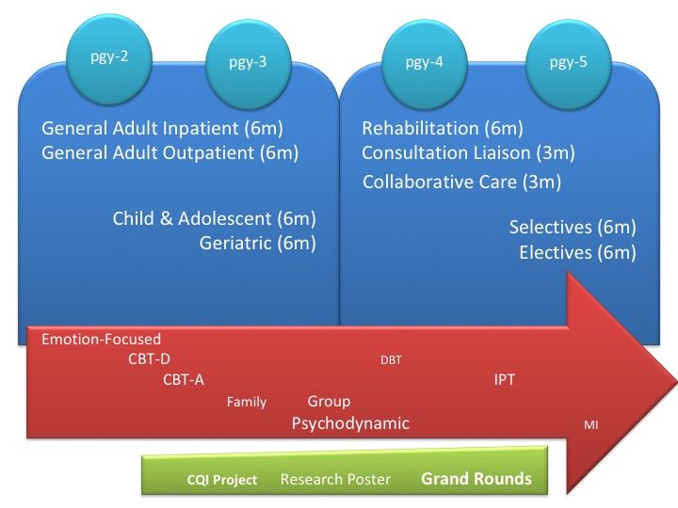
What is Competency Based Medical Education?
Currently,
Time is emphasized as a marker of resident having acquired the required knowledge & skills.
Notes:
Unless something really wrong happens, they do the required time in a rotation, they pass.

Slide 14
What is Competency Based Medical Education?
Problem with our current system of assessment:
Mainly at the end of the experience
Evaluations are not always useful
Inter-evaluator inconsistency
Not capturing concerns early
Less effective at promoting development
Notes:
Unless something really wrong happens, they do the required time in a rotation, they pass.
We evaluate them at the end. While we ask that supervisors provide regular observation & feedback, the only time we know for sure they are getting some sort of assessment & feedback, is at the end.

Slide 15
What is Competency Based Medical Education?
CBME:
Rotations will still be defined times
Emphasize acquisition of knowledge & skills
Organized around outcomes expected of a resident
Advancement dependent on achieving those expected outcomes
Allow more frequent, low-stakes assessments & feedback
Foster effective feedback
Allow residents to be more open to feedback

Slide 16
Key Points
Time will still matter.
Early completion will be exception
Its all about Feedback & Assessment
Quality
Acceptance & Incorporation

Slide 17
What is this going to look like?

Slide 18
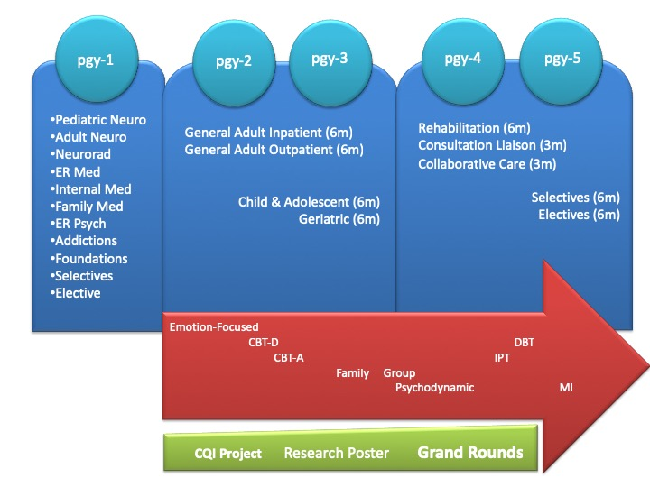
Training Requirements Current:

Slide 19
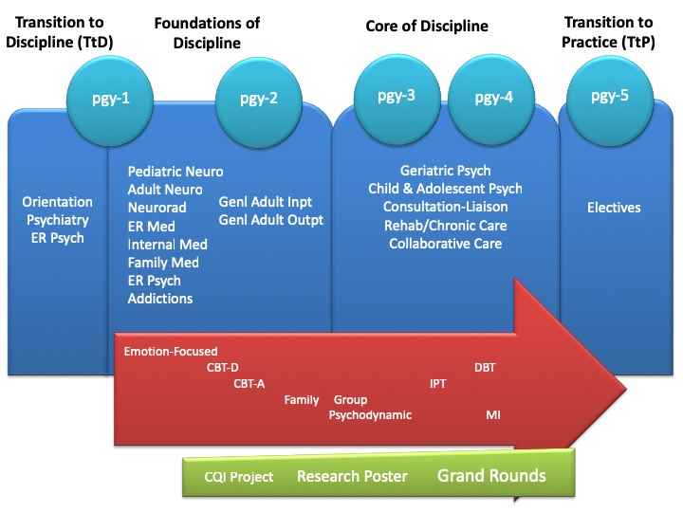
Training Requirements CBME:

Slide 20
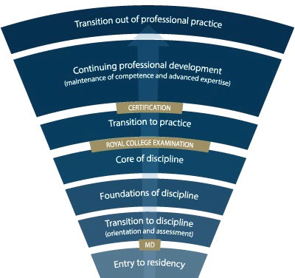
Competence Continuum -Stages of Training-
PGY-5
PGY-4
PGY-6
PGY-3
PGY-2
PGY-1
PGY-5
Subspecialty
Notes:
*for general program
Need to understand how this will look for Subspecialty Programs
Explain the stages of training.
-RC will outline what needs to be accomplished within each Stage of training and give a range of time that stage may last
-Programs will then decide the duration of each stage (within the RC parameters) and what rotations will be included in each stage
-RC is also going to outline what skills & knowledge must be accomplished by a resident before they are to be allowed to progress to the next stage of training. Those required skills & knowledge are packaged into what is called the EPAs and Milestones (which I will explain in a minute)
-Programs will then map which EPAs should be accomplished in which rotations for their residents

Slide 21
Key Points
Residents will progress through
Stages of Training
along the Competence Continuum.
There will be defined
Required Training Experiences
in each stage of training.

Slide 22
During each stage of training there will be defined Competencies (i.e. knowledge & skills) that a resident must acquire

Slide 23
Entrustable Professional Activities (EPAs)
These competencies are called

Slide 24
Entrustable Professional Activities (EPAs)
Key tasks that an individual can be trusted to perform in a given health care context
Example:
Obtaining a psychiatric history, which includes a preliminary diagnostic impression that informs a management plan for patients presenting with mental health concerns.

Slide 25
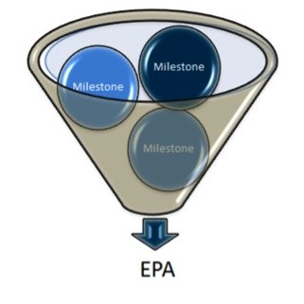
Developmental Milestones
EPAs can be broken down into smaller, component parts called

Slide 26
Developmental Milestones
The smaller, defined components that are needed to complete the full EPA
Examples: Conduct a mental status exam
Respect professional boundaries
Observable markers of an individual’s ability
Reference the CanMEDS roles applicable to that EPA

Slide 27
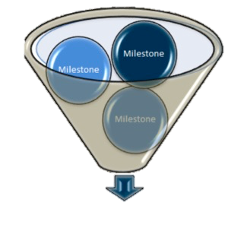
The Royal College will define which EPAs a resident must acquire before they can advance to the next Stage of Training.
Transition to Practice
Core of Discipline
Foundations of Discipline
Transition to Discipline

Slide 28
Key Points
EPAs are competencies residents must acquire.
Milestones are the small tasks that make up an EPA.
Residents will need to achieve specific EPAs in each stage of training.

Slide 29
Entrustability Scale
EPAs will be assessed using the

Slide 30
Entrustment Scale
Resident demonstrates sound knowledge & skill but needed help with unexpected challenges. A few things you needed to f/u on. No significant concerns.
Learner required
constant direction
1 | 2 | 3 | 4 | 5
I had to do. | I had to talk them through. | I needed to prompt. | I had to provide minor direction. | No direction required for safe, indpt care.
Learner didn’t do task or
Needed complete hands on guidance
Some independence but required intermittent direction
Complete independence. Understands risks. Performs safely. Practice ready.
**If any concerns with risk assessment or safety, should not score above 3.
Notes:
Level 1 – the supervisor had to perform the clinical activity while the resident observed. This may apply if resident has never done the task before, or they started but situation became too challenging so supervisor elected to complete the task. Ideally, the supervisor would provide direction and teaching afterwards.
Level 2 – self-explanatory
Level 3 – The resident required frequent direction, requiring occasional prompting and guidance, particularly with more complex aspects of the encounter OR the encounter required supervisor to follow-up on a number of important aspects not completed by the resident
Level 4 – Previously “I needed to be there just in case”. Now Changed to: “I had to provide minor direction.“ Resident demonstrates sound technique but you were not confident that their knowledge base or skill was sufficient to ensure that if they had run into an unexpected challenge or complication, they would have been able to manage this. Examples might include: when you posed questions as to how they would handle a complication of the situation, they were not able to explain; they completed the assessment adequately but there were nuances that made it more akward or less effective; resident completed the assessment thoroughly but it took them a much longer than normal time.
Level 5: Previously”I did not need to be there”. Now changed to: “I did not need to provide direction for safe, independent care” or “No direction required for safe, independent care”. Resident able to complete all aspects of the assessment independently and safely including troubleshooting unexpected challenges; completed in sufficient time frame (may not have been as fast as experienced staff person). Any teaching you provided was more to enrich a competenct knowledge base. Any prompts given were not necessary for resident to complete the task safely and independently.

Slide 31
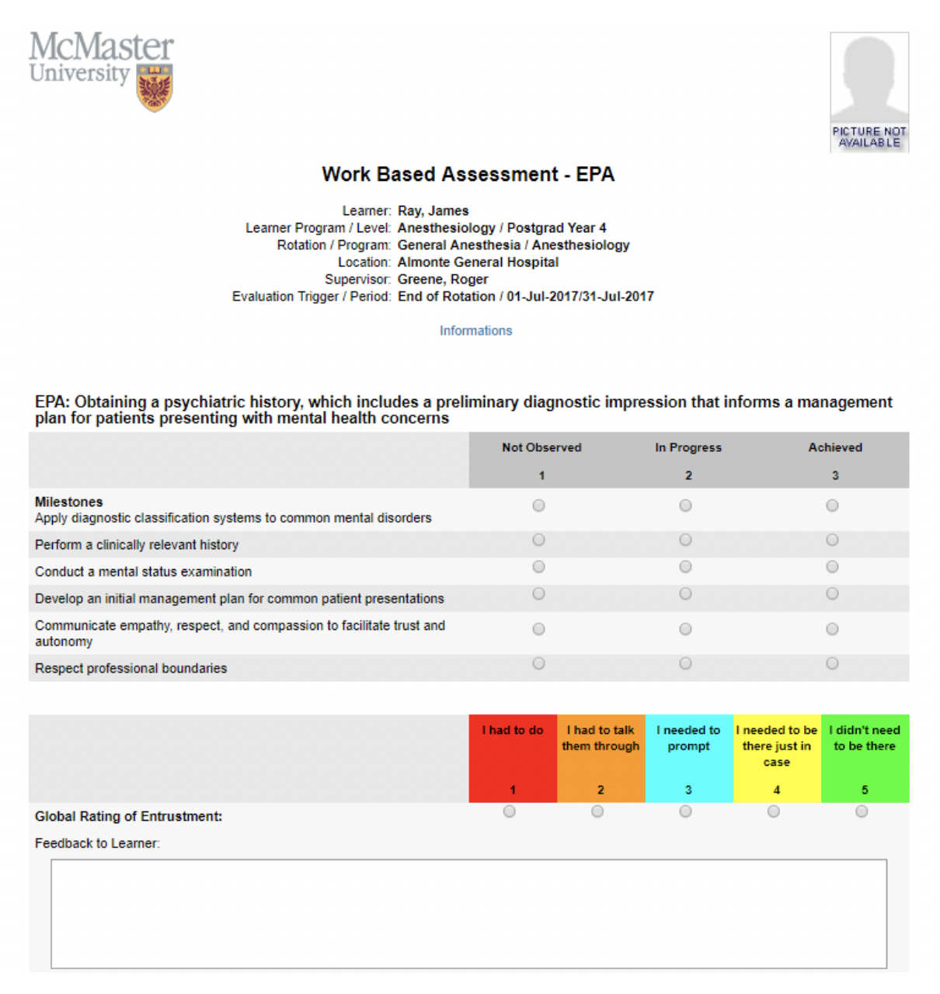
Work-Based Assessment (WBA)

Slide 32
Assessment of EPAs
may involve direct or indirect observation
Complete WBAs even if task rated less than a 4 or 5, to promote knowledge & skill development
it may take 2-3 attempts before a resident achieves a successful assessment.

Slide 33
Other Evals Will Still Matter
ITARs
Scholarly Projects
Longitudinal F/U
Mid- & end- rotation Evaluations
Grand Rounds
Poster presentation
Logs

Slide 34
Key Points
EPAs assessed using
Entrustability Scale.
Milestones guide rating & feedback.
Still using other Evals

Slide 35
How will this work?

Slide 36
Supervisor
Plans their learning
Views Curriculum Map
Know what EPAs working on
Develops a Personal Learning Plan
Resident
Sets Objectives for Rotation
Based on Curriculum Map
Based on Personal Learning Plan
Supported by technology

Slide 37
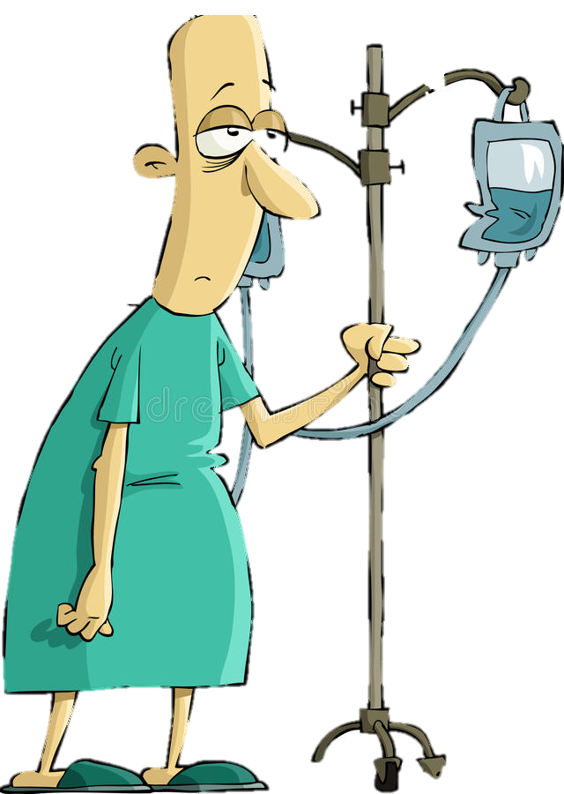
Program
Director
Academic
Coach
Competence Committee
Regional
Education Lead
Notes:
Resident and faculty identify an opportunity for an EPA assessment. Supervisor might review expectations and remind resident of feedback to build on from a previous encounter.
Resident goes to do the EPA activity. Supervisor supervises either directly or indirectly depending on the EPA
Supervisor provides verbal feedback to the resident, giving 1 or 2 specific, actionable pieces of feedback
Supervisor documents the assessment on MedSIS.
They cycle repeats itself, resulting in multiple assessments of the same EPA over time, by different observers.
These get collated on MedSIS, with the data being available to the resident, the Program Director, the REL, the resident’s academic coach and the Competence Committee (formerly the Evaluation Committee)
It is the Competence Committee that makes decisions around progression, promotion

Slide 38
Competence Committee
Assess overall achievement of EPAs & milestones
Regularly review learner EPAs/milestones
Approve changes to learner status:
Monitor overall progress of learner
Confirm acquisition of EPAs
Promote to next stage of training
Identify any concerns
Modify learning plan
Develop & monitor specialized learning plans
Request Royal College certification

Slide 39
Key Points
Regular assessment & feedback.
Cued by the resident
Competence Committee assesses overall achievement.

Slide 40
Academic Coaches
Residents will be assisted by

Slide 41
Academic Coaches
Help facilitate resident’s learning & development over time
Help resident navigate curriculum map
Longitudinal relationship with resident

Slide 42
Supervisor
Plans their learning
Views Curriculum Map
Know what EPAs working on
Develops a Personal Learning Plan
Resident
Sets Objectives for Rotation
Based on Curriculum Map
Based on Personal Learning Plan
Supported by technology

Slide 43
Program
Director
Academic
Coach
Competence Committee
Regional
Education Lead
Notes:
Resident and faculty identify an opportunity for an EPA assessment. Supervisor might review expectations and remind resident of feedback to build on from a previous encounter.
Resident goes to do the EPA activity. Supervisor supervises either directly or indirectly depending on the EPA
Supervisor provides verbal feedback to the resident, giving 1 or 2 specific, actionable pieces of feedback
Supervisor documents the assessment on MedSIS.
They cycle repeats itself, resulting in multiple assessments of the same EPA over time, by different observers.
These get collated on MedSIS, with the data being available to the resident, the Program Director, the REL, the resident’s academic coach and the Competence Committee (formerly the Evaluation Committee)
It is the Competence Committee that makes decisions around progression, promotion

Slide 44
Proposed Timeline

Slide 45
Go-Live for General Program
July 1
2020
Only applies to the incoming residents!
Notes:
Go Live Date July 1, 2020, for residents entering that year. So we will have two cohorts of residents for 4 years (likely 5 given mat leaves, etc)

Slide 46
General Program Soft Launch
July 1
2019
Only applies to the incoming residents!
Notes:
Go Live Date July 1, 2020, for residents entering that year. So we will have two cohorts of residents for 4 years (likely 5 given mat leaves, etc)

Slide 47
Go-Live for Forensic Subspecialty Program
July 1
2021 ?
Only applies to the incoming residents!
Notes:
Go Live Date July 1, 2020, for residents entering that year. So we will have two cohorts of residents for 4 years (likely 5 given mat leaves, etc)

Slide 48
Roll-Out
Competence Committee is in place. *Subspecialty CC planned; to begin July 2, 2019
We have the draft EPAs, Milestones & Required Training Experiences from Royal College (General Program)
Working on potential general program revisions based on new CBME requirements
Development of Curriculum Maps

Slide 49
Soft Launch July 2019

Slide 50
Soft Launch Transition to Discipline Stage

Slide 51
Transition to Discipline EPAs
EPA TtD-1
EPA TtD-2
Obtaining a psychiatric history which includes a preliminary Dx’c impression that informs a management plan for patients presenting with common mental health concerns.
Communicating supervised clinical encounters in oral and written/electronic form.
2 SUCCESSFUL observations
2 different case types
2 SUCCESSFUL observations
At least:
1 written
1 verbal

Slide 52
Soft Launch Foundations Stage - pgy1

Slide 53
Soft Launch Cohort will begin Chronic Care Rotations in 2022-2023

Slide 54
Faculty Development
Large Group Sessions
Small Group & Individual Sessions
Psychiatry Digest Updates
CBME Newsflashes
Department Website
Royal College Website
Notes:
Reminder about tracking form
Use this as MoCOMP credit

Slide 55
Key Points
Go-Live July 1, 2020.
Soft-Launch with pgy1s July 1, 2019
Faculty Development will be ongoing.
Current residents remain in current system.
Faculty Development
Problem solving & revision

Slide 56
Questions?

Slide 57
EPAs Relevant to Forensic Clinical Experiences
For General Psychiatry Program Residents
Notes:
Direct them to the EPA handout & explain how to read it.

Slide 58
Foundations EPA
EPA F-4
Performing a risk assessment that informs the development of an acute safety plan for patients posing risk of harm to self or others.
Notes:
Evaluations during soft launch, at least at beginning, may be paper based.

Slide 59
Core of Discipline EPA C-1
Performing psychiatric assessments, providing differential diagnoses & developing a comprehensive Tx/management plan for all presentations in adults patients of medium to high complexity.

Slide 60
Performing psychiatric assessments, providing differential diagnoses & developing a comprehensive Tx/management plan for all presentations in adults patients of medium to high complexity.
1 | 2 | 3 | 4 | 5
I had to do. | I had to talk them through. | I needed to prompt. | I had to provide minor direction. | No direction required for safe, indpt care.
DISCUSS:
Key Features of this EPA
Define a 3 versus a 4
Define a 4 versus a 5
Notes:
Have them share their responses
Now break into diads. Practice the kind of coaching feedback you would give to help the resident move from a 3 to a 4; from a 4 to a 5.

Slide 62
Performing psychiatric assessments, providing differential diagnoses & developing a comprehensive Tx/management plan for all presentations in adults patients of medium to high complexity.
1 | 2 | 3 | 4 | 5
I had to do. | I had to talk them through. | I needed to prompt. | I had to provide minor direction. | No direction required for safe, indpt care.
DISCUSS:
Key Features of this EPA
Define a 3 versus a 4
Define a 4 versus a 5
Notes:
Have them share their responses
Now break into diads. Practice the kind of coaching feedback you would give to help the resident move from a 3 to a 4; from a 4 to a 5.

Slide 63
Key Words to Coach on Improvement could be made
Because
Next time…
Try…
Recommend…
Consider….
I suggest…

Slide 64
Questions?

Slide 65
Part 2: Supervisors as Coaches
…. and applying this to Child & Adolescent Psychiatry experiences

Slide 66
Workplace Based Assessments
https://youtu.be/uiErUw8Kj1A

Slide 67
THREE KINDS OF FEEDBACK*
APPRECIATION
COACHING
EVALUATION
To acknowledge, connect, motivate or thank.
To expand knowledge, develop skill, improve capability.
To rate against set of standards, align expectations
*Stone & Heen, 2014
Notes:
Sometimes there is overlap
Also important to understand which kind of feedback the recipient thinks they are going to get, need to get at that moment in time.

Slide 68
CBME Coaching Model
Facilitating learning & development of a resident’s competence
Notes:
With CBME, you will hear the term Coaching often. Coaching refers to the manner in which feedback is given.
Coaching over time – PD and Academic Coaches will do.
As Supervisors, the coaching you will do is Coaching in the moment.
Coaching feedback is the prominent method to facilitate the learning and development.
(Resident learning is captured by documentation that is kept in the e-Portfolio and the blue pixelated ring represents the increasingly filled in depiction of the resident’s competence as development of expertise occurs.)

Slide 69
A Coach…
“… helps learners reflect on where their performance stands and how to improve.”
- Deiorio, N., 2016
Notes:
In CBD, the role of clinical teacher is evolving from supervisor to observer and coach. When clinical teachers directly or indirectly observe the work residents do, these observations provide learning opportunities.
A coach is a person who “… can help learners reflect on where their performance stands and how to improve” (Deiorio, 2016).
Ask what qualities made one of their past coaches effective.

Slide 70
How is coaching different?
TEACHING
MENTORING
COACHING
To transmit a specified body of knowledge and skills to learners.
To guide mentees in achieving performance and career growth.
To facilitate skills needed to achieve performance enhancement and growth.

Slide 71
Coaching
A coach’s priority is to promote improvement
Notes:
Coaching is a form of teaching or instruction. It is focused on future performance or practice and is developmental.
Judgment is NOT the purpose of the observation (Assessment). Of course, a coach will make decisions about the quality of the task performed but a coach’s priority is to promote improvement.
A coach always has the best interests and goal of performance improvement of the resident as their primary concerns. Beneficence of the learner!
Although coaching does involve observing the task, the purpose of observation is for the coach and resident to identify learning opportunities.

Slide 72
Coaches …
Explain
Help learner to do a task better, develop a skill or achieve a specific goal.
Develop Skill
Help learner understand what adjustments will allow them to progress to the next level of capability.
Suggest Actions
Give actionable, concrete suggestions for improvement.

Slide 73
CBME: Paradigm Shift
Assessment OF Learning
“Summative assessment”
Assessment FOR Learning (Observations)
“Formative assessment”
Embedded in learning process (frequent & ongoing)
Goal: judge/evaluate learning
At end of learning process
Low stakes, safe environment
High stakes
Goal: monitor progress & provide immediate feedback to improve (feedback loop)
Notes:
FACILITATOR TIP: This slide is illustrating a change in how we, residents and teachers, need to view and value observation and assessment. A shift in thinking to Assessment (Observation) FOR Learning is a big part of the change required for CBME to work. This is a paradigm shift that will take time.
To be truly successful, the CBD coaching model requires an important philosophical shift in thinking about assessment of residents and, particularly, the purpose of such assessment. In our current system, many of our commonly used assessment methods do not get at what a resident does on a typical clinical day. There needs to be more observation of residents doing their daily work, rather than performing in a “testing” environment/situation. Hence, the emphasis on Assessment FOR the purpose of Learning needs to be far greater than what currently exists. In other words, assessments (or observations) identify opportunities for learning.
Within a mindset of Assessment OF Learning (summative assessment), the predominant purpose for assessment is that of a judgement or evaluation of what a resident knows or can do at that particular instant in time (or sometimes even a judgement of what the resident doesn’t know or can’t do). This can create unease for the resident and often puts them in a position of performing – doing what they believe is on “a checklist” as opposed to doing what they would normally do, as they felt appropriate, in the real clinical environment.
With a shift in mindset, to the framing of Assessment FOR Learning (formative assessment), the purpose of assessment is to be part of a process to guide the resident to what they can do to improve their current understanding or practice. Formative assessment is lower stakes, frequent and ongoing and is embedded throughout the learning process rather than at the end. The goal is to monitor learning and provide immediate feedback that can be used to improve both teaching and learning and subsequent resident performance, thereby promoting a growth mindset.

Slide 74
FEEDBACK
COACHING FEEDBACK
Coaching Feedback
Feedback
Observation of Work
Focuses on what has already occurred
Can increase self-awareness
Emphasis on external insight about what occurred
Focus is the learning potential
Provides guidance to improve future practice
Emphasis on specific, actionable advice to strengthen a competency

Slide 75
Coaching in the Moment is…
Workplace-based, occurs in a clinical environment
Becomes part of normal learning activities
Low stakes & frequent
Timely & efficient
Guidance for improvement
Notes:
FACILITATOR TIP: The series of slides on Coaching in the Moment is broadly applicable to all clinical teachers b/c the Coaching in the Moment concept is expected to have the most direct impact on their day-to-day work. We suggest you emphasize these slides when presenting to front-line clinical teachers. Note: if your program already does these things well then you can “shrink the change” for your colleagues and simply tell them to keep up the good work. If, however, there isn’t a lot of coaching in the moment already, then encourage your colleagues to set realistic goals and targets for incorporating this process into their work.
Coaching in the Moment is foundational to competency focused instruction and workplace-based learning.
It is a process that is to occur “in the moment”, close to the time the observation occurred and in a clinical environment.
Clinicians observe residents doing their daily work . The observations are shared with residents in a way that guides learning and improvement and then the observations and feedback is documented for the resident learning portfolio.
Reinforcing that the observations done as part of Coaching in the Moment are low stakes daily assessments and that the feedback given is part of the learning process to facilitate development toward competent practice should help to reassure the resident. This is part of establishing a safe environment for learning.

Slide 76
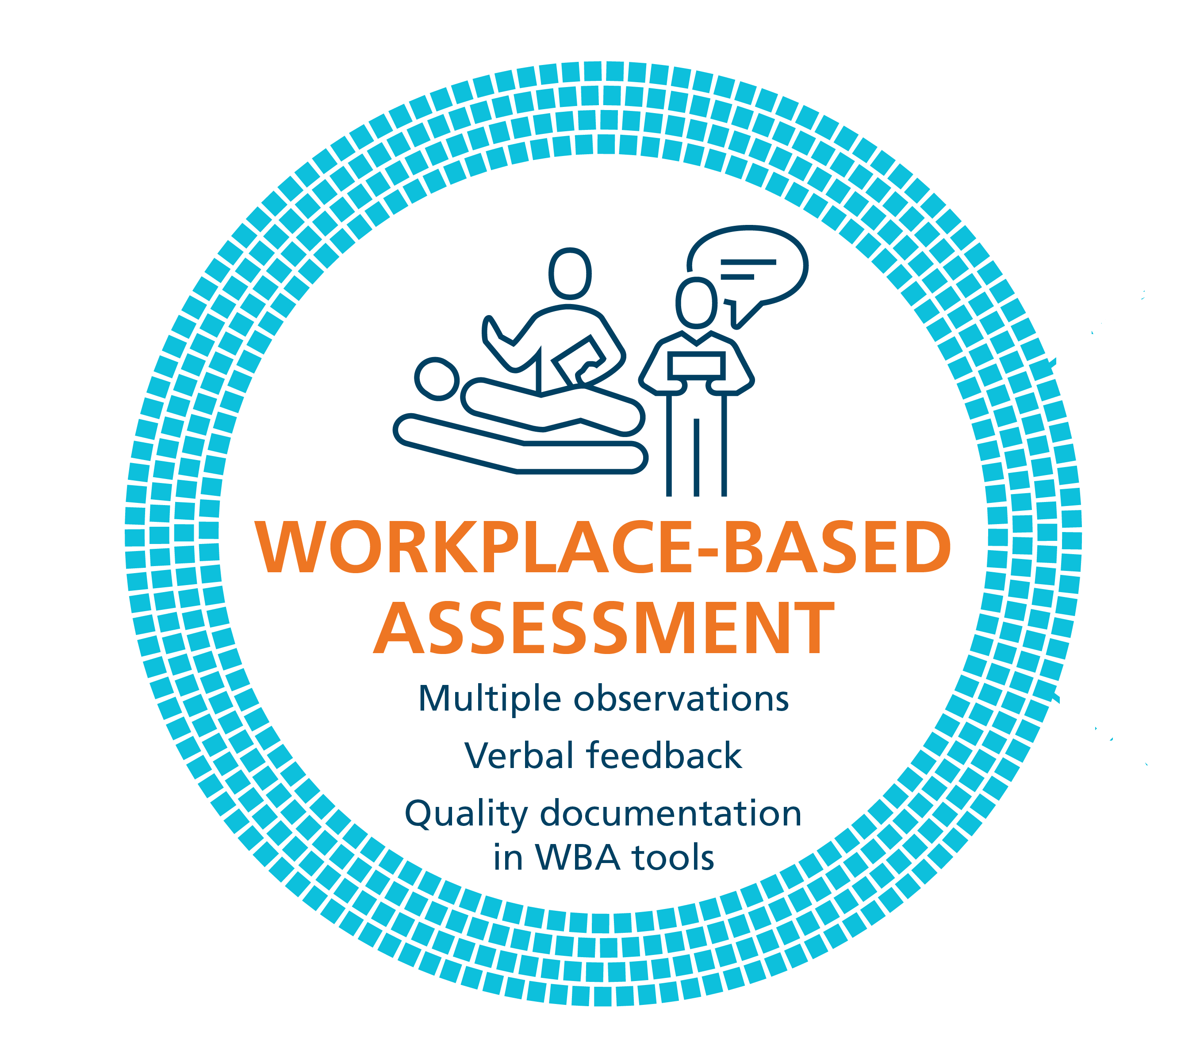
Coaching in the Moment: A Process
RX-OC&D
RAPPORT
EXPECTATIONS
OBSERVE
CONVERSATION
DOCUMENT
Notes:
Coaching in the Moment follows a process,
This process has been coined as the RX-OCD coaching process between the clinician coach and the resident.
The steps in the process are:
R: Establishing educational “Rapport” between the resident and the clinician
X: Setting “eXpectations” for the particular clinical time period;
These initial 2 steps need not take longer than a few minutes.
3) O: “Observing” some type of work that the resident does
4) C: Engaging in a “Conversation” for the purpose of improvement of that work (“coaching”);
5) D: “Documenting” a summary of the dialogue that occurred so that the resident can build a portfolio of observations demonstrating progress and areas to be improved.

Slide 77
RX-OC&D
Create a safe learning environment
Be explicit about role as a learning coach
Form an educational partnership – Growth mindset
RAPPORT
Notes:
The initial conversation, RAPPORT development, as implied, needs to occur at the outset of any learning experience as it will serve as foundational to convey to the resident an established safe learning environment.
Establishing this learning partnership (or educational alliance) between the resident and clinician is a critical reason for the initial conversation. It confirms, for the resident, the clinician’s engagement in the educational process, and specifically the clinician’s commitment to providing guidance for the growth and development of the resident; in other words, employing and conveying a growth mindset. Explicitly stating this is important to assure it is understood.
This initial discussion could also allow the resident to disclose past experiences and preferences related to learning and assessment. Similarly, the clinician could convey their style in the learning environment.
RAPPORT is the “R” in RX-OCD
Image source: https://pixabay.com/en/shops-partnership-cooperation-1014038/

Slide 78
RX-OC&D
Discuss:
Specific learning goals
Components of EPA
Previous feedback
EXPECTATIONS
Notes:
Discussing specific learning goals and objectives, particularly as related to milestones, competencies and EPAs (Entrustable Professional Activities) that the resident is currently working toward, while considering the particular expectations of the clinical setting, will assure that both the resident and clinician have a shared understanding and agreement from the outset.
Again, this discussion need not take longer than a few minutes at the beginning of a clinic or a day or week working together.
EXPECTATIONS is the “X” in RX-OCD

Slide 79
RX-OC&D
OBSERVE
Indirect Observation
Review of products of the resident’s work
clinical notes, presentations, written reflections
Observations from secondary sources
Direct Observation
Watching a resident doing work
in real time or asynchronously (i.e. videotaped)
Notes:
Discussing specific learning goals and objectives, particularly as related to milestones, competencies and EPAs (Entrustable Professional Activities) that the resident is currently working toward, while considering the particular expectations of the clinical setting, will assure that both the resident and clinician have a shared understanding and agreement from the outset.
Again, this discussion need not take longer than a few minutes at the beginning of a clinic or a day or week working together.
EXPECTATIONS is the “X” in RX-OCD

Slide 80
RX-OC&D
CONVERSATION
Related to the task that was observed
To ensure the resident understands how improvements could be made
Notes:
Critical to the process is the dialogue that must occur between the clinician and the resident once the clinician has observed the resident or the resident’s work.
The purpose of this conversation is to ensure the resident understands how improvements could be made. This is “coaching feedback”.
This type of coaching conversation would happen, most often, after the particular work task was completed but still “in the moment” of that clinical experience.
In some instances, this feedback may be offered as the work is being done with the clinician providing real time coaching in the moment. This, of course, needs to be agreed upon by the resident and the clinician prior to the observation occurring and is dependent on the context.
CONVERSATION is the ‘C’ in RX-OCD

Slide 81
Key Words for Helpful Coaching Conversations
Because
Next time…
Try…
Recommend…
Consider….
I suggest…

Slide 82
RX-OC&D
DOCUMENT
Summarize feedback & actionable suggestions for improvement
It is important to document outlier performances because they could be rare but important
Notes:
A final but essential step to the CinM process is for the clinician to take a few minutes to document a summary of the coaching feedback dialogue that takes place (at least some of the time) in the resident portfolio.
Every coaching interaction might not be documented in clinical experiences of longer duration, but a representative sample of the observations during that clinical time period is essential. For short duration clinical experiences (i.e. a resident spending only one half day clinic with a particular staff clinician) the goal should be for at least one coaching conversation to be recorded. In some instances, more than one observation of work and coaching opportunity might occur in one clinic and could be documented.
It is not critical that the clinician know whether what was observed is a representative performance of a task for a particular learner. Documenting observations and suggestions for improvement, whether representative or an outlier execution of a task, helps create a comprehensive illustration of competence. Any one observation leading to Coaching in the Moment is not high stakes and will not lead to grave consequences, but is part of the process to support resident development and progress.
Whether or not a clinician documents an encounter does not restrict the resident from making their own record of the feedback and suggestions given, including their personal reflections on how it was helpful for and/or integrated into their practice performance.
DOCUMENT is the ‘D’ in RX-OCD

Slide 83
Extra Slides

Slide 84
CORE of Discipline EPAs (applicable to clinical experiences in Schizophrenia Service)
EPA C-1
EPA C-4
Developing comprehensive biopsychosocial formulations for patients across the lifespan.
Performing psychiatric assessments, providing differential diagnoses & developing a comprehensive Tx/management plan for all presentations in adults patients of medium to high complexity.

Slide 85
CORE of Discipline EPAs (applicable to clinical experiences in Schizophrenia Service)
EPA C-5
EPA C-8
Integrating the principles & skills of psychopharmacology into patient care.
Identifying,
assessing, and managing emergent situations in
psychiatric care
across the lifespan.

Slide 86
CORE of Discipline EPAs (applicable to clinical experiences in Schizophrenia Service)
EPA C-9
EPA C-10
Teaching students, residents, the public and other health professionals.
Applying relevant legislation & legal principles to patient care & clinical practice.

Slide 87
Notes:
Because you are going to tend to see Residents during pgy3 C & A rotation and then pgy5 Selectives and Electives,
Which translate to (next slide)

Slide 88
Soft Launch Core of Discipline & Transition to Practice Stages
General Adult Inpatient
General Adult Outpatient
Notes:
The Core of Discipline & Transition to Practice Stages of Training
Which will begin to apply for the soft launch cohort in 2022, I will be coming back to meet with you in advance of that to more specifically review the EPAs for those stages, though after the break we are going to look at the EPAs that will apply to Geriatric Psychiatry specifically
Which leads us to one last component of rolling out CBME, (next slide)

Slide 89
Work-Based Assessment (WBA)

Slide 90
Growth Mindset
Fixed Mindset | Growth Mindset
Believes level of achievement is predetermined, and tha dedicated effort will not promote greater achievement. | Believes there is potential for an individual’s growth and improvement .
Desires to prove and avoids looking unintelligent. | Desires to learn, and looks for opportunities to challenge current status.
Asks: Will I succeed or fail? Look smart or not? | Asks: Will I grow? Will I overcome challenges?
Questions the effort of bothering. | Believes that growth & learning require effort.
Ignores constructive criticism. | Learns from feedback; uses it to improve.
Dweck, 2006
Notes:
Carol Dweck is Psychology professor, at Stanford University, in California, and she has been doing research on achievement and success of students for the last several decades. She coined the terms “Growth Mindset” and “Fixed Mindset” to describe peoples beliefs about and therefore their approach to learning.
The Growth Mindset, is one in which it is believed that there is potential for an individual’s growth and improvement and this very much aligns with coaching as a teaching and learning method to promote development.
Whereas someone who ascribes to the Fixed mindset (example features of which are in the yellow column) believes the level of achievement is predetermined, and effort dedicated toward learning will not promote greater achievement.
According to Dweck, someone with a Growth mindset has:
a high DESIRE to learn, looks for opportunities to challenge their current status & grow as a result of taking on challenges,
learns from feedback and wants to know how to improve, while recognising that the improvement will require practice and effort.
In contrast, someone with a Fixed Mindset perspective:
approaches situations with a judgement lens, wondering “how will I look – smart or not?” Individuals who are of a Fixed Mindset don’t value challenging situations as learning opportunities
because effort is pointless as is responding to feedback
If we consider this in the context of clinical teaching, from the residents’ perspective – someone who is aligned with a Fixed Mindset would view observation done by a coach as an assessment at that point in time for what they know, and that judgements and decisions about my future will be made based on this point in time status. This could be called an “assessment OF the learning” that has taken place.
Someone holding a Growth mindset, would see an opportunity to have an expert coach observe their work at any point in time as an opportunity to get expert input and feedback on what they could improve. This could be called an “assessment FOR learning”
Dweck, C. S. (2006). Mindset: The new psychology of success. New York: Random House.

