Slide 1
Prepping for Pgy3
February 2021

Slide 2
You are well on your way!

Slide 3
Biannual Review Form
Tracking your progress
Synchronized with you before each Competence Committee Progress Review Meeting:
Sept for Oct. CC Meeting
March for April CC Meeting
Each June to ensure completion of activities for that Pgy-year
February of Pgy5 for CC Mtg

Slide 4
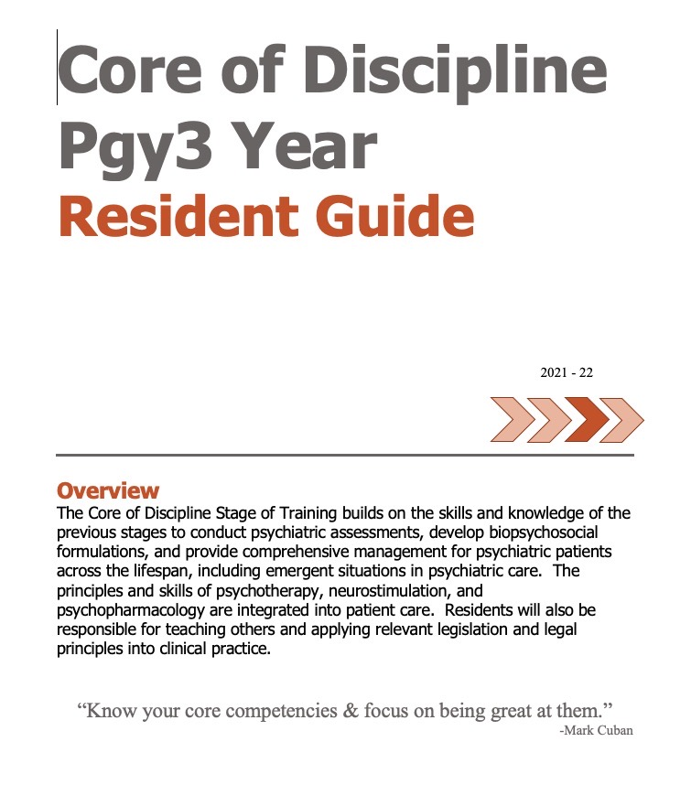
Tracking Tools for You
2019 Cohort Program Requirements Document
Personal Biannual Review Form
Pgy3 Resident
O Guide

Slide 5
Pgy2 Completion Check List

Slide 6
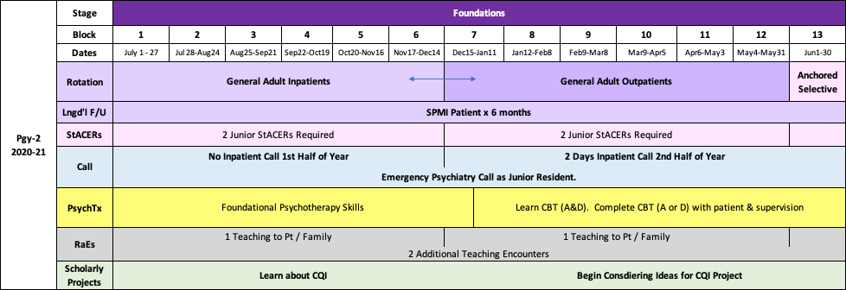
Review of Items for Completion of Pgy2

Slide 7
Longitudinal F/U of Patient with Severe & Persistent Mental Illness
SPMI = Schizophrenia, Schizoaffective Disorder, Bipolar Disorder
6 months following 1 patient or 2 patients x 3 months each
Log each encounter with the patient as individual entries
Log to include:
Date of Encounter | Clinical Update | Tx Plan | Comorbidities / Social Considerations | Personal Reflections | Learning Points

Slide 8
Other Logging Requirements
Addictions Log – minimum 90 hours over residency
Developmental Disorders Log – ensure experience throughout residency
Date of Encounter | Supervisor | Patient Initials | Diagnosis | Description of Addictions Encounter | Learning Points | Time (hours)
Date of Encounter | Supervisor | Patient Initials | Diagnosis | Description of DDx Encounter | Learning Points

Slide 9
CBME Pgy2 & 3 Anchored Selective Options
Dual Diagnosis
Addictions
Forensics
ACT
Shelter Health
Women’s Health Concerns
Other
Schizophrenia Services
Indigenous Health
HIV Psychiatry
Research
Refugee & Immigrant Health
Proposal Due Date:
2 months prior
Experiences with special populations
Total of 8 weeks
May divide or all one experience
If you have other ideas – let us know!
2021: Within 100 km home site

Slide 10
Promoting Reflective Practice Exercises & Discussion Sessions
Coming Spring 2021!

Slide 11
Review of Items for Completion of Pgy2
1

Slide 12
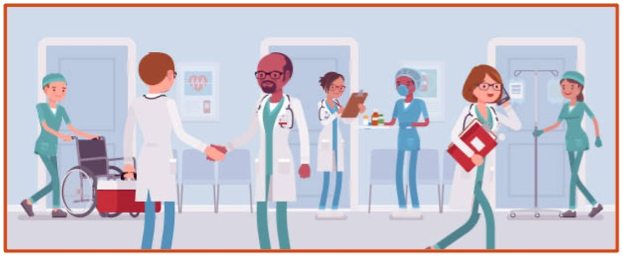
Transitioning to Senior in PES - Hamilton
Discuss with seniors:
Tasks they manage
Organizational strategies
System navigation strategies
Through the spring, “practice” being the senior
Transitioning to senior session with Dr. Fudge this spring

Slide 13
Review of Items for Completion of Pgy2

Slide 14
Psychotherapy Training in Pgy-2
Emotion Focused
CBT
MI
Complete applicable PTeR modules.
Don’t fall behind!

Slide 15
EPA C-6 Integrating the principles of psychotherapy into patient care.
EPA Assessment Form completed at end of Each psychotherapy session
Part A:
13 Observations of Achievement
At least:
3 Psychodynamic Sessions
3 CBT Sessions
2 Family or Group Sessions
2 Sessions in one other Evidence-Based Modality
3 Demonstrating Integration of Psychotherapeutic Interventions in Regular Clinical Care
Notes:
Evaluations during soft launch, at least at beginning, may be paper based.

Slide 16
EPA C-6 Integrating the principles of psychotherapy into patient care.
Part B:
Logbook Tracks:
Modality
Treatment
No extra logging required!
Captured by EPAs & PTeR
Notes:
Evaluations during soft launch, at least at beginning, may be paper based.

Slide 17
Review of Items for Completion of Pgy2

Slide 18
Resident as Educators (RaEs) Required during Pgy-2
General Inpatient Rotation
Teaching to Patient / Family
General Outpatient Rotation
Teaching to Patient / Family
Any Setting
Any Teaching Encounter
Any Teaching Encounter
Use
EPA C10

Slide 19
Review of Items for Completion of Pgy2

Slide 20
EPAs for Completion of Foundations Stage
(ie. by the end of Pgy2)
F1
(medical presentations)
F2
(assmt & DDx, low to med complexity psychiatric pts)
F3
(mngmt plans in low to med complexity psychiatric pts)
F4
(risk assessments)
F5
(critical appraisal)
Notes:
Here are the EPAs that residents must complete by the end of the Foundations of Discipline Stage of Training. Ie. by the end of Pgy2
There are five EPAs that must be achieved during the Foundations Stage of training
Remember – Foundations runs through 2/3 of Pgy1 and all of Pgy2
They must successfully complete all 5 of them by the end of Pgy2

Slide 21
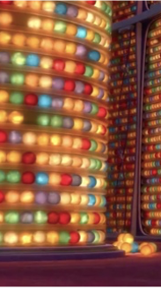
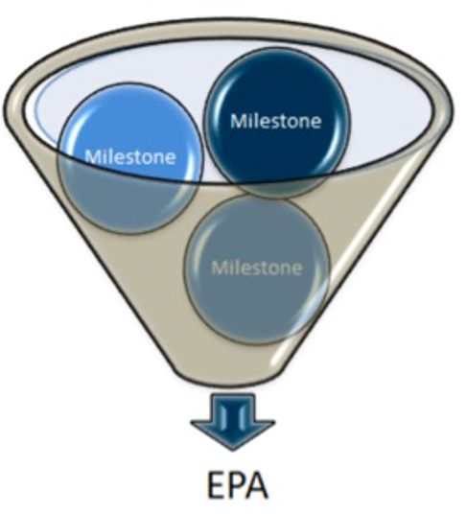
Core EPAs that should be
in progress during Pgy2
C10
Teaching Others
C6
Psychotherapy
Some Core, if context arises
(except C2 or C3)
Notes:
Here are the EPAs that residents must complete by the end of the Foundations of Discipline Stage of Training. Ie. by the end of Pgy2
There are five EPAs that must be achieved during the Foundations Stage of training
Remember – Foundations runs through 2/3 of Pgy1 and all of Pgy2
They must successfully complete all 5 of them by the end of Pgy2

Slide 22
Evals to Be Completed by You in Pgy-2
Eval for each academic half-day session
Psych Emerg Supervisor Evals
Inpatient On Call Supervisor evals
Rotation Supervisor Evals
Rotation Evals
Grand Rounds Evals

Slide 23
Assessments to Be Completed about You in Pgy-2
Mid- & End-Rotation ITARs
On Call Evals (PES & Inpt)
EPA Ass'ts
StACERs
RaEs
(C10)
**Mock OSCE
**Mock MCQ Exams

Slide 24
Planning for Pgy3

Slide 25
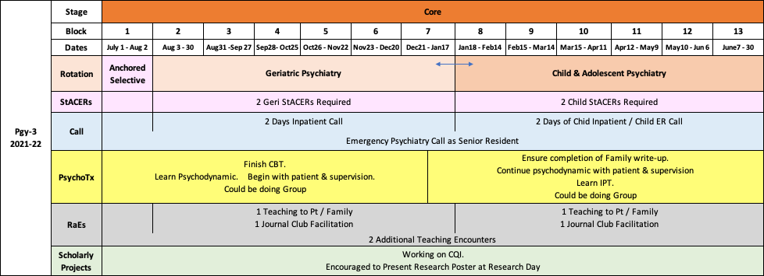
Overview of Pgy3

Slide 26
Rotations & StACERs during Pgy3

Slide 27
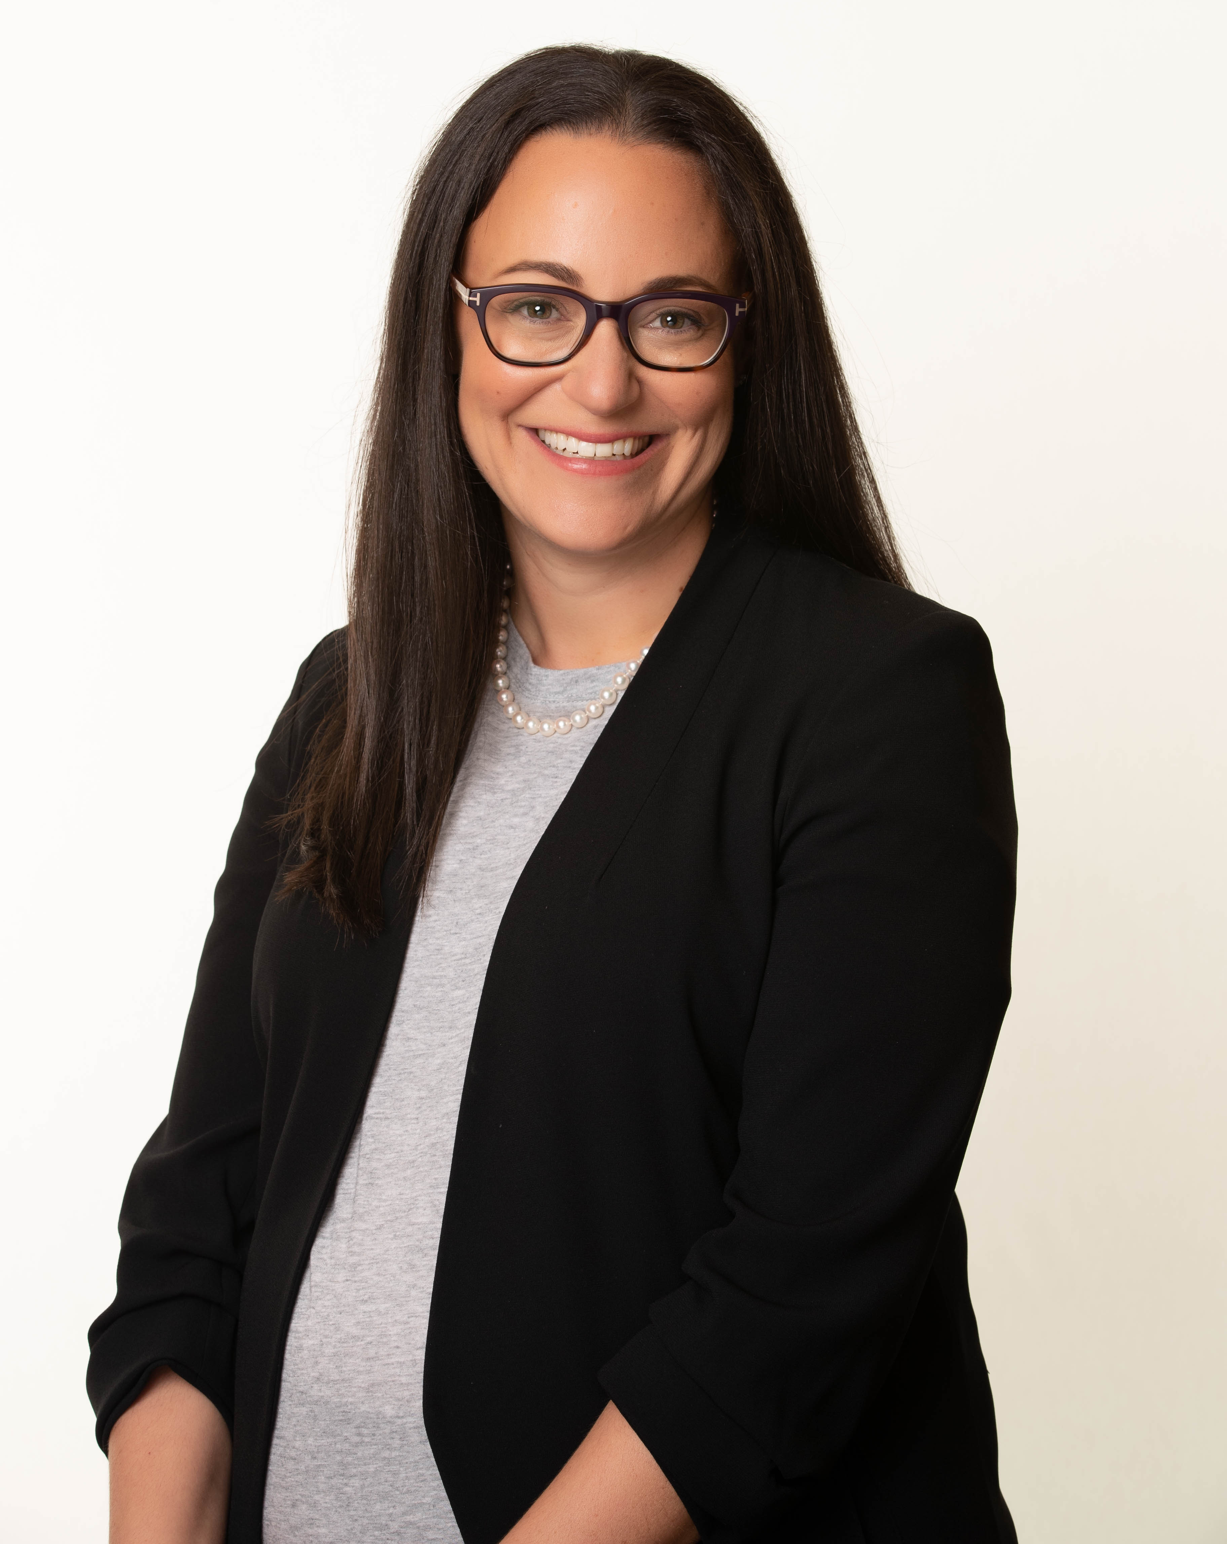
Core Geriatric Psychiatry Rotation
6 blocks
Orientation sessions will be held approximately first week
Rotation Coordinator:
Dr. Jessica Waserman

Slide 28
Core Geriatric Psychiatry Rotation
WRC Residents:
3 months inpatient
3 months outpatient
Hamilton Residents:
2 months inpatient & 4 months outpatients
completion of ECT e-module & ECT experiences
geriatric medicine clinics
supervisor listing will offer combinations

Slide 29
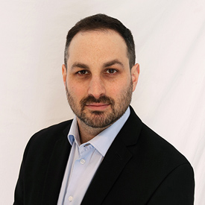
Core Child & Adolescent Psychiatry Rotation
6 blocks
3 months inpatient; 3 months outpatient
Orientation week will be held first week of Block 2 & Block 8
Rotation Coordinator:
Dr. Evan Weizenberg

Slide 30
Core Child & Adolescent Psychiatry Rotation
WRC Residents:
Grand River Hospital
6 blocks concurrent inpatient & outpatient
OR
3 blocks of each consecutively

Slide 31
Core Child & Adolescent Psychiatry Rotation
Hamilton Residents:
Inpatient & Outpatient occur consecutively
2 weeks on MAU & Pediatric C/L
Supervisor listing:
Outpatient Teams & indicate preference for primary outpatient supervisor
Indicate choice for preferred inpatient supervisor

Slide 32
StACERs (Structured Assessment of Clinical Encounter Reports)
2 Child & Adolescent
2 Geriatric
Subspecialty-specific forms on Medportal
Keep copy for yourself
Send to Cheyenne / Ashley asap

Slide 33
Horizontal Electives during Pgy3
Up to ½ day per week
Anything relevant to a career in Psychiatry
Clinical
Administrative
Educational
Research
Must discuss with Core Supervisor
Proposal Required

Slide 34
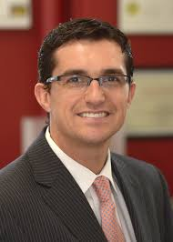
Resident Research & Scholarship Committee
New! Being established Winter 2021
Committee to support residents in their research & scholarly pursuits
Development of research opportunities, networking, marketplace, etc for residents
If pursuing horizontal electives in research/scholarship, review with RR&SC to ensure:
Development in academic goals
Able to meet development of clinical training objectives

Slide 35
On-Call Experiences during Pgy3

Slide 36
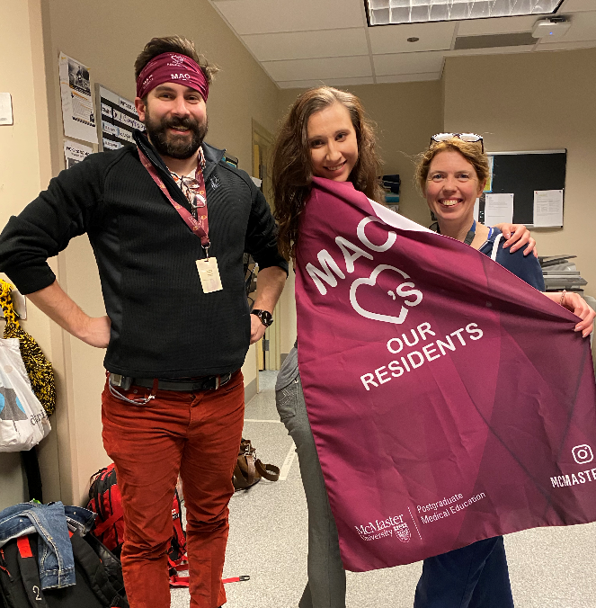
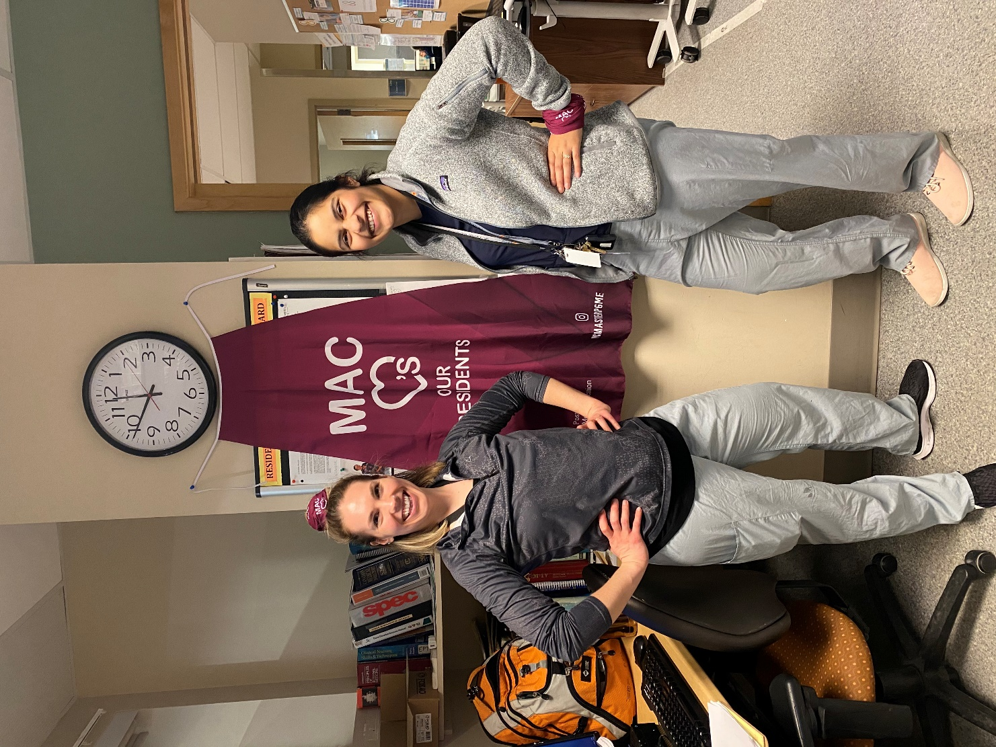
On Call in Hamilton
Psychiatry Emergency Service (PES)
2Plus Model. No Tues or Sat.
M, W, Thurs overnight with post-call day
Friday until 11pm
Anticipating July 2021 – Sunday until 11pm with no post-call day
Senior Resident Call frequency = 1 /12 - 14
Inpatient Call Experiences
2 Saturdays during each half of year. 8am – 11pm
During Child: MUMC on Psychiatry Inpatient Unit, MAU/ER & C/L
During Geri : At SJH Charlton on AMH Units & C/L

Slide 37
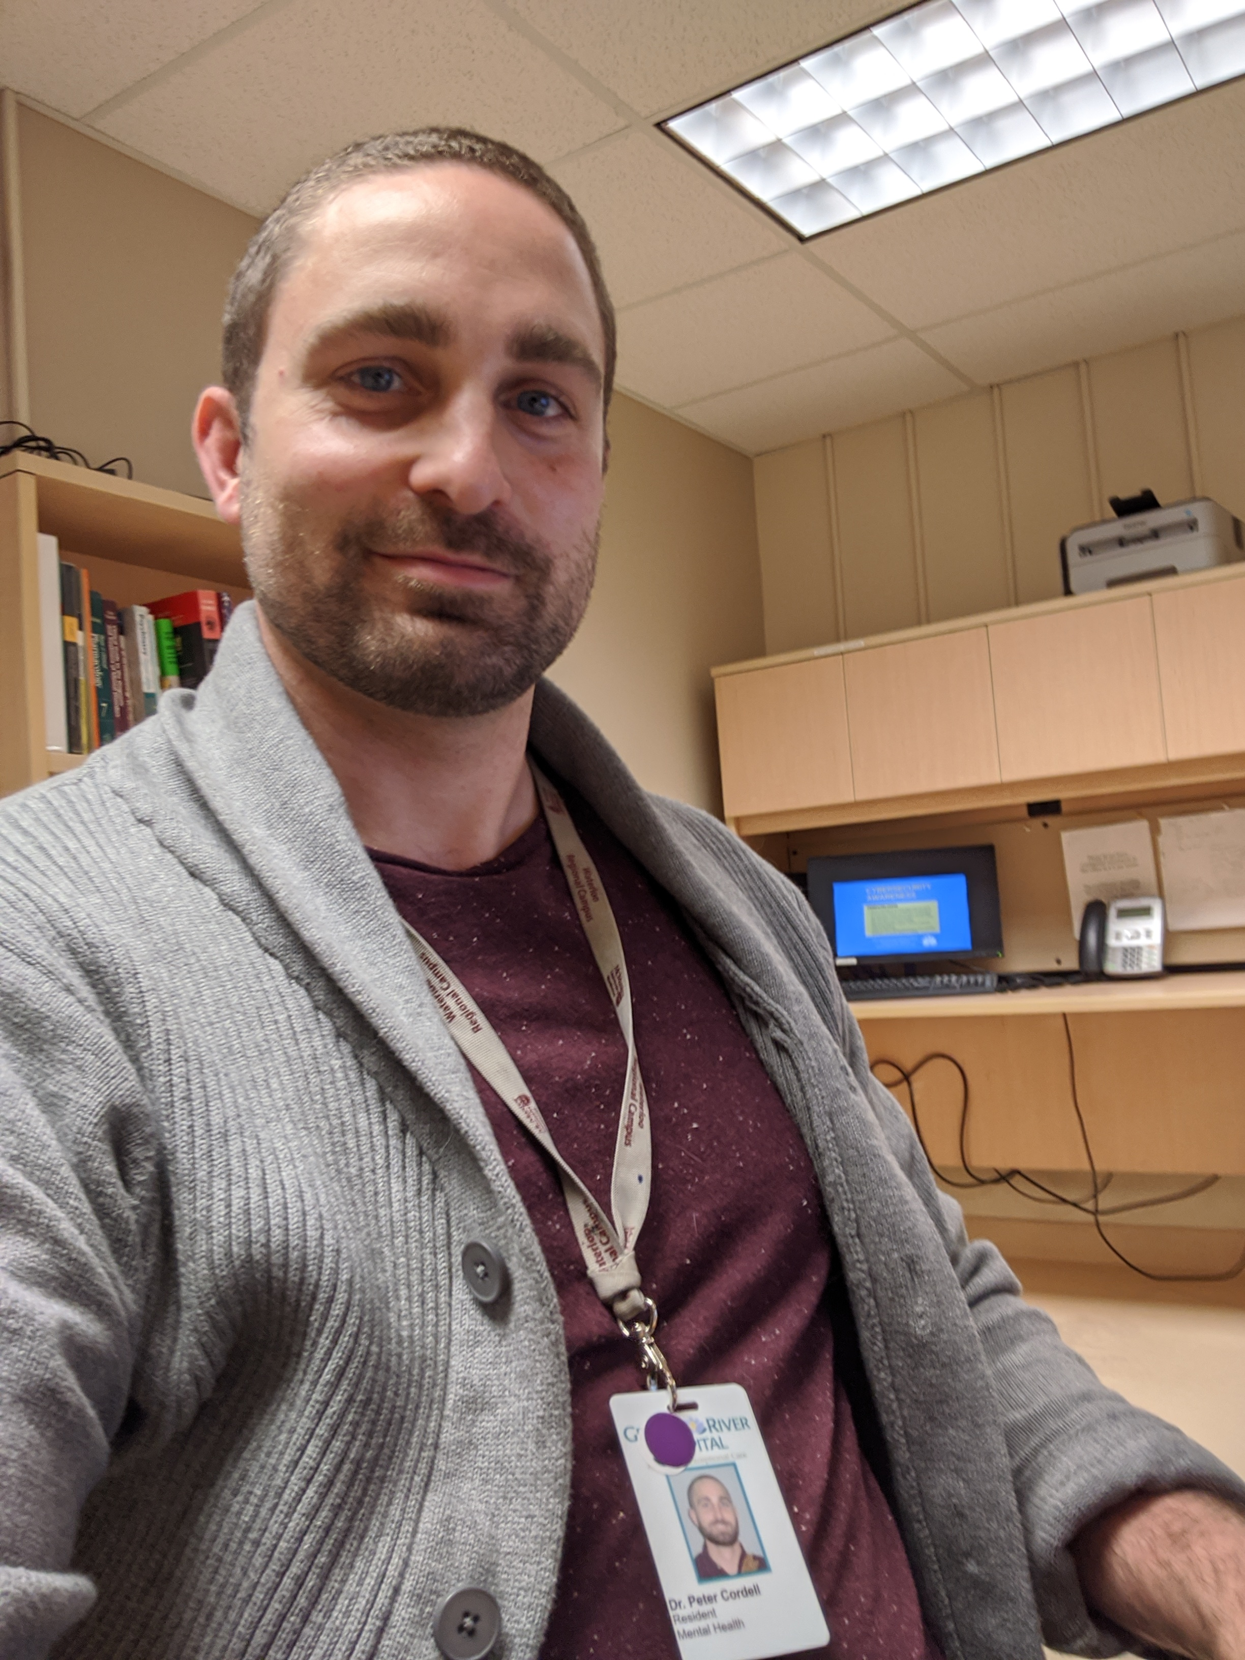
On Call in WRC
Emergency Psychiatry
Senior Resident in Psych Emerg
Until 11pm with no post-call days
Inpatient Call Experiences
2 Saturdays during each half of year. 8am – 11pm
During Child: At GRH
During Geri: At Homewood

Slide 38
Psychotherapy during Pgy3

Slide 39
Psychotherapy Training over Residency
Emotion Focused
CBT
Group
Psychodynamic
Interpersonal
Pgy-2
MI
DBT
Pgy-4
Family

Slide 40
Psychotherapy Training during Pgy3
Group
Psychodynamic
CBT
Complete PTeR modules.
Don’t leave these to Pgy5!
Family

Slide 41
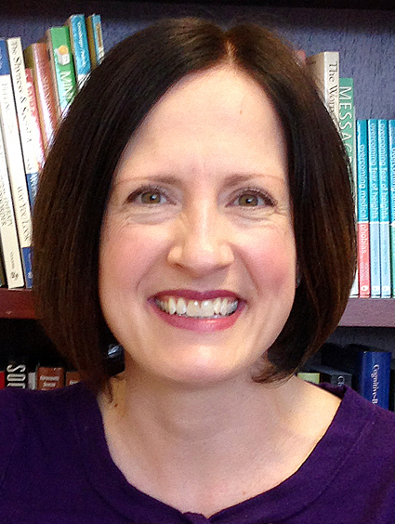
Psychotherapy Training during Pgy3
Finish CBT
Do Family Write Up !
Learn & Begin Psychodynamic
Learn & Consider Doing Group
All PTeR Modules Mandatory
Psychotherapy Coordinators
Dr. Snelgrove
Dr.
Rowa
Dr.
McColl (WRC)

Slide 42
Resident as Educator Requirements during Pgy3

Slide 43
Resident as Educators (RaEs) Required during Pgy-3
Geriatric Psychiatry Core Rotation
Teaching to Patient / Family
Interprofessional Rounds / Journal Club Facilitation
Child & Adolescent Core Rotation
Teaching to Patient / Family
Interprofessional Rounds / Journal Club Facilitation
Any Setting
Any Teaching Encounter
Any Teaching Encounter
Use
EPA C10

Slide 44
Scholarly Project Expectations during Pgy3

Slide 45
Overview of Required Scholarly Projects during Residency
CQI Project
May be done as group
Academic Sessions & Support
Grand Rounds Presentation
Grand Rounds Prep Sessions during Pgy-4
Research Poster
Support in developing poster
Due by Research Day of Pgy-4
Presentations delivered in Pgy-4
Aim to begin Pgy3; complete by end of Pgy-4
One poster at Dept. Research Day during residency

Slide 46
Overview of Required Scholarly Projects during Residency
CQI Project
May be done as group
Academic Sessions & Support
Grand Rounds Presentation
Grand Rounds Prep Sessions during Pgy-4
Research Poster
Support in developing poster - $100
Due by Research Day of Pgy-4
Presentations delivered in Pgy-4
Aim to begin Pgy3; complete by end of Pgy-4
One poster at Dept. Research Day during residency

Slide 47
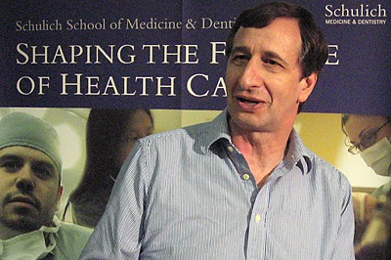
CQI Progress in Pgy-3
Dr. Sophyia Benjamin
CQI Coordinator, WRC
Academic Sessions during half-day curriculum
Meet with CQI Coordinator to discuss
Aim to get started during Pgy3; To be completed by end of Pgy4
Dr. Nick Kates
CQI Coordinator, Hamilton

Slide 48
Research Opportunities

Slide 49
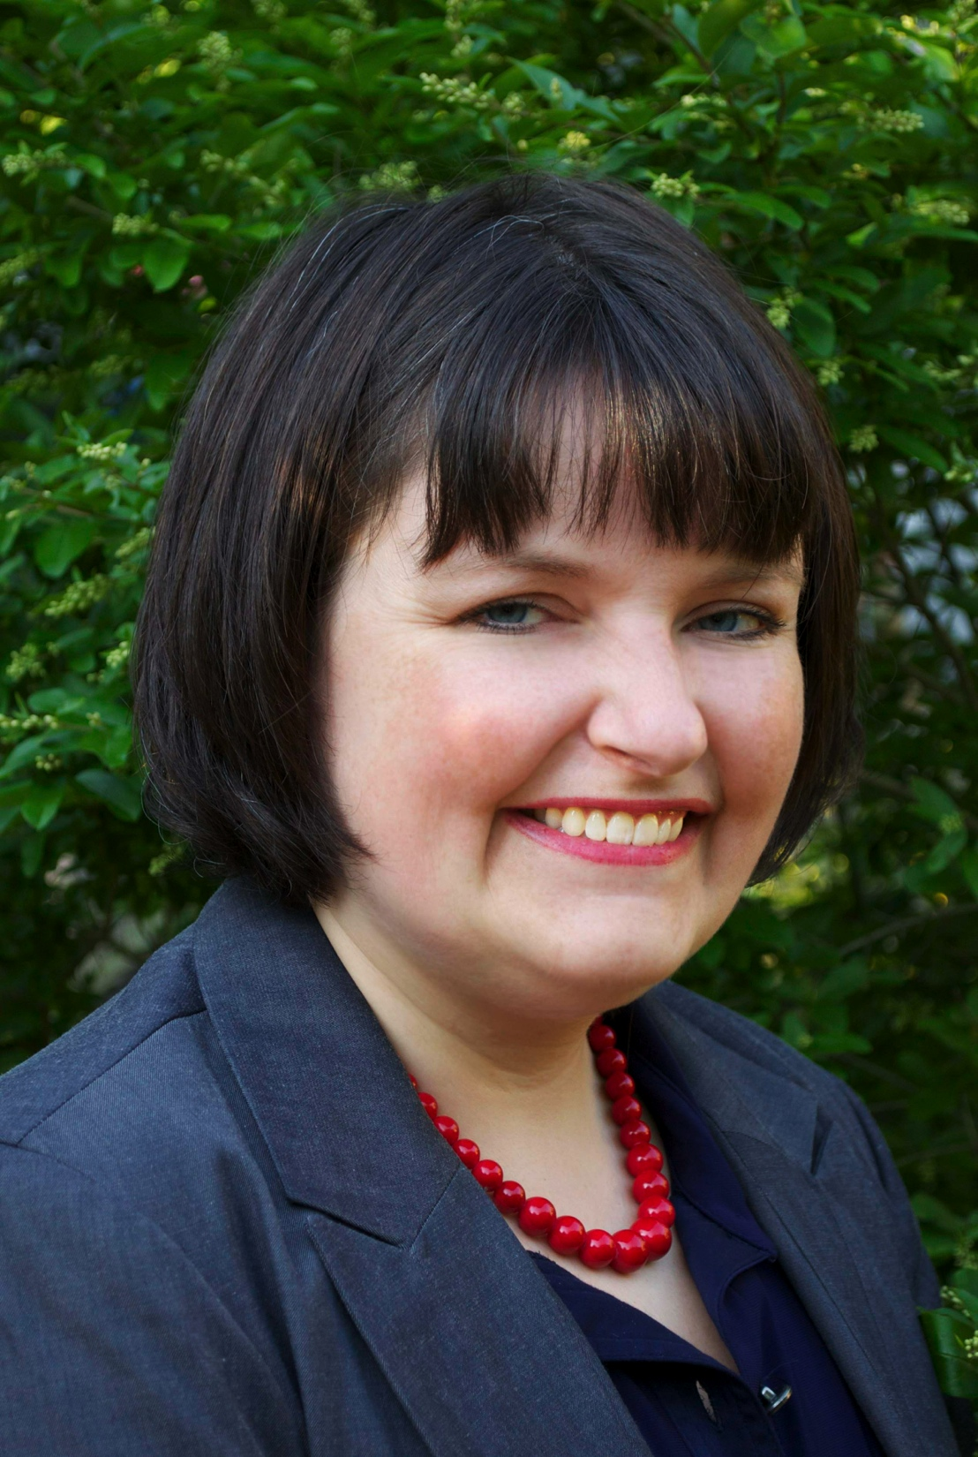
Research Opportunities during Pgy3
Extra-curricular
Horizontal Elective
Block Elective
Concurrent Graduate Studies
During Rot’n
Dr. Sophyia Benjamin
Psychiatry PG Research Lead, WRC
Dr. Margaret McKinnon
Associate Chair, Research
Dept. P&BN
Dr. Benicio Frey
Psychiatry PG Research Lead, Hamilton
Clinician Investigator Program Lead, DP&BN

Slide 50
Resident Research & Scholarship Committee
New! Being established Winter 2021
Committee to support residents in their research & scholarly pursuits
Development of research opportunities, networking, marketplace, etc for residents
If pursuing horizontal electives in research/scholarship, review with RR&SC to ensure:
Development in academic goals
Able to meet development of clinical training objectives

Slide 51
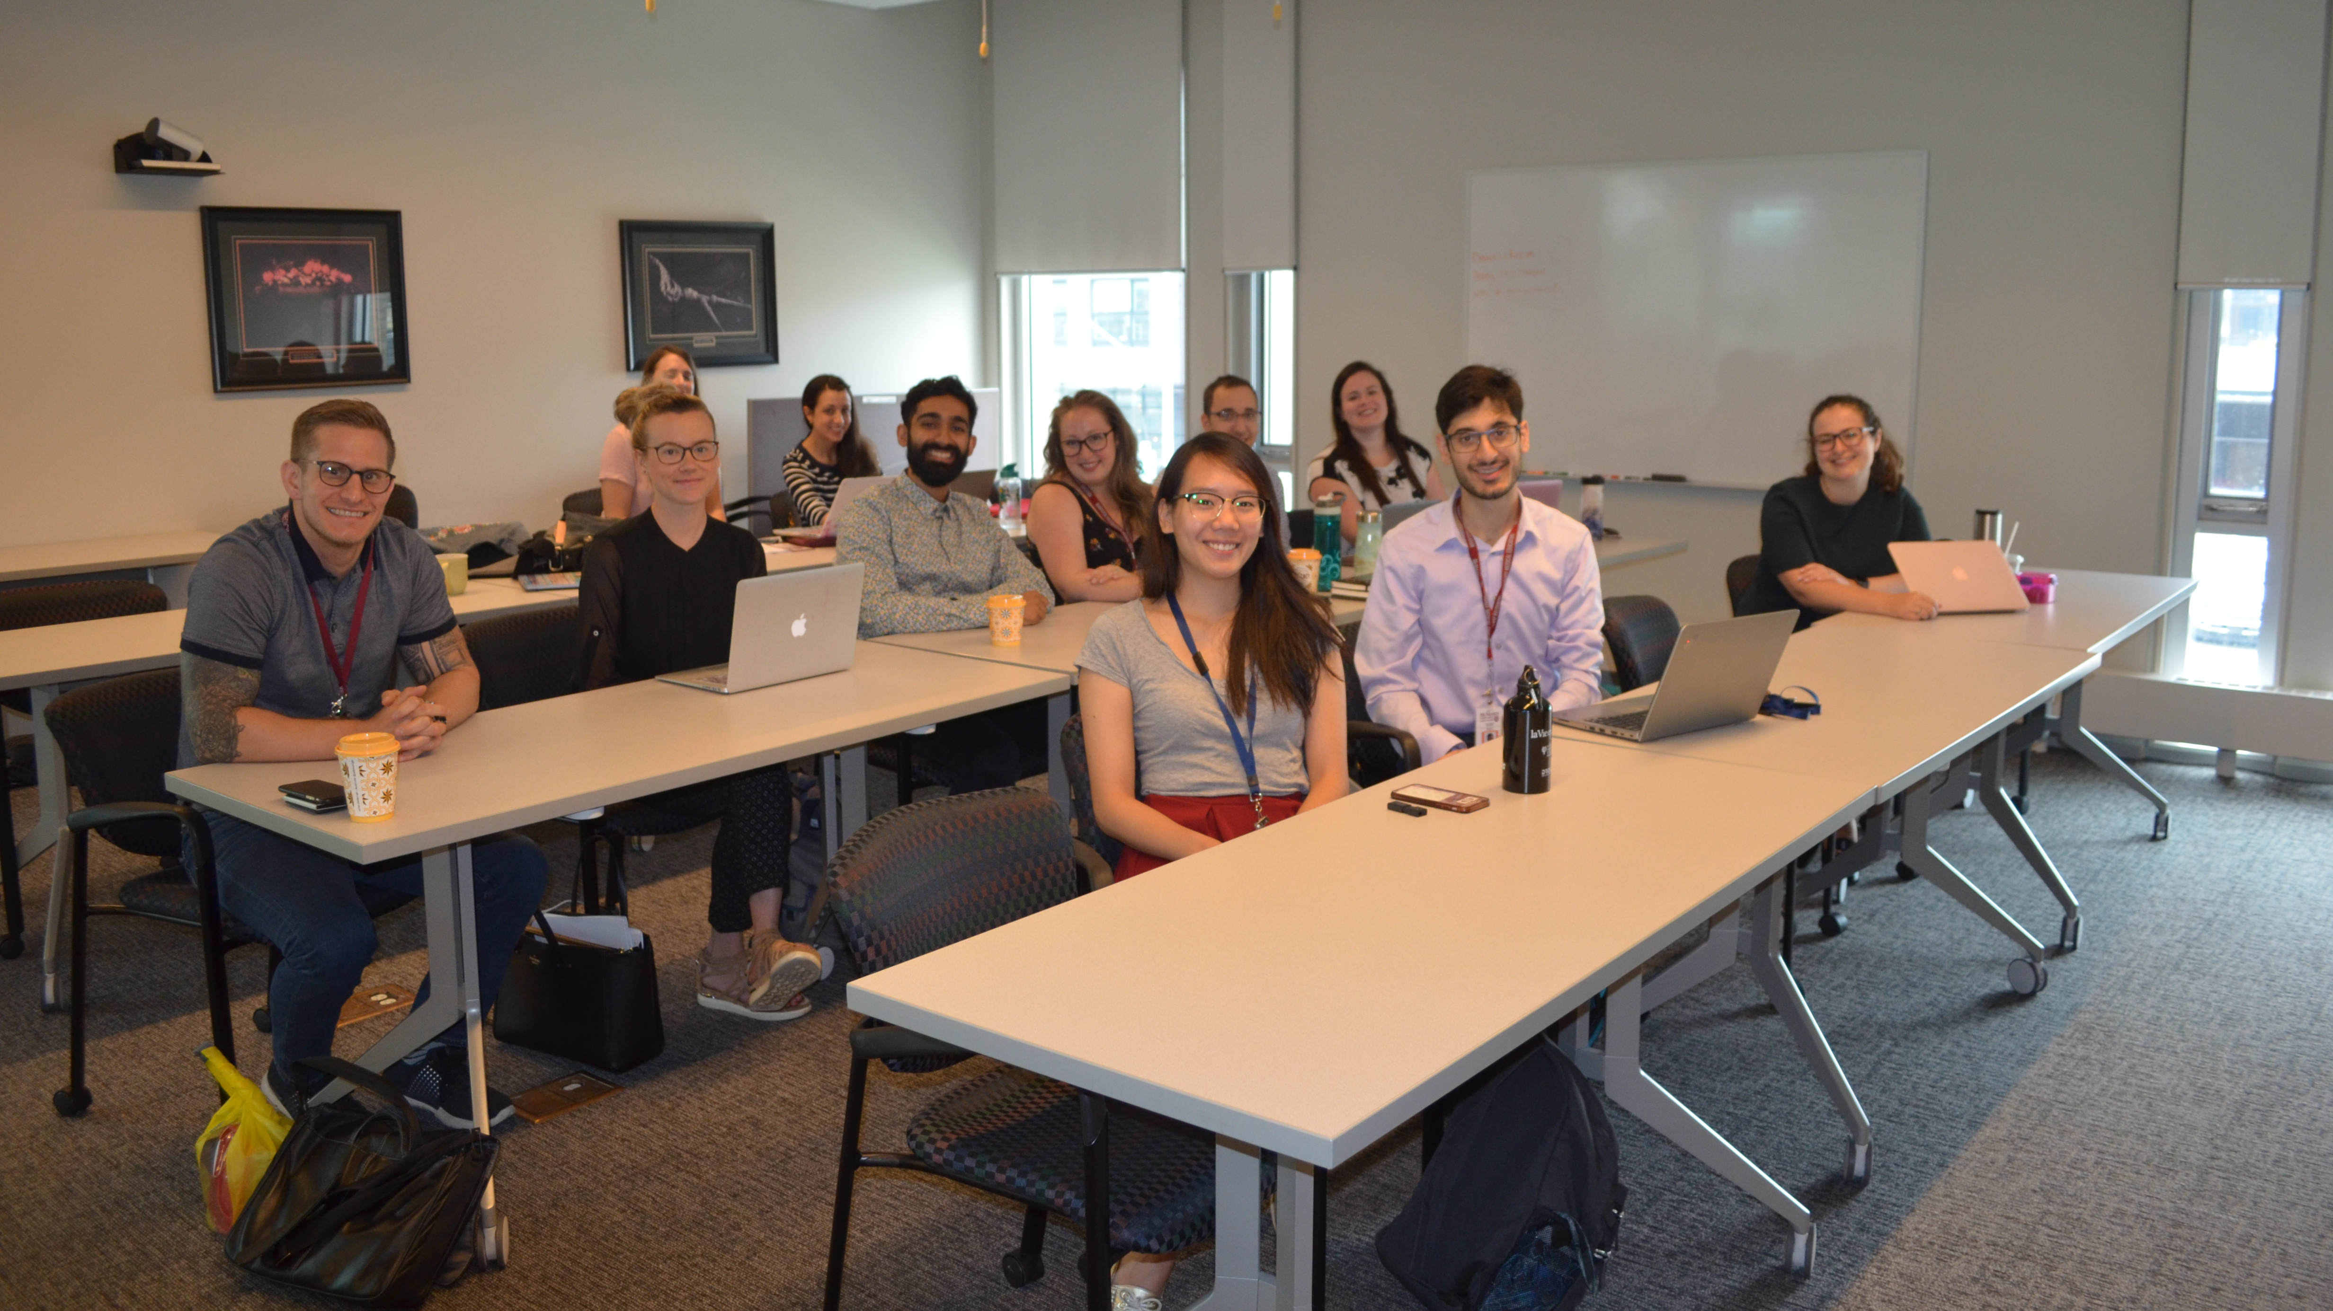
Academic Days

Slide 52
Academic Days during Pgy3
9 – 10 am
Departmental Grand Rounds
10 am – 12:30 pm
Non-scheduled
12:30 – 2:00 Academic Enrichment Session
PRAM; EBM; Interviewing Skills; OSCE Prep; Complex Case Rounds
2:30 – 4:30 pm
Core Curriculum Session
Psychopharmacology
May see Psychotherapy Patient/Supervisor
Notes:
Mandatory

Slide 53
Exam Preparation

Slide 54
Royal College Exam Preparation
OSCE Prep Sessions
Mock OSCE Exams – Mandatory
Fall & Spring
Mock MCQ Exams – Mandatory
PRITE (American) – Early Fall
Two 2-hour sittings
COPE (Canadian) – Late Fall
Online during 2-week window

Slide 55
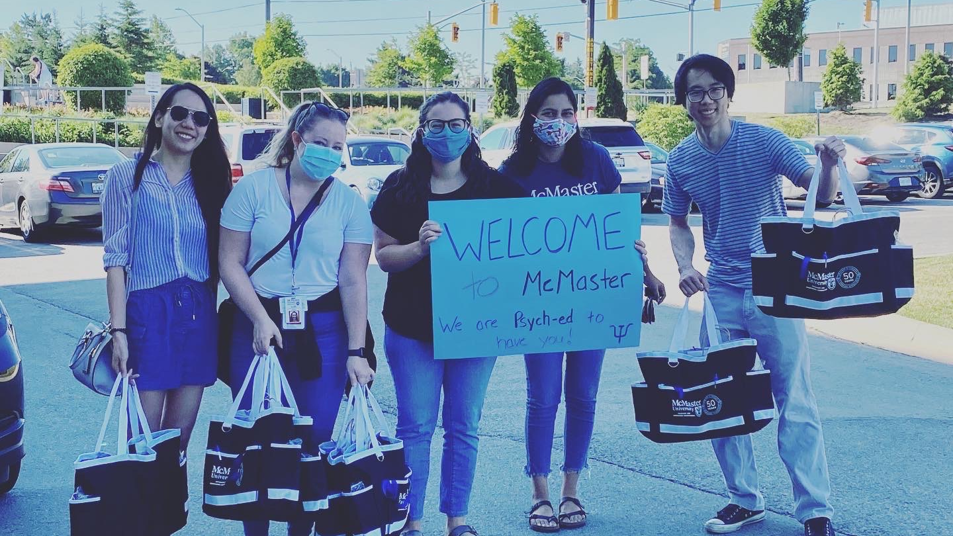
Other Opportunities

Slide 56
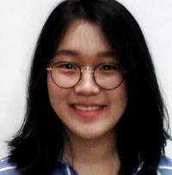
For Consideration
Education
Teaching Chiefs
UG Teaching Opportunities (TOSCE; Clinical Skills; Bootcamp)
TtD Sessions
Leadership
Chief Resident Positions
PRAM & PROW Executive
PRAM & PROW Positions

Slide 57
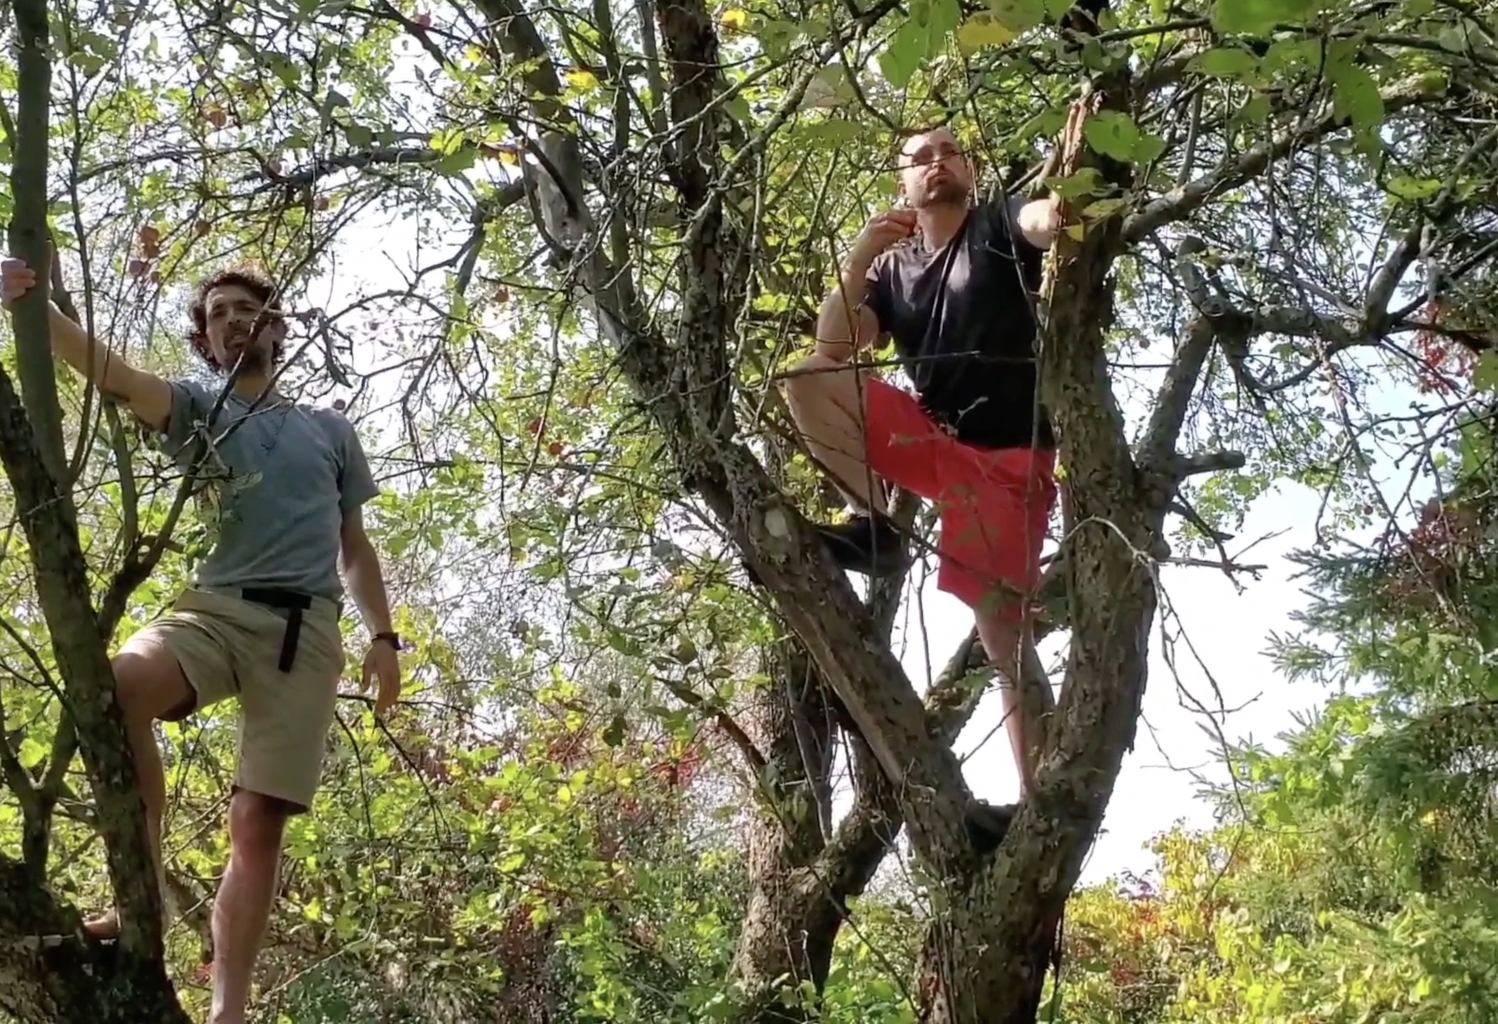
Professional Expectations
Please submit required documentation in timely manner, please
Please read & reply to emails from our program
Enjoy the moments

Slide 58
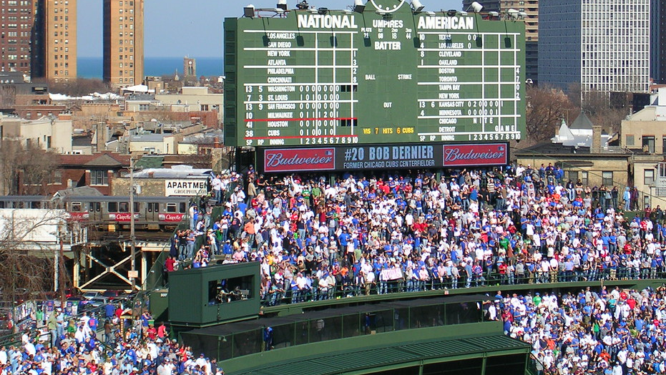
7th Inning Stretch
This Photo by Unknown Author is licensed under CC BY-NC-ND

Slide 59
Core EPAs (all completed by end Pgy4)

Slide 60
EPA Goals by the End of Pgy3
Complete C2
(children & youth)
Complete C3
(older adults)
Complete C7
(neurostimulation)
C6 for all sessions
(psychotherapy)
C10 for Pgy3 RaEs
(teaching)
C4-specific contexts
(formulation)
C8-specific contexts
(psychopharm)
C1-some contexts
(mgmt. plans)
C5-some contexts
(emergent sitns)
C9-some contexts (legislation)

Slide 61
Performing psychiatric assessments and providing differential diagnoses & management plans for Children and Youth.
6 Observations of Achievement
At least:
1 mood disorder, anxiety disorder, or OCD
1 ADHD
1 abuse, neglect, or trauma
1 intellectual disability/ASD comorbidity
2 children 4 – 12 years
4 direct observations with review of document’n
3 different observers
2 adolescents 13 - 18 years
2 by child & adolescent psychiatrist
EPA C-2

Slide 62
Performing psychiatric assessments and providing differential diagnoses & management plans for Older Adults.
6 Observations of Achievement
At least:
3 neurocognitive disorders, including 1 BPSD
1 major depressive disorder and/or bereavement
1 anxiety disorder
1 case with rationalization of polypharmacy
2 different observers
4 direct observations including review of documentation
2 by geriatric psychiatrist or psychiatrist with special interest in older adult patients
EPA C-3

Slide 63
Integrating the principles & skills of Neurostimulation into patient care.
EPA C-7
Part A: Suitability for Neurostimulation
3 Observations of Achievement:
1 older adult
1 adult
At least:
2 for ECT
Part B: Delivery of Neurostimulation
3 Observations of Achievement:
At least:
2 for ECT

Slide 64
Integrating the principles and skills of Psychotherapy into patient care.
EPA C-6
During the Pgy3 Year:
Each Supervision Session
CBT
Psychodynamic
Group

Slide 65
Providing Teaching for students, residents, the public and other health care professionals.
EPA C-10
Geriatric Psychiatry Core Rotation
Teaching to Patient / Family
Interprofessional Rounds / Journal Club Facilitation
Child & Adolescent Core Rotation
Teaching to Patient / Family
Interprofessional Rounds / Journal Club Facilitation
Any Setting
Any Teaching Encounter
Any Teaching Encounter
Use EPA C10
to assess Resident as Educator activities

Slide 66
Developing comprehensive Biopsychosocial Formulations for patients across the lifespan.
EPA C-4
8 Observations of Achievement
At least:
1 child
1 adolescent
4 adults
2 older adults
3 w supervisor having observed the pt ass’t
3 high complexity
4 by psychiatrists
1 by child & adolescent psychiatrist
1 by geriatric psychiatrist

Slide 67
EPA C-8
Integrating the principles & skills of Psychopharmacology into patient care.
12 Observations of Achievement
At least:
1 starting & monitoring LAI
1 starting & monitoring Oral Antipsychotic
2 starting & monitoring 2 different classes Antidepressants
1 starting & monitoring Sedative / Hypnotic
1 starting and/or monitoring Lithium
1 starting and/or monitoring Clozapine
1 managing Benzodiazepine
1 managing Opioid Agonist Therapy
1 Mood Stabilizer Other Than Lithium
12 Observations of Achievement
1 agent to treat Mx-induced SEs
1 patient on multiple psychiatric medications
2 patients in C/L setting
2 Child/Adolescent including starting & managing 1 stimulant
2 Older Adults, including 1 w cognitive enhancer
1 Pregnant or Breastfeeding patient
5 Different Observers
3 by Psychiatrist Observers

Slide 68
EPA C-1
Developing comprehensive Treatment / Management Plans for adult patients (of medium to high complexity)
8 Observations of Achievement
At least:
2 emergency setting
2 inpatient setting
2 outpatient setting
2 consultation-liaison setting
2 psychotic disorders
1 substance use disorder
1 anxiety disorder
1 history of trauma
1 major depressive disorder
8 Observations of Achievement
1 bipolar disorder
1 personality disorder
1 intellectual disability / autism spectrum comorbidity
3 high complexity
5 direct observations with review of documentation
4 different observers
3 by psychiatrists

Slide 69
Identifying, assessing, and managing Emergent Situations in psychiatric care across the lifespan.
EPA C-5
8 Observations of Achievement
At least:
2 patients with acute agitation & aggression
2 patients with active suicidal ideation
1 patient with homicidal/violent ideation or risk of harm to others
2 patients with medical emergencies related to delirium
1 patient with acute dystonic reaction, catatonia, serotonin syndrome or NMS
3 by psychiatrist / psychiatric subspecialist

Slide 70
Applying relevant Legislation & Legal Principles to patient care and clinical practice.
EPA C-9
6 Observations of Achievement
At least:
2 Capacity to Consent to Tx in Complex Patients.
2 Restricting/Limiting Rights with Due Process Protections
1 Evaluation for Restrictions/Limitations re: Disability
1 Mandatory or Discretionary Reporting
4 by Psychiatrists
2 Different Psychiatrist Observers

Slide 71
EPA Benchmarks
Aiming for 2 – 3 EPA assessments a week, between daytime rotation & on-call experiences

Slide 72
EPA Goals by the End of Pgy3
Complete C2
(children & youth)
Complete C3
(older adults)
Complete C7
(neurostimulation)
C6 for all sessions
(psychotherapy)
C10 for Pgy3 RaEs
(teaching)
C4-specific contexts
(formulation)
C8-specific contexts
(psychopharm)
C1-some contexts
(mgmt. plans)
C5-some contexts
(emergent sitns)
C9-some contexts (legislation)

Slide 73
Evals to Be Completed by You in Pgy-3
Eval for each academic half-day session
Psych Emerg Supervisor Evals
Inpatient On Call Supervisor evals
Rotation Supervisor Evals
Rotation Evals
Grand Rounds Evals

Slide 74
Assessments to Be Completed about You in Pgy-3
Mid- & End-Rotation ITARs
On Call Evals (PES & Inpt)
EPA Ass'ts
StACERs
RaEs
(C10)
**Mock OSCE
**Mock MCQ Exams

Slide 75
Dockside / Riverside Chats
Check-in
Ideas for Pgy3 Rotations
Questions / Concerns
Self-Reflection Tool

Slide 76
Tracking Tools for You
2019 Cohort Program Requirements Document
Personal Biannual Review Form
Pgy3 Resident
O Guide

Slide 77
Self-reflective tool

Slide 78
Nobody trips over mountains.
It is the small pebble that
causes you to stumble.
Pass all the pebbles in your path
and you will find
you have crossed the mountain.
-unknown

Slide 79
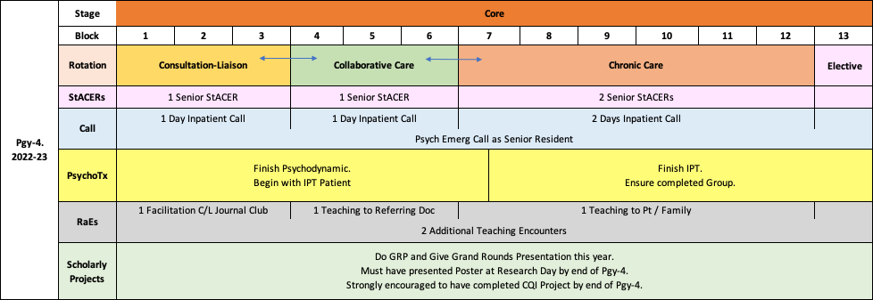
Looking Ahead to Pgy4 & 5

Slide 80
Pgy4 Requirements

Slide 81
Pgy5 Requirements

Slide 82
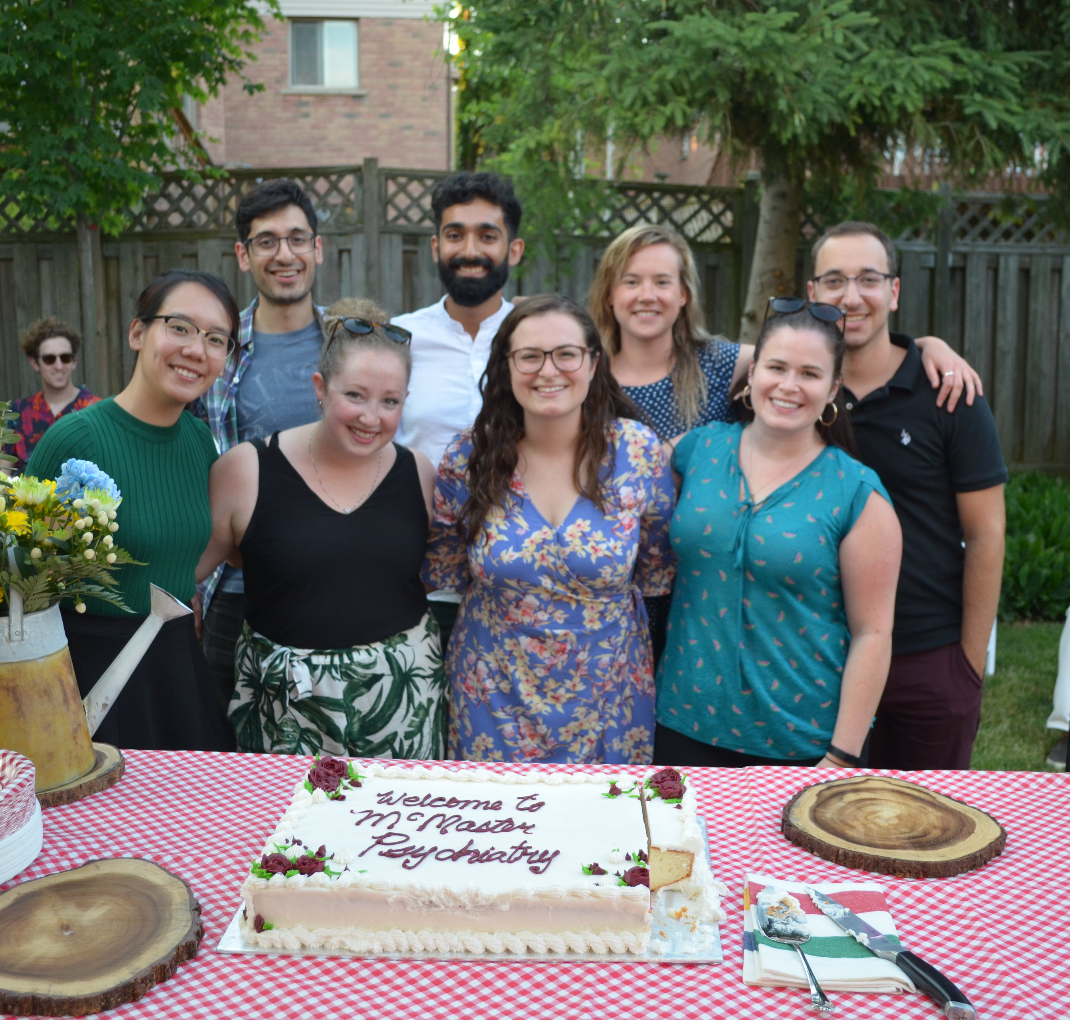
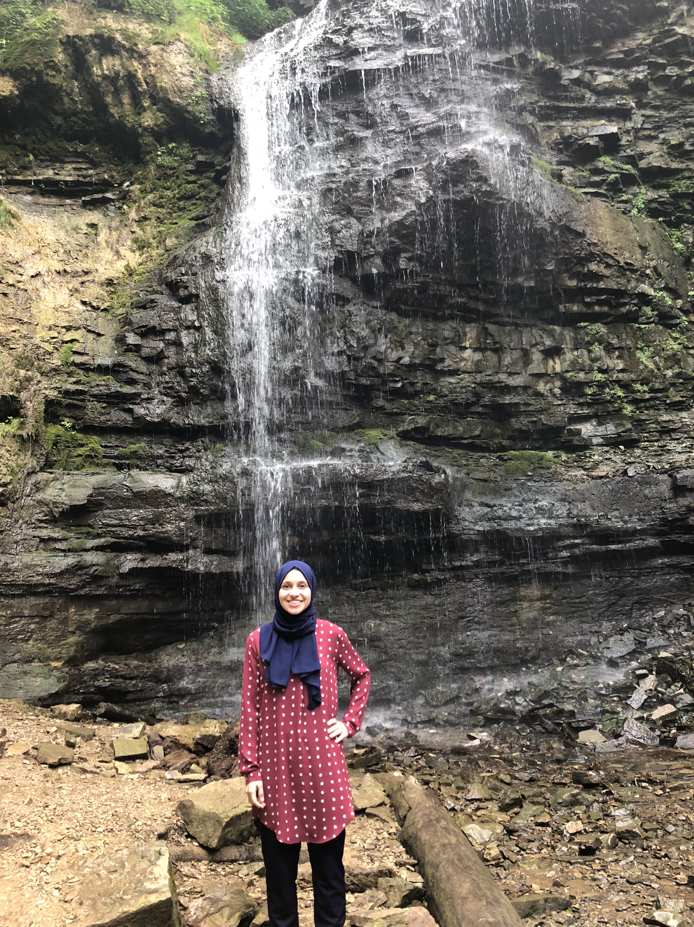
Amazing!

