Slide 1
On the Road to Competency Based Medical Education!
JoAnn Corey, CBME Lead
Dept. of Psychiatry, McMaster University

Slide 2
We are doing well…
Why would we change anything?

Slide 3
Notes:
Sometimes people have good ideas. Things that could make the way we are currently doing things, a little better.
But as humans, we are very resistant to change.
Why would we want to change something if it seems to be working ok?

Slide 4
Why Move to CBME?
Feedback.
Exposure to experiences.

Slide 5
Why move to Competency Based Medical Education?
An effort to educate even better
Better prepared graduates
More fulfilled educators
Improved patient care
Notes:
Because we want to work to educate even better.
To better prepare our graduates
To feel more fulfilled as educators
And most importantly, to provide even better patient care moving forward

Slide 6
What is different ab0ut Competency Based Medical Education?

Slide 7
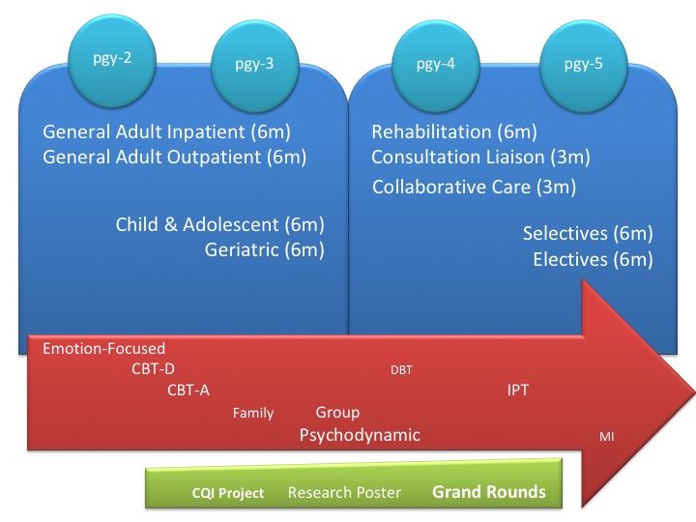
What is Competency Based Medical Education?
Currently,
Time is emphasized as a marker of resident having acquired the required knowledge & skills.
Notes:
Unless something really wrong happens, they do the required time in a rotation, they pass.

Slide 8
What is Competency Based Medical Education?
Problem with our current system of assessment:
Mainly at the end of the experience
Evaluations are not always useful
Inter-evaluator inconsistency
Not capturing concerns early
Less effective at promoting development
Notes:
Unless something really wrong happens, they do the required time in a rotation, they pass.
We evaluate them at the end. While we ask that supervisors provide regular observation & feedback, the only time we know for sure they are getting some sort of assessment & feedback, is at the end.

Slide 9
What is Competency Based Medical Education?
CBME:
Rotations will still be defined times
Emphasize acquisition of knowledge & skills
Organized around outcomes expected of a resident
Advancement dependent on achieving those expected outcomes
Allow more frequent, low-stakes assessments & feedback
Foster effective feedback
Allow residents to be more open to feedback

Slide 10
What is this going to look like?

Slide 11
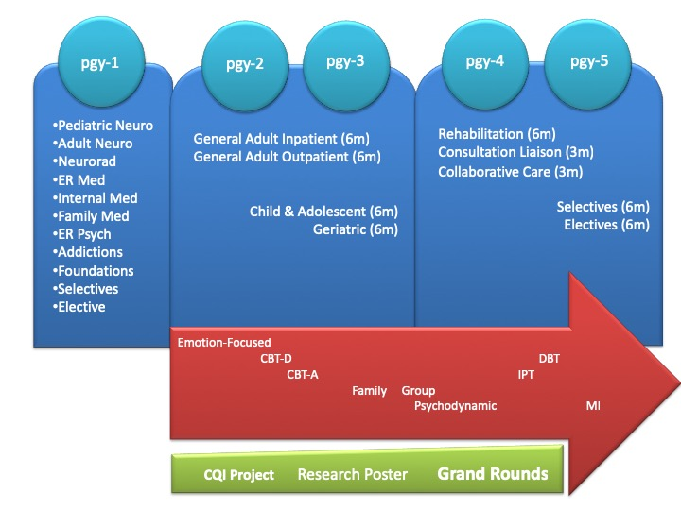
Training Requirements Current:

Slide 12
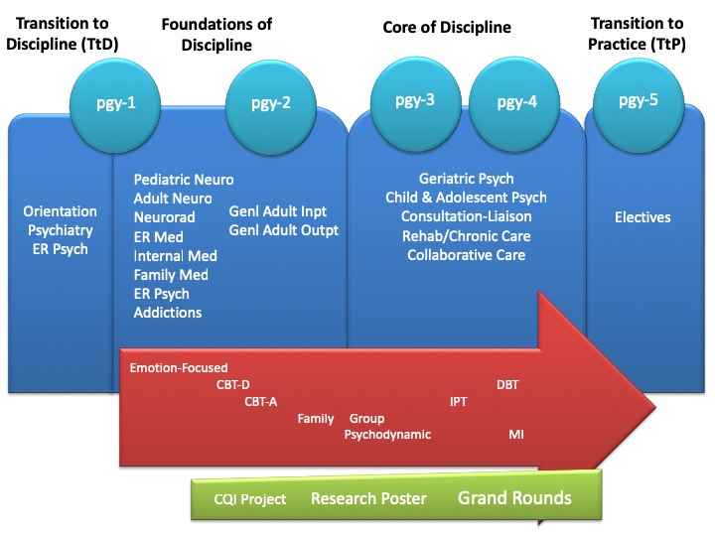
Training Requirements CBME:

Slide 13
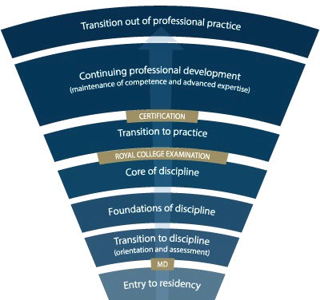
Competence Continuum -Stages of Training-
PGY-5
PGY-4
PGY-3
PGY-2
PGY-1
Notes:
*for general program
Need to understand how this will look for Subspecialty Programs
Explain the stages of training.
-RC will outline what needs to be accomplished within each Stage of training and give a range of time that stage may last
-Programs will then decide the duration of each stage (within the RC parameters) and what rotations will be included in each stage
-RC is also going to outline what skills & knowledge must be accomplished by a resident before they are to be allowed to progress to the next stage of training. Those required skills & knowledge are packaged into what is called the EPAs and Milestones (which I will explain in a minute)
-Programs will then map which EPAs should be accomplished in which rotations for their residents

Slide 14
Key Points
Residents will progress through
Stages of Training
along the Competence Continuum.
There will be defined
Required Training Experiences
in each stage of training.

Slide 15
During each stage of training there will be defined Competencies (i.e. knowledge & skills) that a resident must acquire

Slide 16
Entrustable Professional Activities (EPAs)
These competencies are called

Slide 17
Entrustable Professional Activities (EPAs)
Key tasks that an individual can be trusted to perform in a given health care context
Example:
Obtaining a psychiatric history, which includes a preliminary diagnostic impression that informs a management plan for patients presenting with mental health concerns.

Slide 18
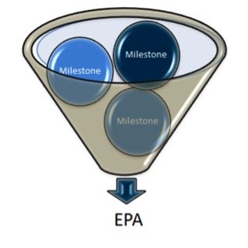
Developmental Milestones
EPAs can be broken down into smaller, component parts called

Slide 19
Developmental Milestones
The smaller, defined components that are needed to complete the full EPA
Examples: Conduct a mental status exam
Respect professional boundaries
Observable markers of an individual’s ability
Reference the CanMEDS roles applicable to that EPA

Slide 20
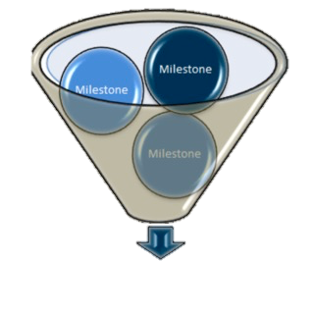
The Royal College will define which EPAs a resident must acquire before they can advance to the next Stage of Training.
Transition to Practice
Core of Discipline
Foundations of Discipline
Transition to Discipline

Slide 21
Key Points
EPAs are competencies residents must acquire.
Milestones are the small tasks that make up an EPA.
Residents will need to achieve specific EPAs in each stage of training.

Slide 22
How will this work?

Slide 23
Supervisor
Plans their learning
Views Curriculum Map
Know what EPAs working on
Develops a Personal Learning Plan
Resident
Sets Objectives for Rotation
Based on Curriculum Map
Based on Personal Learning Plan
Supported by technology

Slide 24
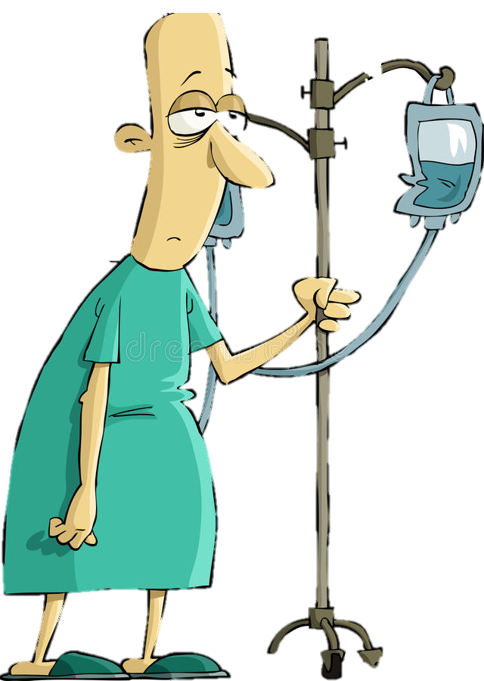
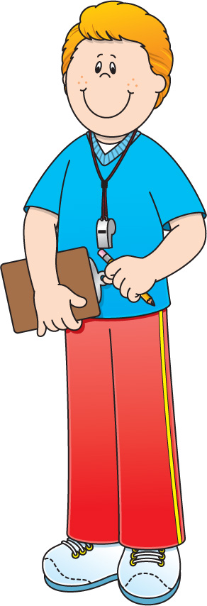
Program
Director
Academic
Coach
Competence Committee
Regional
Education Lead
Notes:
Resident and faculty identify an opportunity for an EPA assessment. Supervisor might review expectations and remind resident of feedback to build on from a previous encounter.
Resident goes to do the EPA activity. Supervisor supervises either directly or indirectly depending on the EPA
Supervisor provides verbal feedback to the resident, giving 1 or 2 specific, actionable pieces of feedback
Supervisor documents the assessment on MedSIS.
They cycle repeats itself, resulting in multiple assessments of the same EPA over time, by different observers.
These get collated on MedSIS, with the data being available to the resident, the Program Director, the REL, the resident’s academic coach and the Competence Committee (formerly the Evaluation Committee)
It is the Competence Committee that makes decisions around progression, promotion

Slide 25
Competence Committee
Assess overall achievement of EPAs & milestones
Regularly review learner EPAs/milestones
Approve changes to learner status:
Monitor overall progress of learner
Confirm acquisition of EPAs
Promote to next stage of training
Identify any concerns
Modify learning plan
Develop & monitor specialized learning plans
Request Royal College certification

Slide 26
Key Points
Regular assessment & feedback.
Cued by the resident
Competence Committee assesses overall achievement.

Slide 27
Entrustability Scale
EPAs will be assessed using the

Slide 28
Entrustment Scale
Resident demonstrates sound knowledge & skill but needed help with unexpected challenges. A few things you needed to f/u on. No significant concerns.
Learner required
constant direction
1 | 2 | 3 | 4 | 5
I had to do. | I had to talk them through. | I needed to prompt. | I had to provide minor direction. | No direction required for safe, indpt care.
Learner didn’t do task or
Needed complete hands on guidance
Some independence but required intermittent direction
Complete independence. Understands risks. Performs safely. Practice ready.
**If any concerns with risk assessment or safety, should not score above 3.
Notes:
Level 1 – the supervisor had to perform the clinical activity while the resident observed. This may apply if resident has never done the task before, or they started but situation became too challenging so supervisor elected to complete the task. Ideally, the supervisor would provide direction and teaching afterwards.
Level 2 – self-explanatory
Level 3 – The resident required frequent direction, requiring occasional prompting and guidance, particularly with more complex aspects of the encounter OR the encounter required supervisor to follow-up on a number of important aspects not completed by the resident
Level 4 – Previously “I needed to be there just in case”. Now Changed to: “I had to provide minor direction.“ Resident demonstrates sound technique but you were not confident that their knowledge base or skill was sufficient to ensure that if they had run into an unexpected challenge or complication, they would have been able to manage this. Examples might include: when you posed questions as to how they would handle a complication of the situation, they were not able to explain; they completed the assessment adequately but there were nuances that made it more akward or less effective; resident completed the assessment thoroughly but it took them a much longer than normal time.
Level 5: Previously”I did not need to be there”. Now changed to: “I did not need to provide direction for safe, independent care” or “No direction required for safe, independent care”. Resident able to complete all aspects of the assessment independently and safely including troubleshooting unexpected challenges; completed in sufficient time frame (may not have been as fast as experienced staff person). Any teaching you provided was more to enrich a competenct knowledge base. Any prompts given were not necessary for resident to complete the task safely and independently.

Slide 29
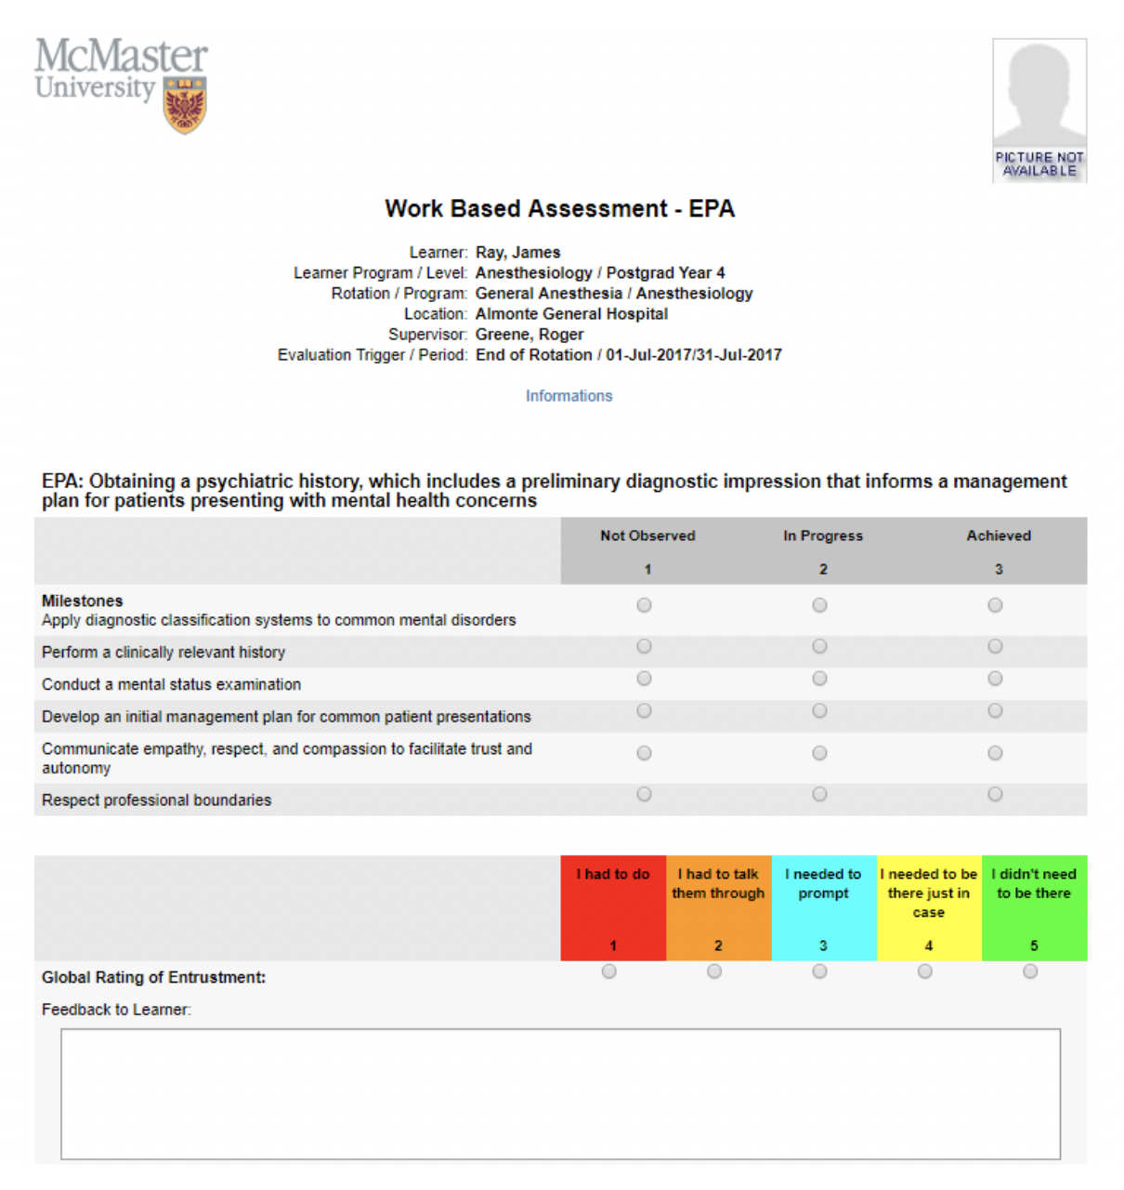
Work-Based Assessment (WBA)

Slide 30
Assessment of EPAs
may involve direct or indirect observation
Complete WBAs even if task rated less than a 4 or 5, to promote knowledge & skill development
it may take 2-3 attempts before a resident achieves a successful assessment.

Slide 31
Other Evals Will Still Matter
ITARs
Scholarly Projects
Longitudinal F/U
Mid- & end- rotation Evaluations
Grand Rounds
Poster presentation
Logs

Slide 32
Key Points
EPAs assessed using
Entrustability Scale.
Milestones guide rating & feedback.
Still using other Evals

Slide 33
Academic Coaches
Residents will be assisted by

Slide 34
Academic Coaches
Help facilitate resident’s learning & development over time
Help resident navigate curriculum map
Longitudinal relationship with resident

Slide 35
Supervisor
Plans their learning
Views Curriculum Map
Know what EPAs working on
Develops a Personal Learning Plan
Resident
Sets Objectives for Rotation
Based on Curriculum Map
Based on Personal Learning Plan
Supported by technology

Slide 36
Program
Director
Academic
Coach
Competence Committee
Regional
Education Lead
Notes:
Resident and faculty identify an opportunity for an EPA assessment. Supervisor might review expectations and remind resident of feedback to build on from a previous encounter.
Resident goes to do the EPA activity. Supervisor supervises either directly or indirectly depending on the EPA
Supervisor provides verbal feedback to the resident, giving 1 or 2 specific, actionable pieces of feedback
Supervisor documents the assessment on MedSIS.
They cycle repeats itself, resulting in multiple assessments of the same EPA over time, by different observers.
These get collated on MedSIS, with the data being available to the resident, the Program Director, the REL, the resident’s academic coach and the Competence Committee (formerly the Evaluation Committee)
It is the Competence Committee that makes decisions around progression, promotion

Slide 37
Proposed Timeline

Slide 38
Go-Live
July 1
2020
Only applies to the incoming residents!
Notes:
Go Live Date July 1, 2020, for residents entering that year. So we will have two cohorts of residents for 4 years (likely 5 given mat leaves, etc)

Slide 39
Soft Launch
July 1
2019
Only applies to the incoming residents!
Notes:
Go Live Date July 1, 2020, for residents entering that year. So we will have two cohorts of residents for 4 years (likely 5 given mat leaves, etc)

Slide 40
Roll-Out
Competence Committee is in place
We have the draft EPAs, Milestones & Required Training Experiences from Royal College
Working on potential program revisions based on new CBME requirements
Development of Curriculum Maps

Slide 41
Soft Launch July 2019

Slide 42
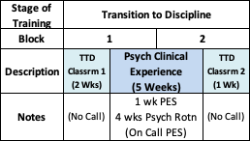
Soft Launch Transition to Discipline Stage

Slide 43
Transition to Discipline EPAs
EPA TtD-1
EPA TtD-2
Obtaining a psychiatric history which includes a preliminary Dx’c impression that informs a management plan for patients presenting with common mental health concerns.
Communicating supervised clinical encounters in oral and written/electronic form.
2 SUCCESSFUL observations
2 different case types
2 SUCCESSFUL observations
At least:
1 written
1 verbal
Notes:
Evaluations during soft launch, at least at beginning, may be paper based.

Slide 44
Soft Launch
Foundations of Discipline
Stage

Slide 45
Soft Launch Foundations Stage - pgy1

Slide 46
Foundations of Discipline EPAs
EPA F-2
EPA F-3
Performing a psychiatric assessment referencing a biopsychosocial approach, and developing a basic differential diagnoses for all psychiatric patients.
Developing & implementing management plans for patients with psychiatric presentations of low to medium complexity.
Notes:
Evaluations during soft launch, at least at beginning, may be paper based.

Slide 47
Foundations of Discipline EPAs
EPA F-4
Performing a risk assessment that informs the development of an acute safety plan for patients posing risk of harm to self or others.
Notes:
Evaluations during soft launch, at least at beginning, may be paper based.

Slide 48
Faculty & Resident Development
Large Group Sessions
Small Group & Individual Sessions
Psychiatry Digest Updates
CBME Newsflashes
Department Website
Royal College Website
Notes:
Reminder about tracking form
Use this as MoCOMP credit

Slide 49
Key Points
Go-Live July 1, 2020.
Soft-Launch with pgy1s July 1, 2019
Faculty & Resident Development will be ongoing.
Current residents remain in current system.
Faculty Development
Problem solving & revision

Slide 50
Questions?

Slide 51
Extra Slides

Slide 52
Soft Launch Foundations Stage - pgy2
pgy2
General Adult Inpatient
General Adult Outpatient
Emergency Psychiatry

Slide 53
Summary Slide:
Feedback is the key
Time WILL STILL MATTER
Will still be end-unit evaluations (ITARs)
Residents will follow curriculum map as a guide
Competencies are described as Entrustable Professional Acts
Milestones are the smaller component parts of an EPA
EPAs are assessed using Entrustability Scale using Work Based Assessments
The Competence Committee monitors progress over time & assesses readiness for promotion to the next stage

