Slide 1
On the Road to Competency Based Medical Education!
JoAnn Corey, CBME Lead
Dept. of Psychiatry, McMaster University

Slide 2
Part 2: Supervisors as Coaches

Slide 3
Workplace Based Assessments
https://youtu.be/uiErUw8Kj1A

Slide 4
THREE KINDS OF FEEDBACK*
APPRECIATION
COACHING
EVALUATION
To acknowledge, connect, motivate or thank.
To expand knowledge, develop skill, improve capability.
To rate against set of standards, align expectations
*Stone & Heen, 2014
Notes:
Sometimes there is overlap
Also important to understand which kind of feedback the recipient thinks they are going to get, need to get at that moment in time.

Slide 5
CBME Coaching Model
Facilitating learning & development of a resident’s competence
Notes:
With CBME, you will hear the term Coaching often. Coaching refers to the manner in which feedback is given.
Coaching over time – PD and Academic Coaches will do.
As Supervisors, the coaching you will do is Coaching in the moment.
Coaching feedback is the prominent method to facilitate the learning and development.
(Resident learning is captured by documentation that is kept in the e-Portfolio and the blue pixelated ring represents the increasingly filled in depiction of the resident’s competence as development of expertise occurs.)

Slide 6
A Coach…
“… helps learners reflect on where their performance stands and how to improve.”
- Deiorio, N., 2016
Notes:
In CBD, the role of clinical teacher is evolving from supervisor to observer and coach. When clinical teachers directly or indirectly observe the work residents do, these observations provide learning opportunities.
A coach is a person who “… can help learners reflect on where their performance stands and how to improve” (Deiorio, 2016).
Ask what qualities made one of their past coaches effective.

Slide 7
How is coaching different?
TEACHING
MENTORING
COACHING
To transmit a specified body of knowledge and skills to learners.
To guide mentees in achieving performance and career growth.
To facilitate skills needed to achieve performance enhancement and growth.

Slide 8
Coaching
A coach’s priority is to promote improvement
Notes:
Coaching is a form of teaching or instruction. It is focused on future performance or practice and is developmental.
Judgment is NOT the purpose of the observation (Assessment). Of course, a coach will make decisions about the quality of the task performed but a coach’s priority is to promote improvement.
A coach always has the best interests and goal of performance improvement of the resident as their primary concerns. Beneficence of the learner!
Although coaching does involve observing the task, the purpose of observation is for the coach and resident to identify learning opportunities.

Slide 9
Coaches …
Explain
Help learner to do a task better, develop a skill or achieve a specific goal.
Develop Skill
Help learner understand what adjustments will allow them to progress to the next level of capability.
Suggest Actions
Give actionable, concrete suggestions for improvement.

Slide 10
Growth Mindset
Fixed Mindset | Growth Mindset
Believes level of achievement is predetermined, and tha dedicated effort will not promote greater achievement. | Believes there is potential for an individual’s growth and improvement .
Desires to prove and avoids looking unintelligent. | Desires to learn, and looks for opportunities to challenge current status.
Asks: Will I succeed or fail? Look smart or not? | Asks: Will I grow? Will I overcome challenges?
Questions the effort of bothering. | Believes that growth & learning require effort.
Ignores constructive criticism. | Learns from feedback; uses it to improve.
Dweck, 2006
Notes:
Carol Dweck is Psychology professor, at Stanford University, in California, and she has been doing research on achievement and success of students for the last several decades. She coined the terms “Growth Mindset” and “Fixed Mindset” to describe peoples beliefs about and therefore their approach to learning.
The Growth Mindset, is one in which it is believed that there is potential for an individual’s growth and improvement and this very much aligns with coaching as a teaching and learning method to promote development.
Whereas someone who ascribes to the Fixed mindset (example features of which are in the yellow column) believes the level of achievement is predetermined, and effort dedicated toward learning will not promote greater achievement.
According to Dweck, someone with a Growth mindset has:
a high DESIRE to learn, looks for opportunities to challenge their current status & grow as a result of taking on challenges,
learns from feedback and wants to know how to improve, while recognising that the improvement will require practice and effort.
In contrast, someone with a Fixed Mindset perspective:
approaches situations with a judgement lens, wondering “how will I look – smart or not?” Individuals who are of a Fixed Mindset don’t value challenging situations as learning opportunities
because effort is pointless as is responding to feedback
If we consider this in the context of clinical teaching, from the residents’ perspective – someone who is aligned with a Fixed Mindset would view observation done by a coach as an assessment at that point in time for what they know, and that judgements and decisions about my future will be made based on this point in time status. This could be called an “assessment OF the learning” that has taken place.
Someone holding a Growth mindset, would see an opportunity to have an expert coach observe their work at any point in time as an opportunity to get expert input and feedback on what they could improve. This could be called an “assessment FOR learning”
Dweck, C. S. (2006). Mindset: The new psychology of success. New York: Random House.

Slide 11
CBME: Paradigm Shift
Assessment OF Learning
“Summative assessment”
Assessment FOR Learning (Observations)
“Formative assessment”
Embedded in learning process (frequent & ongoing)
Goal: judge/evaluate learning
At end of learning process
Low stakes, safe environment
High stakes
Goal: monitor progress & provide immediate feedback to improve (feedback loop)
Notes:
FACILITATOR TIP: This slide is illustrating a change in how we, residents and teachers, need to view and value observation and assessment. A shift in thinking to Assessment (Observation) FOR Learning is a big part of the change required for CBME to work. This is a paradigm shift that will take time.
To be truly successful, the CBD coaching model requires an important philosophical shift in thinking about assessment of residents and, particularly, the purpose of such assessment. In our current system, many of our commonly used assessment methods do not get at what a resident does on a typical clinical day. There needs to be more observation of residents doing their daily work, rather than performing in a “testing” environment/situation. Hence, the emphasis on Assessment FOR the purpose of Learning needs to be far greater than what currently exists. In other words, assessments (or observations) identify opportunities for learning.
Within a mindset of Assessment OF Learning (summative assessment), the predominant purpose for assessment is that of a judgement or evaluation of what a resident knows or can do at that particular instant in time (or sometimes even a judgement of what the resident doesn’t know or can’t do). This can create unease for the resident and often puts them in a position of performing – doing what they believe is on “a checklist” as opposed to doing what they would normally do, as they felt appropriate, in the real clinical environment.
With a shift in mindset, to the framing of Assessment FOR Learning (formative assessment), the purpose of assessment is to be part of a process to guide the resident to what they can do to improve their current understanding or practice. Formative assessment is lower stakes, frequent and ongoing and is embedded throughout the learning process rather than at the end. The goal is to monitor learning and provide immediate feedback that can be used to improve both teaching and learning and subsequent resident performance, thereby promoting a growth mindset.

Slide 12
FEEDBACK
COACHING FEEDBACK
Coaching Feedback
Feedback
Observation of Work
Focuses on what has already occurred
Can increase self-awareness
Emphasis on external insight about what occurred
Focus is the learning potential
Provides guidance to improve future practice
Emphasis on specific, actionable advice to strengthen a competency

Slide 13
Coaching in the Moment is…
Workplace-based, occurs in a clinical environment
Becomes part of normal learning activities
Low stakes & frequent
Timely & efficient
Guidance for improvement
Notes:
FACILITATOR TIP: The series of slides on Coaching in the Moment is broadly applicable to all clinical teachers b/c the Coaching in the Moment concept is expected to have the most direct impact on their day-to-day work. We suggest you emphasize these slides when presenting to front-line clinical teachers. Note: if your program already does these things well then you can “shrink the change” for your colleagues and simply tell them to keep up the good work. If, however, there isn’t a lot of coaching in the moment already, then encourage your colleagues to set realistic goals and targets for incorporating this process into their work.
Coaching in the Moment is foundational to competency focused instruction and workplace-based learning.
It is a process that is to occur “in the moment”, close to the time the observation occurred and in a clinical environment.
Clinicians observe residents doing their daily work . The observations are shared with residents in a way that guides learning and improvement and then the observations and feedback is documented for the resident learning portfolio.
Reinforcing that the observations done as part of Coaching in the Moment are low stakes daily assessments and that the feedback given is part of the learning process to facilitate development toward competent practice should help to reassure the resident. This is part of establishing a safe environment for learning.

Slide 14
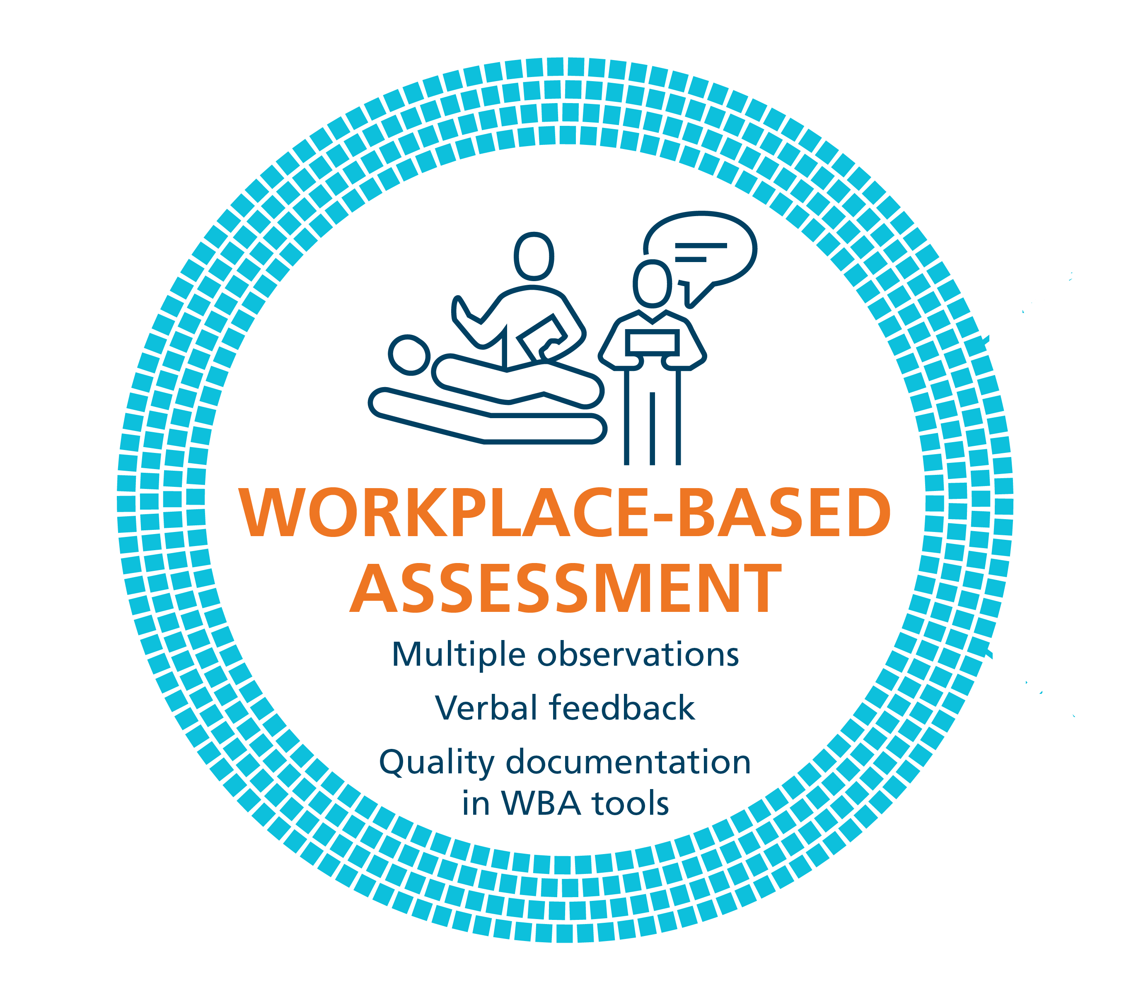
Coaching in the Moment: A Process
RX-OC&D
RAPPORT
EXPECTATIONS
OBSERVE
CONVERSATION
DOCUMENT
Notes:
Coaching in the Moment follows a process,
This process has been coined as the RX-OCD coaching process between the clinician coach and the resident.
The steps in the process are:
R: Establishing educational “Rapport” between the resident and the clinician
X: Setting “eXpectations” for the particular clinical time period;
These initial 2 steps need not take longer than a few minutes.
3) O: “Observing” some type of work that the resident does
4) C: Engaging in a “Conversation” for the purpose of improvement of that work (“coaching”);
5) D: “Documenting” a summary of the dialogue that occurred so that the resident can build a portfolio of observations demonstrating progress and areas to be improved.

Slide 15
RX-OC&D
Create a safe learning environment
Be explicit about role as a learning coach
Form an educational partnership – Growth mindset
RAPPORT
Notes:
The initial conversation, RAPPORT development, as implied, needs to occur at the outset of any learning experience as it will serve as foundational to convey to the resident an established safe learning environment.
Establishing this learning partnership (or educational alliance) between the resident and clinician is a critical reason for the initial conversation. It confirms, for the resident, the clinician’s engagement in the educational process, and specifically the clinician’s commitment to providing guidance for the growth and development of the resident; in other words, employing and conveying a growth mindset. Explicitly stating this is important to assure it is understood.
This initial discussion could also allow the resident to disclose past experiences and preferences related to learning and assessment. Similarly, the clinician could convey their style in the learning environment.
RAPPORT is the “R” in RX-OCD
Image source: https://pixabay.com/en/shops-partnership-cooperation-1014038/

Slide 16
RX-OC&D
Discuss:
Specific learning goals
Components of EPA
Previous feedback
EXPECTATIONS
Notes:
Discussing specific learning goals and objectives, particularly as related to milestones, competencies and EPAs (Entrustable Professional Activities) that the resident is currently working toward, while considering the particular expectations of the clinical setting, will assure that both the resident and clinician have a shared understanding and agreement from the outset.
Again, this discussion need not take longer than a few minutes at the beginning of a clinic or a day or week working together.
EXPECTATIONS is the “X” in RX-OCD

Slide 17
RX-OC&D
OBSERVE
Indirect Observation
Review of products of the resident’s work
clinical notes, presentations, written reflections
Observations from secondary sources
Direct Observation
Watching a resident doing work
in real time or asynchronously (i.e. videotaped)
Notes:
Discussing specific learning goals and objectives, particularly as related to milestones, competencies and EPAs (Entrustable Professional Activities) that the resident is currently working toward, while considering the particular expectations of the clinical setting, will assure that both the resident and clinician have a shared understanding and agreement from the outset.
Again, this discussion need not take longer than a few minutes at the beginning of a clinic or a day or week working together.
EXPECTATIONS is the “X” in RX-OCD

Slide 18
RX-OC&D
CONVERSATION
Related to the task that was observed
To ensure the resident understands how improvements could be made
Notes:
Critical to the process is the dialogue that must occur between the clinician and the resident once the clinician has observed the resident or the resident’s work.
The purpose of this conversation is to ensure the resident understands how improvements could be made. This is “coaching feedback”.
This type of coaching conversation would happen, most often, after the particular work task was completed but still “in the moment” of that clinical experience.
In some instances, this feedback may be offered as the work is being done with the clinician providing real time coaching in the moment. This, of course, needs to be agreed upon by the resident and the clinician prior to the observation occurring and is dependent on the context.
CONVERSATION is the ‘C’ in RX-OCD

Slide 19
Key Words for Helpful Coaching Conversations
Because
Next time…
Try…
Recommend…
Consider….
I suggest…

Slide 20
RX-OC&D
DOCUMENT
Summarize feedback & actionable suggestions for improvement
It is important to document outlier performances because they could be rare but important
Notes:
A final but essential step to the CinM process is for the clinician to take a few minutes to document a summary of the coaching feedback dialogue that takes place (at least some of the time) in the resident portfolio.
Every coaching interaction might not be documented in clinical experiences of longer duration, but a representative sample of the observations during that clinical time period is essential. For short duration clinical experiences (i.e. a resident spending only one half day clinic with a particular staff clinician) the goal should be for at least one coaching conversation to be recorded. In some instances, more than one observation of work and coaching opportunity might occur in one clinic and could be documented.
It is not critical that the clinician know whether what was observed is a representative performance of a task for a particular learner. Documenting observations and suggestions for improvement, whether representative or an outlier execution of a task, helps create a comprehensive illustration of competence. Any one observation leading to Coaching in the Moment is not high stakes and will not lead to grave consequences, but is part of the process to support resident development and progress.
Whether or not a clinician documents an encounter does not restrict the resident from making their own record of the feedback and suggestions given, including their personal reflections on how it was helpful for and/or integrated into their practice performance.
DOCUMENT is the ‘D’ in RX-OCD

Slide 21
Questions?

