Slide 1


Academic Coach Training
Session Two
August 2021

Slide 2
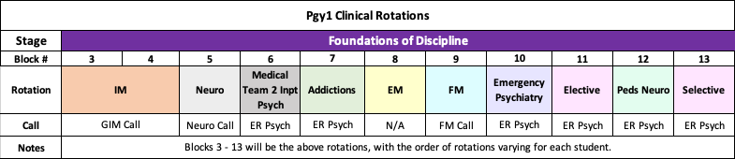
Foundations of Discipline pgy1 clinical rotations
Notes:
Reference Foundations Orientation Guide as go through each type of clinical rotation (page 7)

Slide 3
Pgy-1 Elective Block
Resident’s design!
Residents are to:
  Contact potential supervisors about availability
  review with the supervisor(s) their personal goals & objectives for the elective
  At least one month in advance, submit to Dr. Lentz & Samokhvalov their Elective Proposal:
    Name of Elective & Dates
    Name of Supervisor (& site & contact info if not McMaster Faculty)
    Goals of Elective written in CanMEDS roles
    Possible EPAs of focus, where applicable

Slide 4
Pgy-1 Academic Days (Wednesdays)
During GIM, Neurology, FM, EM, Peds Neuro, Selective, MT2IP
On Rotation in AM
If can make it to Enrichment Session & you are interested, you are welcome to join Enrichment Sessions
12:30 – 2:00 pm
Academic Enrichment Session
PRAM; Evidence Based Rounds; Interviewing Skills; OSCE Prep; Complex Case Rounds; Special Sessions
2:30– 4:30 pm
Psychiatry Pgy1 Core Curriculum Seminar

Slide 5
Pgy-1 Academic Days (Wednesdays)
During ER Psych, Elective & Addictions*
9 – 10 am. (Sept. – June)
Departmental Grand Rounds
West 5th Auditorium; Video-conferenced
10 am – 12 pm
Non-scheduled
12:30 – 2:00 pm
Academic Enrichment Session
PRAM; Evidence Based Rnds; Interviewing Skills; OSCE Prep; Complex Case Rnds
2:30– 4:30 pm
Psychiatry Pgy-1 Core Curriculum Seminar
*check with supervisor if something interesting in AM they think would be a good experience
Notes:
Ask if anyone wants to be Core Curriculum Rep
CBME Rep

Slide 6



Checking in with residents to be mindful of….
Personal Well-being

Slide 7

Supports
Dockside / Riverside Chats
Meetings with Academic Coach
Resident Retreats
PRAM & PROW Meetings
Academic Half-Days
Yearly “Prepping for” Meetings
PARO Hotline
Each other
Vanessa
Andriy (REL)
Academic Coach
Resident Buddies
Senior Residents
Resident Leaders
Faculty
Cheyenne, Menika & Ashley

Slide 8

Entrustable Professional Activities (EPAs)
For Focus in Pgy-1

Slide 9

EPA Benchmarks:
Aim for 2 - 3 assessments per week across all experiences
On Call in Psych Emerg aim for at least one EPA assessment / shift

Slide 10

Foundations of Discipline
EPAs
Notes:
Here are the EPAs that residents must complete by the end of the Foundations of Discipline Stage of Training. Ie. by the end of Pgy2
There are five EPAs that must be achieved during the Foundations Stage of training
Remember – Foundations runs through 2/3 of Pgy1 and all of Pgy2
They must successfully complete all 5 of them by the end of Pgy2

Slide 11
FOUNDATIONS OF DISCIPLINE

Slide 12

EPA F-1
Assessing, diagnosing & participating in the management of medical presentations relevant to Psychiatry.
8 Observations of Achievement
At least:
2 Medical Emergencies
1 Substance Intoxication
1 OD &/or Withdrawal
1 Neuropsychiatric Presentation
1 Endocrine or Metabolic Disorder
4 Different Observers
3 by Supervising Staff MD
HIGH YIELD ROTATIONS
Internal Medicine
Neurology
Emergency Medicine
Family Medicine
Pediatric Neurology
Addictions
ER Psychiatry
Palliative
Adolescent Medicine
MT2IP
Notes:
Evaluations during soft launch, at least at beginning, may be paper based.

Slide 13

Suggested Foundations EPA Goals for pgy-1
Complete F1
(medical presentations)

Slide 14

EPA F-2
Performing psychiatric assessments referencing a biopsychosocial approach & developing basic DDx for patients with mental disorders.(Low to Med Complexity)
6 Observations of Achievement
At least:
1 Emergency Setting
2 Inpatient Settings
2 Outpatient Settings
3 Different Case Types
2 by Psychiatrist Observer
3 Different Observers
At most:
2 Child/Adolescent Patients
2 Older Adult patients
Pgy1 HIGH YIELD ROTATIONS
Emergency Psychiatry
Elective
Addictions
Selective
Notes:
Evaluations during soft launch, at least at beginning, may be paper based.

Slide 15

EPA F-3
DEVELOPING & IMPLEMENTING MANAGEMENT PLANS FOR PATIENTS WITH PSYCHIATRIC Presentations OF LOW TO MEDIUM COMPLEXITY.
6 Observations of Achievement
At least:
1 Mood Disorder
1 Psychotic Disorder
1 Personality Disorder
1 Substance Use Disorder
1 Anxiety or Trauma or OCD
3 Different Observers
2 by Psychiatrist Observers
At most:
2 Child/Adolescent Patients
2 Older Adult Patients
Pgy1
HIGH YIELD ROTATIONS
Emergency Psychiatry
Family Medicine
Elective
Selective
Addictions

Slide 16

EPA F-4 performing risk assessments that inform the development of an acute safety plan for patients posing risk for harm to self or others.
5 Observations of Achievement
At least:
1 with Non-Suicidal Self-Injury
1 with Active Suicidal Ideation or Behaviour
1 with Active Homicidal / Violent Ideation or Behaviour
3 by Psychiatrist Observers
3 Different Observers
Pgy1 HIGH YIELD ROTATIONS
Emergency Psychiatry
Elective
Selective
Notes:
Evaluations during soft launch, at least at beginning, may be paper based.

Slide 17



Suggested Foundations EPA Goals for pgy-1
Complete F1
(medical presentations)
Begin F2
(psych assessment & DDx)
Begin F3
(psychiatric management plan)
Begin F4 (risk assessments)

Slide 18

EPA F-5 performing critical appraisal and presenting psychiatric literature
2 Observations of Achievement
At least:
2 Different Observers
Pgy1 HIGH YIELD ROTATIONS
Peds Neuro
Elective
Selective
Any rotation you make it happen
Notes:
Evaluations during soft launch, at least at beginning, may be paper based.

Slide 19

Suggested Foundations EPA Goals for pgy-1
Complete F1
(medical presentations)
Continue F5 if possible
(risk assessments)
Begin F2
(psych assmnt & DDx)
Begin F3
(psychiatric mgmt plan)
Begin F4 (risk assessments)

Slide 20
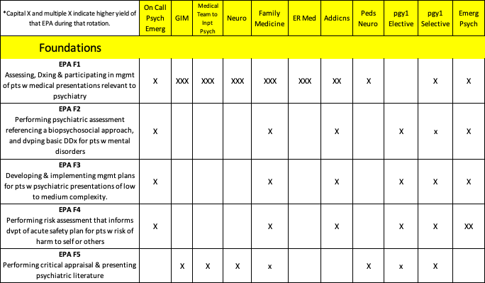
Mapping of EPAS onto Pgy-1 Rotations

Slide 21

Ensuring EPA assessments completed
Trigger it as soon as possible
Let observer know it has been triggered
Remind observer they won’t get a reminder from MedSIS
Create an email template with a link to MedSIS Login page, that can send to observers
Pull it up on phone & hand it to supervisor

Slide 22
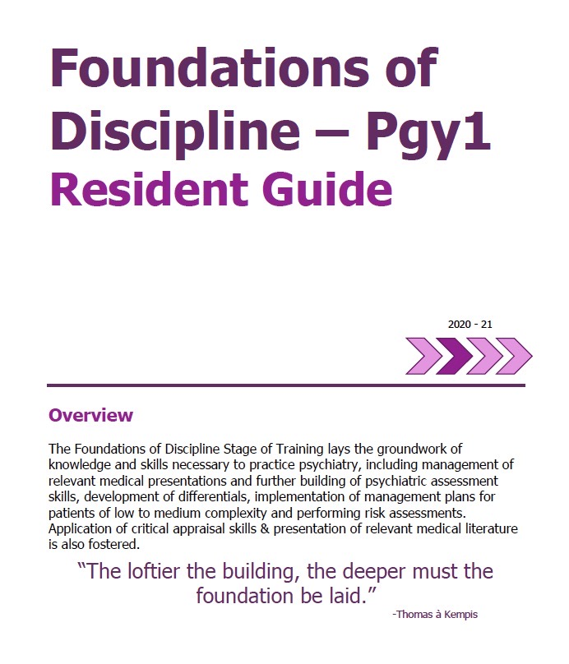
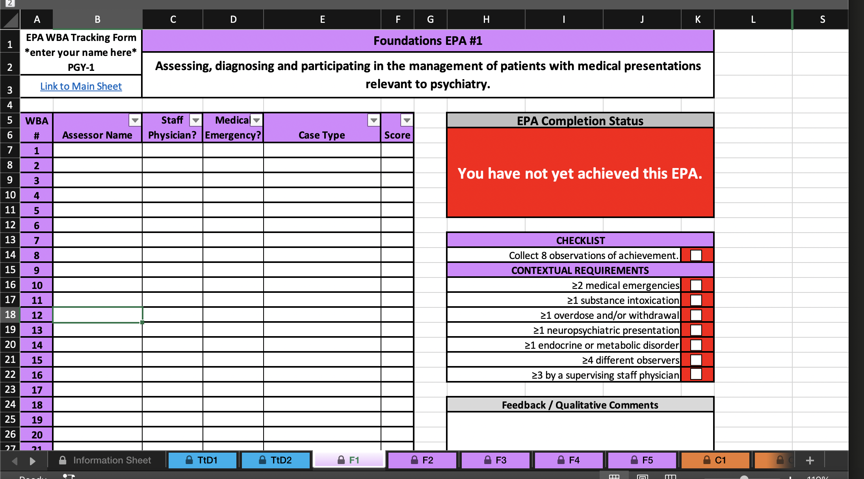
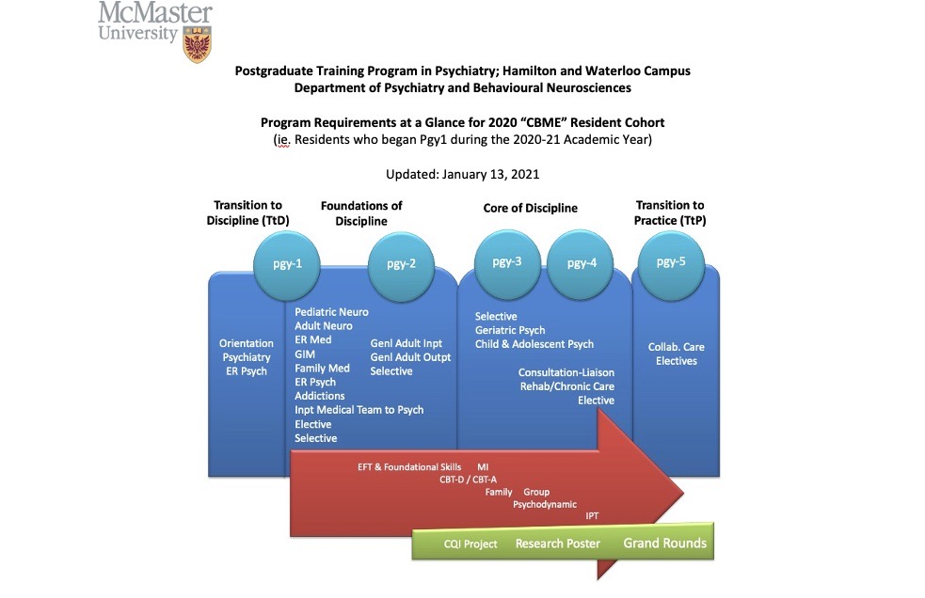
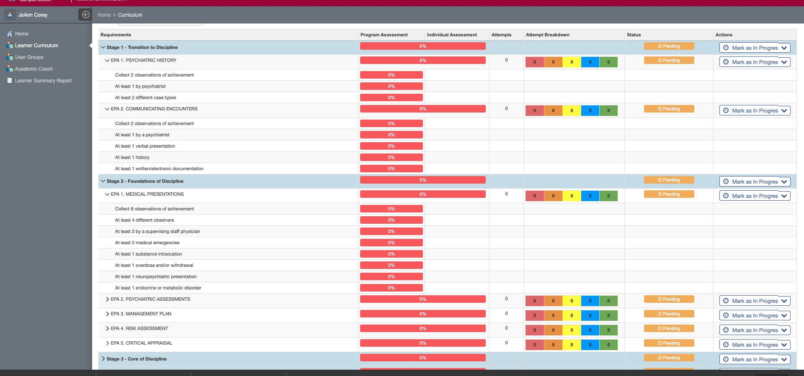
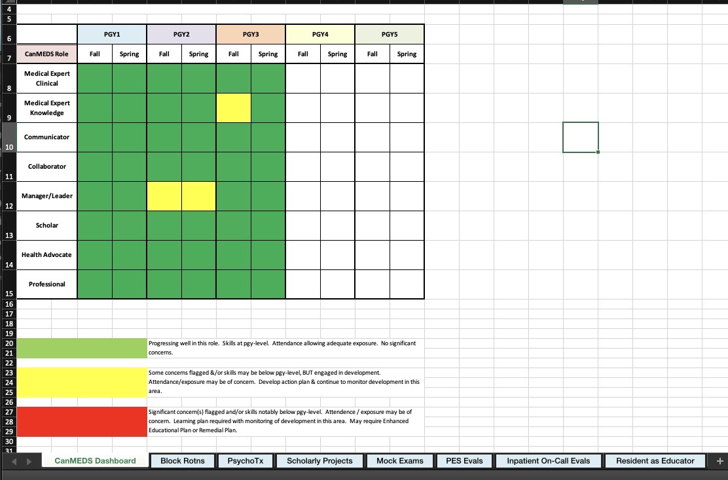
Tracking Tools
MedSIS
Orientation Guides
Program Requirements Document
Personal Tracking Forms
Biannual Review Forms
Notes:
Show them the Biannual Review Form

Slide 23

Biannual Review Form
Tracking resident’s progress
Synchronized with resident before each Competence Committee Progress Review Meeting:
Sept for Oct. CC Meeting
March for April CC Meeting
Each June to ensure completion of activities for that Pgy-year
February of Pgy5 for CC Mtg

Slide 24

It is not about grades anymore.
It is about learning with the goal of self-development
and always moving forward.
Reaction to Feedback
Openness to Learning
Notes:
Encourage them to seek out feedback. It is not about grades any more. It is about learning with the goal of moving forward.
Remind them about the growth mindset

Slide 25

The Academic Coach Role:
Coaching Over Time

Slide 26
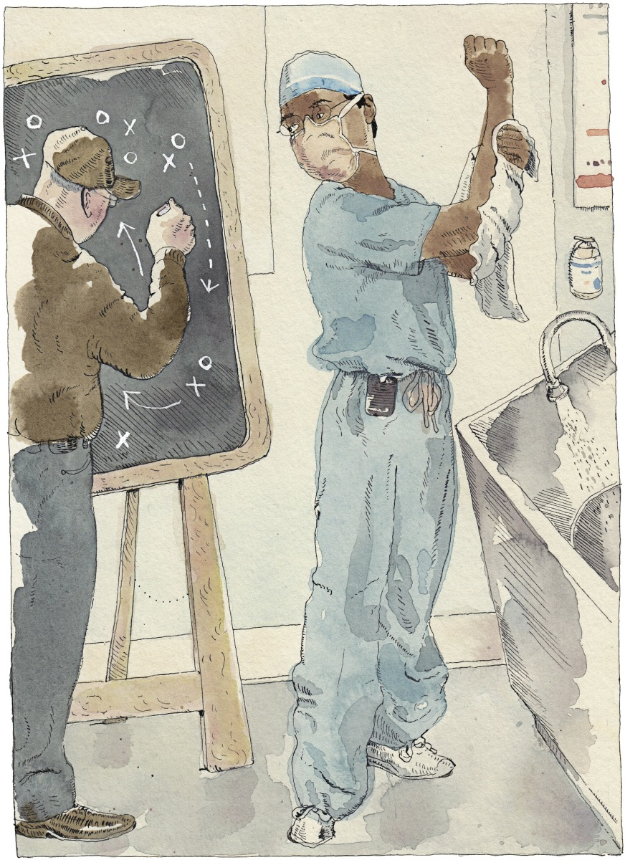
What is Academic Coaching?
“Top athletes and singers have coaches. Should you?”
A. Gawande, 2011,
The New Yorker

Slide 27
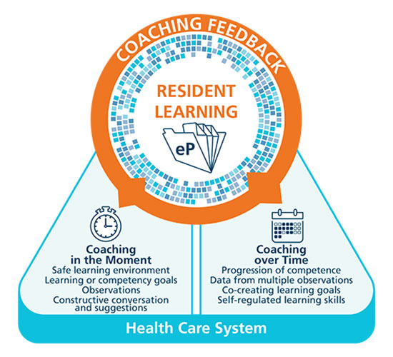
Competence By Design Coaching Model
Royal College of Physicians and Surgeons of Canada
Notes:
Now back to the CBD Coaching Model….
These two types of coaching have been articulated but include actions that teachers have been doing for a long time.
The next slides will describe, in more detail, the “Coaching in the Moment” component part of the Model, including a simple practical approach to its implementation.

Slide 28
 | Teaching (“traditional”) | Mentoring | Coaching
Purpose | To transmit a specified body of knowledge and skills to learners | To guide mentees in achieving performance and career growth | To facilitate skills needed to achieve performance enhancement and growth
Qualities of Faculty | Expert | Expert | Understand what is required for expertise
Process | +/- observation Achievement of required curricular objectives (tests) | +/- observation Uses expertise and experience to guide, advise and endorse mentee | Requires observation Engages learners in self regulated learning through observation, feedback and goal setting
Relationship to learner | Teacher-led All learners treated the same Impartial relationship | Mentor-led their judgement and expertise primary in guiding mentee | Coachee-led Reciprocal, collaborative trust relationship Individualised to coachee abilities and goals
Duration | Specific to the program/course | Long term | Short or long term
Notes:
It is important to distinguish some overlapping concepts – frequently confused both in the literature and in practice.
Coaching requires the observation of performance and is heavily focused on facilitating the learner’s own learning process (self regulated learning) through observation, feedback and goal setting.
Coaches need to be able to help the resident break down what is required to achieve the best possible performance and facilitate actions to achieve it. We are familiar with the concept of coaches with less skill than the “coachee” in performance (sports, music etc) and the same holds true in medicine. It is the ability to help the learner grow and develop that is key.

Slide 29



Coaching in the Moment is…
Workplace-Based Learning - learning activities in the clinical environment
Involves:
  Establishing rapport with resident
  Setting learning goals and expectations.
  Observation (direct or indirect).
  Coaching on what was observed during that encounter.
  Providing suggestions for improvement.
  Low stakes and frequent.
Notes:
FACILITATOR TIP: The series of slides on Coaching in the Moment is broadly applicable to all clinical teachers b/c the Coaching in the Moment concept is expected to have the most direct impact on their day-to-day work. We suggest you emphasize these slides when presenting to front-line clinical teachers. Note: if your program already does these things well then you can “shrink the change” for your colleagues and simply tell them to keep up the good work. If, however, there isn’t a lot of coaching in the moment already, then encourage your colleagues to set realistic goals and targets for incorporating this process into their work.
Coaching in the Moment is foundational to competency focused instruction and workplace-based learning.
It is a process that is to occur “in the moment”, close to the time the observation occurred and in a clinical environment.
Clinicians observe residents doing their daily work . The observations are shared with residents in a way that guides learning and improvement and then the observations and feedback is documented for the resident learning portfolio.
Reinforcing that the observations done as part of Coaching in the Moment are low stakes daily assessments and that the feedback given is part of the learning process to facilitate development toward competent practice should help to reassure the resident. This is part of establishing a safe environment for learning.

Slide 30

Coaching Over Time Involves…
A longitudinal educational relationship over time beyond a single clinical encounter.
Regular reviewing, synthesizing multiple sources of data to provide feedback on resident’s progress.
Helping residents reflect on progress and set specific learning goals and plans.
Following up on action plans and progress.
Facilitating resident’s understanding of ways of improving performance through development of guided self regulated learning skills.
Notes:
In many programs this role has been labelled as “advisor”, and/or may have been taken on in its entirety by the program director. By articulating the actions involved, programs may decide how to best assign this role. This session is going to focus on coaching over time and what is involved.

Slide 31
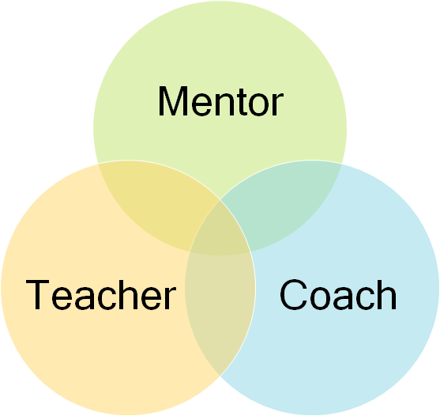
Longitudinal Coaching
Develop educational alliance
Goal setting
Elicit reflective practice
*Understand how to interpret learner assessments
Notes:
A longitudinal educational relationship with a resident with the shared goal of helping them achieve personal excellence.
Regular performance review, synthesizing multiple sources of data in order to provide feedback on resident’s progress.
Help resident reflect on their progress and using that data to set specific learning goals.
Follow up on action plans and progress.
Aid in the development of self-regulated learning skills through guided facilitation.

Slide 32
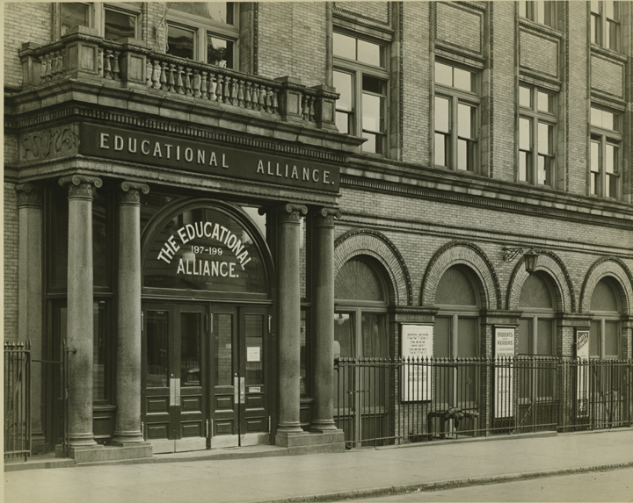
Educational Alliance
Shared understanding of performance and standards
Negotiating agreement on action plans
Working together towards reaching the goals
Co-creating opportunities to use feedback in practice

Slide 33

Building this Alliance
Invest time in knowing the resident’s story
  past experiences, life situation, interests, goals.
Provide clarity about:
  your role
  expectations (yours and the program’s)
  hopes for the relationship
Be Available, Accessible, Affable (the Triple A).
Notes:
Participants will have many additional ideas

Slide 34
Longitudinal Coaching
Develop educational alliance
Goal setting
Elicit reflective practice
*Understand how to interpret learner assessments
Notes:
A longitudinal educational relationship with a resident with the shared goal of helping them achieve personal excellence.
Regular performance review, synthesizing multiple sources of data in order to provide feedback on resident’s progress.
Help resident reflect on their progress and using that data to set specific learning goals.
Follow up on action plans and progress.
Aid in the development of self-regulated learning skills through guided facilitation.

Slide 35
Coaching Over Time
Facilitate development of goals
Adjust learning goals
Plan strategies/actions
Implement plans
Monitor progress & collect data
Assess achievement
Interpret and provide assessment
Guidance suggestions facilitation
Provide periodic progress review
Relationship building
Notes:
This diagram reflects the self regulated learning cycle (the coloured boxes). Effective learning involves moving through each of these steps. However it is not easy to do this on our own and the grey boxes reflect actions that the academic coach can to to facilitate each step. Relationship building underlies the entire process
Most of us who have had a goal setting discussion with learners recognize that many, particularly early in their training, have difficulty in setting concrete and specific goals (SMART goals). As coaches we can lead them through this process, and help ensure that these goals are appropriate to the training program. Similarly, identifying appropriate strategies for achieving them may require our help. Collecting external sources of information and monitoring progress towards achieving the goal is also necessary. Help residents to recognize that none of us can depend on our own sense of how we are doing. Coaches also meet with residents to review progress and to interpret and provide assessment.
As residents mature professionally, they should need less guidance with these steps.

Slide 36
Interpret data
Promote learner reflection
Co-create goals and strategies
Debrief from CC Recommendations
Review performance
Keep learner accountable to goals
Invest in learner growth
Establish and reinforce educational alliance

Slide 37
To do this …
Meet with your learner regularly:
  Review their file including ITERs, EPAs, OSCE and other exam results.
  Review their personal reflections and learning plan.
  Coach the resident around next steps and continued professional development
  Complete a coach summary report
If issues arise:
  Meet with learner more frequently
  Discuss with Vanessa & Andriy

Slide 38

Coaching Feedback
Conversation that enables learners to enhance their performance.
Identifies what was observed.
Encourages learner self-reflection and goal-setting.
Focuses on specific actions for improvement.
Coaching feedback for learning not evaluation.
Notes:
Feedback in its purest meaning is simply information about past performance. Coaching incorporates this into a conversation/ dialogue focused on future performance.
Learner reflection and goal setting is a key component and residents often require assistance in doing this in a way that is useful in identifying specific actions for improvement.
The academic coaches scaffold their support to residents in goal setting and action planning in order that they move to becoming increasingly adept and independent in doing this.

Slide 39

Toolbox for
Academic Coaches
Motivational Coaching
R2C2 model.
GROW model of coaching.
Coaching feedback grid.
Educational plan with reflection.

Slide 40


Motivational Coaching
MI Approaches Adapted to Academic Coaching
and the Educational Environment
Supervisor
Coach
VERSUS
Notes:
Add in some notes from other version of this slide show with NOTES at end of title

Slide 41
Motivational Interviewing
Identify targets for change
Evoke motivation for change
Minimize confrontation or disagreement
Emphasize:
  Autonomy and freedom of choice as a person makes a change
  The person’s own competence in making change
  Relatedness to other key people
Encourage “change talk”

Slide 42
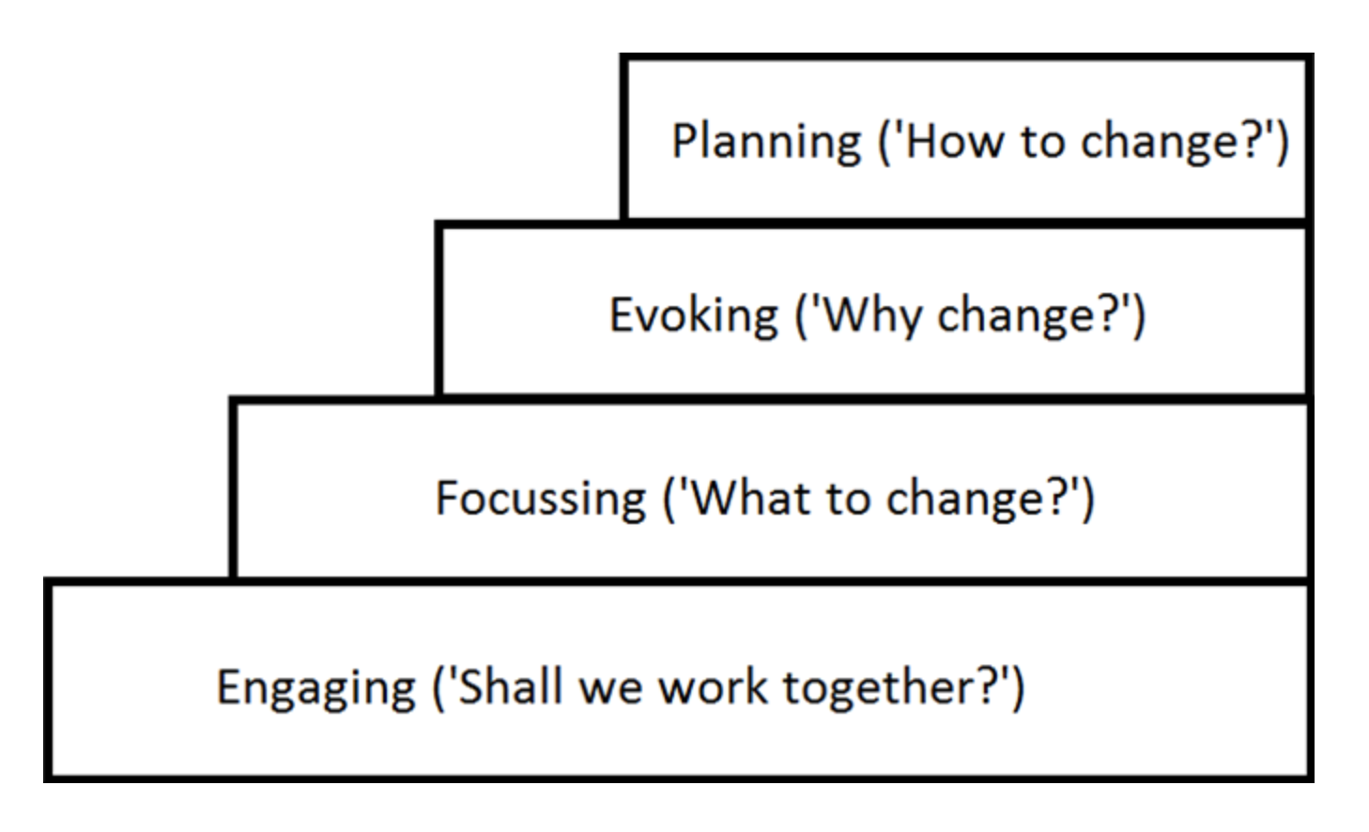
Four Steps in MI Coaching
Affirm strengths and progress
address weaknesses & lack of progress
Promoting change talk

Slide 43
Principles of Motivational Interviewing
Recognize and resist the urge to correct or inform.
Understand the perspective of the person.
  Open ended questions
  Affirmations
  Reflections
  Summaries
Listen reflectively to the person’s experience.
Empower the client to explore change.
  Informing & Advising as appropriate

Slide 44
MI = Helping Conversations
Directing Style
Guiding Style
Following Style
Guide collaborates with the trainee to develop a plan
Guide does not tell the trainee what to do or passively follow them
Guide directs the encounter but responsibility for change lies with the trainee

Slide 45
GROW model of coaching
 | Description | Examples
G-Goal | Ask for goals | What would you like to achieve? What would success look like?
R- Reality | Discuss present realities. | What has worked in the past? What didn’t? What are the limitations?
0- Options | Identify & assess options | What possible options/solutions do you have? What haven’t you tried yet?
W- Way forward | Assist in determining next steps/action plan | What is the most important thing to do next? Who might support you?
Whitmore 1980’s
Notes:
The GROW model of coaching is used in many fields beside medicine. It is a useful acronym to guide a coaching conversation. The focus is on the resident and the residents ideas – although of course they coach may have supplemental ideas

Slide 46
R2C2 model
Step | Examples
Rapport/Relationship Building | Tell me about your experience
Explore Reaction | What were your initial reactions? Any surprises? Anything we should focus on?
Explore Content | Anything you’re unclear about? Do you recognize a pattern?
Coach for Change | What action might you take? What would you like to see in 6 months?
Sargeant et al 2015
Notes:
The R2C2 model was originally described as a guide to discussing an ITAR with a resident. It is adaptable for any coaching conversation that follows the resident’s receipt of feedback information. Note that the relationship building piece underlies to the specific actions.

Slide 47
Coaching Feedback Grid
Continue What was effective, and what was the impact? | Start or do more What would be beneficial and what specific actions could be taken?
Consider Reflection on themes, future actions, goals | Stop or do less What is not helpful and needs to be changed?
Modified from the Coaching Feedback Format, Bayer Institute for Health Care Communication
Notes:
This commonly used model for feedback deliver may also be useful in a coaching conversation. The focus is again on the resident, with a comparison of the resident’s perception with that of the coach or teachers.

Slide 48
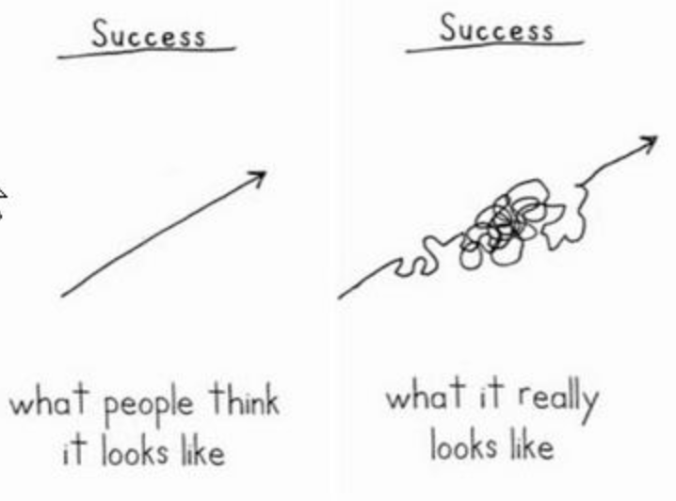
Notes:
Success – this is something we need to keep in mind as we practice MI and trainees also need to be reminded of,
It’s also part of the

