Slide 1


Academic Coach Training
Session One
Spring 2021

Slide 2
Session Objectives
Explain the Role of the Academic Coach in our Program
Overview of CBME
Outline McMaster Psychiatry Program Design in CBME Model
Review of logistics of CBME Model
Keys to Effectiveness of Coaching over Time
Intro to MedSIS Dashboard & Program Tracking Tools
What you need to know for Transition to Discipline

Slide 3
Academic Coaches
Help facilitate resident’s learning & development over time
Help resident navigate curriculum map
Longitudinal relationship with resident

Slide 4


went-Live
July 1
2020
Only applied to the incoming residents …
& all incoming residents afterwards
Notes:
Go Live Date July 1, 2020, for residents entering that year. So we will have two cohorts of residents for 4 years (likely 5 given mat leaves, etc)

Slide 5
Soft
Launch
July 1
2019
Applies to the residents who began July 1, 2019!
Notes:
Go Live Date July 1, 2020, for residents entering that year. So we will have two cohorts of residents for 4 years (likely 5 given mat leaves, etc)

Slide 6
Why move to Competency Based Medical Education?
An effort to educate even better
Better prepared graduates
More fulfilled educators
Improved patient care
Notes:
Because we want to work to educate even better.
To better prepare our graduates
To feel more fulfilled as educators
And most importantly, to provide even better patient care moving forward

Slide 7

What is Competency Based Medical Education?
CBME:
  Rotations will still be defined times
  Emphasize acquisition of required knowledge & skills
  Ensures experiences to gain required competencies
  Organized around outcomes expected of a resident
  Advancement dependent on achieving those expected outcomes
  Allow more frequent, low-stakes assessments & feedback
  Foster effective feedback
  Allow residents to be more open to feedback

Slide 8


CBME:
Paradigm Shift
Assessment
OF Learning
“Summative assessment”
Assessment FOR Learning (Observations)
“Formative assessment”
Embedded in learning process (frequent & ongoing)
Goal: judge/evaluate learning
At end of learning process
Low stakes, safe environment
High stakes
Goal: monitor progress & provide immediate feedback to improve (feedback loop)
Notes:
Growth mindset

Slide 9
Paradigm Shift for
Learning
Feedback for Learning

Slide 10
Growth Mindset
Growth Mindsets
Believes there is potential for growth and improvement
Desires to learn. Looks for opportunities to challenge current status.
Asks: Will I: Grow? Overcome challenges?
Not focused on: Proving self-worth Will I look intelligent?
Recognizes that growth & learning require effort.
Learns from feedback & uses it to improve.
Dweck, 2006
Notes:
Carol Dweck is Psychology professor, at Stanford University, in California, and she has been doing research on achievement and success of students for the last several decades. She coined the terms “Growth Mindset” and “Fixed Mindset” to describe peoples beliefs about and therefore their approach to learning.
The Growth Mindset, is one in which it is believed that there is potential for an individual’s growth and improvement and this very much aligns with coaching as a teaching and learning method to promote development.
Whereas someone who ascribes to the Fixed mindset (example features of which are in the yellow column) believes the level of achievement is predetermined, and effort dedicated toward learning will not promote greater achievement.
According to Dweck, someone with a Growth mindset has:
a high DESIRE to learn, looks for opportunities to challenge their current status & grow as a result of taking on challenges,
learns from feedback and wants to know how to improve, while recognising that the improvement will require practice and effort.
In contrast, someone with a Fixed Mindset perspective:
approaches situations with a judgement lens, wondering “how will I look – smart or not?” Individuals who are of a Fixed Mindset don’t value challenging situations as learning opportunities
because effort is pointless as is responding to feedback
If we consider this in the context of clinical teaching, from the residents’ perspective – someone who is aligned with a Fixed Mindset would view observation done by a coach as an assessment at that point in time for what they know, and that judgements and decisions about my future will be made based on this point in time status. This could be called an “assessment OF the learning” that has taken place.
Someone holding a Growth mindset, would see an opportunity to have an expert coach observe their work at any point in time as an opportunity to get expert input and feedback on what they could improve. This could be called an “assessment FOR learning”
Dweck, C. S. (2006). Mindset: The new psychology of success. New York: Random House.

Slide 11

Key Points
Its all about regular assessment & feedback day to day.
Quality
Acceptance & Incorporation

Slide 12

What is this going to look like?

Slide 13

Still have defined rotations
Many things still the same…

Slide 14



Many things still the same…
ITARs
Scholarly Projects
Psychotherapy
StACERs
CQI Project
Grand Rounds
Poster presentation
Longitudinal training
*Reduced # Modules
Mid- & end- rotation

Slide 15
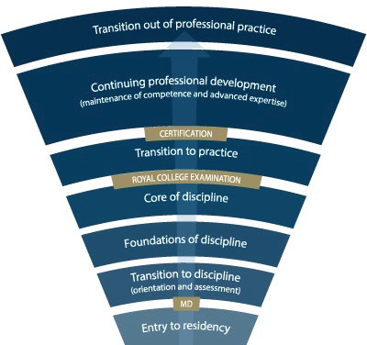
Competence
Continuum
-Stages of Training-
PGY-5
PGY-4
PGY-3
PGY-2
PGY-1
Notes:
*for general program
Need to understand how this will look for Subspecialty Programs
Explain the stages of training.
-RC will outline what needs to be accomplished within each Stage of training and give a range of time that stage may last
-Programs will then decide the duration of each stage (within the RC parameters) and what rotations will be included in each stage
-RC is also going to outline what skills & knowledge must be accomplished by a resident before they are to be allowed to progress to the next stage of training. Those required skills & knowledge are packaged into what is called the EPAs and Milestones (which I will explain in a minute)
-Programs will then map which EPAs should be accomplished in which rotations for their residents

Slide 16




McMaster Psychiatry
CBME
Design

Slide 17
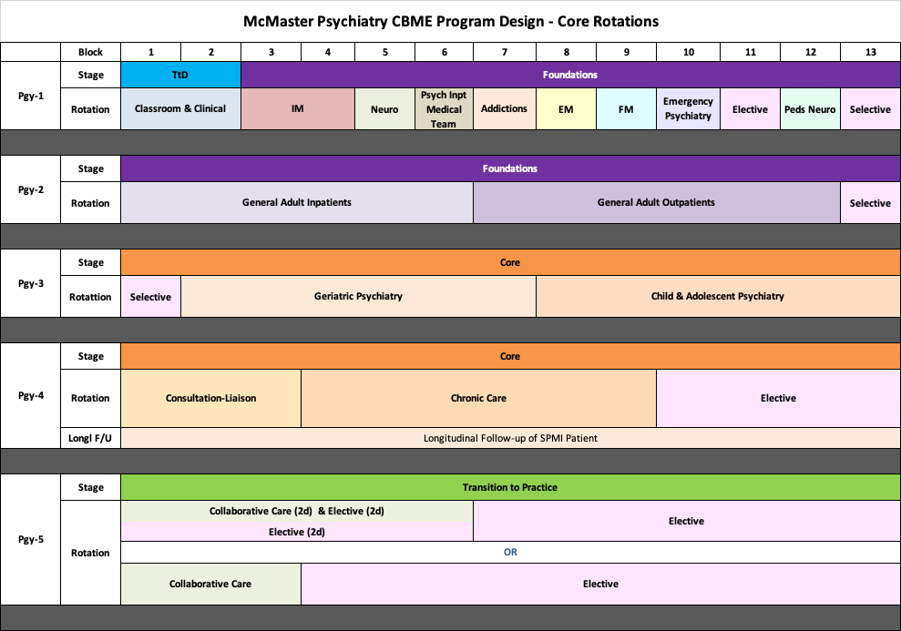
Notes:
This only shows the core rotations.
They will still be completing psychotherapy, Resident as Educator training, Call and have required scholarly projects. Those are not reflected in this diagram for simplicity, to focus on core rotations.
Note that the Soft Launch Cohort will remain on the Block System as they move through the years. Pgy1s have been on blocks for the last 8 years (i.e 13 four-week blocks, instead of months for Pgy2 to 5)
TtD = Transition to Discipline Stage of Training. Reviewed in the intro to CBME from last year. If not familiar or want a refresher/update for this year, after we review Pgy2, for those who want to stay on I will go back to review this.
New rotation in Pgy1 = Medical Team to Inpatient Psychiatry = working with the medical team that provides the medical care to psychiatry inpatients (Hamilton = West 5th; WRC = Homewood)
Pgy2: Note that Longitudinal f/u of SPMI patient has been moved from Pgy2 to Pgy4 for official CBME residents. (for residents of traditional program, it is in Pgy2)
Anchored Selective in Block 13 – because residents must have opportunities to work with “special populations” – Vulnerable, Marginalized Populations; Dual Dx, WHCC, Addictions, Forensics. So rather than doing longitudinally, going to try this as a block.
Pgy3: Also an anchored selective in Block 1, so in fact, have 2 months in a row of the selective with special populations
Pgy4: Remember, exam will be at the end of Pgy4. And, for CBME residents, Collaborative Care is recommended but not required. In our program, we feel experience with Collaborative Care is important, so moved Collaborative Care to Pgy5 and created 4 months of elective in Pgy4. Likely most residents will do telective through the exam time.
Pgy5: Minimum 3 blocks total of collaborative care (can be done as 3 blocks FT or 6 blocks PT combined with elective) + 10 more months of elective

Slide 18
CBME
Pgy2 & 3
Anchored Selective Options
Dual Diagnosis
Addictions
Forensics
ACT
Shelter Health
Women’s Health Concerns
Other
Schizophrenia Services
Indigenous Health
HIV Psychiatry
Refugee & Immigrant Health
LGBTQ2S+ Health

Slide 19

Notes:
This only shows the core rotations.
They will still be completing psychotherapy, Resident as Educator training, Call and have required scholarly projects. Those are not reflected in this diagram for simplicity, to focus on core rotations.
Note that the Soft Launch Cohort will remain on the Block System as they move through the years. Pgy1s have been on blocks for the last 8 years (i.e 13 four-week blocks, instead of months for Pgy2 to 5)
TtD = Transition to Discipline Stage of Training. Reviewed in the intro to CBME from last year. If not familiar or want a refresher/update for this year, after we review Pgy2, for those who want to stay on I will go back to review this.
New rotation in Pgy1 = Medical Team to Inpatient Psychiatry = working with the medical team that provides the medical care to psychiatry inpatients (Hamilton = West 5th; WRC = Homewood)
Pgy2: Note that Longitudinal f/u of SPMI patient has been moved from Pgy2 to Pgy4 for official CBME residents. (for residents of traditional program, it is in Pgy2)
Anchored Selective in Block 13 – because residents must have opportunities to work with “special populations” – Vulnerable, Marginalized Populations; Dual Dx, WHCC, Addictions, Forensics. So rather than doing longitudinally, going to try this as a block.
Pgy3: Also an anchored selective in Block 1, so in fact, have 2 months in a row of the selective with special populations
Pgy4: Remember, exam will be at the end of Pgy4. And, for CBME residents, Collaborative Care is recommended but not required. In our program, we feel experience with Collaborative Care is important, so moved Collaborative Care to Pgy5 and created 4 months of elective in Pgy4. Likely most residents will do telective through the exam time.
Pgy5: Minimum 3 blocks total of collaborative care (can be done as 3 blocks FT or 6 blocks PT combined with elective) + 10 more months of elective

Slide 20

During each stage of training there will be defined Competencies
(i.e. knowledge & skills) that a resident must acquire
Entrustable Professional Activities (EPAs)

Slide 21
Example of an
EPA
EPA TtD-1
Obtaining a psychiatric history to inform the preliminary diagnostic impression for patients presenting with mental disorders.
2 Observations of Achievement
At least:
2 Different Case Types
Contextual Variables
Notes:
Explain what the Observations of Achievement mean
Explain concept of Contextual Variables

Slide 22
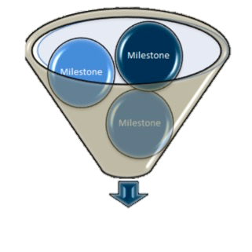
The Royal College has defined which EPAs a resident must acquire before they can advance to the next Stage of Training.
Transition to Practice
Core of Discipline
Foundations of Discipline
Transition to Discipline

Slide 23

How does this work
“on the ground”?
Day to Day

Slide 24
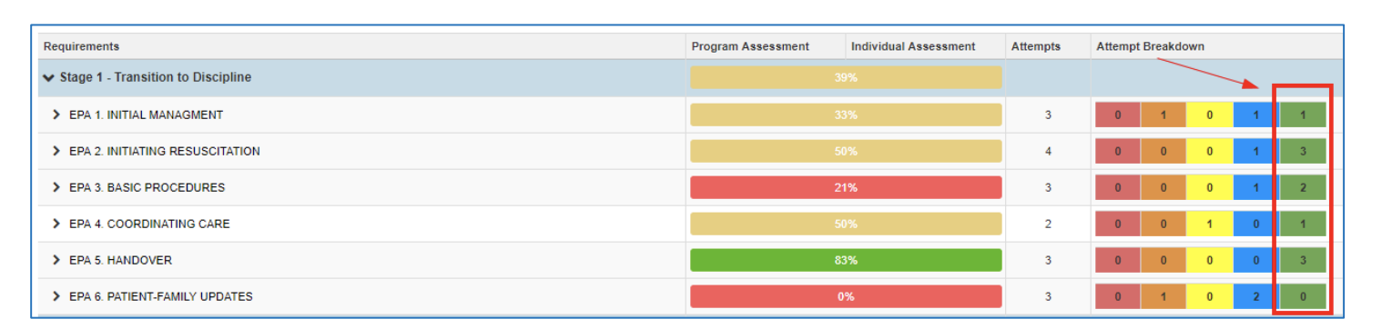
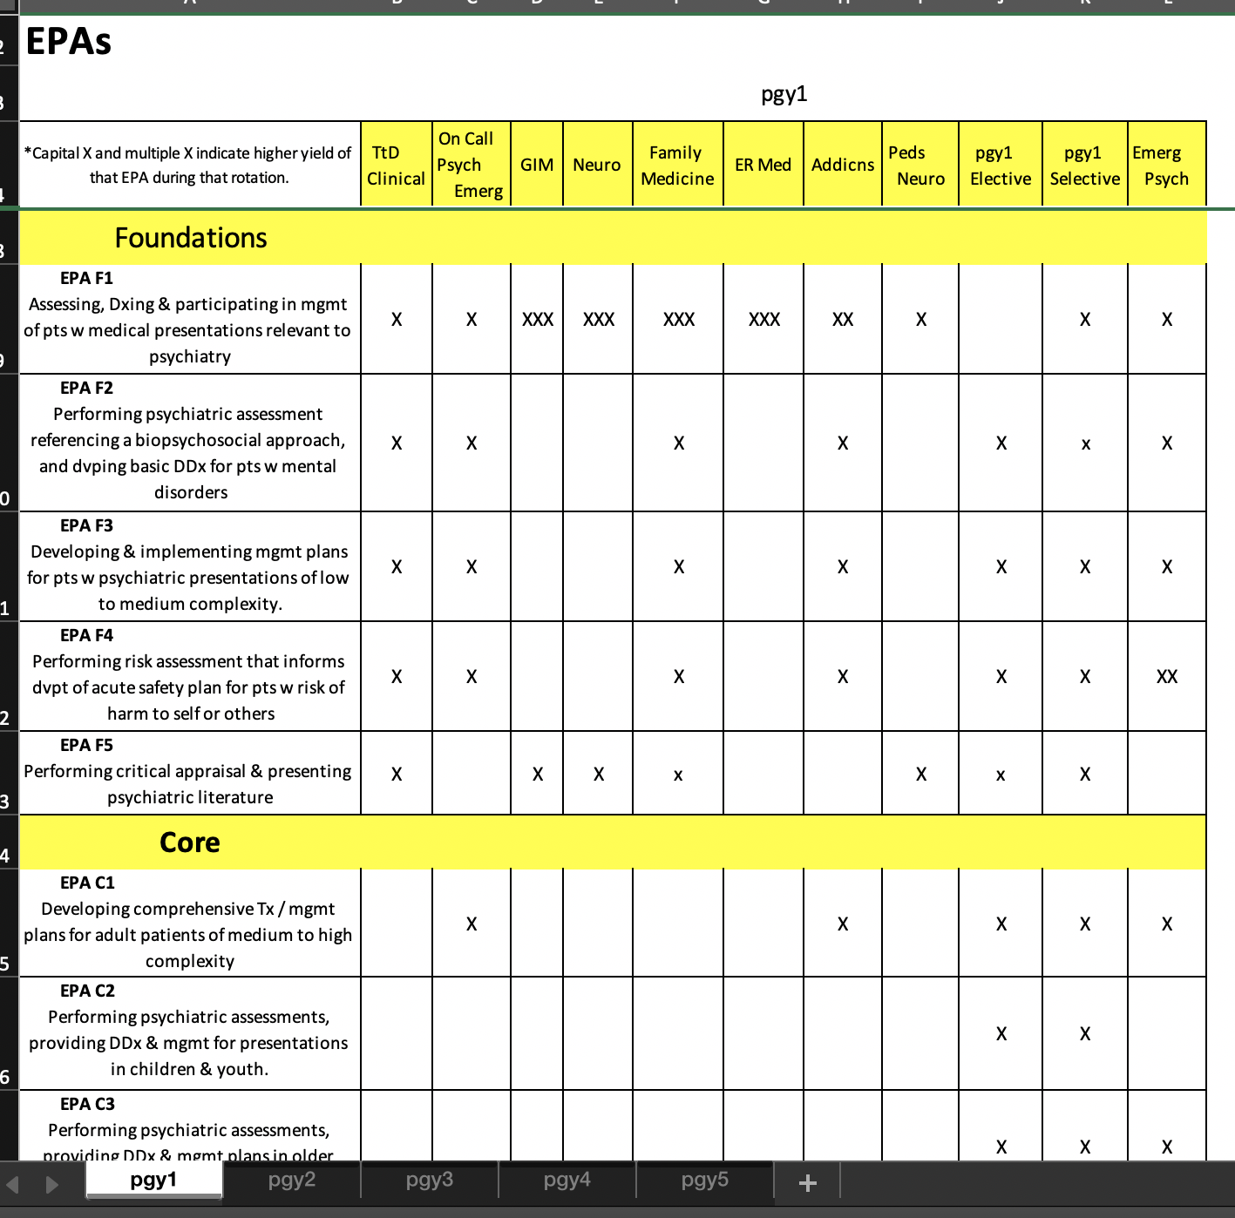
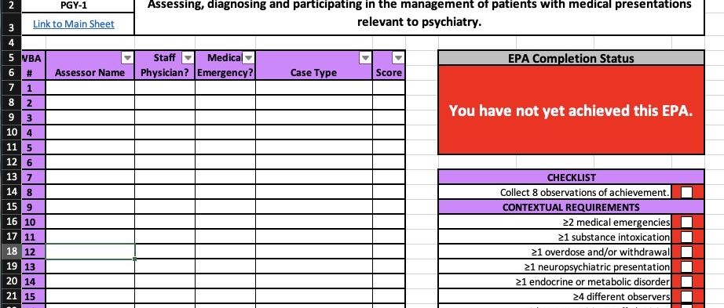
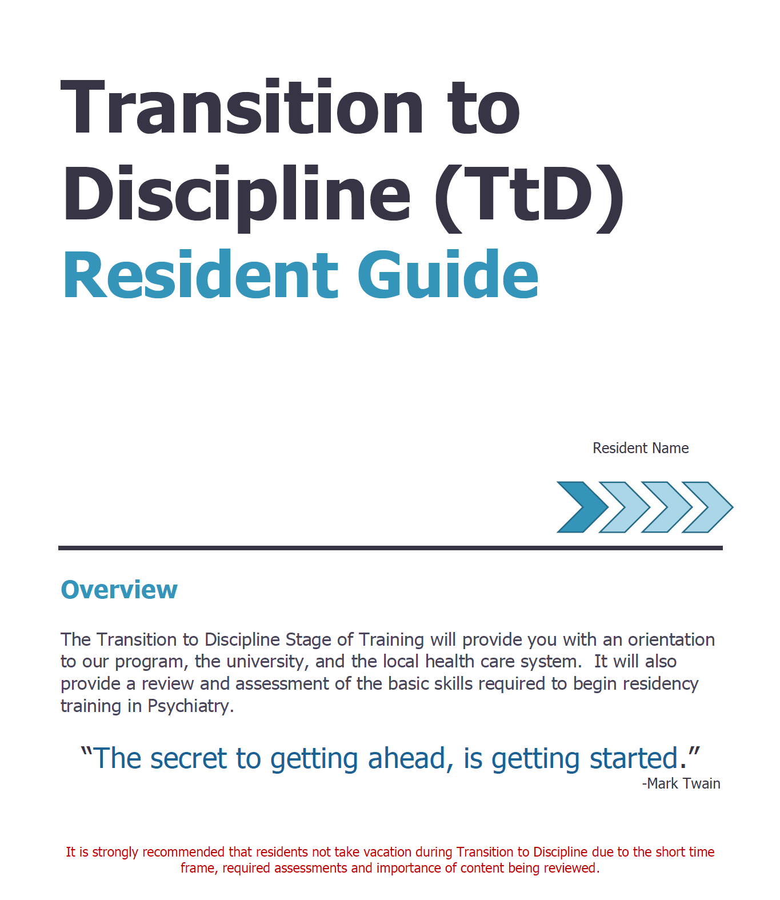


Resident
Supported
by technology
Notes:
Explain the items to help the resident know what they should be working on, etc.
Explain AC

Slide 25


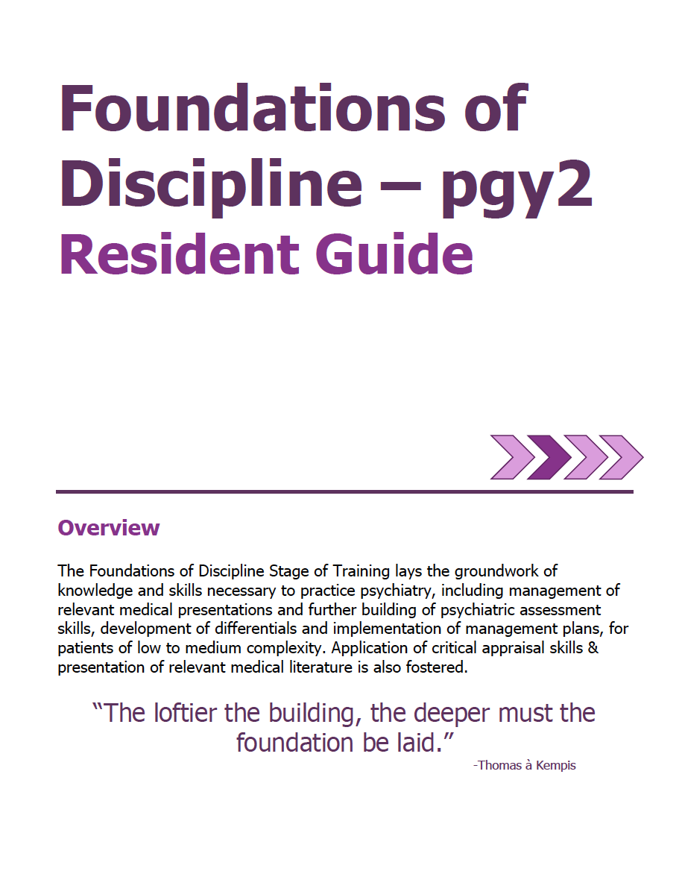
Academic Coach
Plans their learning
Views Curriculum Map
Know what EPAs working on
Develops a Personal Learning Plan
Resident
Supported
by technology
Notes:
Explain ACs

Slide 26
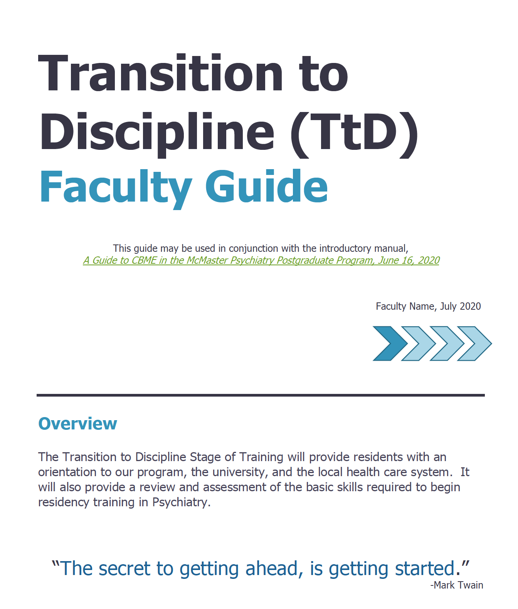

Academic Coach
Plans their learning
Views Curriculum Map
Know what EPAs working on
Develops a Personal Learning Plan
Supervisor
Resident
Sets Objectives for Rotation
Based on Curriculum Map
Based on Personal Learning Plan
Supported
by technology
Notes:
resident & supervisor should discuss at start of rotation, those EPAs of high yield on that placement AND the resident's person learning goals, which would include EPAs on which they are working.
supervisors also have been provided with orientation guides.

Slide 27
Example of an
EPA
EPA TtD-1
Obtaining a psychiatric history to inform the preliminary diagnostic impression for patients presenting with mental disorders.
2 Observations of Achievement
At least:
2 Different Case Types
Notes:
So, using EPA TtD 1 as an example….

Slide 28
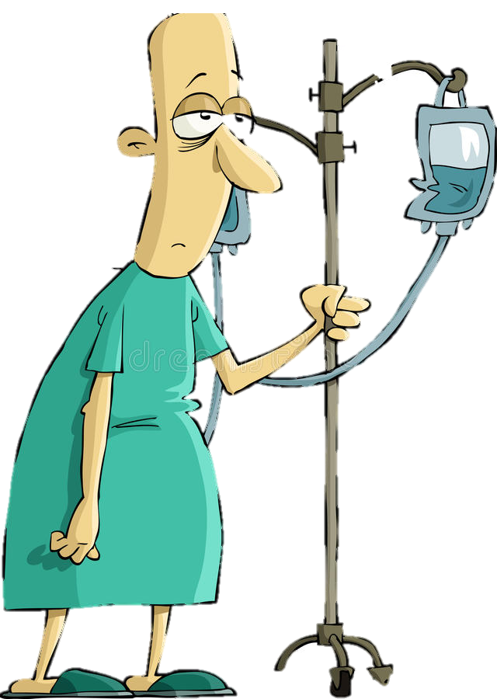


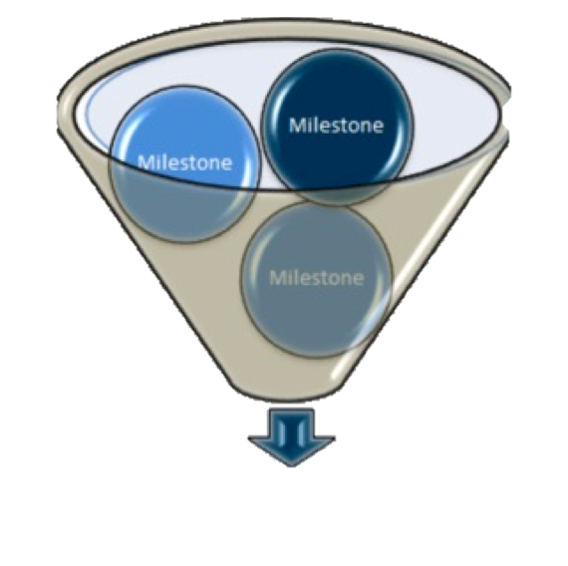





Program
Director
Academic
Coach
Competence Committee
Regional
Education Lead
Notes:
Resident and faculty identify an opportunity for an EPA assessment. Supervisor might review expectations and remind resident of feedback to build on from a previous encounter.
Resident goes to do the EPA activity. Supervisor supervises either directly or indirectly depending on the EPA
Supervisor provides verbal feedback to the resident, giving 1 or 2 specific, actionable pieces of feedback
Supervisor documents the assessment on MedSIS.
They cycle repeats itself, resulting in multiple assessments of the same EPA over time, by different observers.
These get collated on MedSIS, with the data being available to the resident, the Program Director, the REL, the resident’s academic coach and the Competence Committee (formerly the Evaluation Committee)
It is the Competence Committee that makes decisions around progression, promotion

Slide 29
Competence
Committee
Assess overall achievement & progress of residents
Regularly review learner EPAs & other evaluations
Approve changes to learner status:
Monitor overall progress of learner
Confirm acquisition of EPAs
Promote to next stage of training
Identify any concerns
Modify learning plan
Develop & monitor specialized learning plans
Request Royal College certification

Slide 30
Competence
Committee
In our McMaster Psychiatry Program:
  Academic Coaches are not members of the CC
  May be invited to attend a CC Meeting to provide input if there are concerns of a resident’s progress & learning strategies are being developed
    ACs would not be part of decision making process of the CC

Slide 31

Academic
Coaches
Residents will be assisted by

Slide 32
Academic Coaches
Help facilitate resident’s learning & development over time
Help resident navigate curriculum map
Longitudinal relationship with resident

Slide 33
Role of the Academic coach
Assist resident in understanding CBME
Assist in developing personal learning plan
Review resident’s progress in competency acquisition & personal goals
Discuss challenges & explore learning strategies
Assist w incorporation of recommendations from competence committee
May do career planning & mentorship
Notes:
Jo – outline the background of the AC role – can reference the pilot, the results of the pilot

Slide 34

Coaching strategies:
Meet with the resident 3 to 4 times per year
Review:
Competencies they have achieved
Competencies they are having challenges with
Other evals & qualitative comments
Plans for next rotations
Competencies they should be working towards
Assist with:
Plans for next rotations
Strategies to address areas of challenge
Guidance for other concerns that may arise

Slide 35

Next steps
Review required training experiences & EPAs
1
Virtual Meet & Greet lunch July 8, 2021. 11:30am
2
Set up time to meet with resident in August, near end TtD
3
Meet with residents:
-fall 2021
-Feb/Mar 2021
4
Attend Academic Coach Meetings
7
Review resident's progress prior to meetings
5
Ad hoc connections as needed
6

Slide 36

Keys to Being an Effective Academic Coach
Initiate contact with your resident
Meet regularly with your resident
Think proactively
Connect with Program Director & REL if any questions or concerns
Complete the AC Summary Report after eval review & progress planning meetings

Slide 37
Intro to MedSIS Dashboard
https://medsis.mcmaster.ca/medsis/index.cfm/Authentication:Main/index

Slide 38
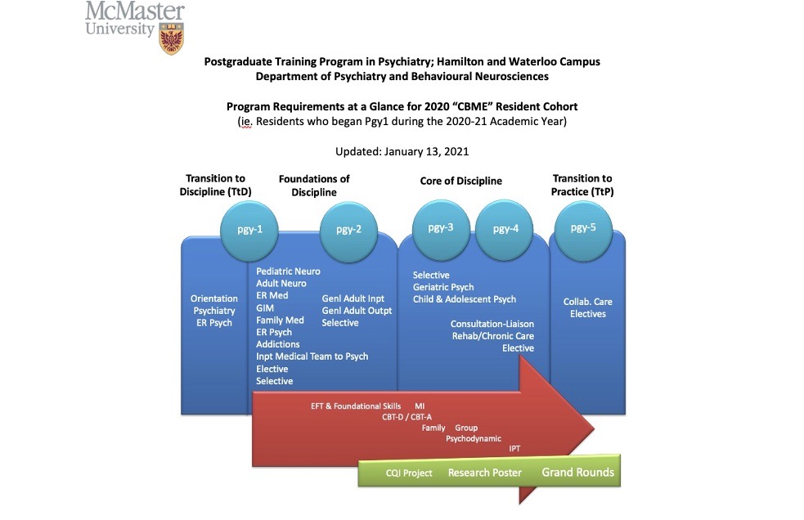
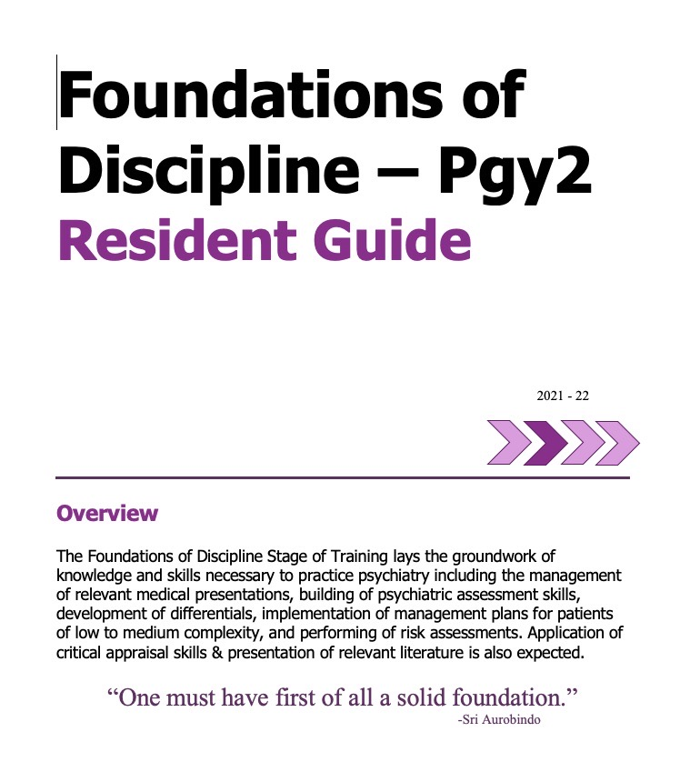
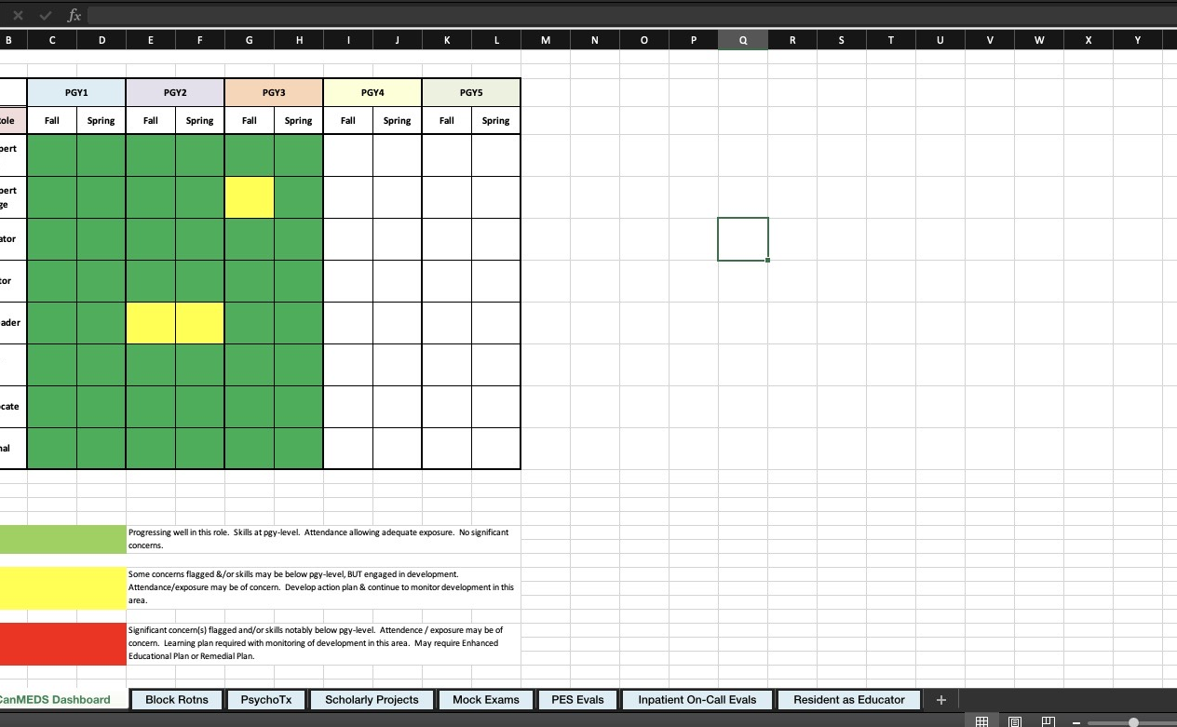
Other Tracking Tools for our Program
CBME CohortS’ Program Requirements Document
Personal Biannual Review Form
Resident & Academic Coach O Guides
Notes:
Reference the Requirements Document that has been sent to them
And the AC Orientation Guide

Slide 39

Biannual Review Form
Tracks Resident’s Progress
Sent to resident & AC before each Competence Committee Progress Review Meeting:
Sept for Oct. CC Meeting
March for April CC Meeting
Each June to ensure completion of activities for that Pgy-year
February of Pgy5 for CC Mtg
Notes:
Show next slide

Slide 40
BRF Demonstration

Slide 41
Intro to
Transition to Discipline
Pgy1 Blocks 1 & 2

Slide 42
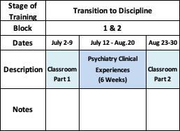
Transition to Discipline Stage
Includes:
Clinical placements
Daytime ER Psych Shifts
On Call ER Psych Shifts
‘till 11pm
May be on call ‘till 11pm
No Call

Slide 43

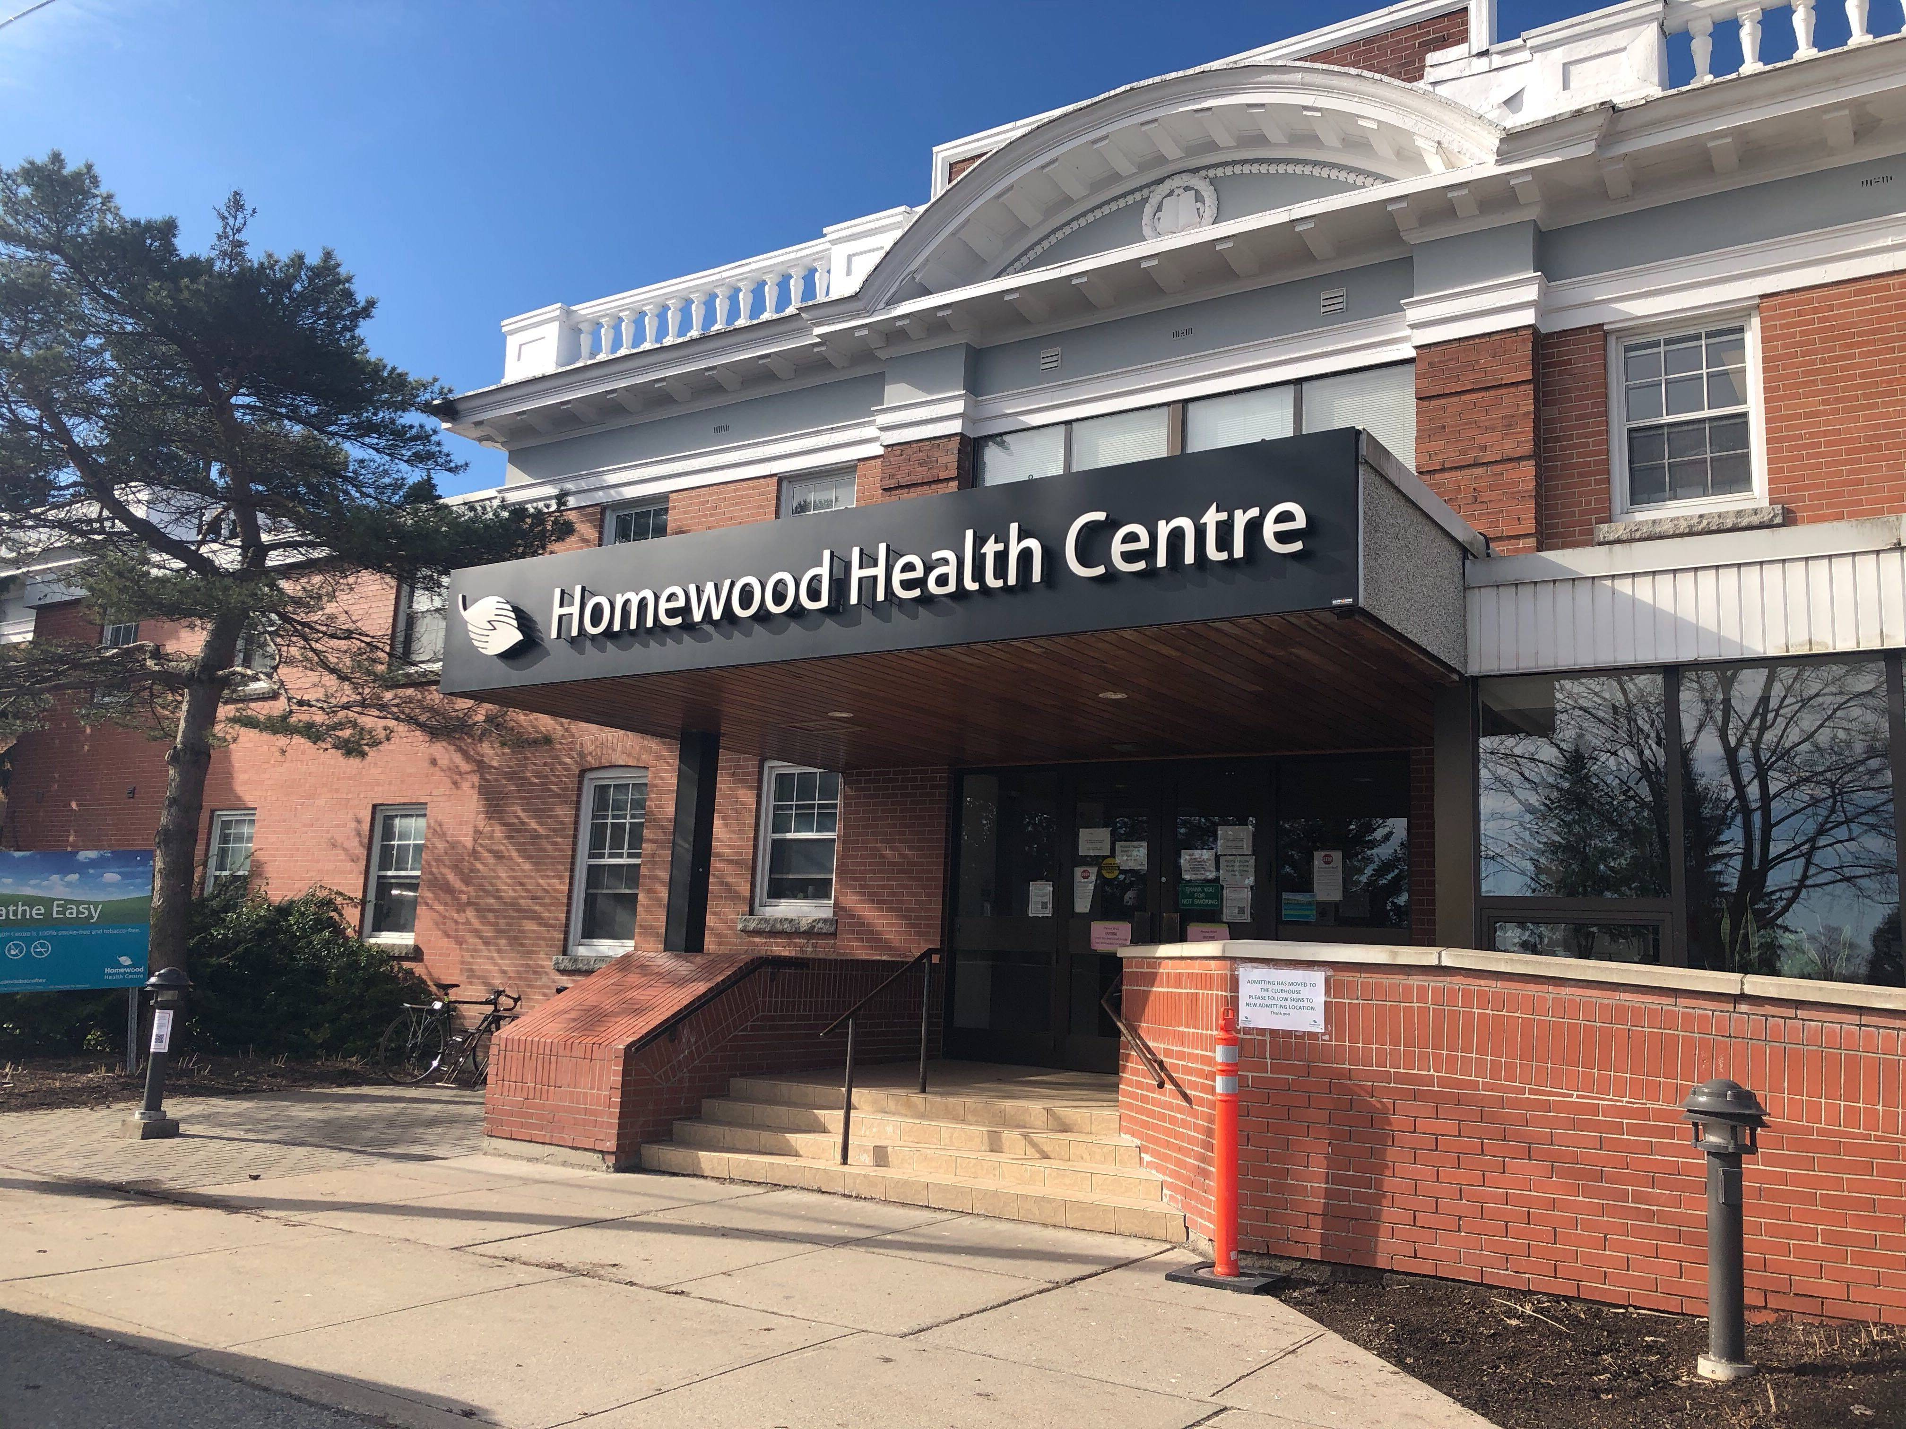
TTD
Design of
Clinical
Experiences
Hamilton Campus
Waterloo Regional Campus
Inpt & Outpt experiences
3 full day shifts in PES
1 evening & 1 w/e Call Shift
Begin call only after first PES day shift
Adjustments to support them on call & to support new seniors
No post-call days away from rotation
2 weeks Inpatients
2 weeks Outpatients
2 weeks Psych Emerg
2 On-Call shifts buddied with senior, until 11pm
No On-Call Shifts during classroom weeks
No post-call days away from rotation

Slide 44
Transition to Discipline EPAs
EPA TtD-1
EPA TtD-2
Obtaining a psychiatric history to inform the preliminary diagnostic impression for patients presenting with mental disorders.
Communicating clinical encounters in oral and written/electronic form.
2 Observations of Achievement
  2 different case types
2 Observations of Achievement
  At least:
    1 written
    1 verbal
    1 must be of observed interview

Slide 45
Assessment of EPAs during Transition to Discipline
Expected to have at least 5 opportunities of assessment & feedback for each EPA.
Score of 3 or higher is considered an observation “of achievement”
**Once in Foundations Stage of Training, 4 or 5 is considered an observation of “achievement”
5
3
4

Slide 46

Heads Up for Additional EPA during TtD Curriculum
EBM
Presentation
= Opportunity
for
EPA O&F
EPA F-5
Performing critical appraisal & presenting psychiatric literature.
2 Observations of Achievement
Notes:
Evaluations during soft launch, at least at beginning, may be paper based.

Slide 47
CBME Assessment Form

Slide 48

CBME
Assessment
Form
EPAs will be assessed using a

Slide 49
EPA
Assessment
Form

Slide 50
Example of an
EPA
EPA TtD-1
Obtaining a psychiatric history to inform the preliminary diagnostic impression for patients presenting with mental disorders.
2 Observations of Achievement
At least:
2 Different Case Types
Contextual Variables

Slide 51
EPA
Assessment
Form

Slide 52
Entrustment
Scale
Resident demonstrates sound knowledge & skill but needed help with unexpected challenges. A few things you needed to f/u on. No significant concerns.
Learner required
constant direction
1 | 2 | 3 | 4 | 5
I had to do. | I had to talk them through. | I needed to prompt. | I had to provide minor direction. | No direction required for safe, indpt care.
Learner didn’t do task or
Needed complete hands on guidance
Some independence but required intermittent direction
Complete independence. Understands risks. Performs safely. Practice ready.
**If any concerns with risk assessment or safety, should not score above 3.

Slide 53
EPA
Assessment
Form
Notes:
So much focus on the score.
What CC is looking for is improvement over time. Expect that a resident will start on the left side of the scale; looking to see that they move to the right side over time with repeated experiences.
There is enough time for this to happen. Try not to worry too much about the score, & focus on feedback for improvement.

Slide 54
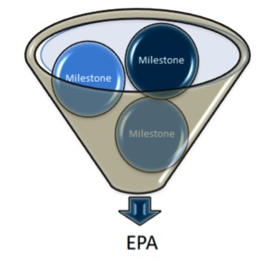
Developmental
Milestones
EPAs can be broken down into smaller, component parts called

Slide 55


Developmental
Milestones
The smaller, defined components that are needed to complete the full EPA
Examples: Conduct a mental status exam
Respect professional boundaries
Observable markers of an individual’s ability
Reference the CanMEDS roles applicable to that EPA

Slide 56
EPA
Assessment
Form
Notes:
Use the milestones as a guide.
Not an exhaustive list.
So if supervisor feels there is something on which to comment that is not listed as a milestone, they are encouraged to do so.
No algorithim for # of milestones to Entrustment Score
Feedback Textbox is the most important part!

Slide 57
FEEDBACK
COACHING FEEDBACK
Coaching Feedback
Feedback
Observation of Work
Focuses on what has already occurred
Can increase self-awareness
Emphasis on external insight about what occurred
Focus is the learning potential
Provides guidance to improve future practice
Emphasis on specific, actionable advice to strengthen a competency

Slide 58
Assessment of EPAs
May involve direct or indirect observation depending on variables:
            the task at hand
            patient complexity
            supervisor comfort level
            resident skill.
EPAs should be completed even if completion of the task was rated less than a 4 or 5, to foster feedback and promote knowledge & skill development
Anticipated it may take 2-3 attempts before a resident achieves a successful assessment.

Slide 59
Intro to
Foundations of Discipline
Rest of Pgy1
& all of Pgy2

Slide 60
FOUNDATIONS OF DISCIPLINE

Slide 61

Assessing, diagnosing & participating in the management of Medical Presentations relevant to Psychiatry.
EPA F-1
8 Observations of Achievement
At least:
2 Medical Emergencies
1 Substance Intoxication
1 OD &/or Withdrawal
1 Neuropsychiatric Presentation
1 Endocrine or Metabolic Disorder
4 Different Observers
3 by Supervising Staff MD
Notes:
Many of the residents will have fully completed this EPA by the end of Pgy1
Due to the pandemic, depending on the timing of some of their rotations such as GIM, FM and Neurology, some of our residents have not yet completed this EPA this year.

Slide 62

Performing Psychiatric Assessments referencing a biopsychosocial approach & developing basic DDx for patients with mental disorders.
EPA F-2
6 Observations of Achievement
At least:
1 Emergency Setting
2 Inpatient Settings
2 Outpatient Settings
3 Different Case Types
2 by Psychiatrist Observer
3 Different Observers
At most:
2 Child/Adolescent Patients
2 Older Adult patients

Slide 63

Developing & implementing Management Plans for patients with psychiatric presentations of low to medium complexity.
EPA F-3
6 Observations of Achievement
At least:
1 Mood Disorder
1 Psychotic Disorder
1 Personality Disorder
1 Substance Use Disorder
1 Anxiety or Trauma or OCD
3 Different Observers
2 by Psychiatrist Observers
At most:
2 Child/Adolescent Patients
2 Older Adult Patients

Slide 64

Performing Risk Assessments that inform the development of an acute safety plan for patients posing risk of harm to self or others.
EPA F-4
5 Observations of Achievement
At least:
1 with Non-Suicidal Self-Injury
1 with Active Suicidal Ideation or Behaviour
1 with Active Homicidal / Violent Ideation or Behaviour
3 by Psychiatrist Observers
3 Different Observers

Slide 65
Performing Critical Appraisal and presenting psychiatric literature.
EPA F-5
2 Observations of Achievement
At least:
2 Different Observers

Slide 66


Questions?

Slide 67
Extra Slides

