Slide 1
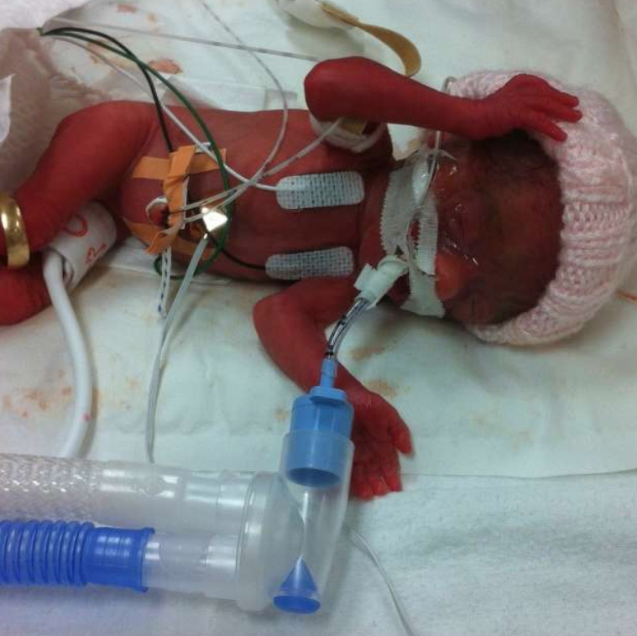
A Tool Kit for CQI of Residency Programs

Slide 2
Domain 5-Standard 9

Slide 3
Why QI of Residency Programs
While it is our mandate to ensure CQI of residency programs, Knowledge translation of how to move from a mandate to implementation of that has not been published yet.
There is no available easy to use toolkit for Program Directors to implement CQI of Residency Programs
By filling such gap, We will be able to create an effective system to implement and sustain CQI of Residency programs

Slide 5
1- PLAN: Define Aim
To evaluate anonymously the status of the program
Identify areas of improvement and areas of strength
To obtain trainees perception and input on how to improve the program
To make trainees feel valued and their input is appreciated
To identify priorities for the program

Slide 6
1-PLAN-Stakeholders-RPC
Chief fellows/residents
Program Director and Program admin
Division chief (And QI expert)
Subcommittee chairs: Curriculum, Research, Competence, Academic coaching and Wellness
Collaborators: Clinical Manager and NP representative

Slide 7
1-PLAN-Survey development for Baseline Measurement
Developed a survey based on the new accreditation standards
Selected the indicators and elements that are relevant to the residents
The survey contains 5-Domains, 18 different sections.
It is a long survey 148 statements , estimated time of completion 60-90 minutes.
Included multiple spaces for comments and some open ended questions
Only one mandatory question (year of training) but the rest non-mandatory.
Done once a year.

Slide 8
Decide on contributing factors to general AOI
PD | Standard 1
PA | Standard 8
RPC | Standard 1
Chief fellow | Standard 1
program collaboration | Standard 2
Education-rotations | Standard 3
Education-AHD sessions | Standard 3
Education-other learning | Standard 3
Education-QI | Standard 3
Education-research | Standard 3
Education-Clinical Teachers | Standard 3
Education-orientation | Standard 3
Education-Assessment | Standard 3
Resources | Standard 4
Learners' Safety culture | Standard 5
Learners'treated fairly | Standard 6
teachers | Standard 7
CQI | Standard 9

Slide 9
2-DO:Conduct survey
Survey
Chief Meeting
RPC
Meeting
Value of the anonymous survey
Protected time 90 min to complete
Survey summary provided to chief fellows
During retreat, discussed the results with the fellows group specifically seeking suggestions and some clarifications
Survey results presented and discussed
Chief fellows added comments on proposed solutions with development of action points
Priorities suggested by RPC committee

Slide 10
3- STUDY: Survey Results
100% respondents
Average time to complete: 41 minutes.
97% completion rate
Notes:
Out of 1,776 anticipated answers to all the questions, only 3% (n=63) of the questions were answered with N/A or unanswered

Slide 11
Form a Pareto chart

Slide 12
3- STUDY: Select priorities
In RPC discussion: based on data and input from chiefs:
Learners’ assessments, Teachers’ development and learners’ safety
Next priority: Curriculum
Less priority but easy to do increase communication/collaboration
In PD-Fellows meeting: update on data and RPC recommendations-->priorities:
Agreed on priorities but added burn out/wellness as a top priority

Slide 13
3- STUDY: Revised priorities
Residents’ wellness/psychological safety
Residents’ Assessments
Curriculum
Faculty development (takes longer time and will align with CBD faculty development)

Slide 14
ACT- Adopt/Adapt/Abandon
Process indicator: Fellows and faculty satisfied with process of program evaluation
Outcome indicator: Able to identify priorities
Balancing indicator: 90 min to complete

Slide 15
QI2: Improve Assessments Completion Rate
Problem
Only 70% of assessments are completed
Team
Stakeholders: CCC, PA, Chief fellows
Fishbone
What are the contributing factors
Priority
Set priorities based on Pareto chart or feasibility
Map
Map the process
Indicators
Process indicator, Outcome indicator, balancing indicator

Slide 16
QI2: Improve Assessments Completion Rate
Overarching Aim
Improve assessment completion rate by 25%
Partners
Engage partners: faculty, learners, managers
Implement change
Aim, PDSA (What, Who, When)
Disseminate
Share Knowledge
Decision making
Adopt, adapt, abandon

Slide 17
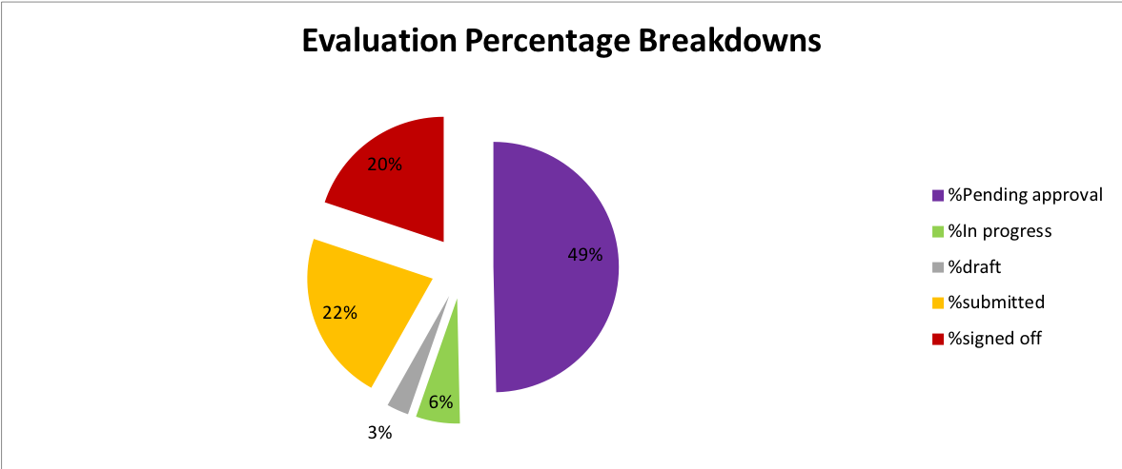
Plan: Procedures Baseline Data
Procedures completion rate
Notes:
We measured the land!

Slide 18
Plan: Survey
Response rate: 50% Faculty and 75% learners
Barriers to completing Assessments
Notes:
We measured the land!

Slide 19
Fishbone Diagram for EPA Completion:
Policies
Learner
Faculty
No guideline on how many EPAs to complete per shift
Unclarity of expectations
No shared mental model
Anxiety related to assessment
Resistance to change
Unfamiliarity with process
Workload
Discomfort in completing assessments
EPA completion rate 70%
Unpredictability of observations
No private space for feedback
No standardized process for procedure assessment
Computers not always available
Busy service
Process/
Procedure
Equipement
Environment
Notes:
Coping with stress: moral distress, family stress, lack of travel.
Priorities identified in the survey: purpose and meaning, Communication and involvement, culture change, autonomy, work efficiency

Slide 20
Plan: suggested ideas
90% recommended training faculty and fellows on feedback
90% recommended the use of mobile application to facilitate accessibility of electronic forms
80% of respondents indicated that having a procedure specific checklist/evaluation will improve feedback
79% recommended incorporating feedback and observation in the workflow of daily clinical activity.

Slide 21
Implemented Interventions
6 Jan. 2021
Neo FacDev
7 Jan. 2021
Neo Fellow dev.
11 Jan. 2021
CBME: Soft launch
8 Feb. 2021
Ipads launch and set limit of maximum 2 EPAs per day, identify EPA before encounter.
10 Mar. 2021
Medsis dashboard faculty advanced training (CC, AC, PA, PD)

Slide 22
Do-Implementation
Phase 1
Orientation to MedSIS
Setting expectations
Phase 2
Smart tablets
Faculty training
Phase 3
Electronic Procedure-Specific evals
WBA- format
Faculty training
2 months
2 months
2 months
2w
2w
2w
% of completed evaluations
Quality of coaching in the moment (survey)

Slide 23
Study and Act
Process measure: less than 10% fellows used smart tablets
Outcome measure: number of assessments: no significant change
Decision: After few Cycles-->Abandon

Slide 24
Aim: Improve EPAs Completion Rate to 95% over 1 year
Notes:
We measured the land!

Slide 25
Rapid PDSA cycles – Indicators Dashobard

Slide 26
Rapid PDSA cycles:

Slide 27
Rapid PDSA cycles:

Slide 28
Rapid PDSA cycles:

Slide 29
Rapid PDSA cycles:

Slide 30
Chart for EPAs Completion Rates

Slide 31
Share Knowledge

Slide 32
Share Knowledge

Slide 33
Share Knowledge

Slide 34
CQI-NPM Program
QI-Safety Culture
Learner/teacher project
Curriculum Development
Neonatal Faculty Development Program
QI-EPA implementations
Wellness Program
CBD implementation feasibility and teachers’ workload
QI Curriculum
Communication Curriculum
Simulation Curriculum

Slide 35
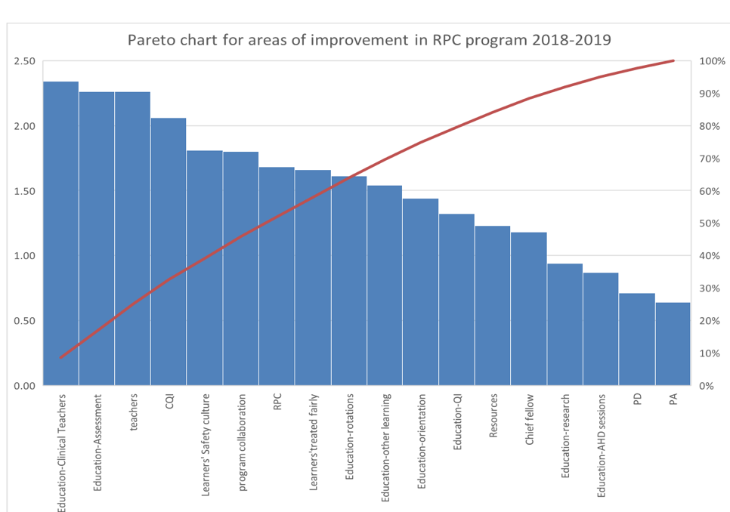
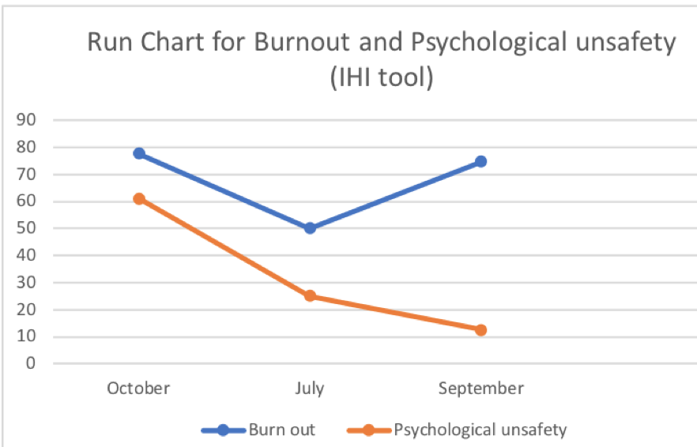
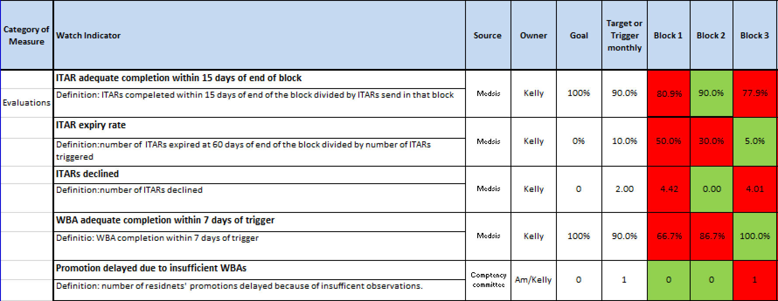
In summary-A Toolkit for CQI of Residency Program

Slide 36
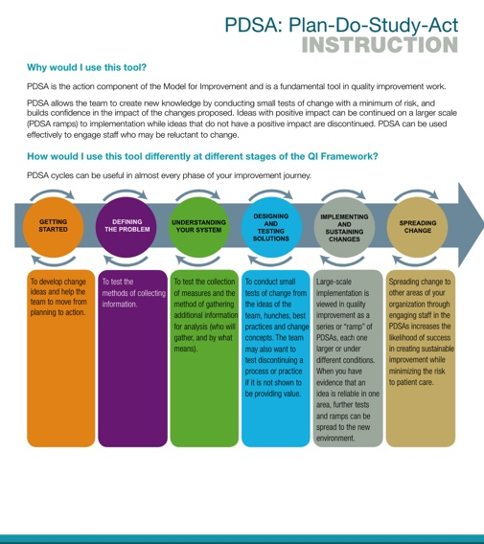
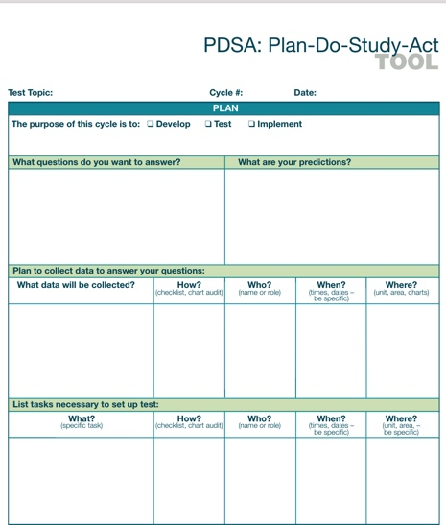

Slide 37
10 steps for QI
Identify the problem
Select your team
Brainstorm Causes (Fishbone Diagram)
Choose a priority (Pareto chart, feasibility tool)
Map the process
Identify indicators (Process, outcome and balancing)
Define your aim
Engage partners
Implement change (Aim PDSA)
Share Knowledge

